Slide 1

Human Factors in Engineering
Words for Leaders
Benjamin Day
www.benday.com
info@benday.com
Notes:
***SETTING***: Pronunciation: C# --> see sharp
***SETTING***: Pronunciation: .NET --> dot net
***SETTING***: Pronunciation: LINQ --> link
***SETTING***: Pronunciation: SQL --> sequel
***SETTING***: Pronunciation: JSON --> jason
***SETTING***: Pronunciation: XML --> X M L
***SETTING***: Pronunciation: XAML --> zammel
***SETTING***: Pronunciation: ASP.NET --> A S P dot net
***SETTING***: Pronunciation: Blazor --> blay-zor
***SETTING***: Pronunciation: Azure --> azure
***SETTING***: Pronunciation: OAuth --> oh-auth
***SETTING***: Pronunciation: GUID --> gwhid
***SETTING***: Pronunciation: regex --> reg-ex
***SETTING***: Pronunciation: enum --> ee-num
***SETTING***: Pronunciation: NuGet --> new-get
***SETTING***: Pronunciation: DevOps --> dev ops
***SETTING***: Pronunciation: RDBMS --> R D B M S
***SETTING***: Pronunciation: NoSQL --> no sequel
***SETTING***: Pronunciation: MySQL --> my sequel
***SETTING***: Pronunciation: PostgreSQL --> post-gres Q L
***SETTING***: Pronunciation: SQLite --> sequel lite
***SETTING***: Pronunciation: jwot --> jot
***SETTING***: Pronunciation: jwt --> jot

Slide 2
Idea:
This Is What Generative
Leadership Sounds Like
Notes:
# Title -- This Is What Generative Leadership Sounds Like
Remember the background music metaphor from this morning? The generative leader sets ambient conditions where people feel comfortable and creative. Well, this module is about what that music actually sounds like. The words, the frames, the phrases. And remember the mountain biker? This morning we talked about three distances: the rocks in front of your wheel, the trail ahead, the destination on the horizon. This module is where you learn to handle the rocks. These are fluency skills. And when you're fluent in them, they become invisible. People don't notice the technique, they just feel the effect.

Slide 3

George Lakoff
Cognitive Linguist
University of California @ Berkeley

Slide 4
Linguistic Frames

Slide 5
On the count of 3…

Slide 6
Don’t think of an elephant.

Slide 7
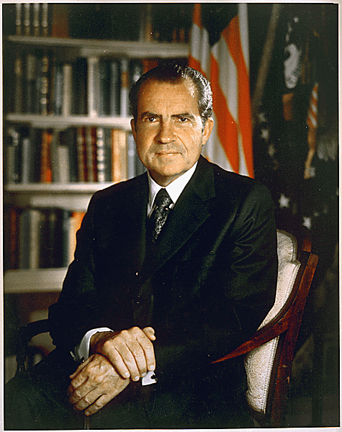
“I’m not a crook.”
Richard M. Nixon
November 17, 1973
https://www.nixonfoundation.org/artifact/official-presidential-portrait/

Slide 8
Linguistic Frames

Slide 9
“Frames are mental structures that shape the way we see the world. … You can't see or hear frames. They are part of what...cognitive scientists call the
'cognitive unconscious’.”
George Lakoff,
“The ALL NEW Don't Think of an Elephant!”

Slide 10
Don't Think of an Elephant.
Notes:
# Title -- Don't Think of an Elephant.
I want to try something. On the count of three, I want you to not think of an elephant. Ready? One... two... three. Don't think of an elephant. [pause] So what happened? You thought of an elephant, right? Everyone does. Your brain has to process the thing before it can negate it. When I say 'don't think of an elephant,' your brain first conjures the elephant, and then tries to suppress it. And it can't.

Slide 11
Linguistic Frames
"I'm not a crook" — Richard Nixon
The brain processes the thing before it can negate it
Choose words that point toward what you want
Notes:
# Title -- Linguistic Frames
# "I'm not a crook" — Richard Nixon
Think about Nixon saying 'I'm not a crook.' What's the frame? Crook. Every time he denies it, he reinforces the association. The brain has to process 'crook' before it can process 'not.'
# The brain processes the thing before it can negate it
This is how framing works. The words you choose determine what your audience pictures. And that picture shapes how they feel, what they believe is possible, and what they do next.
# Choose words that point toward what you want
So the first rule of Words for Leaders: choose words that point toward what you want, not away from what you don't want. Talk about the destination, not the obstacle.

Slide 12
Don't stare at what you're trying to avoid
Look where you want to go
Same with words: talk about what you want
The Mountain Biking Principle
Notes:
# Title -- The Mountain Biking Principle
# Don't stare at what you're trying to avoid
When you're mountain biking, the most important rule is don't stare at the rock you're trying to avoid. Because you'll steer straight into it. Your body follows your eyes.
# Look where you want to go
Instead, look where you want to go. Look at the path, not the obstacle. Your body follows your attention, and so does your team.
# Same with words: talk about what you want
Same with words. When you say 'don't miss the deadline,' the team pictures missing the deadline. When you say 'let's hit this target,' the team pictures hitting the target. Same intention, completely different mental image.

Slide 13
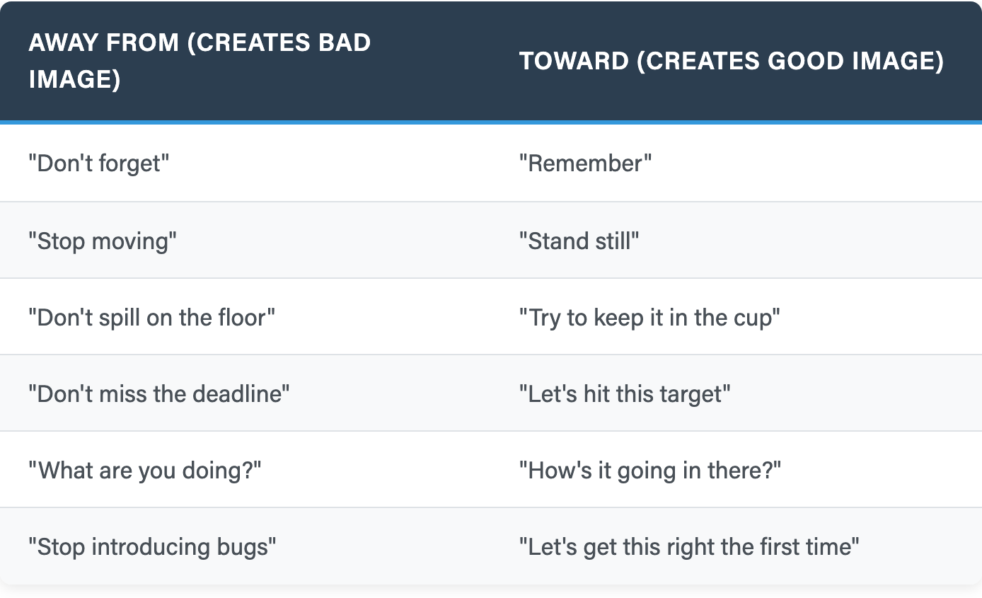
Direction of Language
Left column creates the image you DON'T want
Right column creates the image you DO want
Notes:
# Title -- Direction of Language
# Left column creates the image you DON'T want
Look at the left column. Every one of these creates a mental image of the thing you don't want. Forget. Spill. Miss. Bugs. Your team's brain processes the negative before the negation.
# Right column creates the image you DO want
Now the right column. Remember. Keep it in the cup. Hit the target. Get it right. These create the mental image of success. Same intention, opposite effect on the brain.

Slide 14

Exercise: Reframe These
Notes:
# Title -- Exercise: Reframe These
Alright, your turn. At your tables, I want you to reframe these four phrases. Take the away-from language and flip it to toward language. Here they are: 'Stop introducing bugs.' 'Don't be late to standup.' 'We can't keep missing deadlines.' And one more: 'You need to stop going around the process.' Take about three minutes at your tables, and then we'll hear a few.

Slide 15
'Stop introducing bugs.’
'Don't be late to standup.’
'We can't keep missing deadlines.’
'You need to stop going around the process.'
Reframe
These

Slide 16
Enlisting vs Telling
Telling (Creates Resistance)
Enlisting (Creates Alignment)
"You need to work on..."
"You've got to be careful"
"Period. Full stop."
"We have to change this"
"Things to work on:"
"It's important to be careful"
"Because when you think about it..."
"Let's try..."
Notes:
# Title -- Enlisting vs Telling
# Telling (Creates Resistance)
# Enlisting (Creates Alignment)
# "You need to work on..."
'You need to work on...' Notice the 'you.' It puts the person on the defensive. It sounds like an accusation even when it's not meant as one.
# "You've got to be careful"
'You've got to be careful.' Again, 'you.' It implies they haven't been careful. It creates friction.
# "Period. Full stop."
'Period. Full stop.' This shuts down the conversation entirely. It's an authority move that says 'I'm not interested in your perspective.'
# "We have to change this"
'We have to change this.' Even with 'we,' the 'have to' creates pressure. It implies there's no choice, which triggers resistance.
# "Things to work on:"
Switching to enlisting, 'Things to work on.' No 'you.' It's a list, not a finger. The person can engage without feeling attacked.
# "It's important to be careful"
'It's important to be careful.' No 'you.' It's a principle, not a criticism. The person can agree without feeling judged.
# "Because when you think about it..."
'Because when you think about it...' This invites the person into the reasoning. They arrive at the conclusion themselves. Way more powerful than 'full stop.'
# "Let's try..."
'Let's try...' Two magic words. 'Let's' means we're in this together. 'Try' means it's safe to fail. That single phrase creates more psychological safety than a hundred trust-building exercises.

Slide 17
"You" puts people on the defensive
Shift to "we," "let's," or remove the subject entirely
"You should consider..." → "Things to consider:"
The "You" Problem
Notes:
# Title -- The "You" Problem
# "You" puts people on the defensive
'You need to...' 'You should have...' 'You didn't...' Every one of these sounds like an accusation, even when you mean it as helpful advice. The word 'you' paired with a directive makes the other person the problem.
# Shift to "we," "let's," or remove the subject entirely
The fix is simple. Shift to 'we,' 'let's,' or just remove the subject entirely. 'Things to consider' instead of 'you should consider.' 'Let's think about' instead of 'you need to think about.'
# "You should consider..." → "Things to consider:"
Notice the difference. 'You should consider switching to feature flags.' That's a finger pointed at one person. 'Things to consider: feature flags.' That's a list on a whiteboard. Same idea. One feels like criticism, the other feels like collaboration.

Slide 18
Cortez language: "We're doing this. No discussion."
Pirate captain language: "Come with me. Here's where we're going."
Enlisting IS the alternative to burning ships
Remember Cortez?
Notes:
# Title -- Remember Cortez?
# Cortez language: "We're doing this. No discussion."
Cortez language sounds like: 'We're doing this starting Monday. No discussion.' 'Period. Full stop.' 'You need to get on board.' It burns the ships. Eliminates alternatives. Gets movement but not buy-in.
# Pirate captain language: "Come with me. Here's where we're going."
Pirate captain language sounds like: 'Here's what I'm seeing. Here's what I think we could try. What do you think?' It enlists. It invites. People board the ship because the destination sounds compelling and the captain seems like someone who can get them there.
# Enlisting IS the alternative to burning ships
Enlisting isn't a nice-to-have. It's the alternative to burning ships. Every time you use telling language, you're burning a little ship. Every time you use enlisting language, you're inviting someone aboard. And over time, the difference between a crew that chose to be there and a crew that was trapped is everything.

Slide 19
Let's — "we're in this together"
We — shared ownership
Team — group identity
Together — collaboration, not compliance
Enlisting Words
Notes:
# Title -- Enlisting Words
# Let's — "we're in this together"
'Let's' is the single most powerful word in a leader's vocabulary. It means we're in this together. It's inclusive. It's forward-moving.
# We — shared ownership
'We' creates shared ownership. Not 'you need to fix this,' but 'we need to figure this out.'
# Team — group identity
'Team' invokes group identity. It reminds people they're part of something bigger than their individual task.
# Together — collaboration, not compliance
'Together' signals collaboration, not compliance. 'Let's figure this out together' is a fundamentally different sentence than 'I need you to figure this out.'

Slide 20
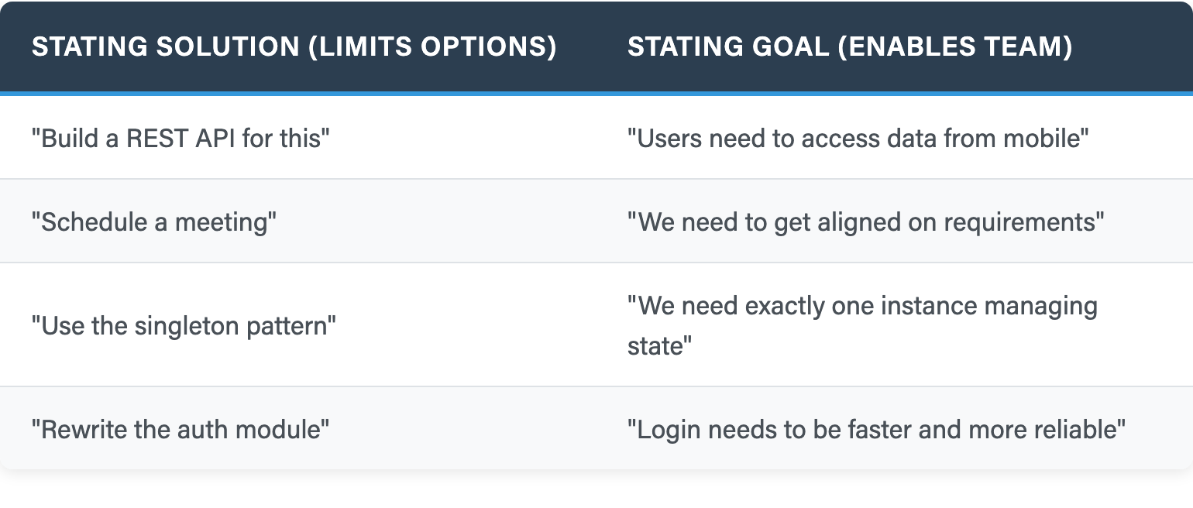
Goal vs Solution
Solutions lock them into one path
Goals let your team self-organize
Notes:
# Title -- Goal vs Solution
# Solutions lock them into one path
When you state a solution, you lock your team into one path. Maybe it's the right path, maybe not. But you've closed off every other option before they even had a chance to think.
# Goals let your team self-organize
When you state a goal, you give your team the problem and let them self-organize around the solution. They might come up with something better than what you would have prescribed. And they'll own it, because it was their idea.

Slide 21
Exercise:
Goal or Solution?
Notes:
# Title -- Exercise: Goal or Solution?
Quick reflection. Think about the last request you made of your team. An assignment, a direction, whatever it was. Was it a goal or a solution? Did you say 'build X' or did you say 'we need Y'? If it was a solution, what would the goal version have sounded like? Take thirty seconds, just think about it. Nobody needs to share.

Slide 22
Think about the last request you made of your team.
An assignment, a direction, whatever it was.
Was it a goal or a solution?
Did you say 'build X' or did you say 'we need Y’?
If it was a solution, what would the goal version have sounded like?
Take thirty seconds, just think about it.
Last Request:
Goal or Solution?

Slide 23
Your audience wants to know if you like them
Your audience wants to feel safe
Show that things are under control — subtly
The comedian principle: the audience relaxes when they trust the performer
Building Rapport
Notes:
# Title -- Building Rapport
# Your audience wants to know if you like them
Whether you're in a one-on-one, a team meeting, or presenting to stakeholders, your audience wants to know one thing before they'll listen: do you like them? Do you respect them? Are you on their side? If the answer feels like no, nothing else you say matters.
# Your audience wants to feel safe
They also want to feel safe. Not physically safe, psychologically safe. Safe to ask a question. Safe to disagree. Safe to not know the answer. All the enlisting language we just talked about builds this safety.
# Show that things are under control — subtly
And they want to know things are under control. Not because you're controlling, but because you've clearly got a handle on the situation. You know the metrics. You understand the constraints. You have the words. This is the fluency piece, and it needs to be subtle. The moment it looks like you're performing competence instead of just being competent, you lose them.
# The comedian principle: the audience relaxes when they trust the performer
Think about a standup comedian. When a comedian is clearly in command of the material, the audience relaxes. They settle into the ride. But when the comedian starts flailing, the audience tenses up, because they're worried about the performer instead of enjoying the show. Same thing in leadership. Your team needs to feel like you've got this.

Slide 24
Common sense is an unconscious conceptual structure
Leadership is reshaping what everyone sees as "obvious"
Uncovering hidden consensus
When people internalize it, enforcement becomes unnecessary
Leading a New Common Sense
Notes:
# Title -- Leading a New Common Sense
# Common sense is an unconscious conceptual structure
Lakoff's insight is that common sense is not simple. It's a deep, unconscious conceptual structure. When something becomes common sense, people stop arguing about it. They stop noticing it. It's just how things are. That's why they call it common sense: it's common, it's shared, and it operates below conscious awareness.
# Leadership is reshaping what everyone sees as "obvious"
Your job as a leader is to reshape what everyone on the team considers obvious. Not by announcing new rules, but by shifting frames, using enlisting language, creating experiences where the new way feels inevitable.
# Uncovering hidden consensus
Most teams already have more agreement than they realize. Your job is to uncover hidden consensus. To say the thing that everyone's thinking but nobody's said. When you do that, people feel seen.
# When people internalize it, enforcement becomes unnecessary
And when people internalize the new common sense, enforcement becomes unnecessary. You don't have to police quality when people genuinely care about quality. You don't have to enforce process when the process feels obvious. That's the difference between Cortez and the pirate captain. One mandates behavior. The other reshapes common sense.

Slide 25
Managing Change Without Creating Enemies
Step 1
Step 2
Step 3
Step 4
Give them a suggestion, not an order
Let them build comfort with the idea
Acknowledge what's being given up
Help them craft the plan themselves
Notes:
# Title -- Managing Change Without Creating Enemies
# 1: Step 1 → Give them a suggestion, not an order
Start with a suggestion, not an order. 'Here's something I've seen work' is completely different from 'here's what we're doing now.' One invites engagement. The other invites resistance.
# 2: Step 2 → Let them build comfort with the idea
Then give people time to sit with it. Let them poke holes. Let them worry. Let them come to terms with the change at their own pace. This is the part most leaders skip because it feels slow. It's not slow, it's investment.
# 3: Step 3 → Acknowledge what's being given up
Acknowledge what's being given up. This is critical. Even good change feels like losing something. When you move from story points to flow metrics, someone is losing a system they understood. When you restructure teams, people are losing relationships they valued. 'I know the old way was comfortable' goes a long way.
# 4: Step 4 → Help them craft the plan themselves
And finally, help them craft the actual plan. Not your plan that they execute. Their plan that you guided. That's how you get ownership instead of compliance.

Slide 26
Even good change triggers loss aversion
Acknowledge what stays the same
"I know the old way was comfortable"
Skipping this step is why mandates fail
The Feelings of Loss
Notes:
# Title -- The Feelings of Loss
# Even good change triggers loss aversion
Even good change triggers loss aversion. Humans are wired to feel losses more strongly than equivalent gains. Moving to a better process still means losing the process you knew. Moving to a better tool still means losing the tool you mastered.
# Acknowledge what stays the same
One of the most powerful things you can do is emphasize what stays the same. 'We're changing how we track work, but we're not changing who does the work, or how we make decisions, or what we value.' That grounds people.
# "I know the old way was comfortable"
'I know the old way was comfortable.' That single sentence tells people you see them. You're not dismissing their experience. You're not calling the old way stupid. You're acknowledging that change has a cost, even when it's worth it.
# Skipping this step is why mandates fail
Skipping this step is why mandates fail. Cortez didn't acknowledge loss, he just eliminated the alternative. And the result was a crew that was compliant but resentful. If you want internalization instead of compliance, you have to honor the transition.

Slide 27
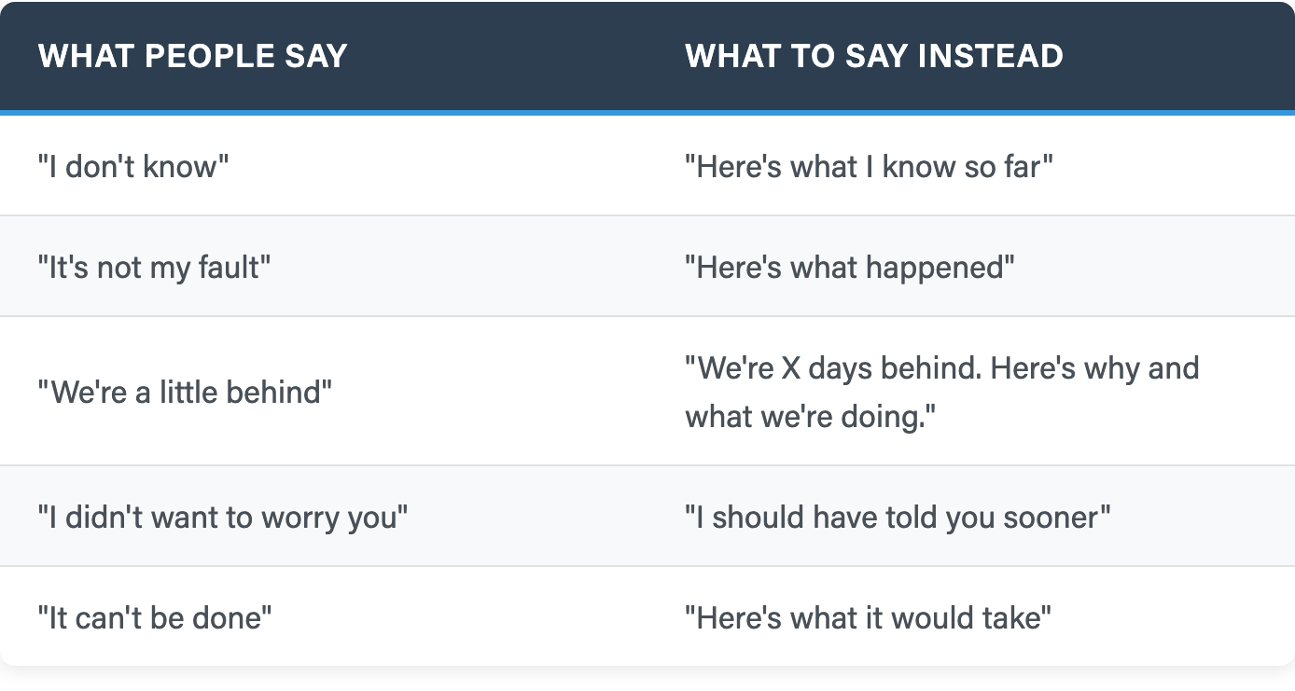
How to Deliver Bad News
Left column creates defensiveness and uncertainty
Right column moves the conversation forward
Notes:
# Title -- How to Deliver Bad News
# Left column creates defensiveness and uncertainty
The left column is what comes naturally, and every one of these creates defensiveness, uncertainty, or both. 'I don't know' stops the conversation. 'It's not my fault' starts a blame hunt.
# Right column moves the conversation forward
The right column keeps things moving forward. 'Here's what I know so far' is honest and useful. 'We're X days behind, here's why and what we're doing,' that's transparency that builds trust even when the news is bad. Notice these are all toward language, pointing toward the next step rather than away from the problem.

Slide 28
"Some things to try..."
"Here's something that might work..."
"Sometimes I find this helpful..."
"Because when you think about it..."
Enlisting Phrases — Your Reference Card
Notes:
# Title -- Enlisting Phrases — Your Reference Card
# "Some things to try..."
'Some things to try' is permission to experiment. It's low stakes. It says 'I'm offering options, not commands.'
# "Here's something that might work..."
'Here's something that might work' positions your experience as a resource, not an authority. They can take it or leave it.
# "Sometimes I find this helpful..."
'Sometimes I find this helpful' is vulnerability disguised as advice. You're sharing your own experience, which is disarming. People lean in.
# "Because when you think about it..."
'Because when you think about it...' This is the magic phrase. It invites the other person to think alongside you. They arrive at the conclusion with you instead of being told the conclusion.

Slide 29
At first, these swaps feel clunky and deliberate
Then they become second nature
That's fluency — leadership becomes ambient, not performed
The words disappear. The culture remains.
When This Becomes Fluency
Notes:
# Title -- When This Becomes Fluency
# At first, these swaps feel clunky and deliberate
At first, all of this is going to feel clunky. You'll catch yourself mid-sentence, rewind, and try again. That's normal. That's learning.
# Then they become second nature
But over time, they become second nature. You stop thinking about 'toward' versus 'away from.' You just naturally say 'let's hit this target' instead of 'don't miss the deadline.' It becomes how you talk.
# That's fluency — leadership becomes ambient, not performed
And that's fluency. The first layer from this morning. When you're fluent in these patterns, people don't notice the technique. They just feel safe. They feel heard. They feel like you've got this. Like being in the audience of a comedian who clearly knows the material, they relax into the ride.
# The words disappear. The culture remains.
The words disappear. The culture remains. And that's when you've started reshaping common sense. Not because you announced a new policy, but because the way you talk changed what feels normal. That's generative leadership in practice.

Slide 30

Here's What Actually Works
Notes:
# Title -- Here's What Actually Works
# Stock Photo: guy-pointing-left
So here's the cheat sheet. Four things to try starting tomorrow. One: catch yourself before you speak and flip away-from language to toward language. Two: replace 'you need to' with 'things to consider.' Three: state goals, not solutions, in your next planning meeting. And four: say 'let's try' at least once a day. These are small changes. They're also the background music that changes the entire feel of your team.

Slide 31
Words shape perception and reality — don't think of an elephant
Point toward what you want — the mountain biking principle
Enlist, don't tell — be the pirate captain, not Cortez
State goals, not solutions — let your team own the answer
Honor the loss — even good change costs something
Fluency makes it invisible — the words disappear, the culture remains
Module 4 Key Takeaways
Notes:
# Title -- Module 4 Key Takeaways
# Words shape perception and reality — don't think of an elephant
Words shape perception and reality. Don't think of an elephant. The brain processes the thing before it can negate it.
# Point toward what you want — the mountain biking principle
Point toward what you want, not away from what you don't want. Look at the path, not the rock.
# Enlist, don't tell — be the pirate captain, not Cortez
Enlist people, don't tell them. Be the pirate captain, not Cortez. 'Let's try' beats 'we're doing this starting Monday' every time.
# State goals, not solutions — let your team own the answer
State goals, not solutions. Give your team the problem and let them own the answer.
# Honor the loss — even good change costs something
Honor the loss. Even good change costs something. Acknowledge it.
# Fluency makes it invisible — the words disappear, the culture remains
And practice until it becomes fluency. The words disappear, the culture remains. That's when you've started leading a new common sense.

