Slide 1

Human Factors in Engineering Why Does Everyone Suddenly Hate Agile & Scrum?
Benjamin Day www.benday.com info@benday.com
Notes:
***SETTING***: Pronunciation: C# --> see sharp
***SETTING***: Pronunciation: .NET --> dot net
***SETTING***: Pronunciation: LINQ --> link
***SETTING***: Pronunciation: SQL --> sequel
***SETTING***: Pronunciation: JSON --> jason
***SETTING***: Pronunciation: XML --> X M L
***SETTING***: Pronunciation: XAML --> zammel
***SETTING***: Pronunciation: ASP.NET --> A S P dot net
***SETTING***: Pronunciation: Blazor --> blay-zor
***SETTING***: Pronunciation: Azure --> azure
***SETTING***: Pronunciation: OAuth --> oh-auth
***SETTING***: Pronunciation: GUID --> gwhid
***SETTING***: Pronunciation: regex --> reg-ex
***SETTING***: Pronunciation: enum --> ee-num
***SETTING***: Pronunciation: NuGet --> new-get
***SETTING***: Pronunciation: DevOps --> dev ops
***SETTING***: Pronunciation: RDBMS --> R D B M S
***SETTING***: Pronunciation: NoSQL --> no sequel
***SETTING***: Pronunciation: MySQL --> my sequel
***SETTING***: Pronunciation: PostgreSQL --> post-gres Q L
***SETTING***: Pronunciation: SQLite --> sequel lite
***SETTING***: Pronunciation: jwot --> jot
***SETTING***: Pronunciation: jwt --> jot

Slide 2

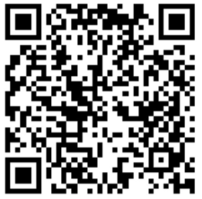
Values = | Connection | Authenticity | Service to Others
Passion = | Helping humans who help other humans to be the best humans they can be
Location = | Chicago
Fun facts = | Obsessed with Halloween; Raises chickens in her backyard!
Email = | adugan@redfoundry.com
URL = | www.duganstrategic.com, https://www.redfoundry.com/
Instagram = | @OakParkGirl
Angela Dugan (she/her)
Vice President, Client Delivery
Red Foundry
Notes:
I’ve always loved solving hard problems, usually related to messy people stuff,
And I strive to lead and manage from the heart
A lot of what I’ll be sharing today comes directly from the Experiences, strategies, and mistakes that have served me well
I’ve been at a handful of small consulting firms as well as Microsoft, twice now
I’ve made moves I loved that grew my career, been forced to make moves that led to me quitting,
and last year I got to experience being laid off for the first time, that was NOT awesome
I’m often entrenched at companies, In both leadership and individual contributor roles, usually as a full time employee
I live the things I talk about here, It’s not just about the SHOULD happen, it’s about what DOES happen
Because I stick around for the long haul, I navigate politics, I manage down AND up,
and I live with the consequences, good and bad
Today I can be the yin to Ben’s yang
At times we’ll be in lock step, And sometimes we’ll be offering dual perspectives
Don’t worry, we’ve become very good friends over the last 16 years, but that doesn’t mean we always agree

Slide 3

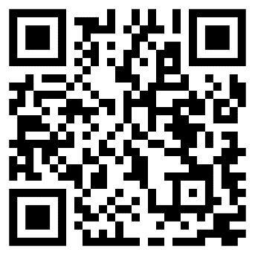

Benjamin Day
Software Delivery Rescue
Therapist for Teams
.NET, Azure, DevOps, Architecture
Fractional CTO & delivery diagnostics
Microsoft MVP
@benday
linkedin

Slide 4
And now…more talking

Slide 5
"Scrum Just Slowed Us Down."
Notes:
# Title -- "Scrum Just Slowed Us Down."
I hear this constantly. I've heard it from CTOs, from VPs of engineering, from individual developers. Scrum just slowed us down. We were faster before. All those meetings, all that ceremony, all that overhead, and we still missed the deadline. So we went back to doing things the old way, or we moved to something lighter, or we just stopped doing anything in particular. And honestly? I get it. That's a completely rational response to an uncomfortable experience. But I think the diagnosis is backwards.

Slide 6
"Too many meetings"
"We never finish anything on time"
"Story points are meaningless theater"
"It's just process for the sake of process"
The Complaint Department
Notes:
# Title -- The Complaint Department
# "Too many meetings"
Too many meetings. Standup, sprint planning, review, retro, backlog refinement. Every day there's another meeting where nothing gets decided and I can't get any real work done.
# "We never finish anything on time"
We never finish what we planned for the sprint. We commit to ten things, we finish four, we drag six into the next sprint, and then we commit to ten more on top of those six. Every sprint feels like failure.
# "Story points are meaningless theater"
Story points. Planning poker. Is this a 5 or an 8? Who cares? We argue for 20 minutes about a number that doesn't map to anything real and then we miss the deadline anyway.
# "It's just process for the sake of process"
And underneath all of it: this feels like process for the sake of process. It feels like we're doing agile AT people instead of actually building software. And if you've felt that way, you're not wrong, but I want to reframe what's actually happening.

Slide 7

Scrum Didn't Slow You Down.
Notes:
# Title -- Scrum Didn't Slow You Down.
# Stock Photo: mind-blown
Here's my theory, and this is the thing that I think explains why the entire agile movement has fallen out of favor. Scrum didn't slow you down. Scrum showed you how slow you already were. Before scrum, you had no feedback loop. You'd work for six months, miss a deadline, and blame requirements changes or scope creep or the database team. Scrum put a two-week mirror in front of your process and said: look. This is what you actually accomplished in two weeks. This is what done actually looks like. And for most teams, what they saw in that mirror was deeply, deeply uncomfortable.

Slide 8
Transparency makes extractive habits visible
The discomfort IS the tool working
People don't shoot the fracture — they shoot the X-ray machine
The "Oogie" Feeling
Notes:
# Title -- The "Oogie" Feeling
# Transparency makes extractive habits visible
When you introduce transparency into an extractive system, which is what most organizations are running, the extractive habits become visible.
Work that was half-done for months? Visible. Dependencies that nobody wanted to talk about? Visible.
The fact that your Definition of Done is really a Definition of Kinda Sorta Maybe? Visible. And that visibility is deeply uncomfortable.
# The discomfort IS the tool working
And here's what I want you to sit with: the discomfort is the tool working.
That oogie feeling, that creeping anxiety when the sprint review reveals that nothing is really done, that's not a problem with scrum.
That's scrum doing exactly what it's supposed to do. It's a diagnostic. It's the X-ray showing you the fracture.
# People don't shoot the fracture — they shoot the X-ray machine
But here's the thing about humans: when the X-ray shows something uncomfortable, we don't get mad at the fracture.
We get mad at the X-ray machine. And that's what happened to agile. The industry shot the X-ray machine.
We threw out scrum, we abandoned the ceremonies, we stopped doing retrospectives, and now we're back to working in the dark, and we feel better, because we can't see the fracture anymore. But the fracture is still there.

Slide 9
The Extractive Response to Transparency
Extractive Response
Generative Response
Velocity becomes a target
Ceremonies become compliance
Discomfort triggers removal
Velocity informs conversation
Ceremonies become learning
Discomfort triggers curiosity
Notes:
# Title -- The Extractive Response to Transparency
# Extractive Response
# Generative Response
# Velocity becomes a target
Take the diagnostic signal, velocity, and turn it into a target. Now velocity is something teams are punished or rewarded for, which means it instantly becomes meaningless because people inflate their estimates.
# Ceremonies become compliance
Take the ceremonies, which are supposed to be learning opportunities, and turn them into compliance checkboxes. Did you have your standup? Check. Did you do planning? Check. Is anyone learning anything? Who cares, we checked the box.
# Discomfort triggers removal
And when the transparency creates discomfort, the extractive response is to remove the transparency. Kill the retro. Stop doing sprint reviews. Go back to quarterly status reports where nobody can see what's actually happening.
# Velocity informs conversation
Take velocity not as a target but as a conversation starter. We finished less than we planned, what happened? Were the items bigger than we thought? Were we blocked? Are we carrying too much WIP? The number isn't the answer, it's the first question.
# Ceremonies become learning
Take the ceremonies and treat them as structured learning opportunities. The retro isn't a complaint session, it's an experiment design meeting. What one thing will we try differently next sprint?
# Discomfort triggers curiosity
And when transparency creates discomfort, instead of removing the mirror, you get curious about what you're seeing. That's the shift. That's the whole game.

Slide 10

What Survives Any Methodology?
Notes:
# Title -- What Survives Any Methodology?
# Stock Photo: question-yellow
So if agile is out of favor, and scrum is optional, and methodologies come and go, what actually matters? What survives regardless of what process you're using or not using? I'd argue there are a handful of things that are true whether you're doing Scrum, Kanban, SAFe, waterfall, or nothing in particular. And the first one, the one that makes everything else possible, is understanding what done actually means.

Slide 11
Definition of Done Is Everything
Notes:
# Title -- Definition of Done Is Everything
Angela and I have walked into dozens of organizations over the years, and I can tell you that almost every delivery problem we've ever diagnosed traces back to this one thing: the team doesn't have a shared, honest definition of what done means. Not aspirational done, not 'done on my machine' done, not 'the code compiles' done. Actually done. Releasable. In the hands of users. Collecting feedback. That kind of done. And the reason this matters so much is that a Definition of Done is not a scrum artifact, it's a diagnostic tool. Every line on your DoD that you can't check off is a human problem wearing a technical costume.

Slide 12
Requirements DoD
PLACEHOLDER FOR DEFINITION OF READY

Slide 13
Code is written with unit tests
Unit tests have minimum 75% code coverage
Code has been merged to main
Code compiles and tests pass in automated build
Code reviewed by someone other than the author
The Developer's Definition of Done
Notes:
# Title -- The Developer's Definition of Done
# Code is written with unit tests
Code is written with unit tests, great, you're testing as you go.
# Unit tests have minimum 75% code coverage
You've got a coverage target, 75 percent, that's reasonable.
# Code has been merged to main
Code is merged to main, so it's not sitting in a feature branch somewhere rotting.
# Code compiles and tests pass in automated build
It compiles and all the tests pass as part of an automated build. Continuous integration is working.
# Code reviewed by someone other than the author
And it's been code reviewed. So you've got another set of eyes on it. A developer looking at this list would say, yeah, we're doing well. We're professional. We're thorough. And they'd be right, as far as this list goes.

Slide 14
Written QA test plan, tested by someone else
Deployed and tested in staging environment
Reviewed by Product Owner, passes acceptance criteria
Known deployment and rollback plan
Deployed to production
The ACTUAL Definition of Done
Notes:
# Title -- The ACTUAL Definition of Done
# Written QA test plan, tested by someone else
There's a QA test plan, and it's been tested by someone other than the person who wrote the code. That's a coordination problem, a scheduling problem, and a skills problem all in one line.
# Deployed and tested in staging environment
It's been deployed to a staging environment and tested there. Do you even have a staging environment? Is it up to date? Who deploys to it? How long does that take?
# Reviewed by Product Owner, passes acceptance criteria
The Product Owner has reviewed it and confirmed it passes the acceptance criteria. Does your PO have time to do that? Do you even have acceptance criteria? Are they written before the work starts or after?
# Known deployment and rollback plan
There's a deployment plan AND a rollback plan, reviewed by ops. When was the last time your team had a rollback plan before they deployed something?
# Deployed to production
And finally, deployed to production. Not merged to main. Not sitting in staging. In production. In front of users. Collecting value. Code sitting in GitHub with all the unit tests passing has zero value to the people paying for this software.

Slide 15

Every Unchecked Box Is a Human Problem
Notes:
# Title -- Every Unchecked Box Is a Human Problem
# Stock Photo: headache-stress
Now look at that full list and ask yourself honestly: how many of those boxes can your team actually check?
Because every single one you can't check is not a technical problem. It's a human problem.
Can't get code reviewed? That's a collaboration problem.
No staging environment? That's a prioritization problem.
Product Owner doesn't have time to review? That's an organizational design problem.
No rollback plan? That's a risk management conversation nobody wants to have.
The Definition of Done is the single best diagnostic tool I know for surfacing the human problems that are actually slowing your team down.

Slide 16
Done Software Is Where You START
Notes:
# Title -- Done Software Is Where You START
And here's the key reframe I want you to take away from this section.
Shipping done software is not the goal.
Shipping done software is the place to START asking where the human problems are.
The DoD is your X-ray.
The stuff you can't do, the lines you can't check off, that's where the fractures are.
That's where the oogie feeling lives.
And that is exactly where your attention as a leader needs to go.
Not to the process. Not to the ceremonies. To the human problems the process revealed.

Slide 17
"Go faster" is almost always the wrong instruction
Busy is not the same as productive
Multitasking is the engine of the busy trap
The Busy Trap
Notes:
# Title -- The Busy Trap
# "Go faster" is almost always the wrong instruction
Go faster is almost always the wrong instruction. Not because speed doesn't matter, it does. But because when you tell a team to go faster, what actually happens is they start more things. They don't finish more things, they START more things. And now you've got fifteen items in progress and nothing getting to done.
# Busy is not the same as productive
Being busy is not the same as being productive. And I can almost guarantee you: your team is very, very busy. The question is whether that busyness is producing finished, valuable, done work, or whether it's producing a lot of motion that looks like progress but isn't.
# Multitasking is the engine of the busy trap
And the engine that drives the busy trap is multitasking. Context switching. Working on five things at once and finishing none of them. This is the single most common anti-pattern I see in every organization I walk into, and it's almost always driven by leadership, not by the team.

Slide 18
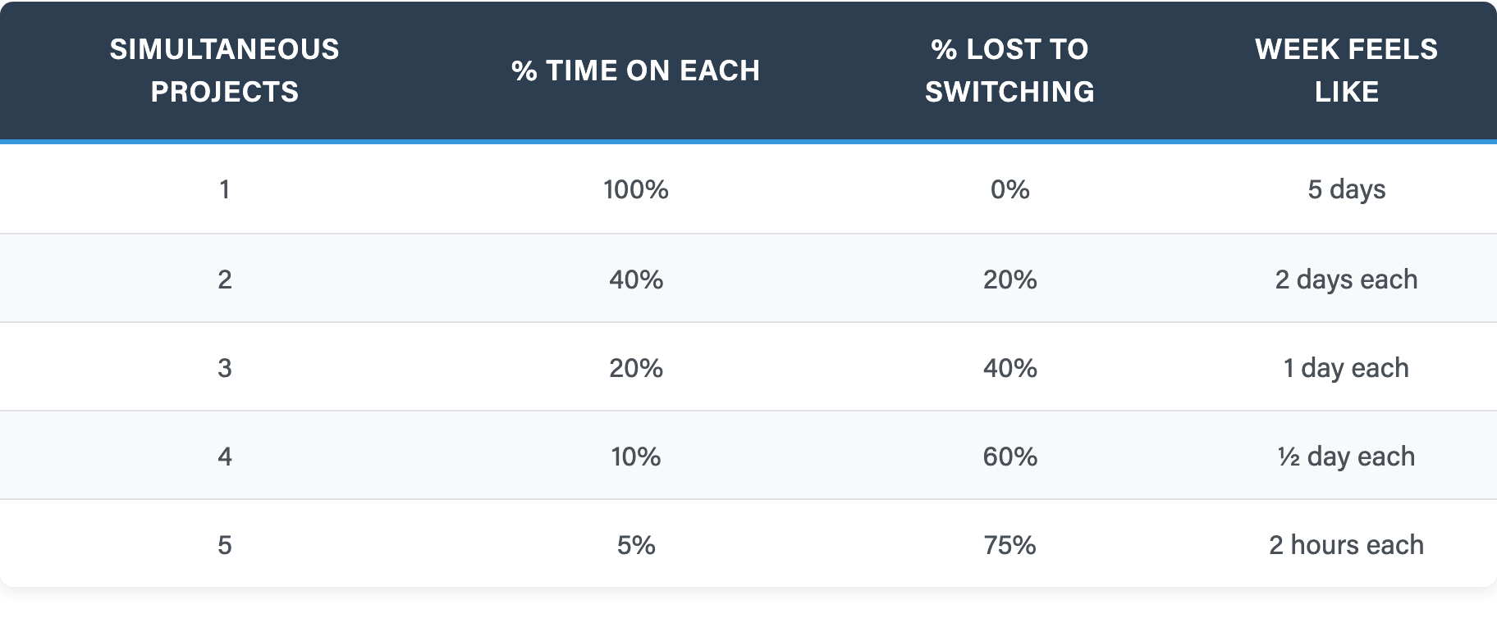
The Real Cost of Multitasking
One project: all your time, zero waste
Three projects: 60% of your week is gone
Five projects: you are functionally useless
Notes:
# Title -- The Real Cost of Multitasking
# One project: all your time, zero waste
One project, you get a hundred percent of your productive time on it. No switching cost. This is the baseline.
# Three projects: 60% of your week is gone
Three simultaneous projects, and 40 percent of your week is lost to context switching. You're spending 1 day per week on each project. That's not three times as productive, that's barely productive at all.
# Five projects: you are functionally useless
At five projects, 75 percent of your time is waste. You're spending about 2 hours per week on each project. You are functionally useless on all five, but you look incredibly busy, which is the whole problem.

Slide 19
Outputs vs. Outcomes
Outputs
Outcomes
Lines of code written
Story points completed
Features shipped
Customer support tickets reduced
User adoption increased
Revenue or renewal impact
Notes:
# Title -- Outputs vs. Outcomes
# Outputs
# Outcomes
# Lines of code written
Lines of code written. More lines must mean more progress, right? Except the best code change I ever made was deleting 2,000 lines.
# Story points completed
Story points completed per sprint. Velocity. Except we just showed how easily that's gamed, just inflate the estimates.
# Features shipped
Number of features shipped. Except shipping a feature nobody uses is worse than shipping nothing, because now you have to maintain it forever.
# Customer support tickets reduced
Did the thing we shipped actually reduce support tickets? That's a measurable change in customer experience that the business cares about.
# User adoption increased
Are more people using the feature? Or did we ship something that sits there gathering dust while users find workarounds?
# Revenue or renewal impact
Did it move the business needle? More renewals, more revenue, lower churn? That's the outcome the investment was supposed to produce.

Slide 20
What Survives Any Methodology
Know What Done Means
Finish Before You Start
Measure Outcomes, Not Outputs
Use Discomfort as a Signal
A shared, honest definition everyone can see
Stop starting, start finishing
Did it matter, not did we ship it
The oogie feeling is information, not a problem
Notes:
# Title -- What Survives Any Methodology
# 1: 1. Know What Done Means → A shared, honest definition everyone can see
First, know what done means. Have a shared, honest definition that everyone on the team and everyone who depends on the team can see. This is your diagnostic. This is where the human problems surface.
# 2: 2. Finish Before You Start → Stop starting, start finishing
Second, finish before you start. Stop starting new things and start finishing the things that are already in progress. This is the antidote to the busy trap. Lower your WIP, finish what you've started, and watch what happens to your throughput.
# 3: 3. Measure Outcomes, Not Outputs → Did it matter, not did we ship it
Third, measure outcomes, not outputs. The question isn't how much did we ship, it's did what we shipped actually matter. Did it change something for a user, for a customer, for the business?
# 4: 4. Use Discomfort as a Signal → The oogie feeling is information, not a problem
And fourth, use discomfort as a signal, not as a reason to retreat. The oogie feeling is information. It's the diagnostic working. When your process makes something uncomfortable visible, the generative response is curiosity, not avoidance.

Slide 21
The Oogie Feeling Is a Gift.
Notes:
# Title -- The Oogie Feeling Is a Gift.
So the next time you feel that oogie feeling, the next time a retro gets uncomfortable, or a sprint review reveals that nothing is really done, or your Definition of Done makes everyone squirm, don't shoot the X-ray machine.
Read the X-ray.
The discomfort is telling you exactly where the human problems are. And those human problems, that's what we're going to spend the rest of today learning how to address.

