Slide 1

Human Factors Workshop
Angela Dugan
Benjamin Day
Level: All are Welcome!

Slide 2

Human Factors in Engineering
The Leadership Shift
Benjamin Day
www.benday.com
info@benday.com
Notes:
***SETTING***: Pronunciation: C# --> see sharp
***SETTING***: Pronunciation: .NET --> dot net
***SETTING***: Pronunciation: LINQ --> link
***SETTING***: Pronunciation: SQL --> sequel
***SETTING***: Pronunciation: JSON --> jason
***SETTING***: Pronunciation: XML --> X M L
***SETTING***: Pronunciation: XAML --> zammel
***SETTING***: Pronunciation: ASP.NET --> A S P dot net
***SETTING***: Pronunciation: Blazor --> blay-zor
***SETTING***: Pronunciation: Azure --> azure
***SETTING***: Pronunciation: OAuth --> oh-auth
***SETTING***: Pronunciation: GUID --> gwhid
***SETTING***: Pronunciation: regex --> reg-ex
***SETTING***: Pronunciation: enum --> ee-num
***SETTING***: Pronunciation: NuGet --> new-get
***SETTING***: Pronunciation: DevOps --> dev ops
***SETTING***: Pronunciation: RDBMS --> R D B M S
***SETTING***: Pronunciation: NoSQL --> no sequel
***SETTING***: Pronunciation: MySQL --> my sequel
***SETTING***: Pronunciation: PostgreSQL --> post-gres Q L
***SETTING***: Pronunciation: SQLite --> sequel lite
***SETTING***: Pronunciation: jwot --> jot
***SETTING***: Pronunciation: jwt --> jot

Slide 3



Benjamin Day
Software Delivery Rescue
Therapist for Teams
.NET, Azure, DevOps, Architecture
Fractional CTO & delivery diagnostics
Microsoft MVP
@benday
linkedin

Slide 4
There's an Arc to Technical Careers
Individual
Contributor
Senior
Lead
Manager
Write code, solve problems
Guide others, own systems
Multiply the team
People, process, strategy
Notes:
# Title -- There's an Arc to Technical Careers
# 1: IC → Write code, solve problems
You start as an individual contributor. Your job is to write code and solve technical problems, and you're good at it, which is why people start noticing you.
# 2: Senior → Guide others, own systems
Then you become a senior. Now you're guiding others and owning entire systems, not just features. You're still writing code but you're also mentoring.
# 3: Lead → Multiply the team
Then you become a lead. And this is where it gets weird, because your job is now to make the whole team more effective. Your individual code output matters less than it ever has.
# 4: Manager → People, process, strategy
And some people end up in management, which is people, process, and strategy. You might not write code at all. And here's the thing, each one of these transitions requires letting go of the skills that made you successful at the previous level.

Slide 5
Han Solo is a hero
Heroes do amazing individual things
Heroes don't scale
The Han Solo Problem
Notes:
# Title -- The Han Solo Problem
# Han Solo is a hero
Han Solo is a hero. He swoops in, he saves the day, he's amazing under pressure.
# Heroes do amazing individual things
Heroes do amazing individual things. They write the critical fix at 2am. They debug the impossible issue. They architect the elegant solution.
# Heroes don't scale
But heroes don't scale. You can only be in one meeting, fix one crisis, write one piece of code at a time. And when you're not there, nothing works, because you've trained everyone to wait for you.

Slide 6
Picard is... kind of boring
He asks questions instead of giving answers
Boring scales
The Picard Alternative
Notes:
# Title -- The Picard Alternative
# Picard is... kind of boring
Picard is, let's be honest, kind of boring. He delegates. He asks questions. He trusts his team. He rarely does anything dramatic himself.
# He asks questions instead of giving answers
He asks questions instead of giving answers. He says things like 'what do you recommend, Number One?' instead of jumping in with his own solution.
# Boring scales
But here's the thing, boring scales. When Picard's not on the bridge, the ship still works. Because he built a team that can function without him. That's the transition. From being the smartest person in the room to building a room full of smart people.

Slide 7
The Control Spectrum
More Control
Less Control
Specify HOW
Give answers
Do it yourself
Check constantly
Specify WHAT
Ask questions
Coach them through
Check at milestones
Notes:
# Title -- The Control Spectrum
# More Control
# Less Control
# Specify HOW
You specify how things should be done, not just what needs to happen.
# Give answers
You give answers instead of asking questions.
# Do it yourself
When something's hard, your instinct is to just do it yourself because it's faster.
# Check constantly
And you check in constantly, because you don't trust that it'll be done right without you watching.
# Specify WHAT
On the other side, you specify what needs to happen and let the team figure out how.
# Ask questions
You ask questions instead of providing answers.
# Coach them through
When something's hard, you coach them through it, even if it takes longer.
# Check at milestones
And you check at milestones instead of constantly hovering.

Slide 8

The Metrics All Look Fine. The Soul of the Place Is Dead.
Notes:
# Title -- The Metrics All Look Fine. The Soul of the Place Is Dead.
# Stock Photo: headache-stress
Now here's the thing I want to plant in your brain for the rest of the day. I've been doing this consulting work for 28 years, and I keep seeing the same pattern. Companies call me for technical problems, and 80 percent of the time, it's actually a human problem. And the deepest version of that human problem is this:

Slide 9
"What are you working on lately?"
An album of Rilke poems set to music
"Believing that there can be visions after visions"
The extractive version: work on your exercises, pay for the hour, leave
A Jazz Lesson and a Poet
Notes:
# Title -- A Jazz Lesson and a Poet
# "What are you working on lately?"
And one day, instead of jumping straight into vocal exercises, I asked him: 'so what are you working on lately?' Just curiosity. Just a question.
# An album of Rilke poems set to music
He lit up and told me about this album he was working on, setting poems by the poet Rainer Maria Rilke to music. And one line stuck with me. It's been rattling around in my head for twenty years now.
# "Believing that there can be visions after visions"
The line is: 'believing that there can be visions after visions.' That's it. The belief that the next idea exists. That you haven't already seen the best version of this thing. That improvement is possible.
# The extractive version: work on your exercises, pay for the hour, leave
Now here's the point of the story. The extractive version of that lesson is: you pay for the hour, you work on your vocal exercises, you leave. Maximum efficiency. Zero butterflies. I would have gotten exactly what I came for and missed the line that ended up shaping how I think about leadership.

Slide 10
Extractive vs Generative
Extractive
Generative
"How do I get more from what I have?"
Measures, optimizes, defends
Can see what IS
Cannot see what COULD BE
"What are we building?"
Invests, creates, invites
Builds something people want to be part of
The velocity takes care of itself
Notes:
# Title -- Extractive vs Generative
# Extractive
# Generative
# "How do I get more from what I have?"
The extractive leader asks how do I get more from what I have? How do I optimize, defend, and squeeze more output from these people?
# Measures, optimizes, defends
They measure everything, optimize everything, defend everything. And it's necessary, by the way. You have to manage delivery. You have to hit deadlines.
# Can see what IS
But the extractive mindset can only see what is. It can measure what it extracts.
# Cannot see what COULD BE
It literally cannot see what it prevents from existing. There's no line item for the idea nobody had because you made it too exhausting to suggest things.
# "What are we building?"
The generative leader asks a completely different question: what are we building? What could this become? Visions after visions.
# Invests, creates, invites
They invest in people, create space for ideas, and invite contribution rather than demanding compliance.
# Builds something people want to be part of
They build something people actually want to be part of. Not just a job, but a crew, a mission.
# The velocity takes care of itself
And here's the wild thing, when you get generative leadership right, the velocity takes care of itself. People who care about what they're building naturally move faster than people who are just optimizing a spreadsheet.

Slide 11
Twenty-Five Years of Defensive Crouch
2001
2008
2020
2023+
9/11 taught organizations to protect
The crash taught them to contract
The pandemic taught them to freeze
AI is teaching them to wait
Notes:
# Title -- Twenty-Five Years of Defensive Crouch
# 1: 2001 → 9/11 taught organizations to protect
September 11th taught organizations to protect. Lock things down. Secure the perimeter. That was rational.
# 2: 2008 → The crash taught them to contract
The 2008 financial crash taught them to contract. Cut costs. Do more with less. Survive. Also rational.
# 3: 2020 → The pandemic taught them to freeze
The pandemic taught them to freeze. Don't make any big moves. Just maintain. Wait it out. Still rational.
# 4: 2023+ → AI is teaching them to wait
And now AI is teaching them to wait. Don't commit to anything because everything might change. Hold. Defer. Optimize what you have.

Slide 12
Most Organizations Aren't Broken. They're Numb.
Notes:
# Title -- Most Organizations Aren't Broken. They're Numb.
Most organizations aren't broken. They're numb. People show up, they do the work, they go home. Nobody raises their hand anymore because they learned a long time ago that raising your hand costs something and produces nothing. They're not angry. They're not resisting. They've just stopped believing that there can be visions after visions. And that's worse than broken, because nobody's even trying to fix it.

Slide 13
Three Kinds of Rooms
Dead Silent
TV Too Loud
Background Music
Stiff. Awkward.
Whole lot of process &
status meetings
Balanced & Comfortable
Notes:
# Title -- Three Kinds of Rooms
# 1: Dead Silent →
A bad leader creates a dead-silent room. People are stiff. Everyone is performing. Nobody says anything risky because the silence afterward would be excruciating. That's a fear-based culture.
# 2: TV Too Loud →
An extractive leader creates a room with the TV on too loud. There's noise, metrics reviews, status updates, process compliance, sound that fills space but doesn't create warmth. People are busy, but it's not their energy, it's imposed energy.
# 3: Background Music →
A generative leader is like background music at a dinner party. Present but not dominating. Setting a tone without dictating content. Making it safe to pause. Nobody consciously notices the music, they just feel comfortable. They'd tell you afterward 'that was a great dinner party' and they wouldn't mention the music. That's the goal.

Slide 14
Generative or Extractive…
…you Still Have to Ship Software
Notes:
# Title -- But You Still Have to Ship Software
Now, before you think I'm saying extractive is bad and generative is good, let me be clear: you have a responsibility to manage delivery. Software needs to ship. Deadlines are real. Constraints need to be identified and addressed. The point is not to abandon extractive thinking. The point is to also pick your head up and remember that you're a leader, not just a manager. All extractive, all the time, is a recipe for boredom and non-innovation.

Slide 15
“Bottlenecks”
Dr. Eliyahu Goldratt
“The Goal: A Process of Ongoing Improvement”
→ Theory of Constraints
Constraints

Slide 16
Conference with 1,000 people, lunch was hamburgers
Three hamburger lines. One bottle of ketchup.
The constraint wasn't the hamburger lines
Optimizing anything that isn't the constraint is waste
Theory of Constraints: The Ketchup Bottle
Notes:
# Title -- Theory of Constraints: The Ketchup Bottle
# Conference with 1,000 people, lunch was hamburgers
I was at a conference with about 1,000 people. Lunch was hamburgers. They set up three hamburger lines, Line 1, Line 2, Line 3. People could pick up buns, patties, salad, and move through quickly.
# Three hamburger lines. One bottle of ketchup.
But at the end of all three lines? One bottle of ketchup. People would come through fast, then queue up waiting for ketchup. The line backed up, and backed up, and backed up.
# The constraint wasn't the hamburger lines
The constraint wasn't the hamburger lines, it was the ketchup. They could have added ten more hamburger lines and it wouldn't have helped. The solution was three bottles of ketchup, one per line.
# Optimizing anything that isn't the constraint is waste
This is the core insight of Theory of Constraints. If you have a bottleneck, the only thing that will make you go faster is optimizing that constraint. Optimizing anything else is waste. And in software teams, the constraint is almost never where people think it is.

Slide 17
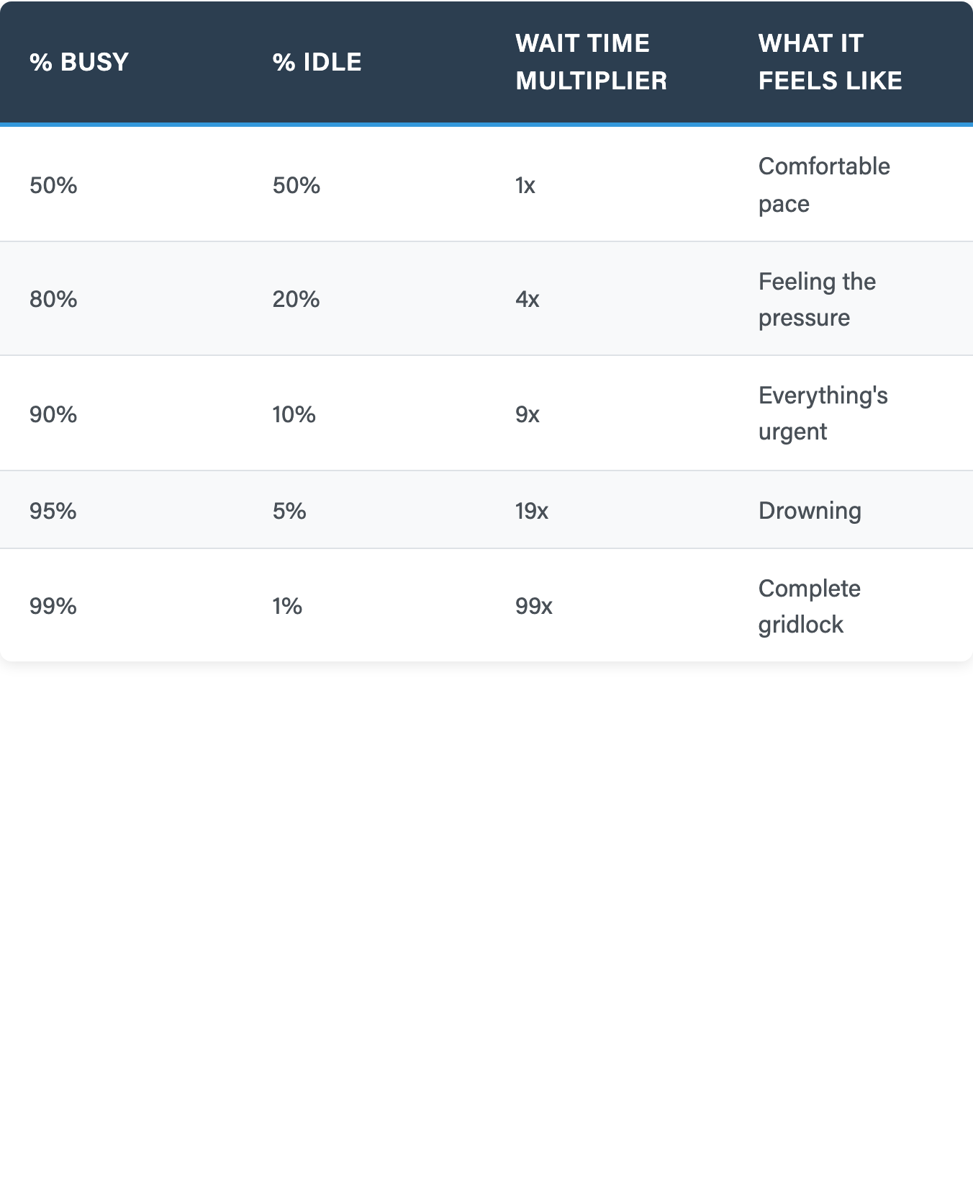
The Wait Time Formula
Wait Time =
% Busy / % Idle
Going from 90% to 99% isn't a little worse — it's 11x worse
Your CFO would never run a factory at 100% utilization…
…so why does everyone think dev teams should?
Notes:
# Title -- The Wait Time Formula
# Wait Time = % Busy / % Idle
The formula is simple: wait time equals percent busy divided by percent idle. At fifty-fifty, things flow. At ninety-ten, you're already nine times busier than fifty-fifty.
# Going from 90% to 99% isn't a little worse — it's 11x worse
But here's the killer: going from ninety percent to ninety-nine percent isn't a little bit worse, it's eleven times worse. Ninety-nine to one is 99x. That's not a team, that's a traffic jam.
# Your CFO would never run a factory at 100% utilization
Your CFO would never run a factory at 100 percent utilization, because they understand the queue math. But they'll run the dev team at 99 percent and wonder why nothing finishes. This is why 'everyone's busy but nothing's shipping' happens.

Slide 18
No slack.

Slide 19
Brittleness increases when redundancy gets optimized away.

Slide 20
99% Busy Isn't Just a Delivery Problem.
It's a "Generative" Problem.
Notes:
# Title -- 99% Busy Isn't Just a Delivery Problem. It's a Generative Problem.
And here's what I want you to notice: a person at ninety-nine percent utilization has no capacity for anything new. That's not just a delivery problem, that's a generative problem. There's no slack in the system for anyone to have an idea. No room for someone to say 'hey, what if we tried this differently?' You've optimized all the space out of the room where something unexpected could happen. The utilization trap doesn't just kill throughput. It kills curiosity.

Slide 21
The Four Types of Work
Planned Work
Unplanned Work
Maintenance Work
Internal Work
Strategic
Projects
Emergencies
“Keeping the lights on.”
Process Improvements & Automation
Notes:
# Title -- The Four Types of Work
# 1: Planned Work →
First, planned work. Features, projects, roadmap items. This is the work everyone talks about in planning meetings. It's visible and tracked.
# 2: Unplanned Work →
Second, unplanned work. The fires, the outages, the urgent escalations. This is the work that steals capacity from everything else. And here's the thing, if you're not tracking unplanned work separately, you have no idea how much capacity it's burning.
# 3: Maintenance Work →
Third, maintenance work. Updates, patches, keeping the lights on. Necessary but invisible. Nobody celebrates keeping the servers running, but when you stop doing it, everyone notices.
# 4: Internal Work →
And fourth, internal work. Improvements to your own processes, automation, tooling. This is where generative energy lives. This is the type of work that makes everything else easier. And it's the first thing that gets cut when you're too busy.

Slide 22
Four Types of Work in IT
Business
Projects
Internal IT
Projects
Changes
Unplanned Work
“The Phoenix Project” by Gene Kim

Slide 23
Four Types of Work in IT
Profit & Goals
Efficiency, Infrastructure, Overhead
Business
Projects
Internal IT
Projects
Changes
Unplanned Work
Maintenance
Emergencies
“The Phoenix Project” by Gene Kim

Slide 24
Four Types of Work in IT
Profit & Goals
Efficiency, Infrastructure, Overhead
Business
Projects
Internal IT
Projects
Makes Money
Saves Money
Changes
Unplanned Work
??? / Neutral
Burns $$$$$
Maintenance
Emergencies
“The Phoenix Project” by Gene Kim

Slide 25

Your metrics probably stink.
Notes:
# Title -- What If You Could Predict Without Estimating?
# Stock Photo: question-yellow
So imagine this: what if you could tell a stakeholder when something will probably be done, not based on guesses, but based on what your team has actually demonstrated? That's what Monte Carlo forecasting does. You feed it your real throughput data, it runs thousands of simulations, and it gives you probability ranges. Not a promise, a probability. And stakeholders love it because it's honest.

Slide 26
Story points measure effort guesses, not outcomes
Velocity rewards inflation, not delivery
Flow metrics measure what actually happened
Observing reality is a generative act
Abandon Your Current Metrics
Notes:
# Title -- Abandon Your Current Metrics
# Story points measure effort guesses, not outcomes
Story points measure effort guesses. They don't measure outcomes. They don't tell you when something will be done. And they get gamed the moment they become a target, which is Goodhart's Law: when a measure becomes a target, it ceases to be a good measure.
# Velocity rewards inflation, not delivery
Velocity rewards inflation, not delivery. Teams learn to make stories bigger so velocity goes up while nothing actually ships faster. Your velocity can increase 30 percent in a quarter while customers see zero difference.
# Flow metrics measure what actually happened
Flow metrics, throughput, cycle time, Monte Carlo forecasting, these measure what actually happened. How many things did you complete per week? How long does work actually take once you start it? These are observations of reality, not estimates of fiction.
# Observing reality is a generative act
And here's the connection back to our framework: observing reality instead of imposing a model on reality, that's a profoundly generative act. You're revealing the system to itself instead of forcing it into a framework. That's the kind of metric that helps people see clearly rather than just perform compliance.

Slide 27

What If You Could Predict Without Estimating?
Notes:
# Title -- What If You Could Predict Without Estimating?
# Stock Photo: question-yellow
So imagine this: what if you could tell a stakeholder when something will probably be done, not based on guesses, but based on what your team has actually demonstrated? That's what Monte Carlo forecasting does. You feed it your real throughput data, it runs thousands of simulations, and it gives you probability ranges. Not a promise, a probability. And stakeholders love it because it's honest.

Slide 28
Fluency — so leadership is ambient, not performed
Awareness — so you notice which mode you're in
New Common Sense — so people want to follow you
Three Things a Leader Needs
Notes:
# Title -- Three Things a Leader Needs
# Fluency — so leadership is ambient, not performed
First, fluency. The metrics, the constraint thinking, the communication patterns we'll cover later today. These give you fluency in delivery, the way a fluent speaker uses grammar without thinking about it. When you're fluent, leadership becomes ambient instead of performed. People don't notice your skill, they just feel safe. Like being in the audience of a comedian who clearly has the material down, you relax into the ride.
# Awareness — so you notice which mode you're in
Second, awareness. Knowing which mode you're in. Are you heads-down managing delivery? Fine. But when's the last time you picked your head up? Fluency makes awareness possible, because when you're not white-knuckling the basics, you have the capacity to notice the bigger picture.
# New Common Sense — so people want to follow you
And third, the new common sense. This is the piece that makes people actually want to follow you. Not enforcement, internalization. Not compliance, belief. We'll go deep on this one in Words for Leaders after lunch.

Slide 29
The Mountain Biker
Fluency
Awareness
New Common Sense
Handle the
immediate, day-to-day
“Head on a swivel”
“Where should we be going?”
Notes:
# Title -- The Mountain Biker
# 1: Fluency →
Fluency is being able to handle the rocks right in front of your wheel. The immediate terrain. The stakeholder asking when it'll be done. The constraint you need to identify. The difficult conversation you need to have this afternoon. If you can't handle the rocks, nothing else matters.
# 2: Awareness →
Awareness is noticing that you've been staring at the rocks for three months straight. You got so focused on the immediate terrain that you forgot you're supposed to be going somewhere. You haven't picked your head up. That's the inspect and adapt without the retrospective meeting.
# 3: New Common Sense →
And the new common sense is picking your head up and looking at the trail. Where are we actually going? To boldly go where no one has gone before. That's the generative view. And a skilled rider scans at all three distances simultaneously, rocks here, trail twenty feet ahead, destination on the horizon. You don't stop watching the rocks. You just stop only watching the rocks.

Slide 30
Know which mode you're in
  Generative or extractive?
When's the last time you picked your head up?
  Are we too stressed to notice?
Extractive is where gravity pulls you
  The constant ”Where’s my stuff?”
  Metrics & progress obsessed
Nobody announces "I've stopped being creative"
  Your team follows the ‘vibe’
Layer 2: Awareness
Notes:
# Title -- Layer 2: Awareness
# Know which mode you're in
The question is simply: do you know which mode you're in right now? Are you heads-down managing delivery? That's fine, that's necessary.
# When's the last time you picked your head up?
But when's the last time you picked your head up? When's the last time you asked 'what could this become?' instead of 'are we on track?'
# Extractive is where gravity pulls you
Here's the trap: extractive is where gravity pulls you. Every meeting becomes a status update. Every conversation becomes 'are we on track.' Every metric becomes a target. Because it's measurable and feels productive, you never notice you've stopped doing anything else.
# Nobody announces "I've stopped being creative"
Nobody announces 'I've stopped being creative.' You just get busy. And the team follows your lead. If you're all extraction, all the time, they will be too.

Slide 31
You're Probably 90/10 Extractive Right Now.
Notes:
# Title -- You're Probably 90/10 Extractive Right Now.
Here's my guess: you're probably ninety-ten extractive to generative right now. And you might not have noticed. That's how it works. The wait time math applies to your leadership capacity too. If you're at ninety-nine percent utilization managing delivery, you have almost no capacity left to lead. To inspire. To notice what your team actually needs. The utilization trap isn't just about your team's throughput. It's about your own leadership bandwidth.

Slide 32

George Lakoff
Cognitive Linguist
University of California @ Berkeley

Slide 33
Whenever a cognitive scientist hears the words “It’s just common sense,” his ears perk up and he knows there’s something to be studied in detail and depth—something that needs to be understood.
Nothing is “just” common sense.
Common sense has a conceptual structure that is usually unconscious. That’s what makes it “common sense.”
George Lakoff
“Moral Politics”

Slide 34
Common sense is an unconscious conceptual structure
Leadership is reshaping what feels "obvious"
When people internalize it, enforcement becomes unnecessary
Layer 3: The New Common Sense
Notes:
# Title -- Layer 3: The New Common Sense
# Common sense is an unconscious conceptual structure
There's a cognitive scientist named George Lakoff who makes this observation: common sense is not simple. It's an unconscious conceptual structure that people operate from without being aware of it. When something becomes common sense, people stop arguing about it. They stop noticing it. It's just the water they swim in.
# Leadership is reshaping what feels "obvious"
And that's what a generative leader does. You're not changing rules. You're reshaping what feels obvious. When 'quality early' becomes common sense on your team, nobody has to enforce it. When 'small batches' becomes common sense, someone proposing a six-month waterfall plan gets puzzled looks, not because anyone memorized a rule, but because that's obviously not how we do things.
# When people internalize it, enforcement becomes unnecessary
That's the goal. When people internalize the new common sense, enforcement becomes unnecessary. You don't have to police quality when people genuinely care about quality. You don't have to mandate process when the process feels inevitable.

Slide 35
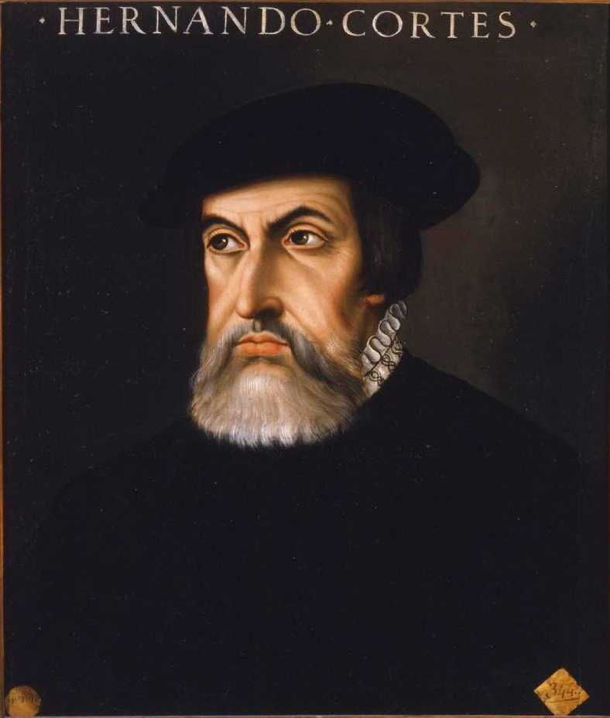
Hernán Cortés
Conquistador
1485 - 1547

Slide 36
Motivating Change

Slide 37
Two Ways to Get People to the
New World
Cortez
The Pirate Captain
Burn the ships — eliminate all other options
Reorgs, mandates, "we're doing this starting Monday"
Changed behavior, but not common sense
"Come with me — here's where we're going"
Nobody gets conscripted — they volunteer
Some people won't come — and that's fine
Notes:
# Title -- Two Ways to Get People to the New World
# Cortez
# The Pirate Captain
# Burn the ships — eliminate all other options
Cortez burned the ships. No going back. His crew was 'well motivated' because they had no alternative. That's extractive change management: eliminate all other options and call the result buy-in.
# Reorgs, mandates, "we're doing this starting Monday"
In organizations, this looks like reorgs, mandates, 'we're doing this starting Monday, no discussion.' People move, but only because you destroyed the alternative.
# Changed behavior, but not common sense
The problem is Cortez changed behavior but he didn't change common sense. His crew's mental model was still 'we want to go home.' The moment you give them ships again, they leave. That's enforcement without internalization.
# "Come with me — here's where we're going"
The pirate captain says 'come with me! Here's where we're going and here's why it's worth it.' People join because the destination is compelling and the captain seems like someone who can get them there.
# Nobody gets conscripted — they volunteer
Nobody gets conscripted onto a pirate ship. You join because the captain is going somewhere interesting. There's risk and adventure and the whole thing might fail spectacularly, but it's alive.
# Some people won't come — and that's fine
And some people won't come. That's fine. A pirate ship has a crew, not a headcount. The people who choose to be there are worth ten people who were forced to stay.

Slide 38
Hero skills don't scale — be Picard, not Han Solo
Both extractive and generative are necessary — but know which mode you're in
Fluency, Awareness, New Common Sense — three layers that build on each other
99% utilization kills both throughput AND curiosity
Be the pirate captain, not Cortez
Module 2 Key Takeaways
Notes:
# Title -- Module 2 Key Takeaways
# Hero skills don't scale — be Picard, not Han Solo
Hero skills don't scale. Be Picard, not Han Solo. Build a team that works without you.
# Both extractive and generative are necessary — but know which mode you're in
Both extractive and generative are necessary. The problem is when extraction becomes the only mode and you stop believing that there can be visions after visions.
# Fluency, Awareness, New Common Sense — three layers that build on each other
Fluency, awareness, new common sense. Three layers that build on each other. Handle the rocks, see the trail, choose the destination.
# 99% utilization kills both throughput AND curiosity
Ninety-nine percent utilization kills both throughput and curiosity. Leave room in the system for something unexpected to happen.
# Be the pirate captain, not Cortez
And be the pirate captain, not Cortez. Don't burn the ships. Build something people actually want to board.

