Slide 1




Branches That Don’t Suck:
Smarter Strategies for Modern Dev Teams
Benjamin Day
www.benday.com
@benday

Slide 2


Benjamin Day
Software Delivery Rescue
Therapist for Teams
.NET, Azure, DevOps, Architecture
Fractional CTO & delivery diagnostics
Microsoft MVP
@benday
linkedin

Slide 3

Smarter Strategies for Modern Dev Teams
Benjamin Day
www.benday.com
info@benday.com
Notes:
***SETTING***: Pronunciation: C# --> see sharp
***SETTING***: Pronunciation: .NET --> dot net
***SETTING***: Pronunciation: LINQ --> link
***SETTING***: Pronunciation: SQL --> sequel
***SETTING***: Pronunciation: JSON --> jason
***SETTING***: Pronunciation: XML --> X M L
***SETTING***: Pronunciation: XAML --> zammel
***SETTING***: Pronunciation: ASP.NET --> A S P dot net
***SETTING***: Pronunciation: Blazor --> blay-zor
***SETTING***: Pronunciation: Azure --> azure
***SETTING***: Pronunciation: OAuth --> oh-auth
***SETTING***: Pronunciation: GUID --> gwhid
***SETTING***: Pronunciation: regex --> reg-ex
***SETTING***: Pronunciation: enum --> ee-num
***SETTING***: Pronunciation: NuGet --> new-get
***SETTING***: Pronunciation: DevOps --> dev ops
***SETTING***: Pronunciation: RDBMS --> R D B M S
***SETTING***: Pronunciation: NoSQL --> no sequel
***SETTING***: Pronunciation: MySQL --> my sequel
***SETTING***: Pronunciation: PostgreSQL --> post-gres Q L
***SETTING***: Pronunciation: SQLite --> sequel lite
***SETTING***: Pronunciation: jwot --> jot
***SETTING***: Pronunciation: jwt --> jot

Slide 4
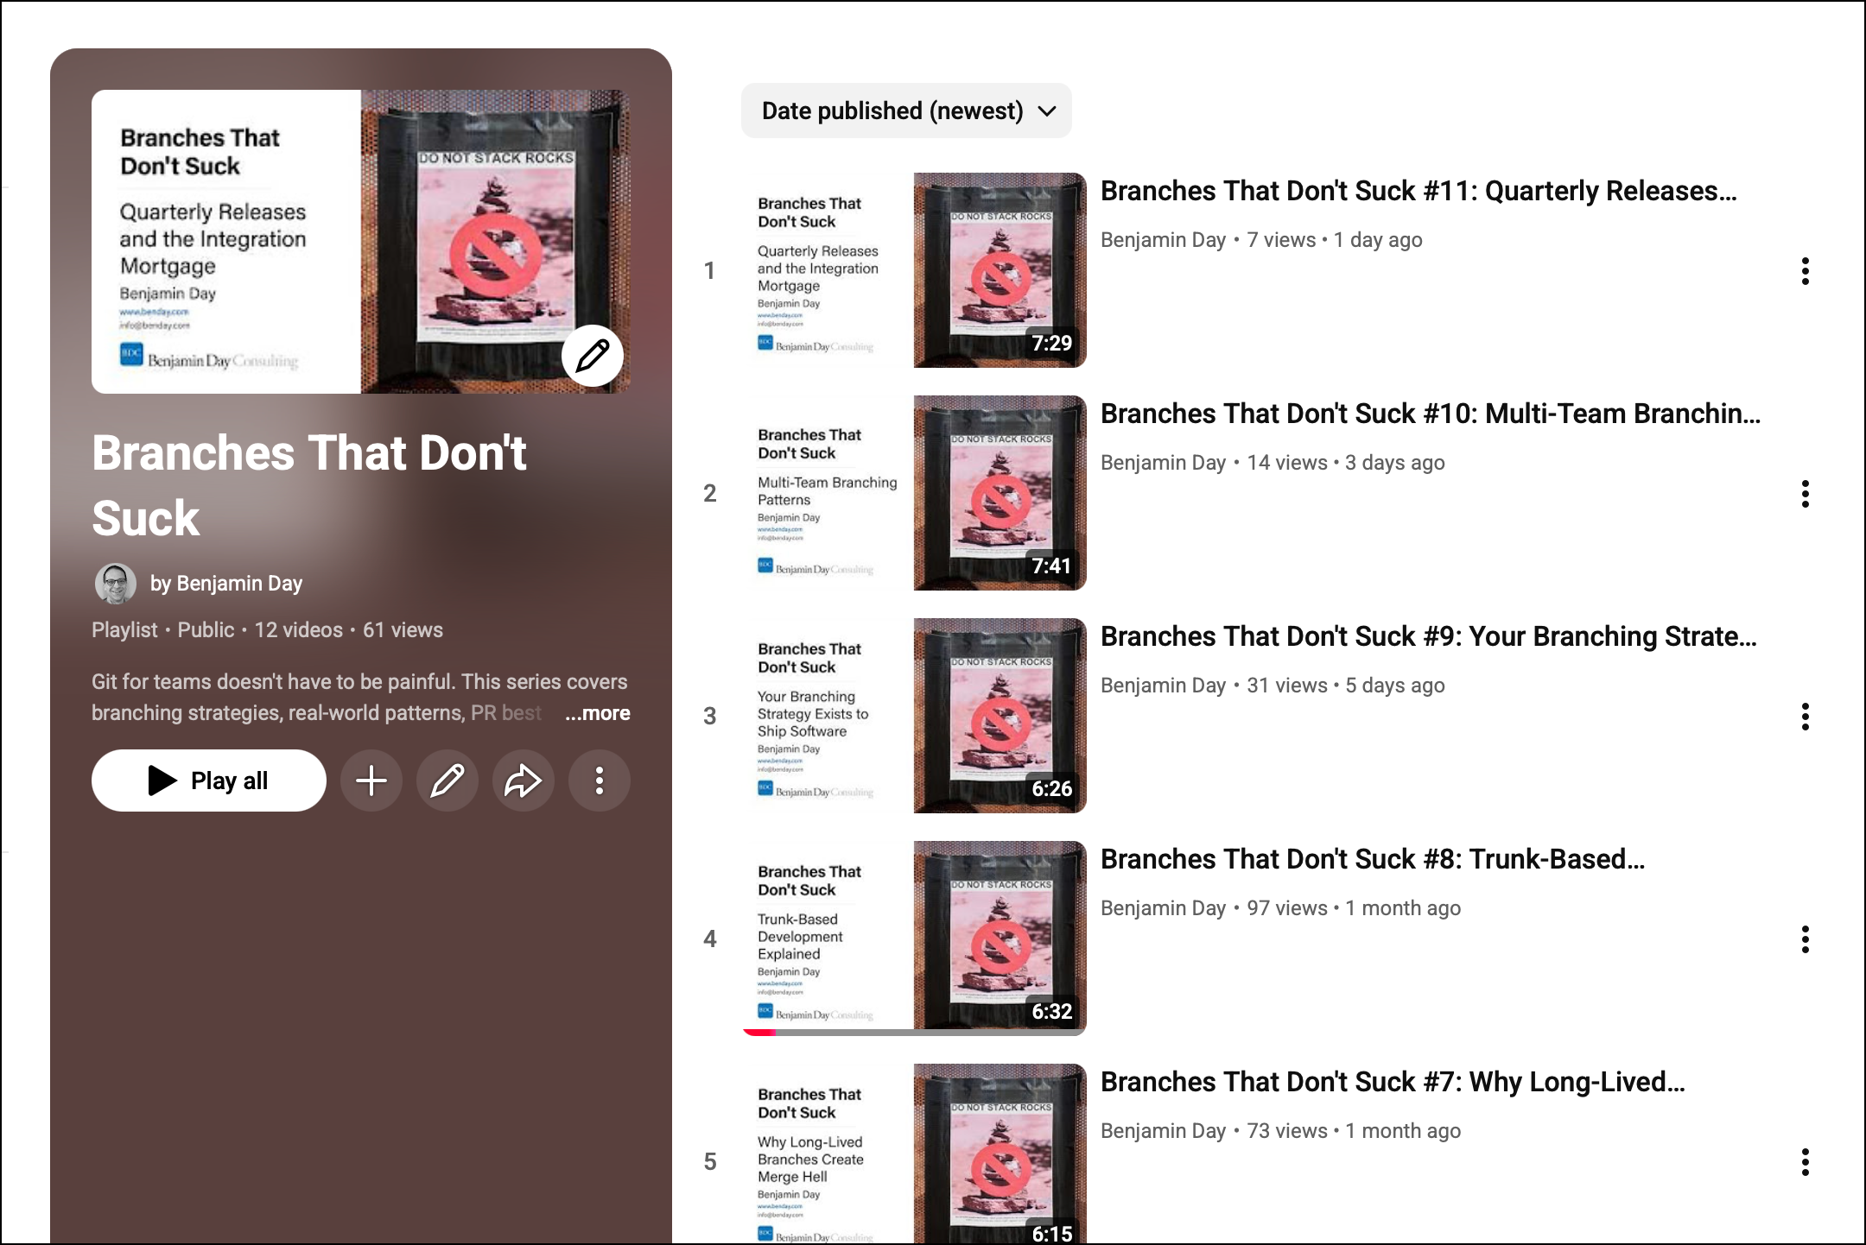

Branches That Don’t Suck
YouTube Series

Slide 5
What branches actually are (and aren't)
The strategies everyone claims to follow
When branching problems are really people problems
What We're Covering
Notes:
# Title -- What We're Covering
# What branches actually are (and aren't)
We'll start with some mechanics, because I find a lot of people are fuzzy on what a branch actually is under the hood.
# The strategies everyone claims to follow
Then we'll talk about the branching strategies you've heard of: GitFlow, GitHub Flow, trunk-based. And why most teams aren't actually doing what they think they're doing.
# When branching problems are really people problems
And then the fun part: when your branching strategy is a symptom of something deeper going on with your team.

Slide 6

How Many Branches Does Your Team Have Right Now?
Notes:
# Title -- How Many Branches Does Your Team Have Right Now?
# Stock Photo: question-yellow
Quick question for the room. How many branches does your team have right now? Not how many should you have. How many do you actually have? If you don't know the answer, that's already telling you something.

Slide 7
What Is a Branch?
A pointer to a commit, not a container for files
Source control tracks the relationship
A branch lets you work in isolation
For every branch, there's a merge
Notes:
# Title -- What Is a Branch?
# Source control tracks the relationship
The source control system knows what changed and where those changes came from. It tracks the relationship between your branch and the branch you came from.
# A branch lets you work in isolation
The whole point of a branch is isolation. Two versions of similar code, separated from each other so you can work without stepping on someone else's toes.
# For every branch, there's a merge
But here's the thing people forget: for every branch you create, there's a merge waiting for you. That isolation isn't free. You will pay for it eventually.

Slide 8
Type of automated test
Goal:
  Verify the behavior of an application…
  …without requiring human involvement
Best Practice: Don't Branch.
Notes:
# Title -- Best Practice: Don't Branch.
I know that sounds crazy coming from a guy who's about to spend 75 minutes talking about branching. But hear me out. The best branching strategy is the one where you branch as little as possible. If you can get away with not branching, you're better off. Every branch you create is work you're choosing to defer.

Slide 9

Best Practice:
Don’t Branch

Slide 10
Type of automated test
Goal:
  Verify the behavior of an application…
  …without requiring human involvement
A Branch Is an Integration Credit Card.
Notes:
# Title -- A Branch Is an Integration Credit Card.
Think of it this way. A branch is an integration credit card. You get to work in isolation for free, right? Create your branch, write some code, feel productive. But at the end of the month, the bill comes due. That bill is the merge. And just like a credit card, the longer you wait to pay, the more interest you're going to owe.

Slide 11

A branch is an integration credit card.

Slide 12
Short-lived branches = small balance
Long-lived branches = compounding interest
Until it's merged, it's not done
The Credit Card Rules
Notes:
# Title -- The Credit Card Rules
# Short-lived branches = small balance
Short-lived branches are like paying your credit card every month. Small balance, easy to manage, no surprises.
# Long-lived branches = compounding interest
Long-lived branches are like making minimum payments. The interest compounds. Other people are committing to main while you're off in your branch, and the gap between your code and everyone else's code keeps growing.
# Until it's merged, it's not done
And here's the part that matters: until you've merged that code back with everything else, it's not really done. It doesn't matter how beautiful your code is in your branch. If it doesn't work with everyone else's code, it doesn't work.

Slide 13

If the Best Practice Is Don't Branch, Why Do We Branch?
Notes:
# Title -- If the Best Practice Is Don't Branch, Why Do We Branch?
OK so if the best practice is don't branch, why does everyone branch? There are legitimate reasons. Let's talk about when branching makes sense, and when it's just something you're doing because somebody told you to.

Slide 14
Four Reasons Teams Branch
Feature Isolation
Code Review (PRs)
Release Snapshots
Environment Modeling
Notes:
# Title -- Four Reasons Teams Branch
# 1: Feature Isolation →
First: feature isolation. You want to work on a feature without breaking the main codebase. This is the most common reason and it's generally fine, as long as the branch doesn't live too long.
# 2: Code Review (PRs) →
Second: code review through pull requests. Create a branch, do your work, submit a PR, get it reviewed, merge. This is a good workflow. It creates a quality gate.
# 3: Release Snapshots →
Third: release snapshots. You want to know exactly what code went to production so you can do hotfixes if needed. In Git, you're probably using tags for this, which is even simpler than branching.
# 4: Environment Modeling →
And fourth: environment modeling. A branch for dev, a branch for QA, a branch for production. This one... we're going to come back to this one. Because this one is where things go sideways.

Slide 15
The Branching Strategies Everyone Talks About
"You keep using that word.
I do not think it means what you think it means."

Slide 16
Main, develop, feature, release, hotfix branches
Designed for scheduled, versioned releases
Heavy coordination overhead
GitFlow
Notes:
# Title -- GitFlow
# Main, develop, feature, release, hotfix branches
GitFlow has a lot of moving parts. You've got a main branch, a develop branch, feature branches, release branches, and hotfix branches. Each one has specific rules about where you can merge and when.
# Designed for scheduled, versioned releases
It was designed for teams doing scheduled, versioned releases. Think: version 2.3 ships in March, version 2.4 ships in June. If that's your world, GitFlow makes sense.
# Heavy coordination overhead
But if you're doing continuous delivery or deploying multiple times a week, GitFlow is way more ceremony than you need. All those branches require coordination, and coordination is where mistakes happen.

Slide 17
Main + short-lived feature branches
Deploy from main, always
Works great for continuous delivery
GitHub Flow
Notes:
# Title -- GitHub Flow
# Main + short-lived feature branches
GitHub Flow is basically: you have main, and you have short-lived feature branches. That's it. Branch off main, do your work, open a PR, merge back to main.
# Deploy from main, always
Main is always deployable. When you merge to main, that code goes to production. Simple.
# Works great for continuous delivery
This works beautifully for teams that deploy frequently. Low overhead, fast feedback, minimal ceremony. But it requires discipline: main has to actually be deployable at all times.

Slide 18
Everyone commits to main (trunk)
Branches live for hours, not days
Requires CI/CD maturity and feature flags
Trunk-Based Development
Notes:
# Title -- Trunk-Based Development
# Everyone commits to main (trunk)
In trunk-based development, everyone commits directly to main. Or if you do use branches, they live for hours, not days. Definitely not weeks.
# Branches live for hours, not days
The idea is: minimize the time between writing code and integrating it with everyone else's code. That integration credit card? You're paying it off immediately.
# Requires CI/CD maturity and feature flags
But this requires real maturity. You need solid CI/CD, you need automated testing, you probably need feature flags. Trunk-based is a destination, not a starting point.

Slide 19

“Yeah, We Do GitHub Flow."
Notes:
# Title -- Yeah, We Do GitHub Flow.
# Stock Photo: teen-eye-roll
Here's what I actually see when I talk to teams. They say: yeah, we do GitHub Flow. Or: we're trunk-based. And then I look at their repos, and they've got 47 open branches, some of them three months old, and a develop branch that nobody can explain. They latched onto a slogan and vaguely gesture in that direction.

Slide 20
What Teams Say vs. What Teams Do
What They Say
What They Do
We follow GitHub Flow
Short-lived branches only
Main is always deployable
47 open branches, some 3 months old
A 'develop' branch nobody can explain
Main broke twice last week
Notes:
# Title -- What Teams Say vs. What Teams Do
# What They Say
# What They Do
# We follow GitHub Flow
We follow GitHub Flow. Nice and simple.
# Short-lived branches only
We only use short-lived branches. A few days at most.
# Main is always deployable
Main is always deployable. We're very disciplined about that.
# 47 open branches, some 3 months old
47 open branches. Some of them haven't been touched in three months. Nobody knows what's in them.
# A 'develop' branch nobody can explain
There's a develop branch that was created by someone who left the company. Nobody's sure if they need it but nobody wants to delete it.
# Main broke twice last week
And main broke twice last week because somebody merged without running tests.

Slide 21
Use what makes sense for YOU.

Slide 22
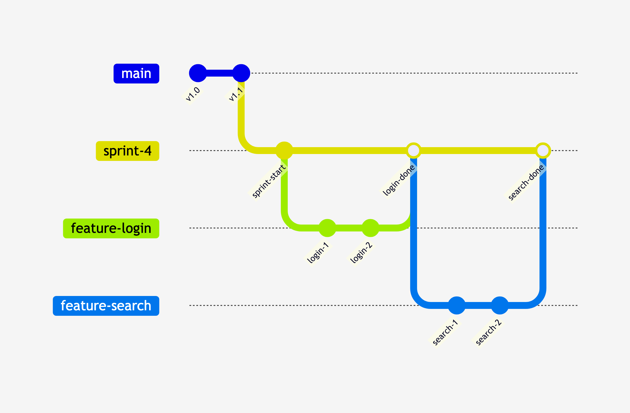
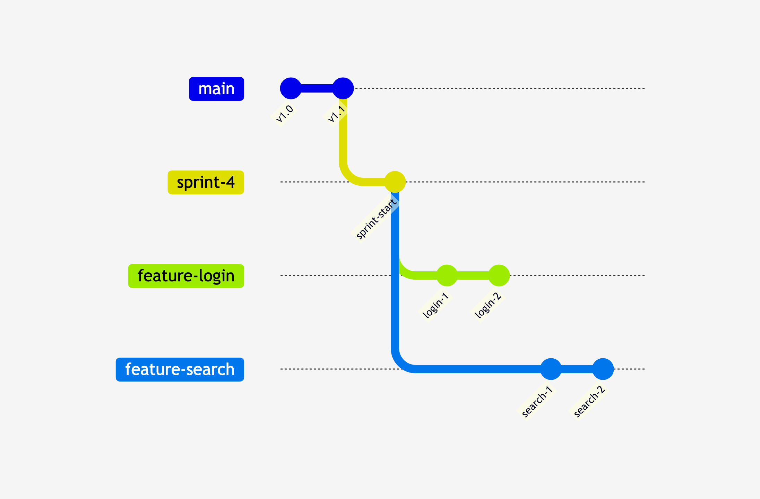
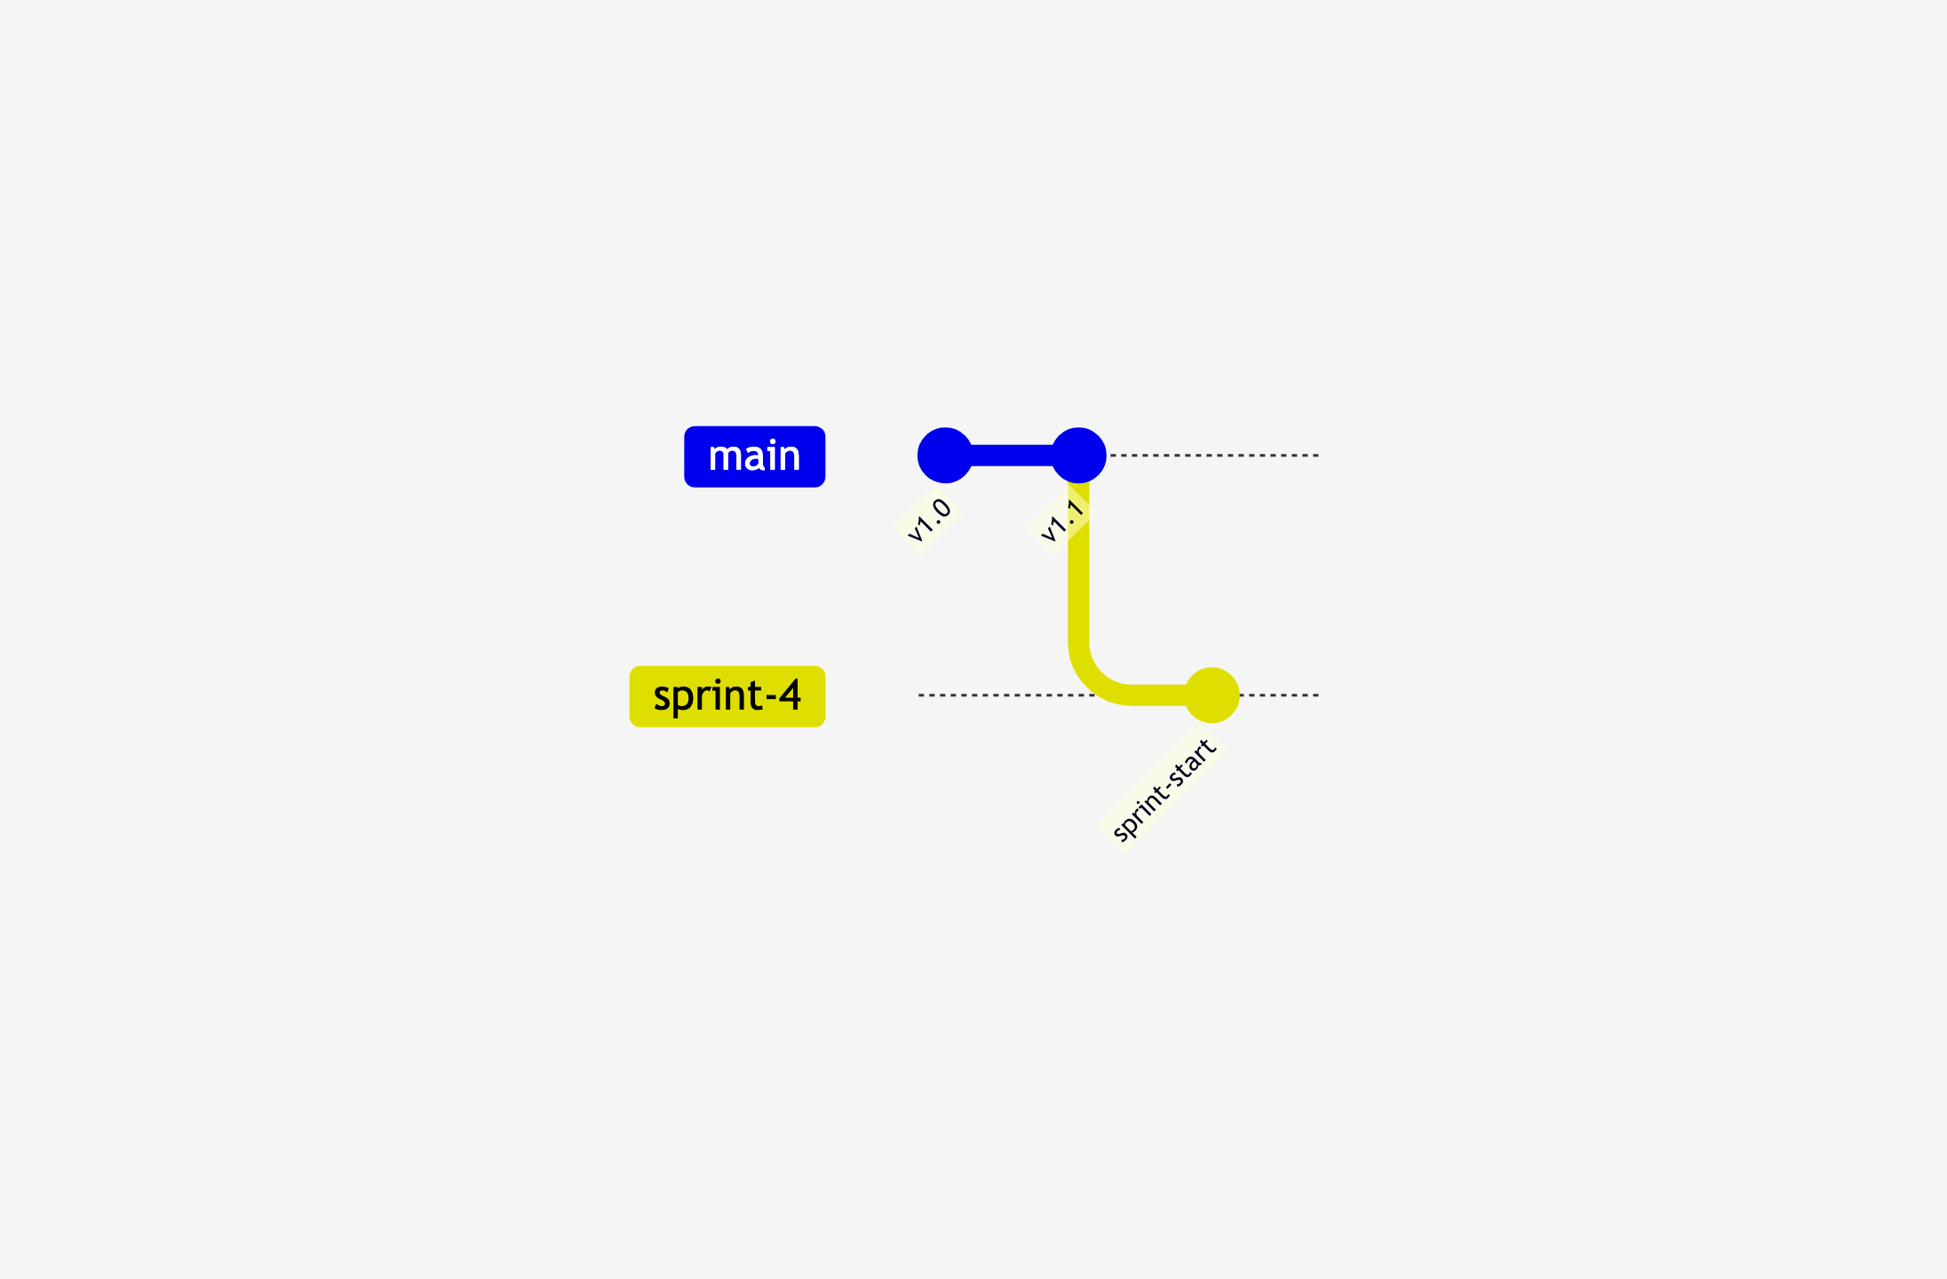
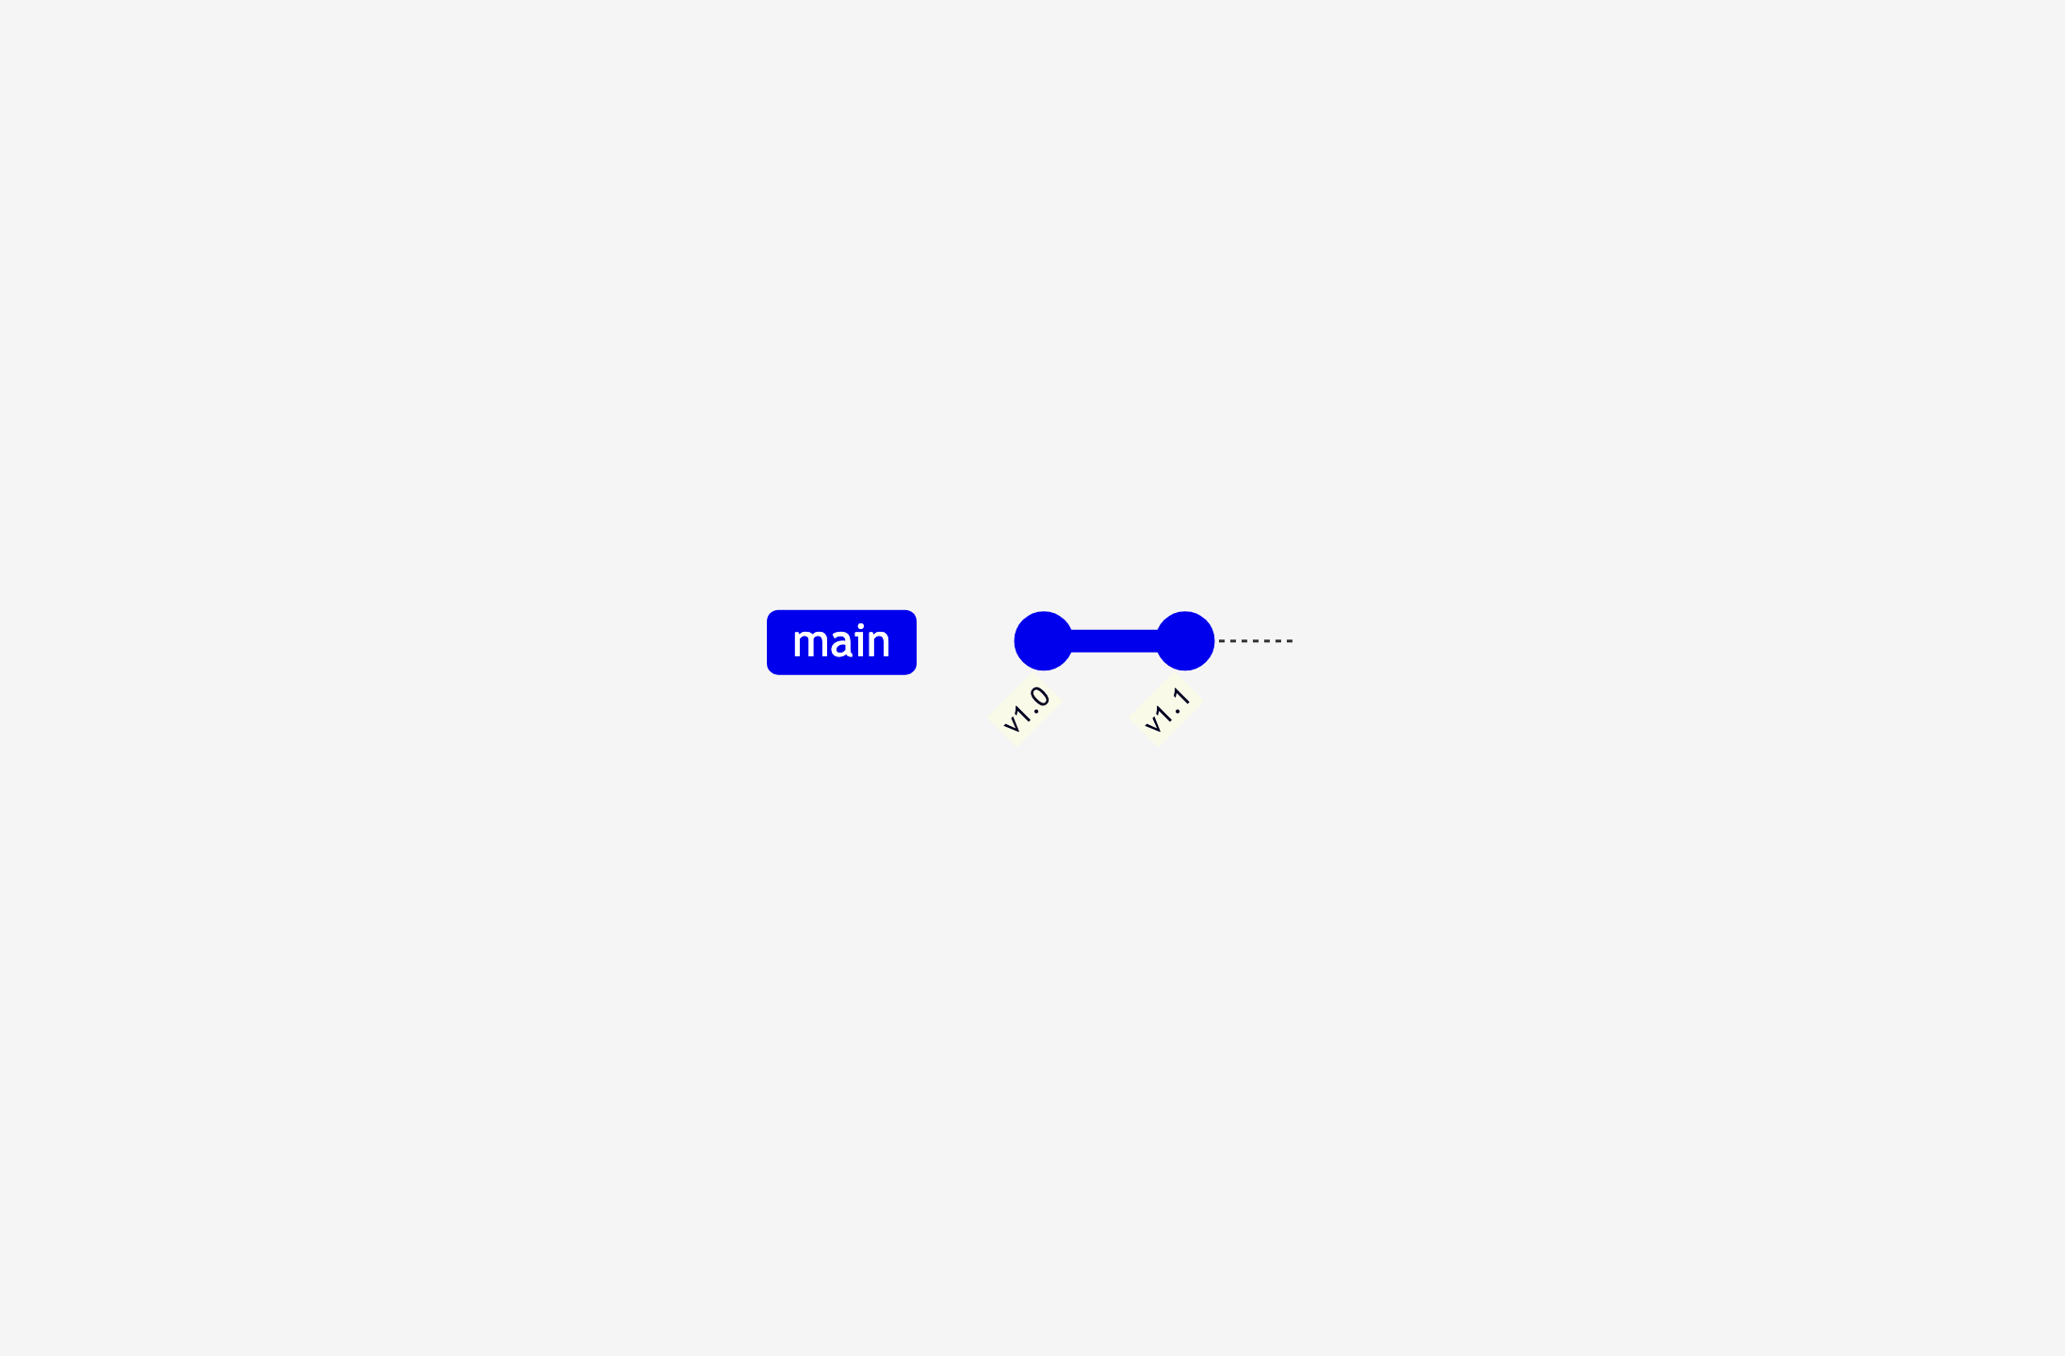
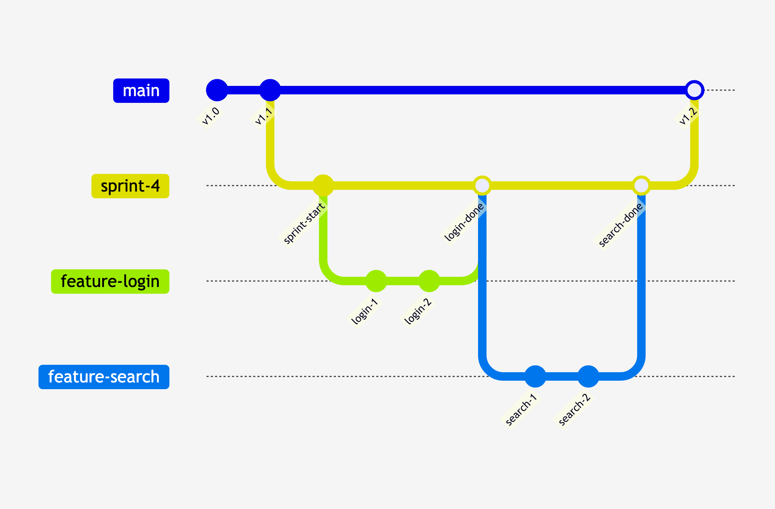
Recommendation: Sprint Branches
Main = truth
Sprint / Iteration Branch
Feature branches
Features merge to sprint
Sprint merges to main
Notes:
# Title -- Recommendation: Sprint Branches
# Main = truth
You start with main. Main is your source of truth. It represents what's in production or what's ready to go to production. Nobody commits directly to main.
# Sprint / Iteration Branch
When you start a sprint, you create a sprint branch off main. This is your integration point for the sprint. Everything the team builds this sprint will come together here.
# Feature branches
Individual features branch off the sprint branch, not off main. Developer picks up a work item, creates a feature branch off the sprint branch, does their work, opens a PR back to the sprint branch.
# Features merge to sprint
As features finish and pass code review, they merge into the sprint branch. Notice what's happening: features are integrating with each other during the sprint, not at the end. You're paying that credit card as you go.
# Sprint merges to main
At the end of the sprint, the sprint branch merges to main. Everything that's done, tested, and integrated goes to main in one clean merge. Main stays stable. And you start the next sprint with a fresh branch off main.

Slide 23
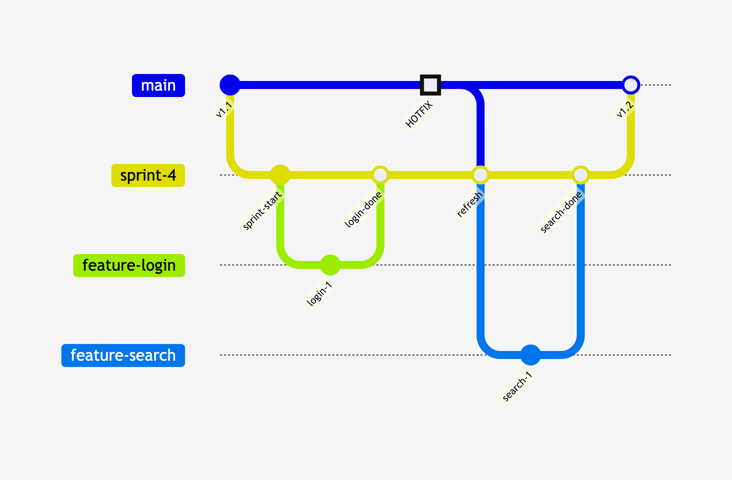
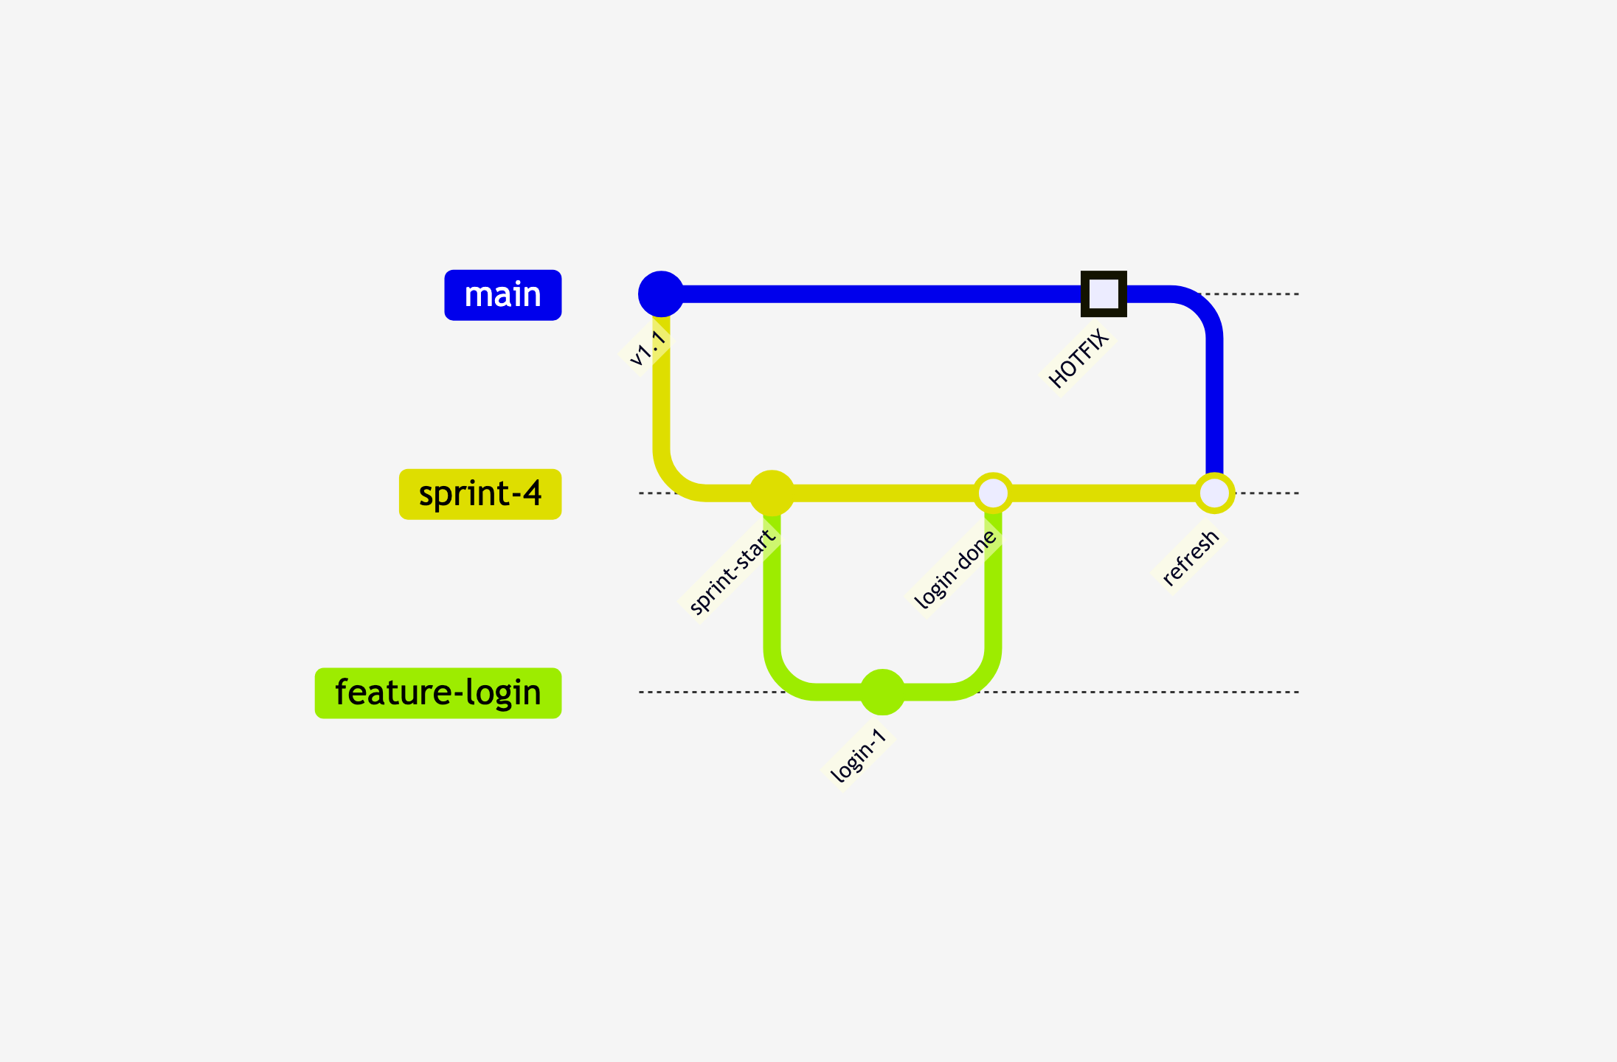
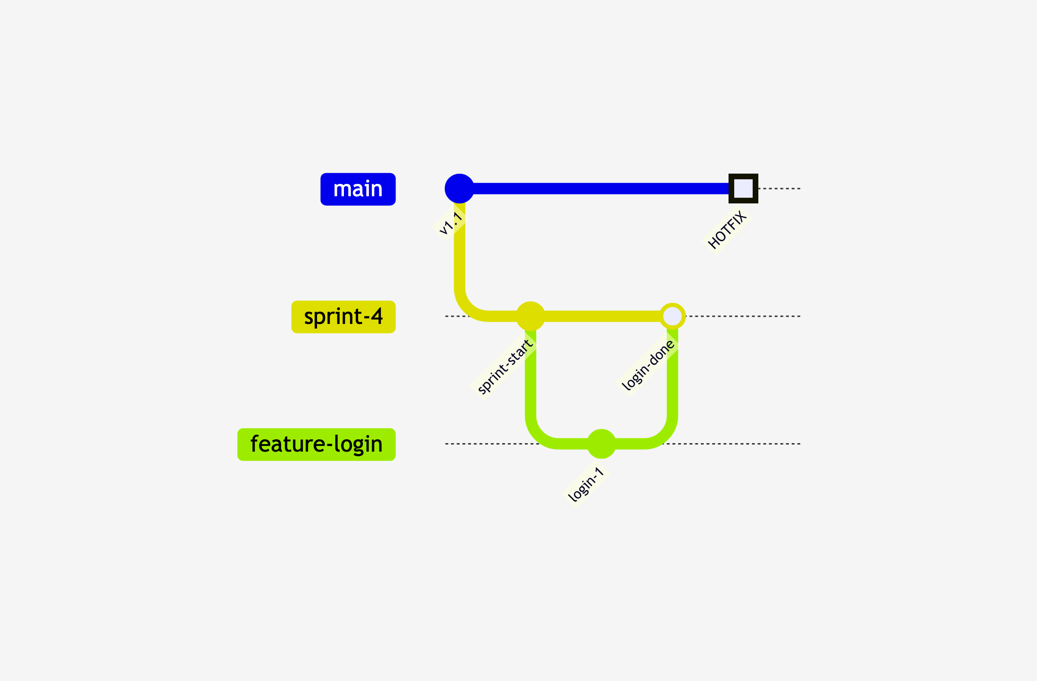
Sprint Branches and Hotfixes
Hotfix mid-sprint
Refresh merge to sprint
Sprint merges cleanly
Notes:
# Title -- Sprint Branches and Hotfixes
# Hotfix mid-sprint
You're mid-sprint. Features are getting built. And then a production emergency hits. The hotfix goes to main because main is production.
# Refresh merge to sprint
Here's the move: you do a refresh merge. You pull main down into your sprint branch. Now the sprint branch has the hotfix plus everything the team has been working on. The sprint branch stays current with production.
# Sprint merges cleanly
Work continues. More features merge to the sprint branch. And at the end of the sprint, the merge to main is clean because you already incorporated the hotfix during the sprint. No surprises. No conflicts. No deploying untested code.

Slide 24
What About Multiple Teams on the Same Product?
Notes:
# Title -- What About Multiple Teams on the Same Product?
Everything I just showed you works great for one team. But what happens when you've got two or three teams all working on the same codebase, shipping in the same iteration? Now you've got a coordination problem. And it comes down to one question: where is your integration point?

Slide 25
Two Major Options:
Teams that deliver independently
Teams that deliver together
What About Multiple Teams on the Same Product?

Slide 26
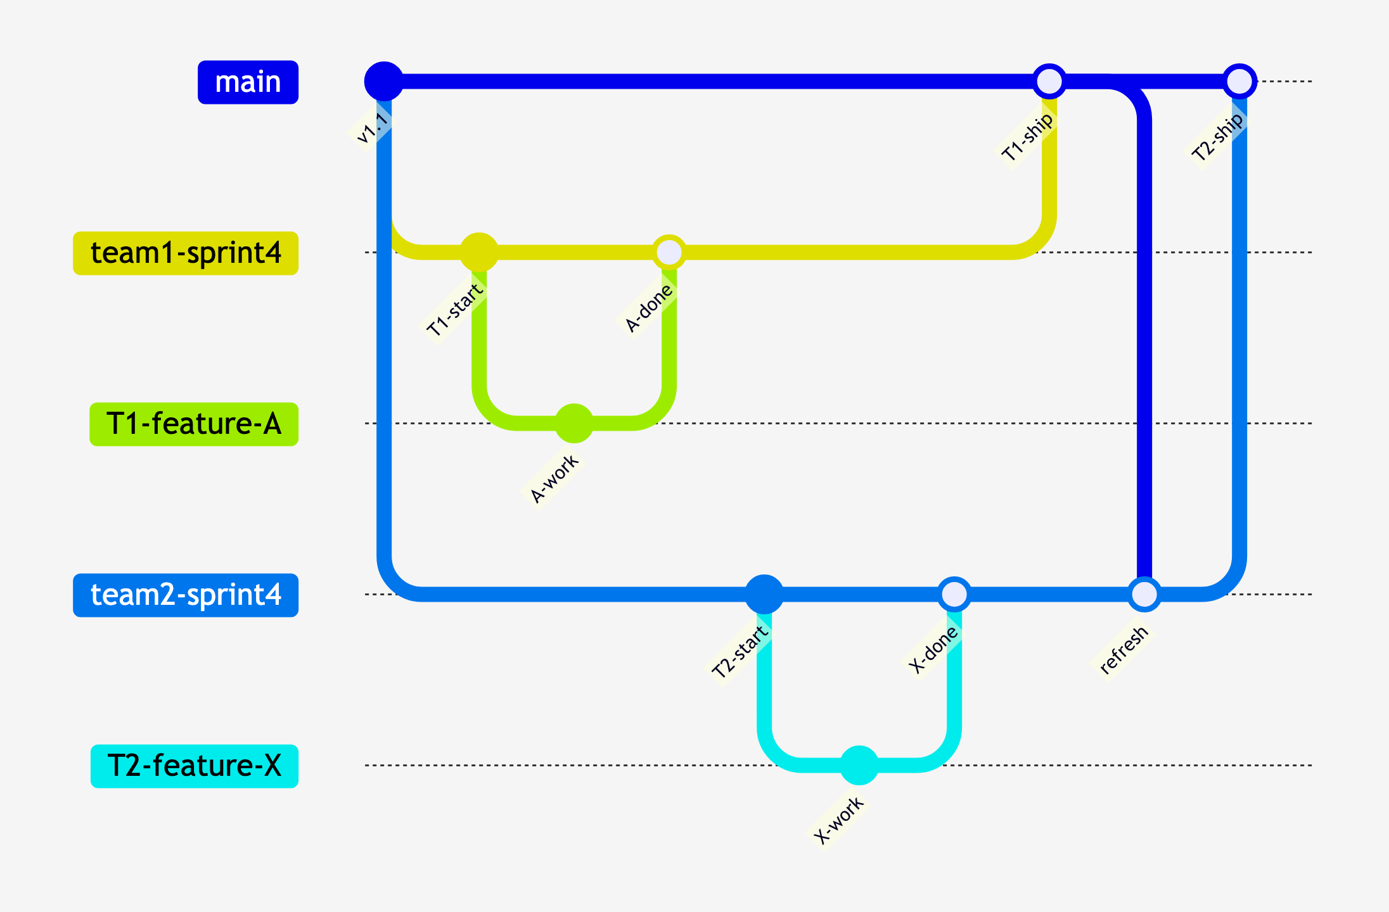
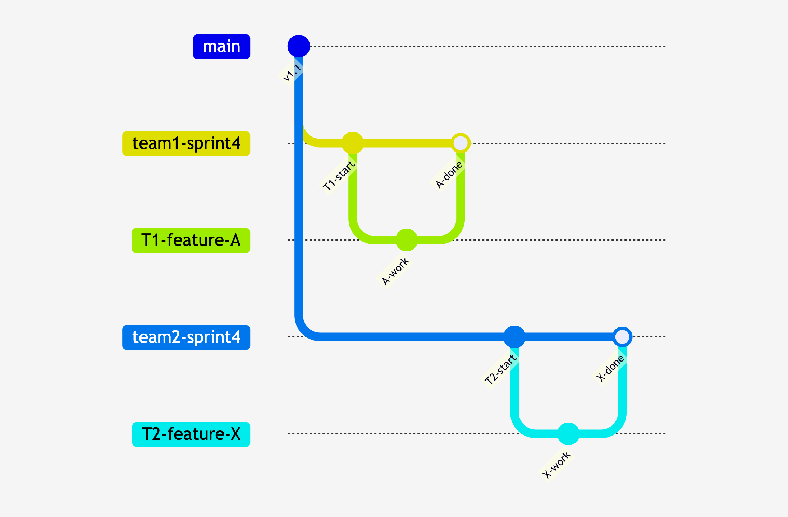
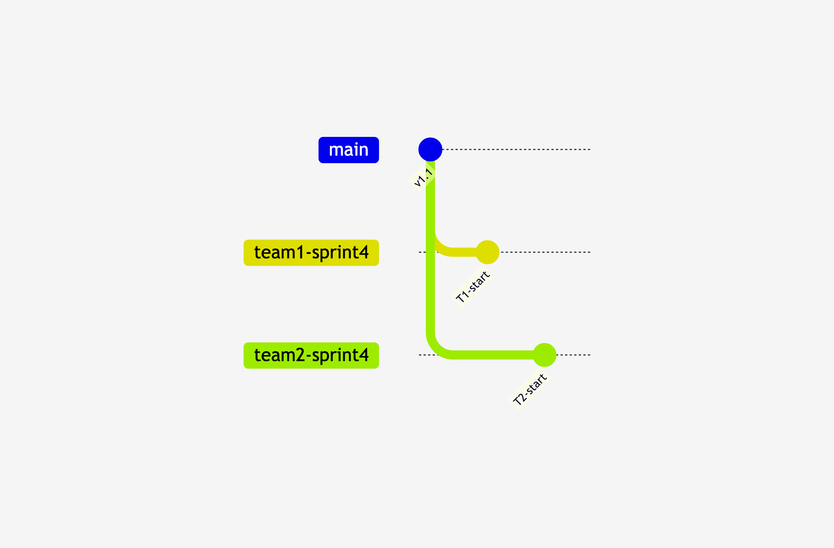
Option 1: Teams Merge Independently
Team branches
Teams work in parallel
Teams merge to main
Notes:
# Title -- Option 1: Teams Merge Independently
# Team branches
Each team creates their own sprint branch directly off main. Team 1 has their sprint branch, Team 2 has theirs. They're working in parallel, independently.
# Teams work in parallel
Each team creates feature branches off their own sprint branch, does their work, merges features back to their sprint branch. Same pattern as before, just two teams doing it at the same time.
# Teams merge to main
When a team finishes their sprint, they merge to main. Team 1 finishes first, merges. Now Team 2 does a refresh merge to pick up Team 1's changes, then merges to main. Simple. Each team controls their own timeline.

Slide 27
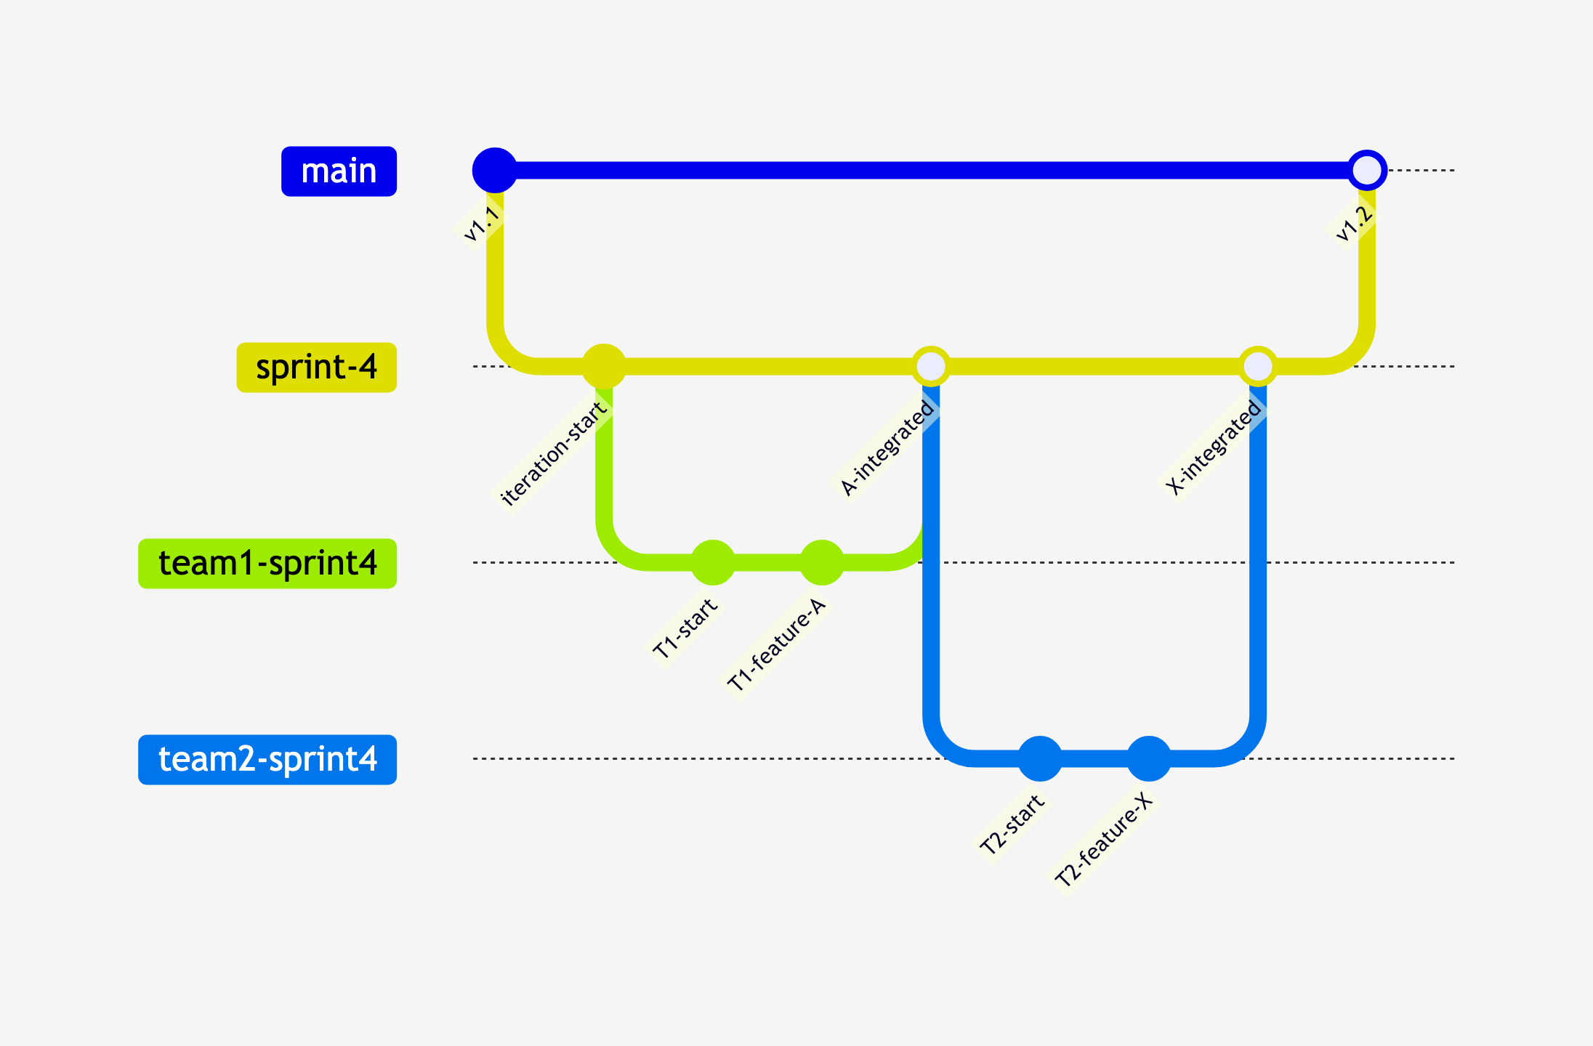
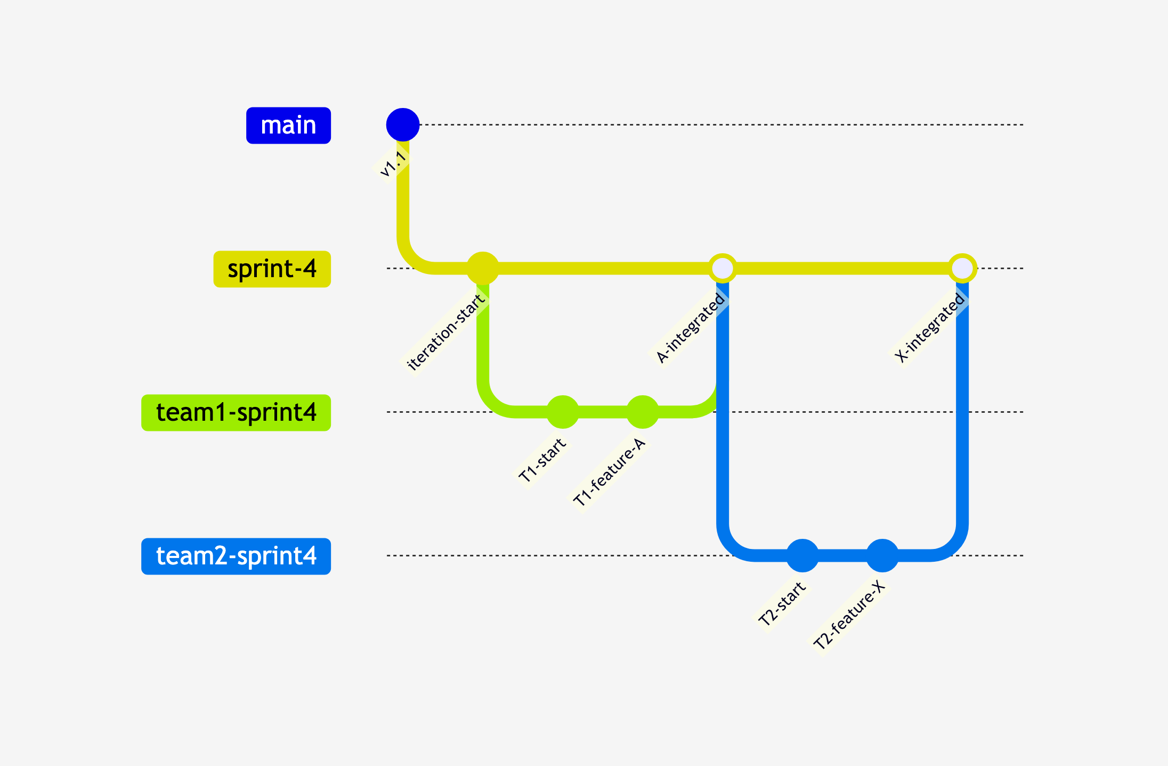
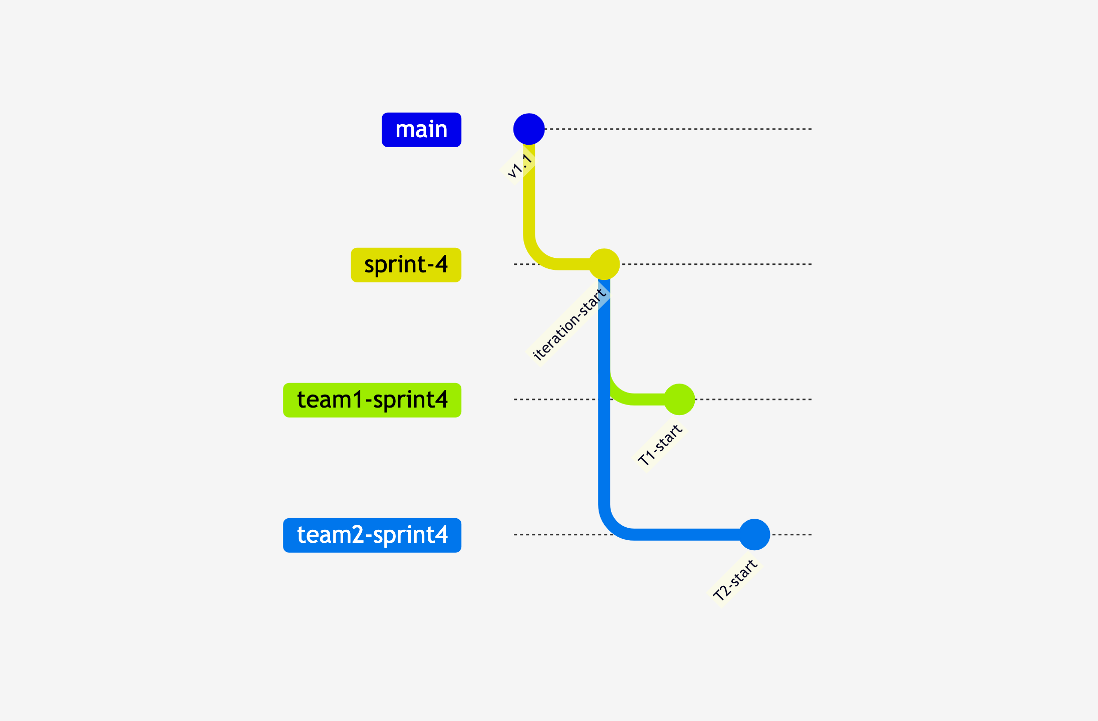
Option 2: Shared Iteration Branch
Iteration branch
Team branches
Iteration branch = release candidate
Notes:
# Title -- Option 2: Shared Iteration Branch
# Iteration branch
You create an iteration branch off main. Then each team creates their sprint branch off the iteration branch, not off main. The iteration branch is the shared integration point where all the teams' work comes together.
# Team branches
Teams do their work in their own branches, same as before. But when a team finishes a feature, they merge up to the shared iteration branch, not directly to main. Now both teams' work is integrating in one place.
# Iteration branch = release candidate
The iteration branch is now your release candidate. It has Team 1's work and Team 2's work, integrated together. You can test this as a unit. You can deploy it to a QA environment. When everyone is happy, the iteration branch merges to main. One clean merge that includes everything.

Slide 28
Which Multi-Team Model?
Teams Merge Independently
Shared Iteration Branch
Simpler, less coordination
Teams don't see each other's work until main
Best for loosely coupled teams
More coordination, but shared release candidate
Teams collaborate on a release candidate
Best for tightly coupled teams shipping together
Notes:
# Title -- Which Multi-Team Model?
# Teams Merge Independently
# Shared Iteration Branch
# Simpler, less coordination
Less coordination overhead. Each team owns their own timeline and their own merge to main.
# Teams don't see each other's work until main
But teams don't see each other's changes until they hit main. If Team 2's feature depends on Team 1's feature, they need to coordinate refresh merges.
# Best for loosely coupled teams
This works best when teams are loosely coupled: working on different parts of the codebase, shipping independently, not dependent on each other's features.
# More coordination, but shared release candidate
More coordination, but you get a shared release candidate. Everyone's work is integrated and tested together before it touches main.
# Teams collaborate on a release candidate
The iteration branch is where the teams come together. You can see cross-team integration issues early, not at the last minute.
# Best for tightly coupled teams shipping together
This works best when teams are tightly coupled: working on the same features, shipping in the same release, where cross-team integration matters.

Slide 29
Explain Your Branching Strategy in Two Sentences
How does code go from your
machine → production
Easy to explain?
  Probably ok
Hard to explain?
  Probably not great
Try this:
Can you explain it?
Notes:
# Title -- Can You Explain Your Branching Strategy in Two Sentences?
Here's a test for you. When you get back to the office on Monday, ask your team: can you explain our branching strategy in two sentences? Not which blog post you read. Not which buzzword you use. Can you actually describe how code gets from your machine to production? If your team can't do that consistently, you don't have a branching strategy. You have a branching suggestion.

Slide 30
Minimal branching
Go fast
Continuous Deployment
Trunk-based
Development

Slide 31

Trunk-Based Is a Destination, Not a Starting Point
Notes:
# Title -- Trunk-Based Is a Destination, Not a Starting Point
# Stock Photo: windmills-sunset
Now, I'm a big believer in trunk-based development as the goal. But I want to be honest with you: most teams aren't ready for it today. And that's OK. The point is to move in that direction. Shorten your branches. Integrate more frequently. Pay off that credit card faster.

Slide 32
Step 1: Know what you're actually doing today
Step 2: Shorten your branch lifetimes
Step 3: Refresh merges to pay the tax gradually
Step 4: Invest in CI/CD and automated testing
The Path Toward Trunk-Based
Notes:
# Title -- The Path Toward Trunk-Based
# Step 1: Know what you're actually doing today
First, be honest about where you are. Don't claim you're doing GitHub Flow if your branches live for a month. Name what you're actually doing.
# Step 2: Shorten your branch lifetimes
Then start shortening your branch lifetimes. If your branches typically live for two weeks, try to get them down to a week. Then a few days. Then a day.
# Step 3: Refresh merges to pay the tax gradually
While your branches exist, do refresh merges. Pull changes from main into your branch frequently. Don't let your branch diverge. Pay the integration tax a little bit at a time instead of all at once.
# Step 4: Invest in CI/CD and automated testing
And invest in your pipeline. You can't do trunk-based without fast, reliable CI/CD and good test coverage. The pipeline is what gives you the confidence to merge frequently.

Slide 33
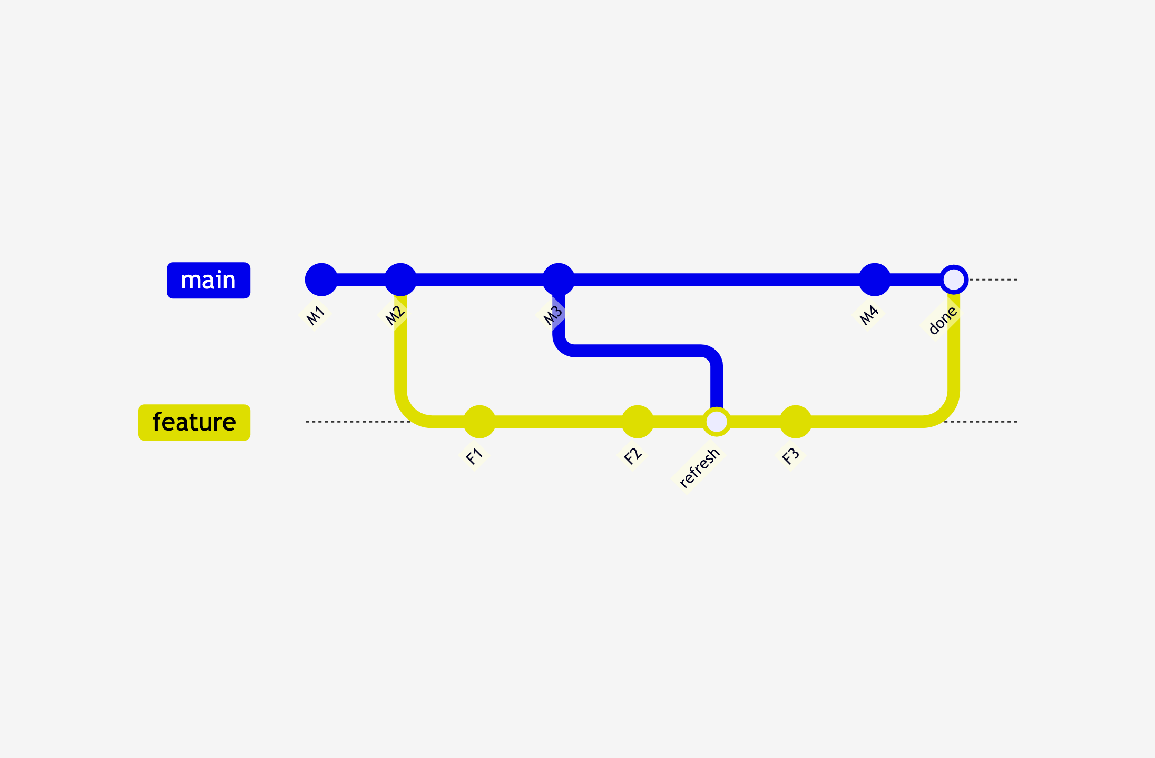
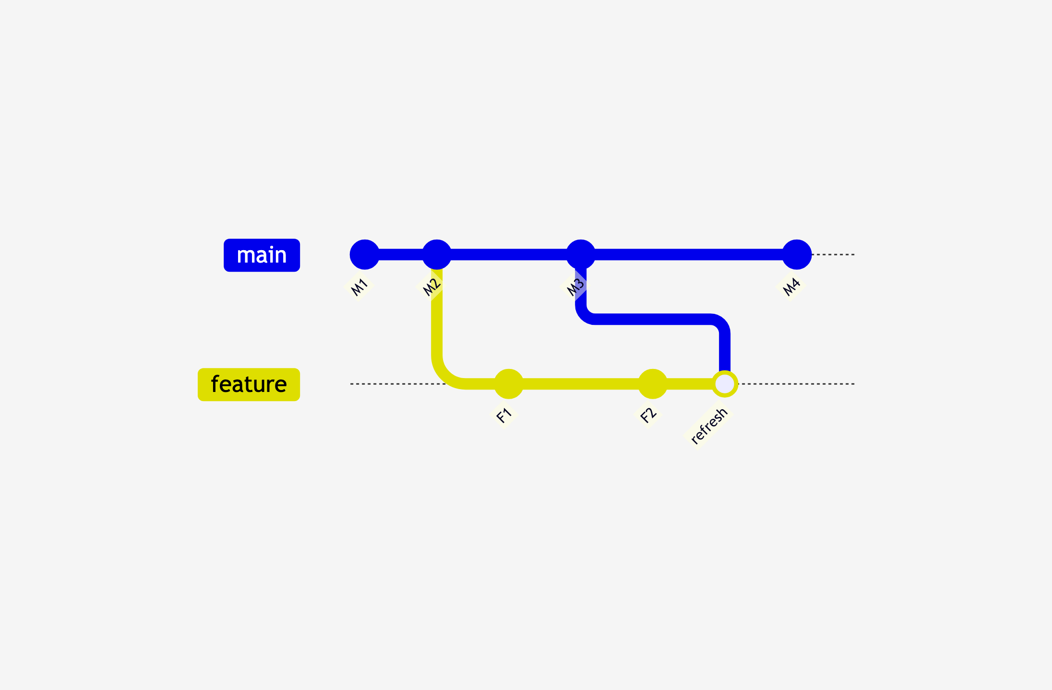
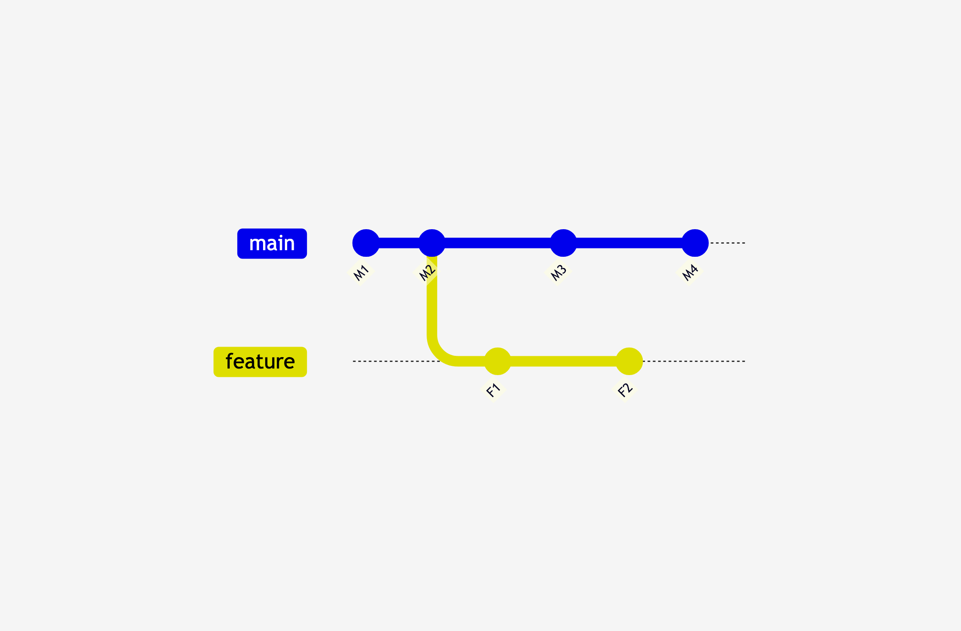
Refresh Merges: Paying the Tax Gradually
Feature branch diverges from main
Refresh merge pulls main into your branch
Final merge to main is much smoother
Notes:
# Title -- Refresh Merges: Paying the Tax Gradually
# Feature branch diverges from main
Here's the setup. You create a feature branch off main. Meanwhile, other people are committing to main. Your branch starts to diverge.
# Refresh merge pulls main into your branch
A refresh merge pulls the latest changes from main into your feature branch. Now your branch has everything main has, plus your changes. The gap closes.
# Final merge to main is much smoother
When it's time to merge back to main, the final merge is much smoother because you've been staying current all along. No surprises. No merge day nightmares.

Slide 34
Short-Lived vs. Long-Lived Branches
Short-Lived (hours/days)
Long-Lived (weeks/months)
Small merge conflicts, easy to resolve
Fast feedback on integration issues
Lower risk, less coordination
Massive merge conflicts, hard to understand
Integration surprises at the worst time
Higher risk, more coordination pain
Notes:
# Title -- Short-Lived vs. Long-Lived Branches
# Short-Lived (hours/days)
# Long-Lived (weeks/months)
# Small merge conflicts, easy to resolve
When you merge, the conflicts are small. You changed 50 lines, not 5,000. Easy to understand, easy to fix.
# Fast feedback on integration issues
You find out quickly if your code doesn't play well with someone else's changes. Fast feedback means fast fixes.
# Lower risk, less coordination
And the risk is low. If something goes wrong, you haven't invested weeks of work into a branch that won't merge.
# Massive merge conflicts, hard to understand
The merge conflicts are enormous. You're looking at hundreds of conflicting lines and trying to figure out what happened three weeks ago.
# Integration surprises at the worst time
You find integration problems at the very end, when you're under the most pressure to ship. The worst possible time to discover problems.
# Higher risk, more coordination pain
And the coordination overhead is brutal. Merge day becomes a feared event. People start coming in on weekends to deal with merges.

Slide 35
Merge Pain Is Proportional to Isolation Time.

Slide 36

When Branches Are Symptoms
Notes:
# Title -- When Branches Are Symptoms
# Stock Photo: headache-stress
OK. Now we get to the good stuff. Everything we've talked about so far has been mechanics and strategy. Now I want to talk about what's really going on. Because in my experience, branching problems are almost never about branching.

Slide 37
If we DON'T branch, what bad thing happens?
If we DO branch, what does it enable?
Before You Branch, Ask Two Questions
Notes:
# Title -- The Two Questions
# 1. If we DON'T branch, what bad thing happens?
Question one is about risk. What are you protecting yourself from? If the answer is nothing, or something vague like 'it's just how we do it,' that's a red flag.
# 2. If we DO branch, what does it enable?
Question two is about value. What do you gain? Isolation for code review? That's good. Isolation because Tim's code is scary? That's a symptom, not a solution.

Slide 38
Before You Redesign
Your Branching Strategy,
Ask What Problem
You're Actually Solving.
Notes:
# Title -- Before You Redesign Your Branching Strategy, Ask What Problem You're Actually Solving.
This is the thing I see teams get wrong over and over. They come to me and say: we need a better branching strategy. And I say: what problem are you trying to solve? And they can't tell me. They just know it feels painful. Don't reorganize the deck chairs. Figure out why the ship is sinking.

Slide 39
Environment-based Branching
“Oh no. That’s not good.”

Slide 40

The IT'S NOT FINE Story
Notes:
# Title -- The IT'S NOT FINE Story
# Stock Photo: slow-sign
OK. Story time. This is my favorite example of how branch-per-environment goes wrong. I'm going to walk you through it step by step, and I want you to tell me where the problem is.

Slide 41
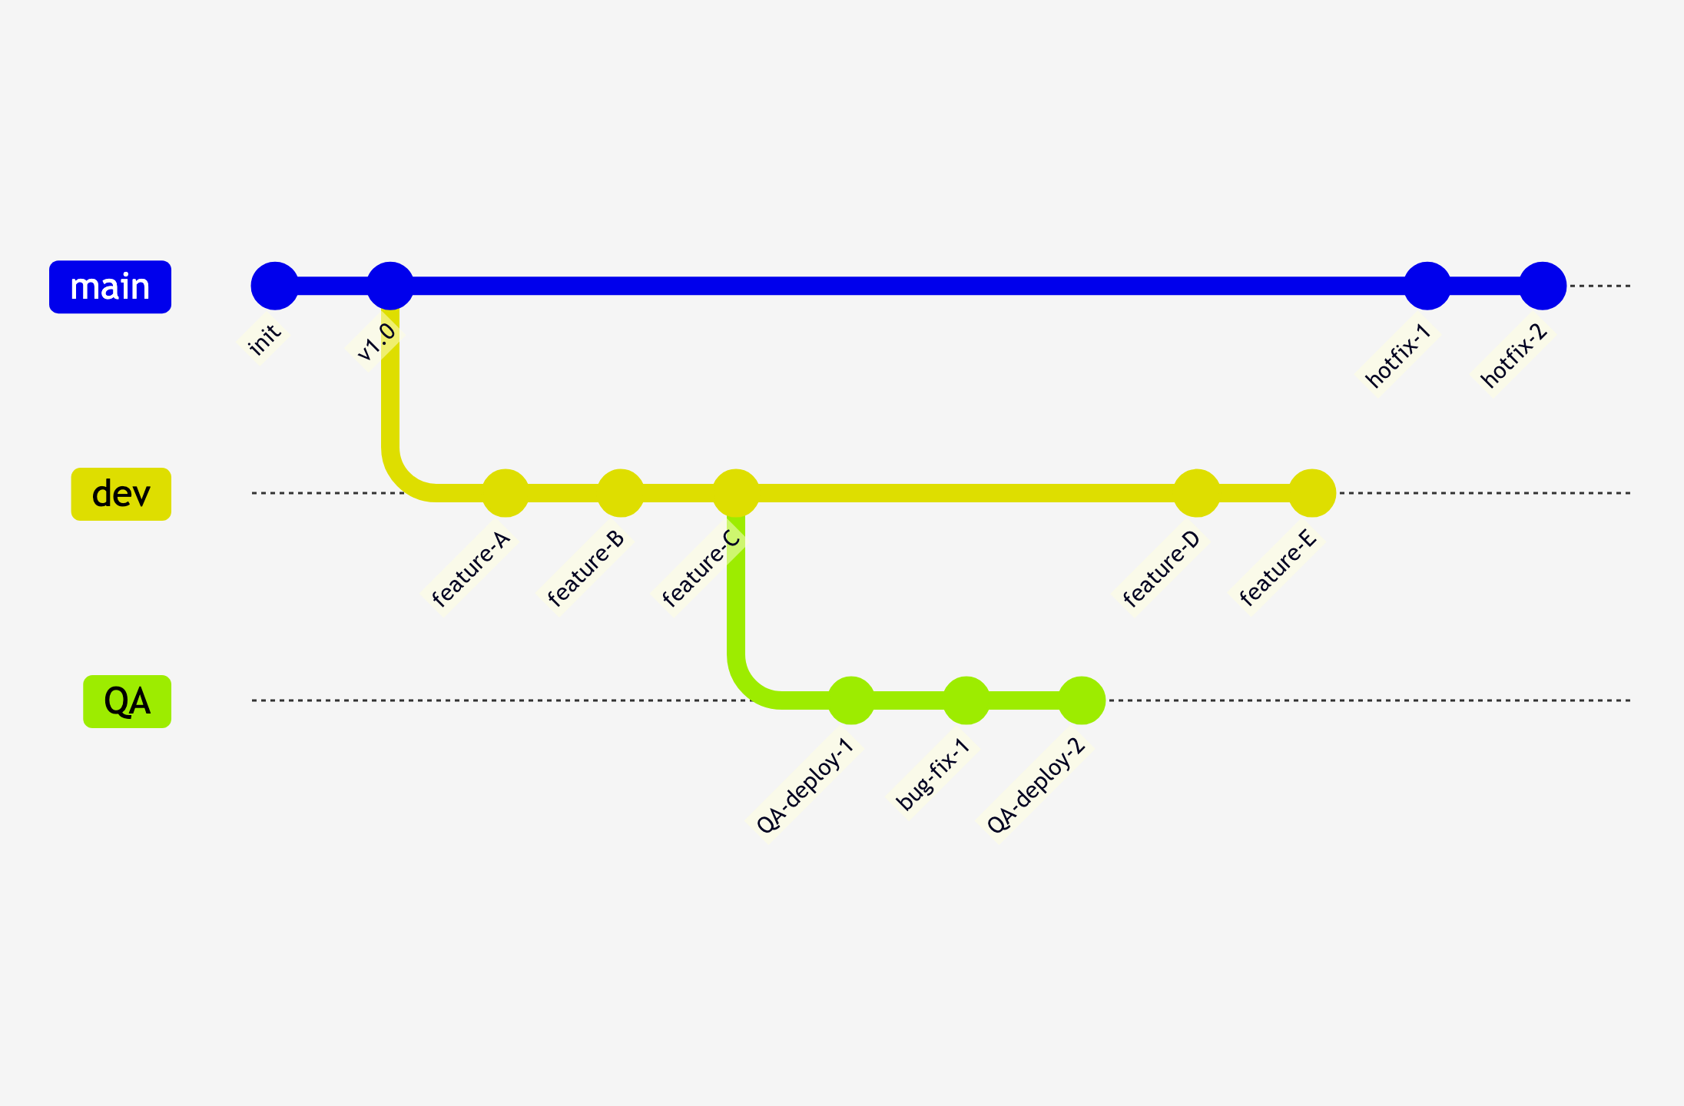
The Environment Branch Model
Long-lived branches for each environment
Notes:
# Title -- The Environment Branch Model
# Long-lived branches for each environment
You've got main at the top, and then a branch for dev, a branch for QA, and a branch for production. These branches live forever. They never get deleted. Code moves from left to right: dev to QA to production. Seems organized, right? Each environment has its own branch, its own deployable code, its own version of the truth. On paper this looks really clean. In practice, it's a nightmare. Let me show you why.

Slide 42
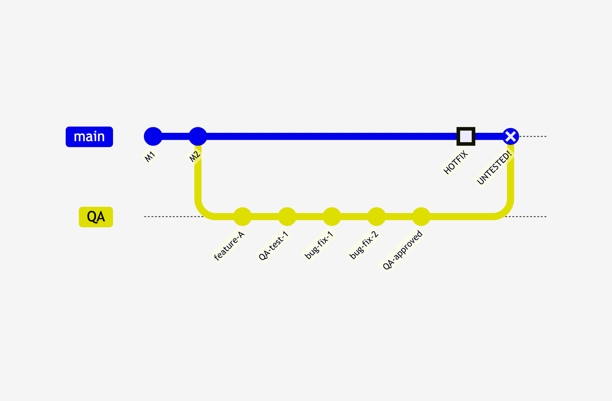
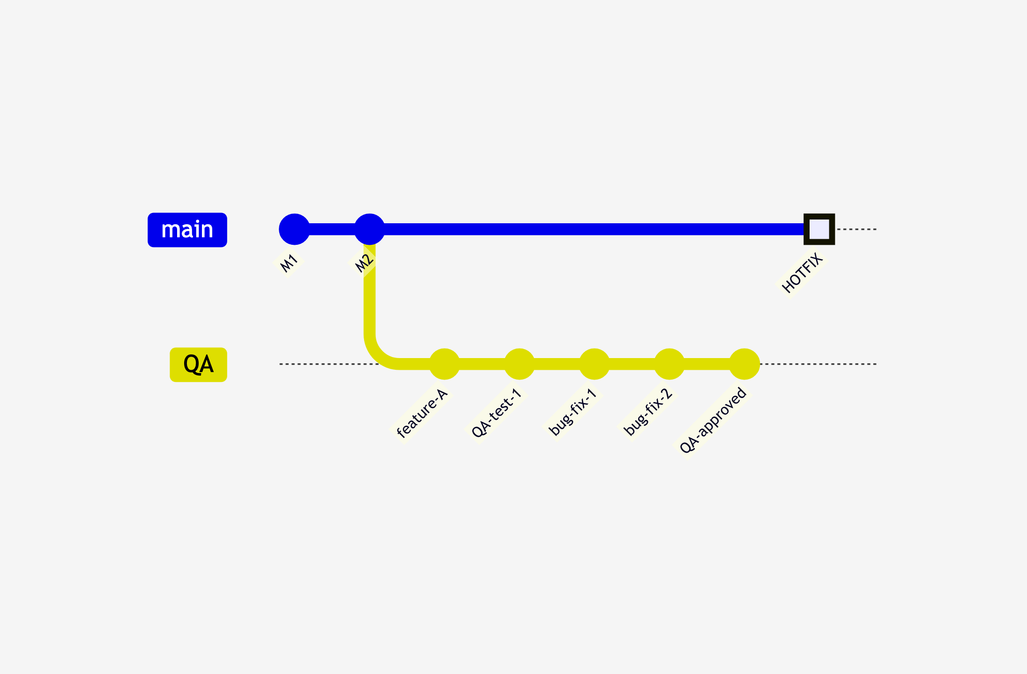
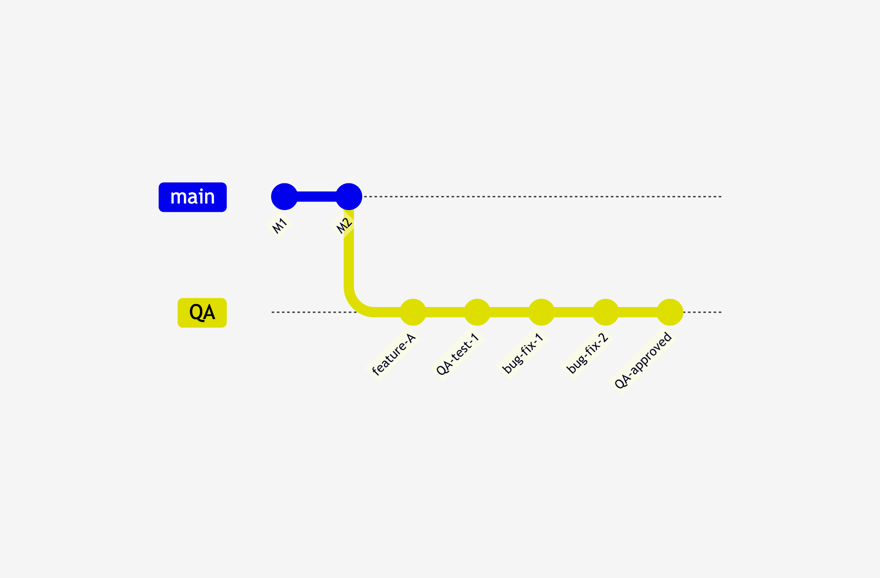
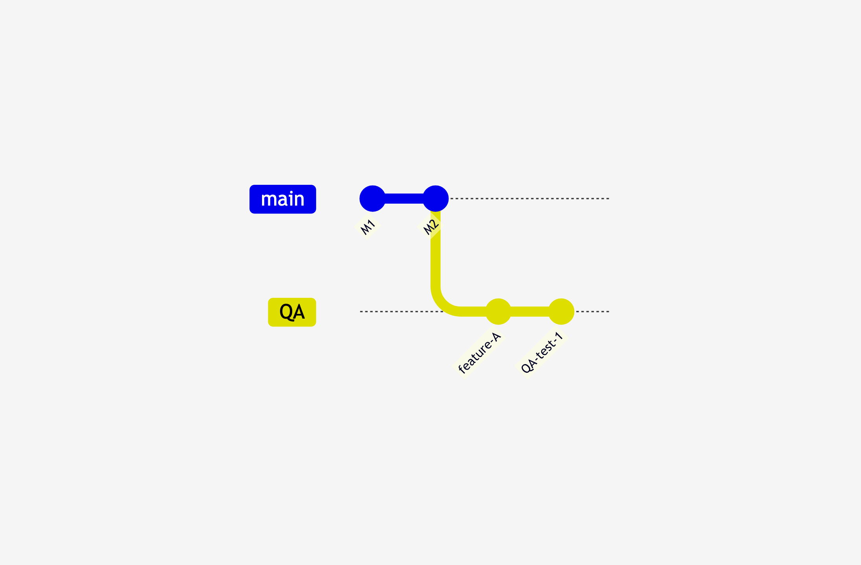
The Merge Disaster in Slow Motion
Feature → QA
Find & Fix Bugs
Hotfix in Main
QA → Main w/ conflicts
Resolve conflicts → deploy
Notes:
# Title -- The Merge Disaster in Slow Motion
# Feature → QA
Step one: your feature gets merged into the QA branch. QA deploys it and starts testing. Everything looks good so far. Nice and clean.
# Find & Fix Bugs
QA finds some bugs. You fix them directly in the QA branch, rebuild, redeploy. A couple of rounds of this and QA is happy. They sign off. You're feeling good.
# Hotfix in Main
But while all that QA testing was happening, somebody had to put a hotfix into production. That hotfix went into main. Main now has commits that the QA branch has never seen.
# QA → Main w/ conflicts
Now you merge QA into main. You hit merge conflicts because of that hotfix. You resolve them. You compile. It builds. Great. But stop. The code you just created by resolving those conflicts? Nobody tested that. QA tested the code before the merge. Production is getting the code after the merge. They are not the same thing. IT'S NOT FINE.

Slide 43
Branch-Per-Environment: A Love Story
Step 1
Step 2
Step 3
Step 4
Step 5
Merge your feature to the QA branch
QA finds bugs, you fix them in the QA branch
Repeat until QA is happy
Merge QA branch to production branch
But production changed since you branched...
Notes:
# Title -- Branch-Per-Environment: A Love Story
# 1: Step 1 → Merge your feature to the QA branch
Step one: you finish your feature and merge it to the QA branch. You deploy that QA branch to the QA environment. So far so good.
# 2: Step 2 → QA finds bugs, you fix them in the QA branch
Step two: QA finds some bugs. No big deal, that's what QA is for. You fix the bugs in the QA branch, rebuild, redeploy to QA.
# 3: Step 3 → Repeat until QA is happy
Step three: you go back and forth until QA is happy. Fix, test, fix, test. Eventually QA signs off. Great.
# 4: Step 4 → Merge QA branch to production branch
Step four: now you merge the QA branch into the production branch. Time to deploy to production.
# 5: Step 5 → But production changed since you branched...
But wait. While you were in QA, somebody put a hotfix into production. The production branch has changes that your QA branch doesn't know about. You've got merge conflicts.

Slide 44
You resolved merge conflicts in the prod branch
The code you're deploying is NOT what QA tested
You're betting everything on that merge going perfectly
You Resolve the Conflicts and Deploy
Notes:
# Title -- You Resolve the Conflicts and Deploy
# You resolved merge conflicts in the prod branch
You just resolved merge conflicts in the production branch. That means the code in the production branch is now different from what QA tested.
# The code you're deploying is NOT what QA tested
Let me say that again. The code you are about to deploy to production is NOT the code that QA tested and signed off on. It's close. But it's not the same. It can't be. The merge changed it.
# You're betting everything on that merge going perfectly
You're deploying something to production that has never been tested as a unit. You're betting your production environment on that merge going perfectly.

Slide 45

IT'S NOT FINE.
Notes:
# Title -- IT'S NOT FINE.
# Stock Photo: head-slap
IT'S NOT FINE. You're deploying untested code to production. And the crazy part is, this feels safe. You have a process. You have branches for each environment. You have sign-offs. But the process itself guarantees that you'll deploy something different from what you tested.

Slide 46
QA is testing Feature A in the QA branch
Developer merges Feature B into the QA branch
QA now has to start over
The QA Branch Collision Problem
Notes:
# Title -- The QA Branch Collision Problem
# QA is testing Feature A in the QA branch
QA is testing Feature A. They're halfway through their test plan. Things are looking good.
# Developer merges Feature B into the QA branch
And then a developer merges Feature B into the QA branch. Because hey, it's the QA branch, that's where QA stuff goes, right?
# QA now has to start over
Now QA has to start over. Because that merge of Feature B might have broken the features they were already testing. The environment they were testing against just changed underneath them.

Slide 47
Best Practice:
Build Once. Deploy Many.
Notes:
# Title -- Build Once. Deploy Many.
The antidote is this: build once, deploy many. Compile your code once. Create one artifact. Promote that exact same artifact through your environments. Dev, QA, staging, production: same bits. The only thing that changes between environments is configuration. Use deployment pipelines, not branches, to model your environments.

Slide 48
Environment Branches vs. Deployment Pipelines
Branch-Per-Environment
Deployment Pipeline
Merge to QA branch, build, deploy
Different builds for each environment
Deploy what you DIDN'T test
Build once from main, promote through stages
Same bits everywhere, only config changes
Deploy exactly what you tested
Notes:
# Title -- Environment Branches vs. Deployment Pipelines
# Branch-Per-Environment
# Deployment Pipeline
# Merge to QA branch, build, deploy
You merge to the QA branch. You build. You deploy. Then you merge to the prod branch. You build again. You deploy. Different builds.
# Different builds for each environment
Every environment gets a different compiled artifact. You never deploy the same thing twice.
# Deploy what you DIDN'T test
Which means you deploy to production something you didn't test. Every single time.
# Build once from main, promote through stages
You build once from main. One artifact. Then you promote that exact artifact through your stages: dev, QA, staging, production.
# Same bits everywhere, only config changes
Same bits in every environment. The only thing that changes is the configuration: connection strings, API keys, feature flags.
# Deploy exactly what you tested
Which means you deploy to production exactly what QA tested and signed off on. No merge surprises.

Slide 49
What If Deploy and Release Were Two Different Things?
Notes:
# Title -- What If Deploy and Release Were Two Different Things?
# Stock Photo: question-yellow
Here's the question that changes everything. What if deploying code and releasing a feature were two completely different activities? What if you could deploy code to production without anyone noticing? And then turn on the feature whenever you're ready?

Slide 50
Feature Flags
A configuration switch that enables or disables a feature at runtime
Deploy code without turning it on
Deployment and enablement are separate
Vastly decreases branching pressure
Notes:
# Title -- Feature Flags
# Deploy code without turning it on
With feature flags, you can deploy code to production without turning it on. The code is there, but it's behind a switch. Flipped off.
# Deployment and enablement are separate
Deployment and enablement become two completely separate activities. You deploy whenever your pipeline is ready. You enable when the business is ready.
# Vastly decreases branching pressure
And this vastly decreases the pressure on your branching strategy. If you can deploy without releasing, you don't need environment branches. You don't need to hold back features. You just deploy and toggle.

Slide 51
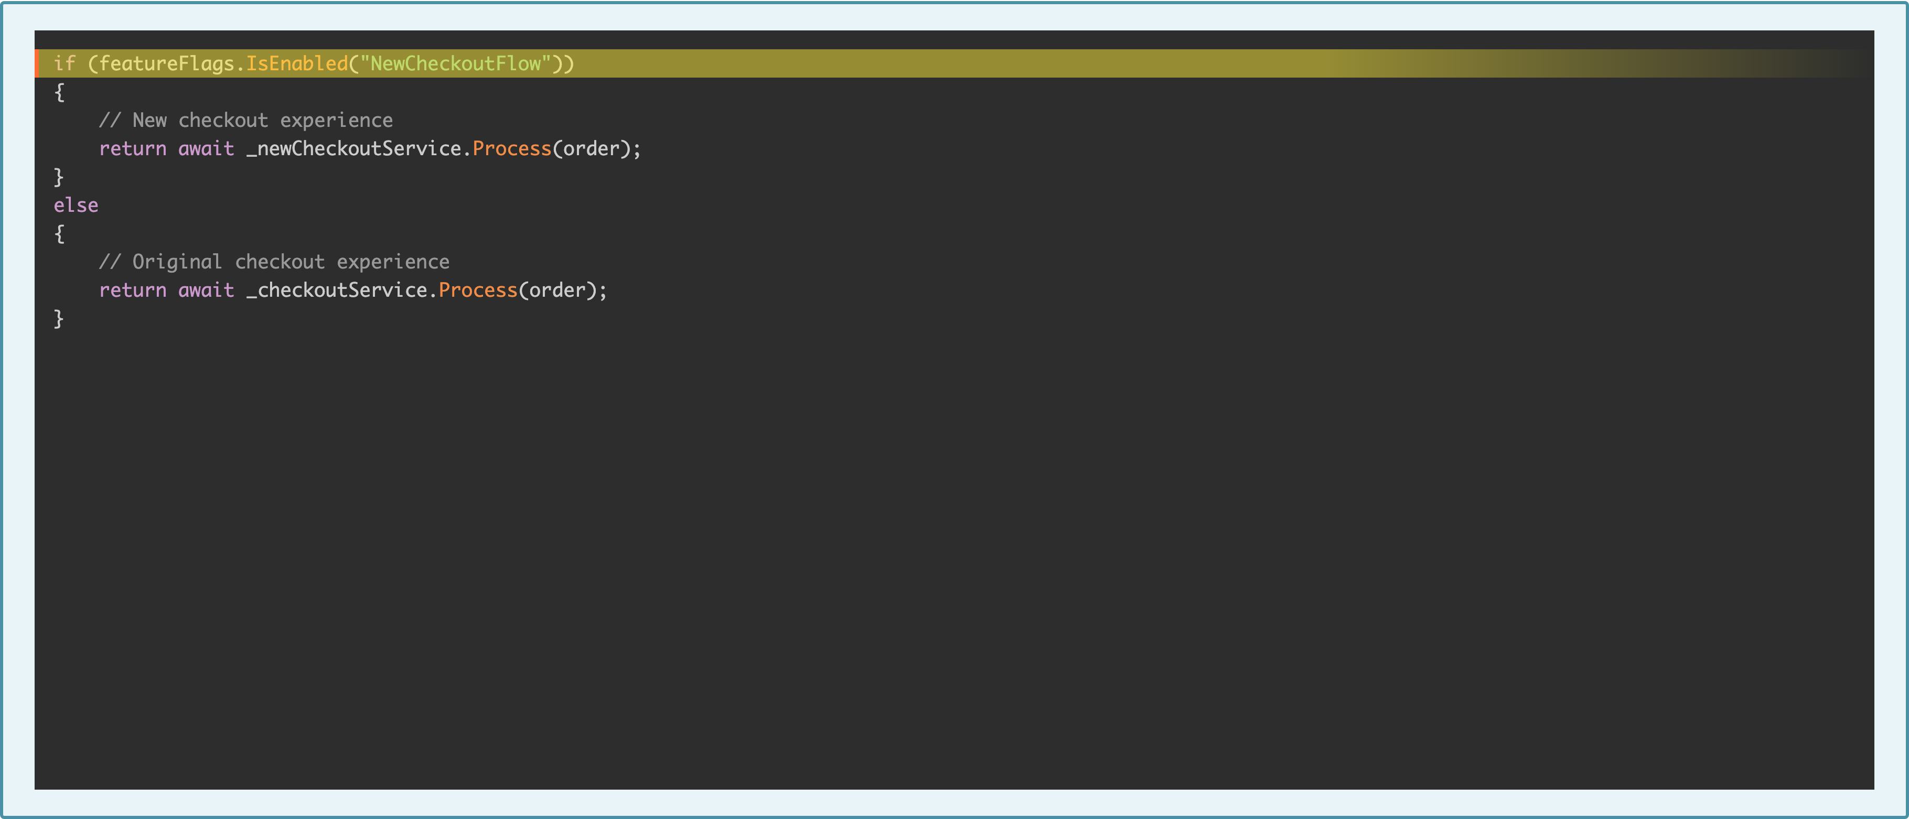
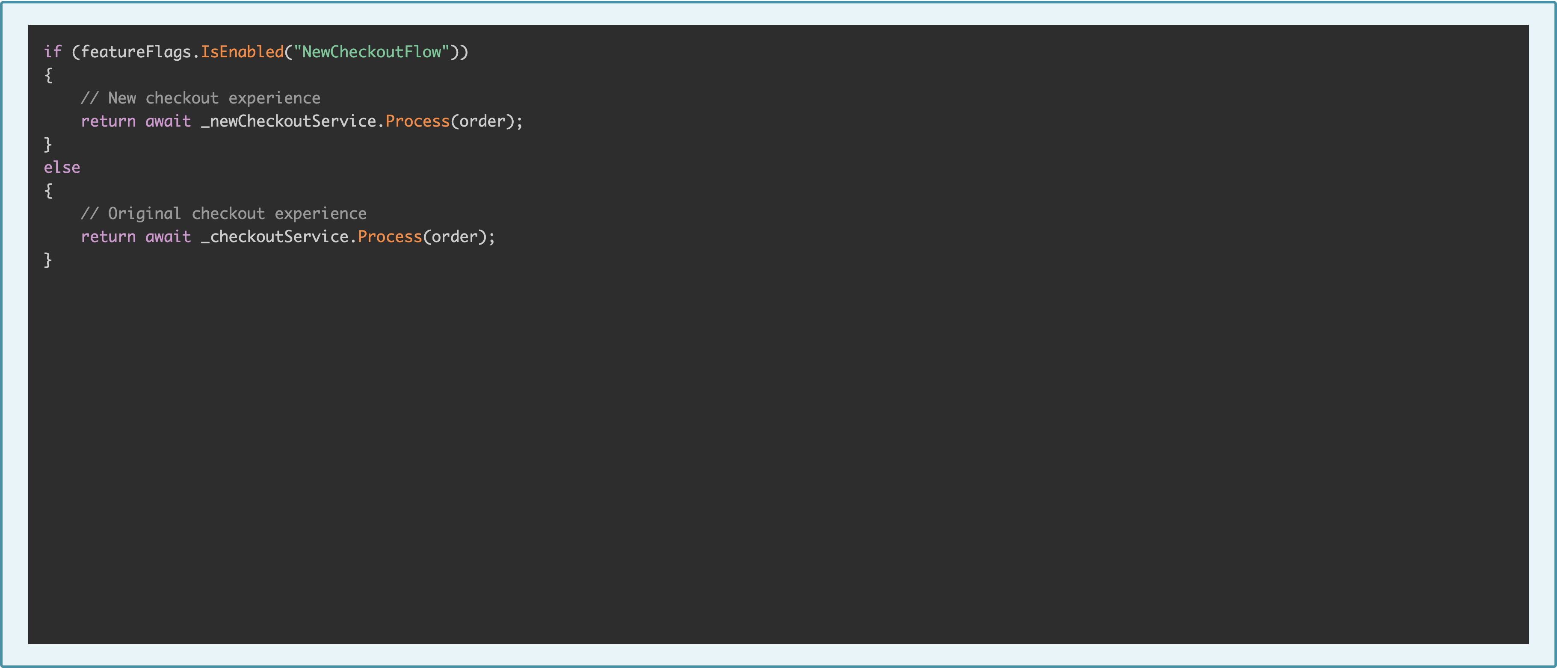
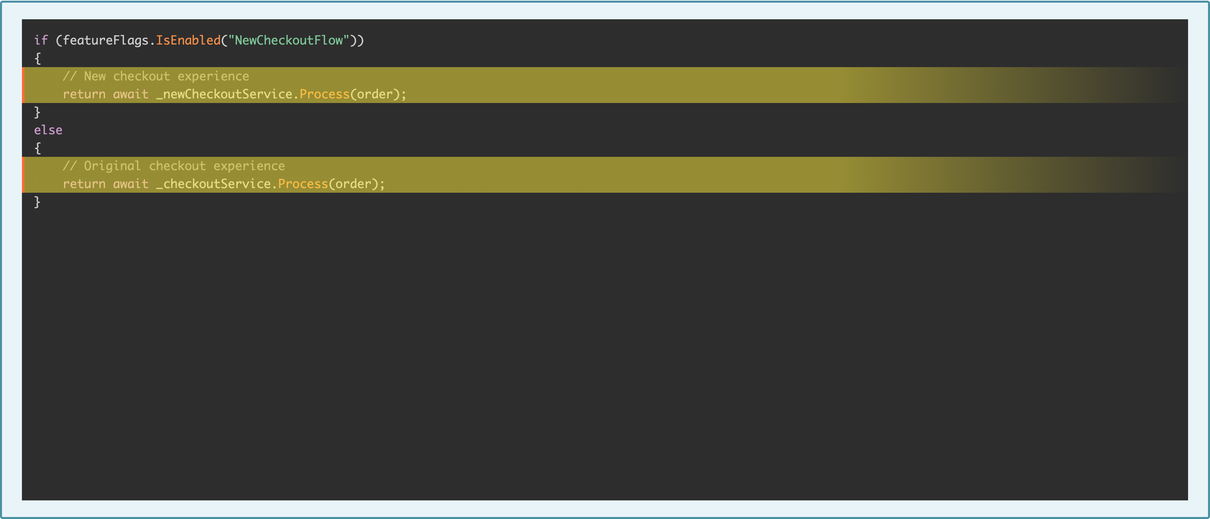
Feature Flags in C#
Notes:
# Title -- Feature Flags in C#
Here's what it looks like in code. Simple if-else.
# Check if the feature is enabled
You check if the feature is enabled. This could be reading from a config file, a database, a feature flag service like LaunchDarkly. The point is: it's a runtime decision, not a deployment decision.
# New code and old code both deployed
Both versions of the code are deployed. They're both sitting there in production. But only one of them runs, depending on the flag.
# Outro

Slide 52
Feature Flags: Trade-Offs
Pros
Cons
Deploy without releasing
Easy rollback: just flip the switch
A/B testing and gradual rollout
Two versions of code side by side
Feature flags ARE technical debt
Moral hazard: 'we'll just turn it off'
Notes:
# Title -- Feature Flags: Trade-Offs
# Pros
# Cons
# Deploy without releasing
You can deploy without releasing. Deploy on Tuesday, turn on the feature on Thursday. Or next month. Or never, if you decide it's not ready.
# Easy rollback: just flip the switch
Rollback is trivial. Feature breaking in production? Flip it off. No redeployment needed. No emergency at 2 AM.
# A/B testing and gradual rollout
You can do A/B testing. Show the new checkout to 10% of users and measure whether it converts better. Gradual rollout to catch issues early.
# Two versions of code side by side
Your code now has two versions of everything sitting side by side. That's confusing. It's more to think about when you're developing and more to test.
# Feature flags ARE technical debt
Feature flags are technical debt. Strategic debt, but debt. Every flag you create needs to eventually be removed. The old code path needs cleanup.
# Moral hazard: 'we'll just turn it off'
And there's a moral hazard. If you can just turn it off, it's tempting to ship something that isn't really ready. Don't use feature flags as an excuse to skip quality.

Slide 53

Don't Ship Garbage Just Because You Have a Safety Net.
Notes:
# Title -- Don't Ship Garbage Just Because You Have a Safety Net.
# Stock Photo: old-guy-pointing
Feature flags are a safety net, not a license to ship garbage. The flag should be there for unexpected problems, not as a substitute for doing the work right. If you find yourself saying 'eh, we'll just turn it off if it breaks,' that's a warning sign.

Slide 54
Under 400 lines, one logical change
Easier to review, faster feedback
Smaller merge conflicts when they happen
Small PRs Win
Notes:
# Title -- Small PRs Win
# Under 400 lines, one logical change
The single best thing you can do for your PR workflow: keep them small. Under 400 lines of changes. One logical change per PR. Not three features crammed into one branch.
# Easier to review, faster feedback
Small PRs are easier to review, which means faster feedback, which means shorter branch lifetimes. See how this all connects? Small PRs help you pay off that credit card faster.
# Smaller merge conflicts when they happen
And when merge conflicts do happen, they're smaller and easier to resolve. A merge conflict in a 50-line PR is a speed bump. A merge conflict in a 3,000-line PR is a car crash.

Slide 55
Four PR Anti-Patterns
The Rubber Stamp
The Gatekeeper
The Perfectionist
The Ghost
Review Theater
Bottleneck
Control Freak
Never happens.
Notes:
# Title -- Four PR Anti-Patterns
# 1: The Rubber Stamp →
The rubber stamp. Someone clicks approve without actually reading the code. The PR process exists, but the review doesn't. It's theater.
# 2: The Gatekeeper →
The gatekeeper. One person, usually a senior dev, must approve every single PR. They become a bottleneck. PRs pile up waiting for their blessing.
# 3: The Perfectionist →
The perfectionist. Every PR gets 47 comments about variable naming and brace placement. The code works, but it doesn't match someone's aesthetic preferences. Use a linter. Move on.
# 4: The Ghost →
And the ghost. Assigned as a reviewer but never actually reviews. The PR sits there for days. Eventually someone merges it without review because they're blocked and frustrated.

Slide 56
Type of automated test
Goal:
  Verify the behavior of an application…
  …without requiring human involvement
DEMO: Branch Protection in GitHub
Notes:
# Title -- DEMO: Branch Protection in GitHub
Let me show you something in GitHub. Branch protection rules let you encode your branching strategy into the tool itself. Instead of relying on people to remember the rules, the tool enforces them. Let me show you how to set this up.

Slide 57
→ Rules
Encode Your Strategy,
Don't Just Document It.
Notes:
# Title -- Encode Your Strategy, Don't Just Document It.
If your branching strategy exists in a wiki that nobody reads, you don't have a branching strategy. You have a branching wish. Put it in the tool. Make it impossible to violate. And test your protection rules before you need them.

Slide 58
GitHub
  Repo →
  Settings →
  Code and automation →
  Rules →
  Rulesets
Azure DevOps
  Team Project →
  Project Settings →
  Repositories →
  Policies
Branch Rules

Slide 59
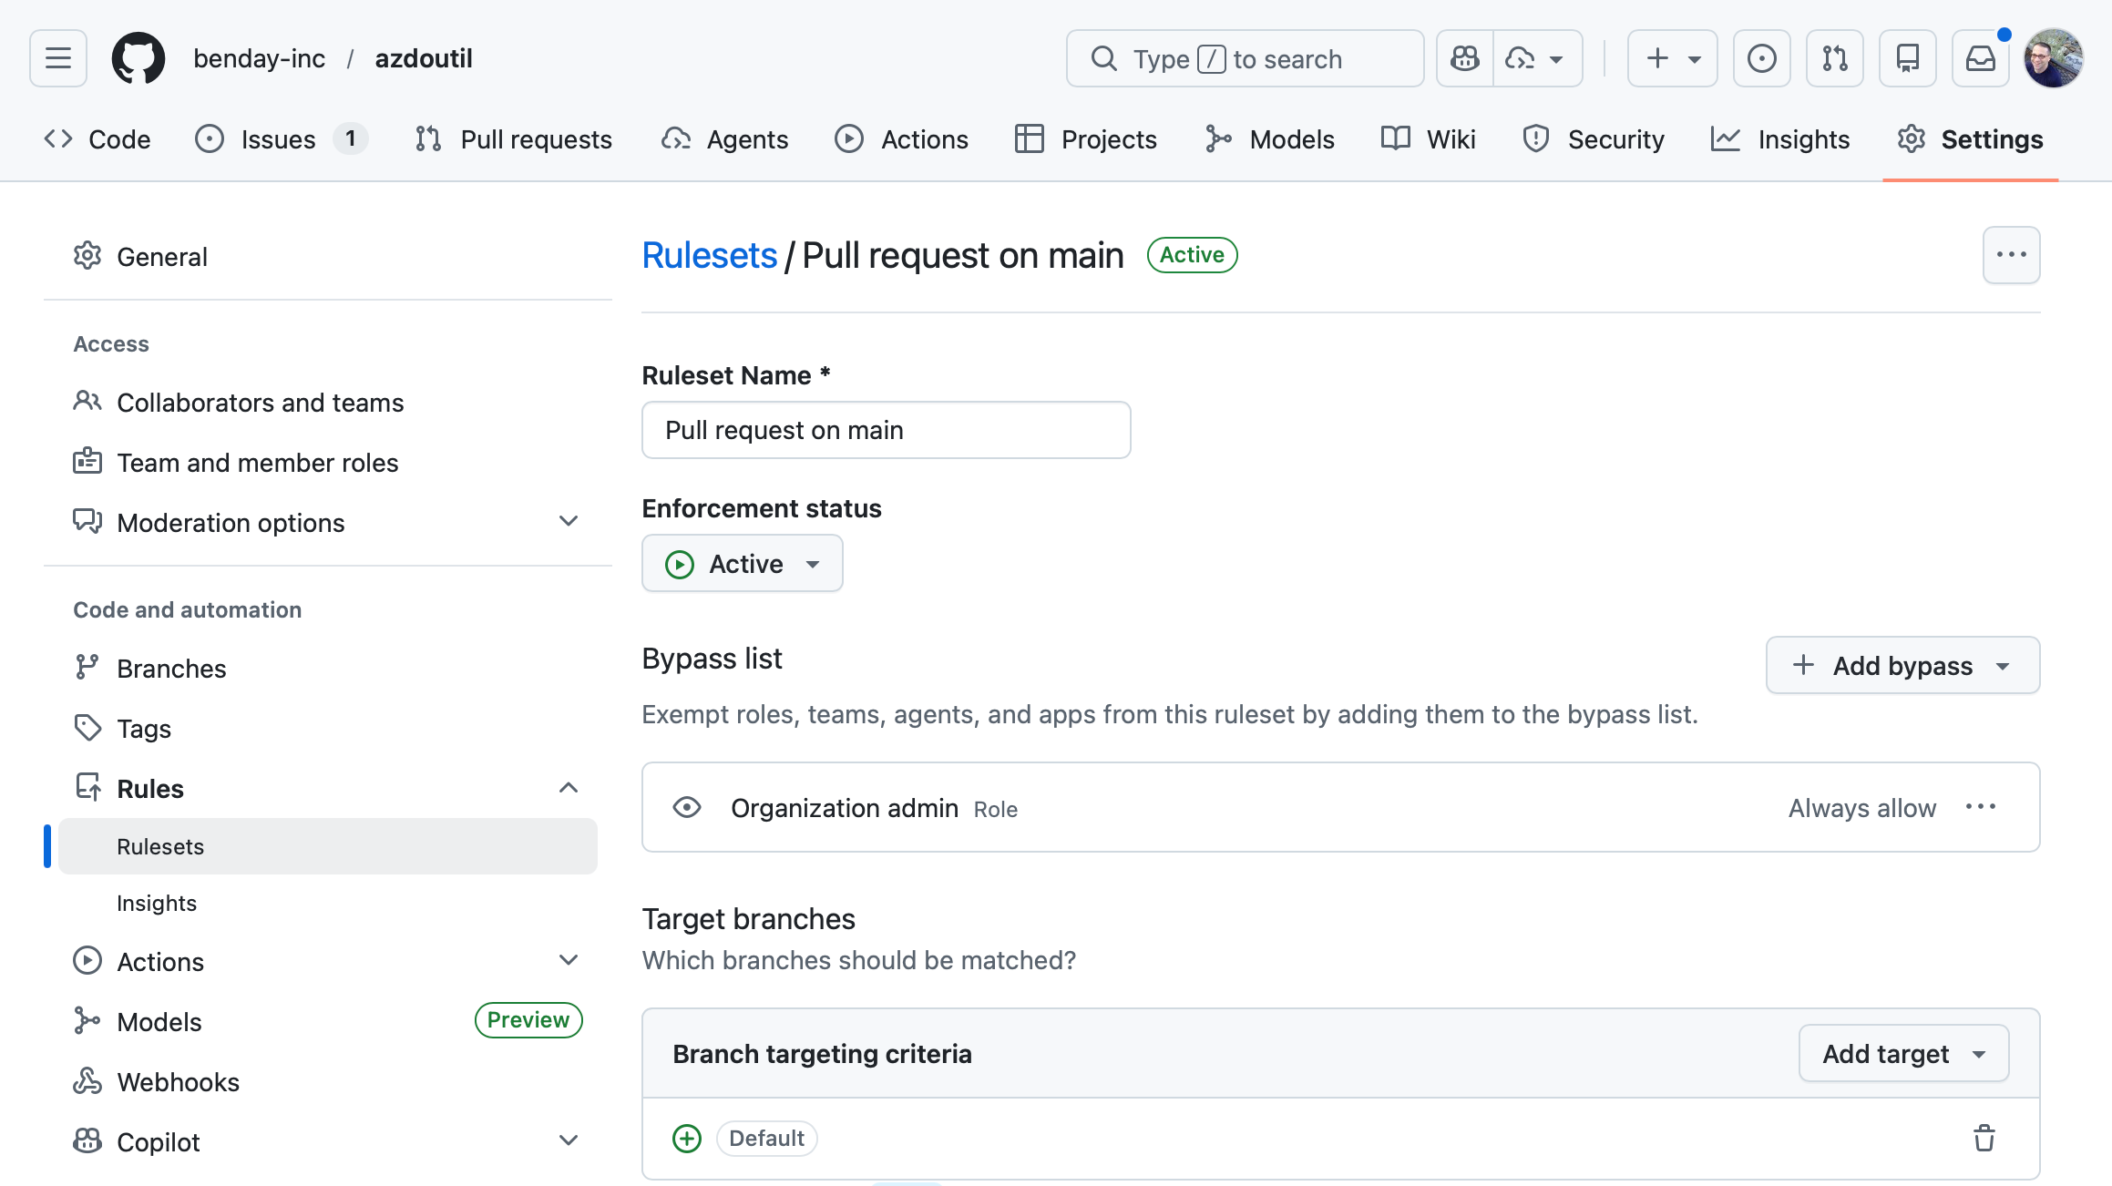

Slide 60
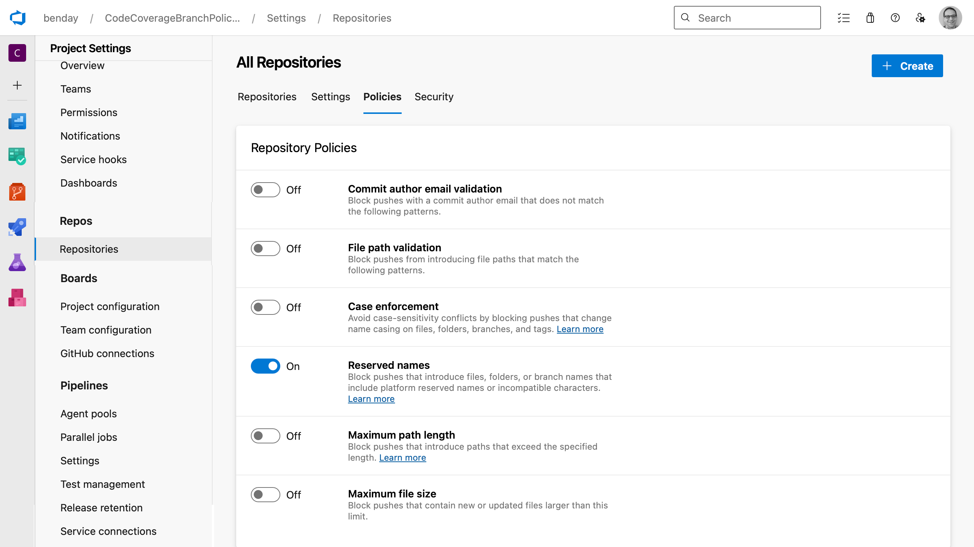

Slide 61
Require pull request reviews before merging
Require status checks to pass
Require branches to be up to date
Protect against force pushes and history rewrites
Branch Protection: Encode Your Strategy
Notes:
# Title -- Branch Protection: Encode Your Strategy
# Require pull request reviews before merging
You can require PR reviews before anyone merges to main. No more cowboy commits. Someone has to look at the code first.
# Require status checks to pass
You can require that your CI build passes before the merge is allowed. If the tests fail, you can't merge. Period.
# Require branches to be up to date
You can require that branches are up to date with main before merging. This forces those refresh merges we talked about. The tool does the nagging for you.
# Protect against force pushes and history rewrites
And you can protect against force pushes. Nobody accidentally rewrites the history of your main branch.

Slide 62
Don't branch unless you have a really good reason
A branch is a credit card: you WILL pay
Until it's merged, it's not done
Branch problems are usually people problems
Can you explain your strategy in two sentences?
The Playbook
Notes:
# Title -- The Manifesto
# 1. Don't branch unless you have a really good reason
Number one: don't branch unless you have a really good reason. Ask the two questions. If you can't answer them, don't create the branch.
# 2. A branch is a credit card: you WILL pay
Number two: a branch is a credit card. You will pay. The only question is how much interest you're going to accumulate before you do.
# 3. Until it's merged, it's not done
Number three: until it's merged, it's not done. I don't care how beautiful your code is in your branch. If it doesn't work with everyone else's code, it doesn't work.
# 4. Branch problems are usually people problems
Number four: branch problems are usually people problems. Too many branches means too much WIP. Long-lived branches mean fear of integration. Fix the root cause, not the symptom.
# 5. Can you explain your strategy in two sentences?
And number five: can everyone on your team explain your branching strategy in two sentences? If not, you have work to do. Start there.

Slide 63
Branches That Don’t Suck
YouTube Series

Slide 64
Thanks. benday@benday.com | www.benday.com

Slide 65
Type of automated test
Goal:
  Verify the behavior of an application…
  …without requiring human involvement
Quarterly Releases: The Integration Mortgage
Notes:
# Title -- Quarterly Releases: The Integration Mortgage
Some of you are thinking: my team doesn't ship every sprint. We do quarterly releases. The sprint branch pattern doesn't fit. You're right. But the principles still apply. You're just carrying a bigger balance. I call this an integration mortgage.

Slide 66
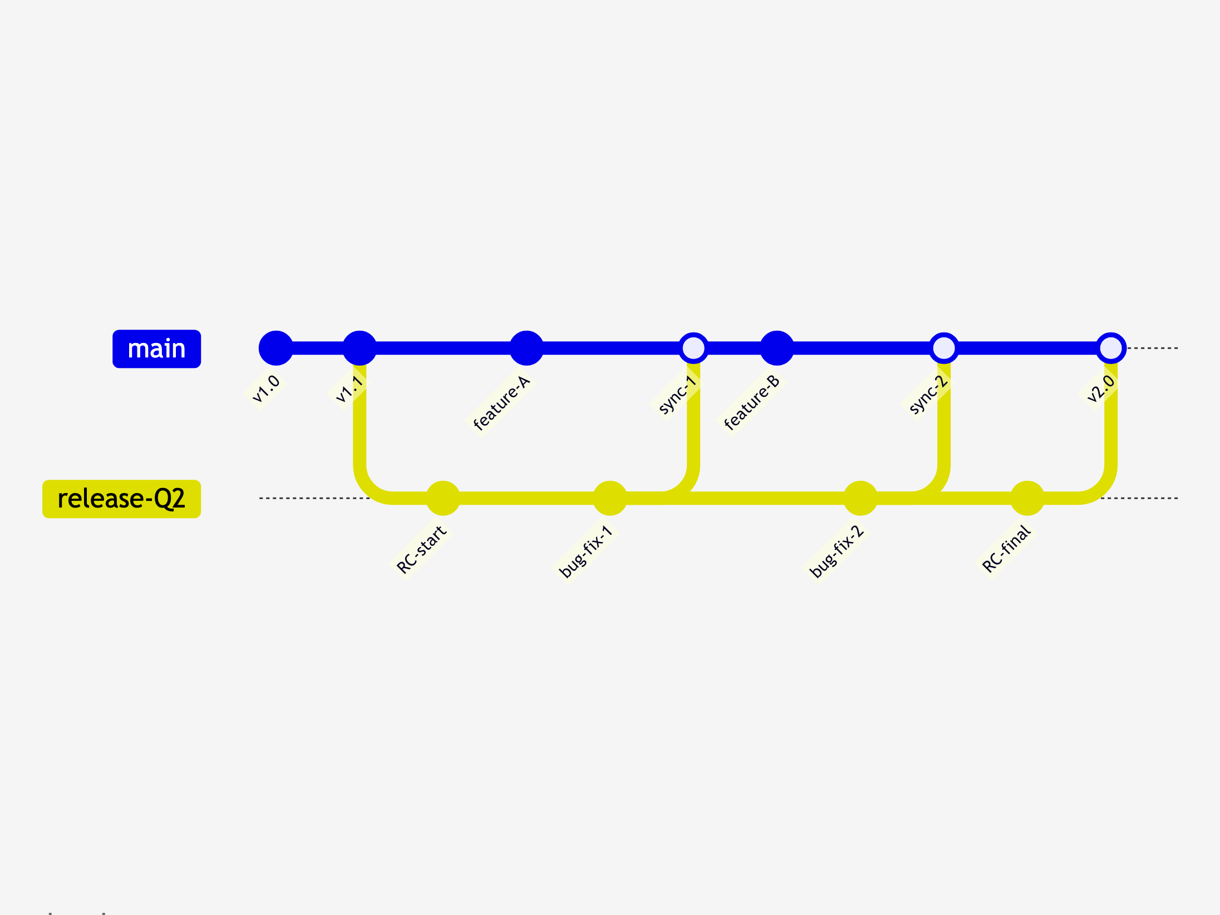
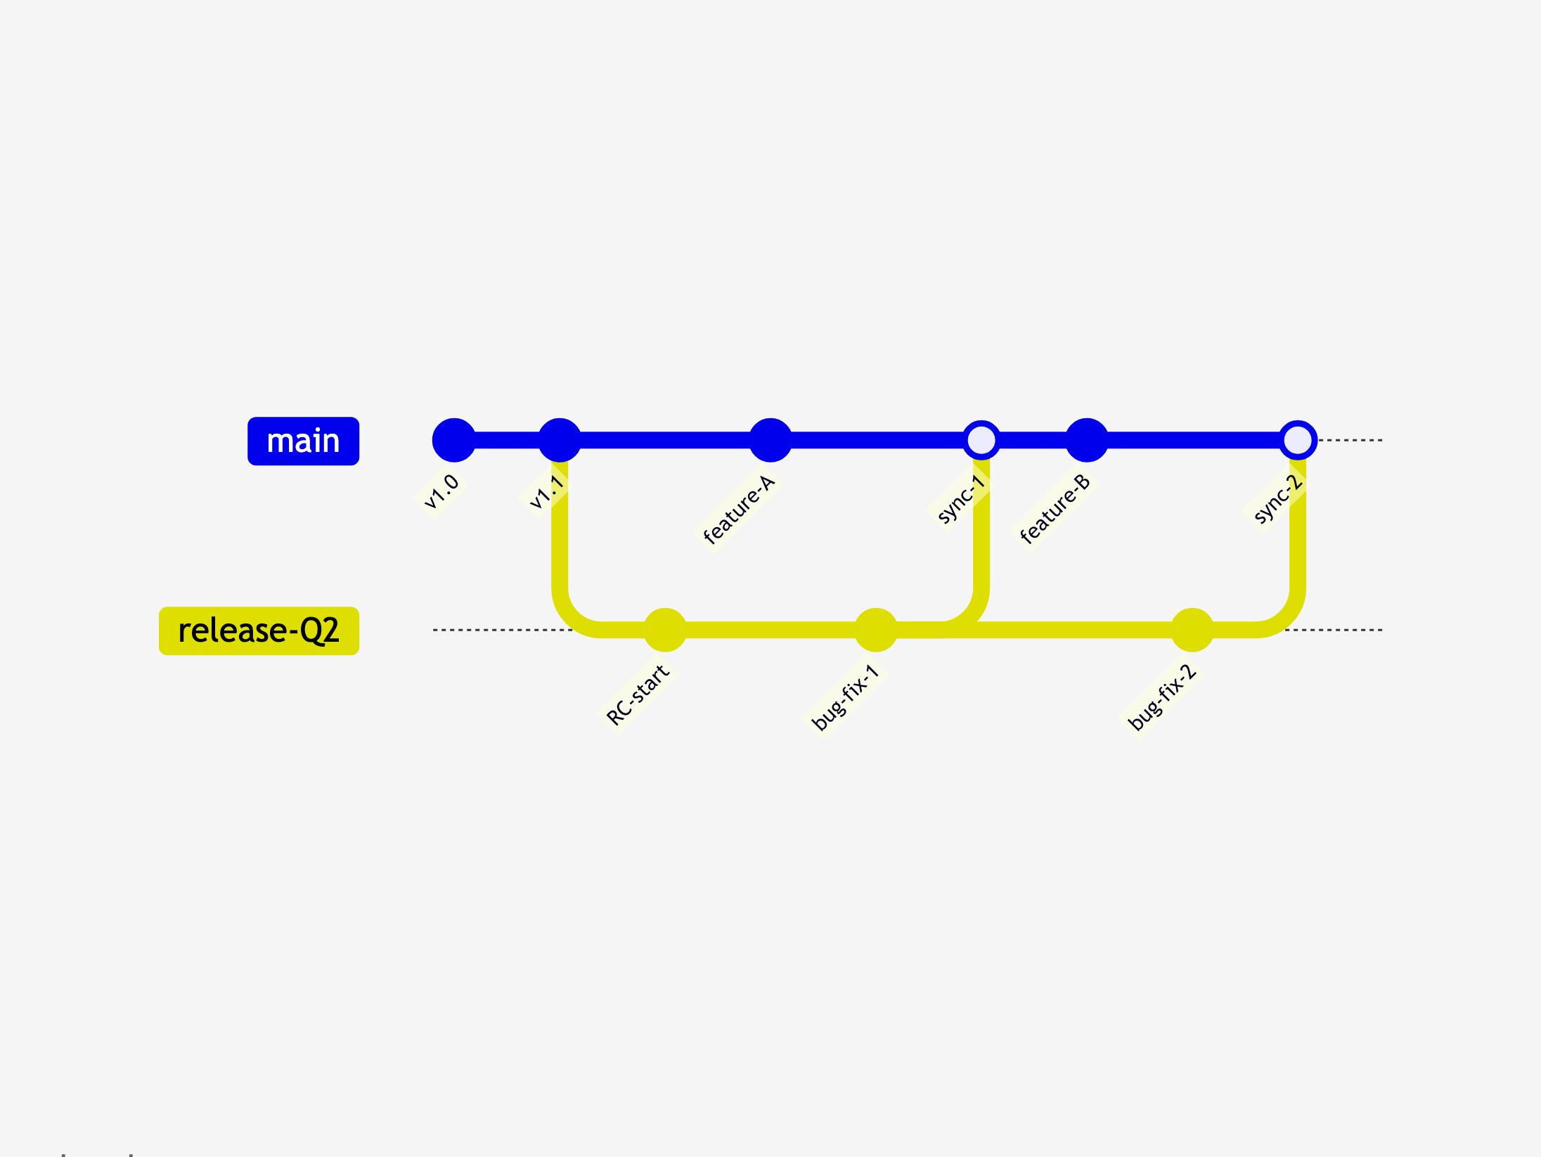
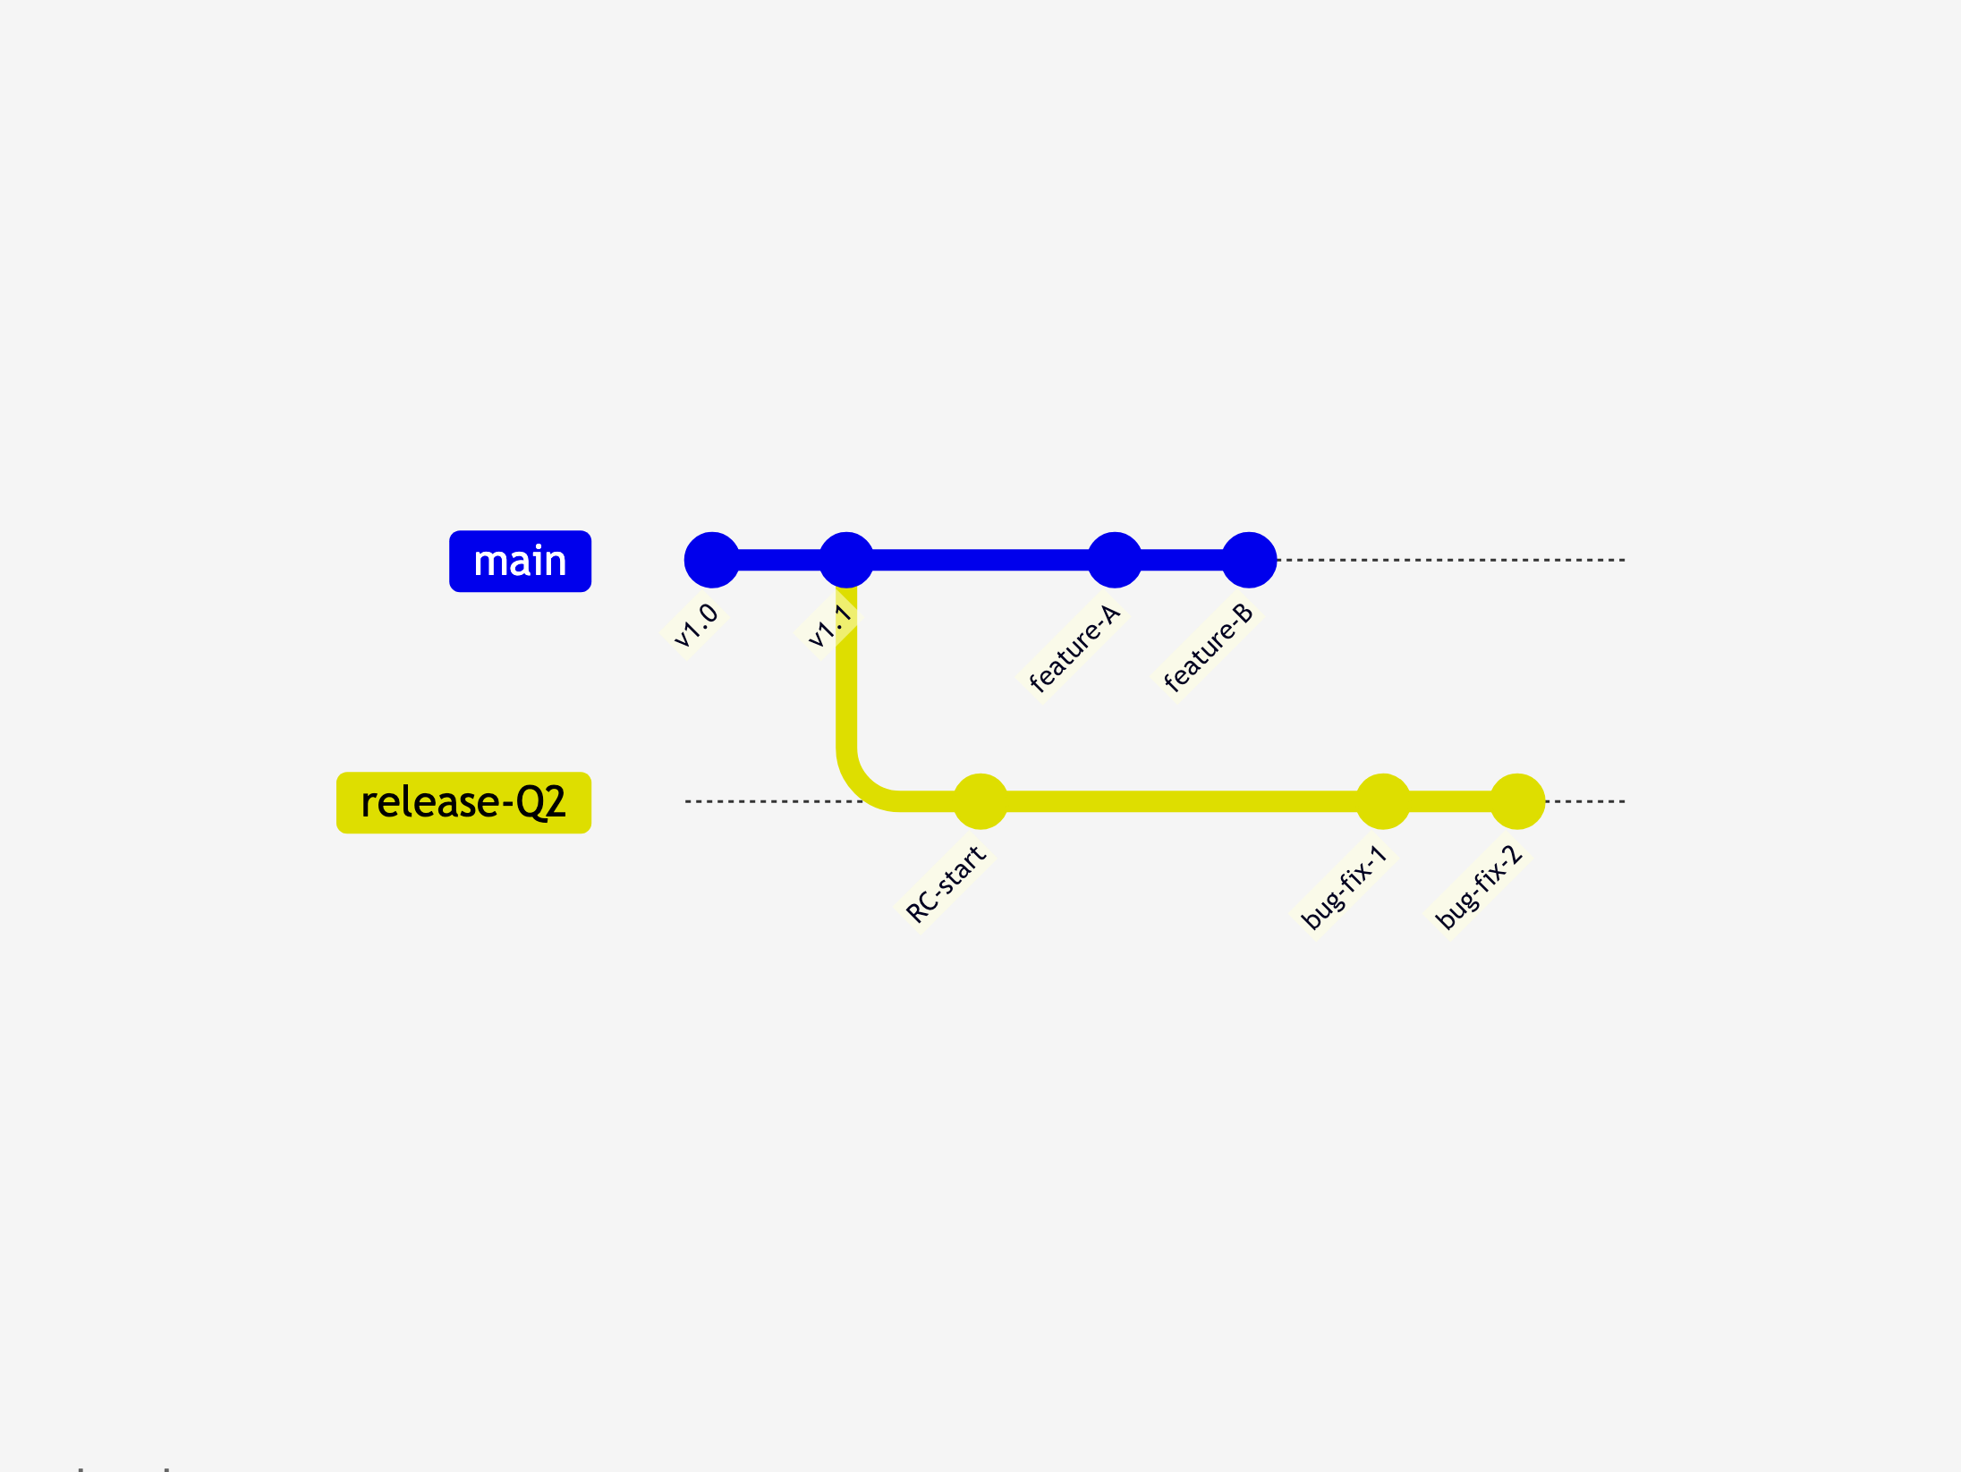
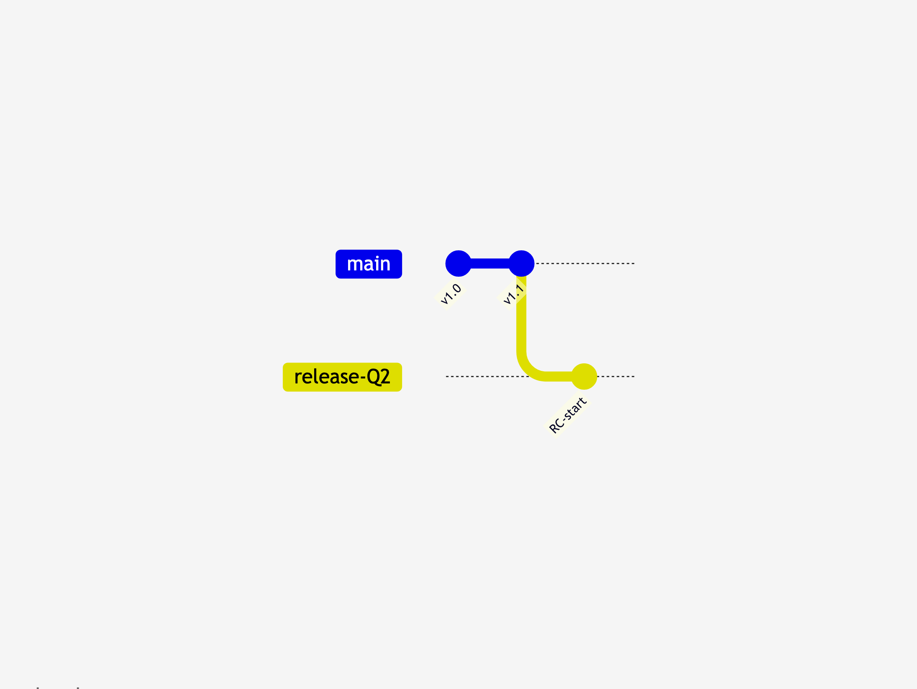
Quarterly Release Branch Pattern
Cut release branch from main
Features on main, fixes on release
Fixes flow back to main regularly
Release ships, branch ends
Notes:
# Title -- Quarterly Release Branch Pattern
# Cut release branch from main
At the start of the quarter, you cut a release branch from main. This is your release candidate. From this point forward, this branch is for stabilization only. No new features go here.
# Features on main, fixes on release
Development continues on main. New features, sprint branches, whatever your normal workflow is. Meanwhile, the release branch only gets bug fixes. Two tracks, two purposes. This is the key discipline: the release branch is not a development branch.
# Fixes flow back to main regularly
Here's the payment schedule. When you fix a bug on the release branch, merge that fix back to main. Don't let them diverge. Main should always have everything the release branch has, plus new features. These regular merges are your mortgage payments. Skip them and the interest compounds.
# Release ships, branch ends
The release ships. Final merge back to main. And then the branch is done. Delete it. Next quarter, cut a new one from main. The mortgage is paid off. Notice: the final merge to main should be boring. If you've been making your payments all quarter, there's nothing left to reconcile.

Slide 67
Features ONLY go to main
Fixes flow from release back to main
Do NOT merge main into release
Delete the branch when the release ships
Quarterly Release Rules
Notes:
# Title -- Quarterly Release Rules
# Features ONLY go to main
Rule one: features only go to main. The release branch is for stabilization. The moment you start adding features to the release branch, you've turned your mortgage into a second credit card.
# Fixes flow from release back to main
Rule two: every fix on the release branch gets merged back to main. Every single one. Don't accumulate fixes that only exist on the release branch. That's how you end up with a nightmare merge at the end of the quarter.
# Do NOT merge main into release
Rule three: do not refresh-merge main into the release branch. That's backwards. You don't want new features leaking into a release you're stabilizing. Fixes flow from release to main. Not the other way around.
# Delete the branch when the release ships
And rule four: when the release ships, delete the branch. Pay off the mortgage. Don't let it sit there accumulating confusion. Next quarter, cut a fresh one from main.

Slide 68
Type of automated test
Goal:
  Verify the behavior of an application…
  …without requiring human involvement
What About Multiple Versions in Production?
Notes:
# Title -- What About Multiple Versions in Production?
Now here's the really ugly one. What if you have to support multiple versions of your product in production at the same time? Version 3, version 4, version 5, all running at different customer sites. This is common in on-prem enterprise software, embedded systems, and regulated industries. And the honest answer is: there is no branching strategy that makes this clean.

Slide 69
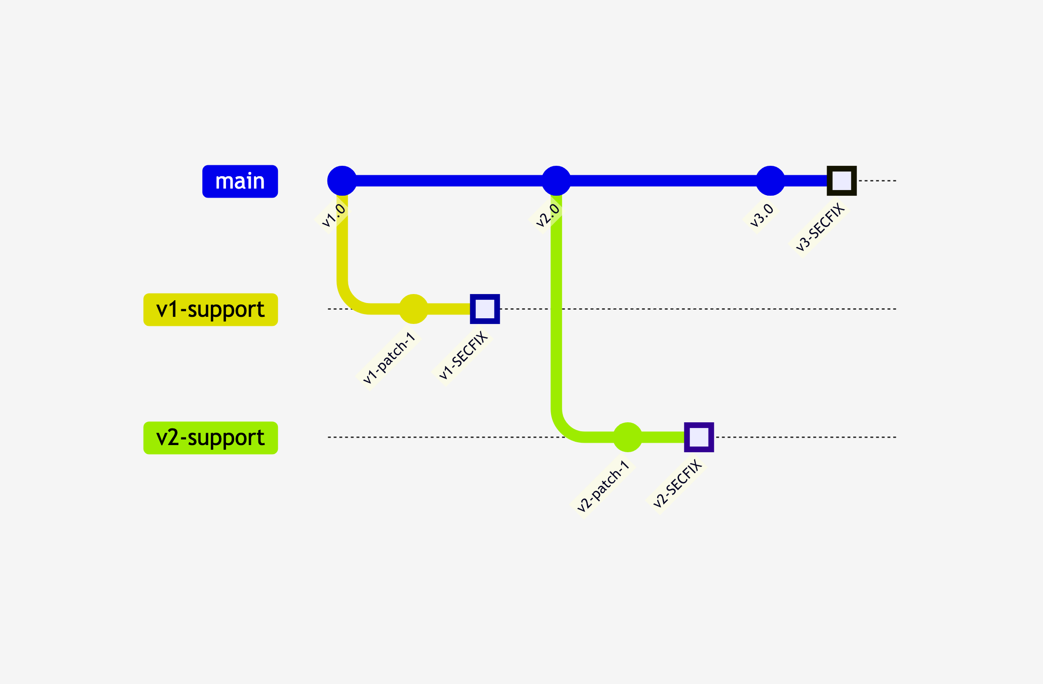
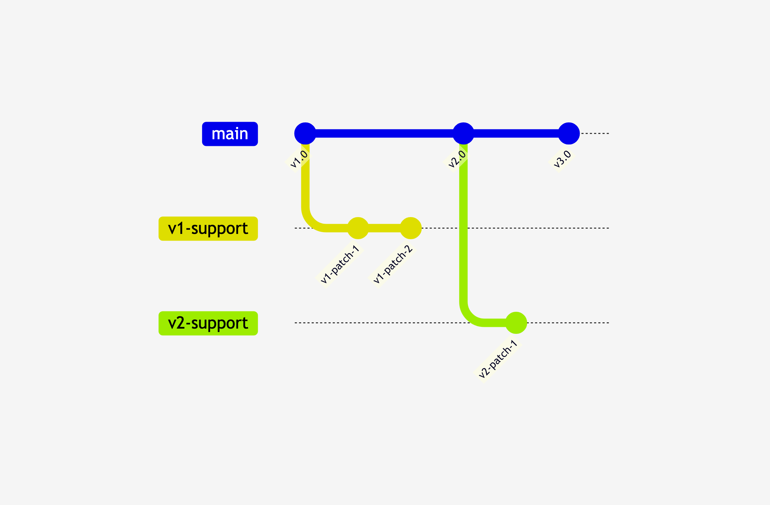
Multi-Version Support Pattern
One branch per supported version
Fix oldest first, forward-port up
Notes:
# Title -- Multi-Version Support Pattern
# One branch per supported version
Each supported version gets its own long-lived branch. These are not branches in the normal sense. They diverged intentionally and permanently. They're never coming back together. These are forks that happen to live in the same repo.
# Fix oldest first, forward-port up
When a security vulnerability hits, you fix it in the oldest supported version first. Then you forward-port that fix to each newer version. v1 to v2 to v3 to main. Each forward-port is a potential merge conflict because the codebases have drifted apart. The older the version, the worse it gets.

Slide 70
Type of automated test
Goal:
  Verify the behavior of an application…
  …without requiring human involvement
Every Supported Version Is a Tax on Everything Else.
Notes:
# Title -- Every Supported Version Is a Tax on Everything Else.
Every version you keep alive is a tax on everything else you do. Every fix gets applied multiple times. Every security patch gets forward-ported through every supported version. The branching isn't the hard part. The hard part is the business commitment to maintain divergent codebases. The best branching strategy for multi-version support is: support fewer versions.

