Slide 1

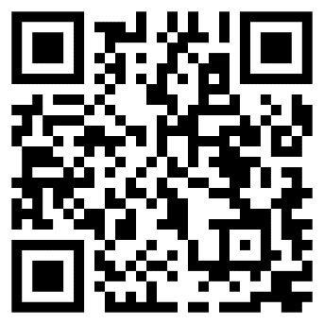


Agile-ish: Lightweight Project Management with GitHub Projects
Benjamin Day
www.benday.com
@benday

Slide 2


Benjamin Day
Software Delivery Rescue
Therapist for Teams
.NET, Azure, DevOps, Architecture
Fractional CTO & delivery diagnostics
Microsoft MVP
@benday
linkedin

Slide 3
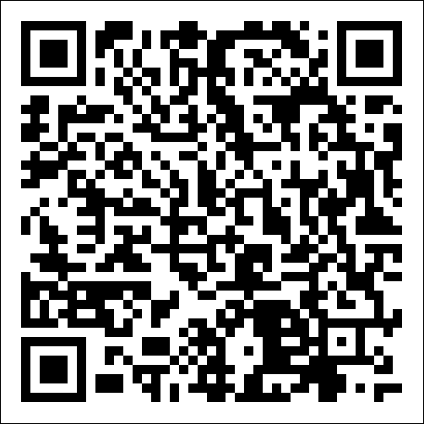
YouTube Series: Scrum With GitHub Projects

Slide 4
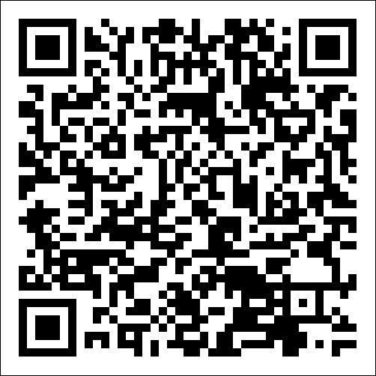
YouTube Series: Flow Metrics Explained

Slide 5

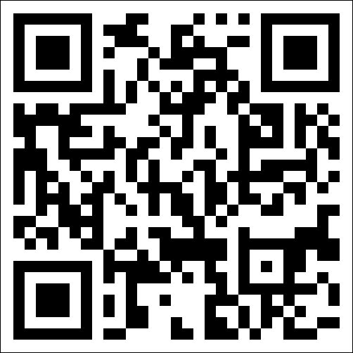
Free Tool for GitHub & Azure DevOps honestcheetah.com

Slide 6
...you're doing Scrum
...you're doing Kanban
...you invented something and aren't sure what to call it
...you're doing Scrum but skip half the ceremonies
Raise Your Hand If...
Notes:
# Title -- Raise Your Hand If...
# ...you're doing Scrum
Raise your hand if you're doing Scrum. Okay, nice, some hands. Good for you.
# ...you're doing Kanban
Kanban? A few. Respect.
# ...you invented something and aren't sure what to call it
How about this, raise your hand if your team is doing something you kinda invented, and you're not totally sure what to call it.
# ...you're doing Scrum but skip half the ceremonies
And finally, raise your hand if you're technically doing Scrum, but you secretly skip about half the ceremonies. Yeah. That's most of the room. Congratulations, you're all Agile-ish. And that's actually fine.

Slide 7

Let’s face it… The world has gotten sick of Agile and Scrum.

Slide 8
"Scrum Just Slowed Us Down."
Notes:
# Title -- "Scrum Just Slowed Us Down."
I hear this constantly. I've heard it from CTOs, from VPs of engineering, from individual developers. Scrum just slowed us down. We were faster before. All those meetings, all that ceremony, all that overhead, and we still missed the deadline. So we went back to doing things the old way, or we moved to something lighter, or we just stopped doing anything in particular. And honestly? I get it. That's a completely rational response to an uncomfortable experience. But I think the diagnosis is backwards.

Slide 9
"Too many meetings"
"We never finish anything on time"
"Story points are meaningless theater"
"It's just process for the sake of process"
The Complaint Department
Notes:
# Title -- The Complaint Department
# "Too many meetings"
Too many meetings. Standup, sprint planning, review, retro, backlog refinement. Every day there's another meeting where nothing gets decided and I can't get any real work done.
# "We never finish anything on time"
We never finish what we planned for the sprint. We commit to ten things, we finish four, we drag six into the next sprint, and then we commit to ten more on top of those six. Every sprint feels like failure.
# "Story points are meaningless theater"
Story points. Planning poker. Is this a 5 or an 8? Who cares? We argue for 20 minutes about a number that doesn't map to anything real and then we miss the deadline anyway.
# "It's just process for the sake of process"
And underneath all of it: this feels like process for the sake of process. It feels like we're doing agile AT people instead of actually building software. And if you've felt that way, you're not wrong, but I want to reframe what's actually happening.

Slide 10

Scrum Didn't Slow You Down.
Notes:
# Title -- Scrum Didn't Slow You Down.
# Stock Photo: mind-blown
Here's my theory, and this is the thing that I think explains why the entire agile movement has fallen out of favor. Scrum didn't slow you down. Scrum showed you how slow you already were. Before scrum, you had no feedback loop. You'd work for six months, miss a deadline, and blame requirements changes or scope creep or the database team. Scrum put a two-week mirror in front of your process and said: look. This is what you actually accomplished in two weeks. This is what done actually looks like. And for most teams, what they saw in that mirror was deeply, deeply uncomfortable.

Slide 11

What Survives Any Methodology?
Notes:
# Title -- What Survives Any Methodology?
# Stock Photo: question-yellow
So if agile is out of favor, and scrum is optional, and methodologies come and go, what actually matters? What survives regardless of what process you're using or not using? I'd argue there are a handful of things that are true whether you're doing Scrum, Kanban, SAFe, waterfall, or nothing in particular. And the first one, the one that makes everything else possible, is understanding what done actually means.

Slide 12
What Survives Any Methodology
Know What Done Means
Finish Before You Start
Measure Outcomes, Not Outputs
Use Discomfort as a Signal
A shared, honest definition everyone can see
Stop starting, start finishing
Did it matter, not did we ship it
The oogie feeling is information, not a problem
Notes:
# Title -- What Survives Any Methodology
# 1: 1. Know What Done Means → A shared, honest definition everyone can see
First, know what done means. Have a shared, honest definition that everyone on the team and everyone who depends on the team can see. This is your diagnostic. This is where the human problems surface.
# 2: 2. Finish Before You Start → Stop starting, start finishing
Second, finish before you start. Stop starting new things and start finishing the things that are already in progress. This is the antidote to the busy trap. Lower your WIP, finish what you've started, and watch what happens to your throughput.
# 3: 3. Measure Outcomes, Not Outputs → Did it matter, not did we ship it
Third, measure outcomes, not outputs. The question isn't how much did we ship, it's did what we shipped actually matter. Did it change something for a user, for a customer, for the business?
# 4: 4. Use Discomfort as a Signal → The oogie feeling is information, not a problem
And fourth, use discomfort as a signal, not as a reason to retreat. The oogie feeling is information. It's the diagnostic working. When your process makes something uncomfortable visible, the generative response is curiosity, not avoidance.

Slide 13
Your code is in GitHub
Your PRs and CI/CD are in GitHub
Your project management is in... Jira? A spreadsheet? Someone's head?
Context-switching kills more projects than bad methodology
Where Does Your Code Live?
Notes:
# Title -- Where Does Your Code Live?
# Your code is in GitHub
Your code is in GitHub.
# Your PRs and CI/CD are in GitHub
Your pull requests are in GitHub. Your CI/CD pipelines are in GitHub Actions.
# Your project management is in... Jira? A spreadsheet? Someone's head?
But your project management is in... Jira? A spreadsheet? Someone's head? Maybe a whiteboard that nobody's updated since last Tuesday?
# Context-switching kills more projects than bad methodology
The friction of context-switching between your code tool and your planning tool kills more projects than picking the wrong methodology ever will. What if they were the same place?

Slide 14
Flexible views: table, board, roadmap
Custom fields, views, and workflows
Not too simple, not too prescriptive
GitHub Projects in 30 Seconds
Notes:
# Title -- GitHub Projects in 30 Seconds
# Flexible views: table, board, roadmap
Think of it as a flexible spreadsheet plus a kanban board plus a roadmap view, all wired into your repos. You get table views for planning, board views for tracking, and roadmap views for the timeline people.
# Custom fields, views, and workflows
You add whatever custom fields make sense for your team. Priority, size, team, whatever. Create saved views and filters. Set up automations. You design your own process.
# Not too simple, not too prescriptive
It's not the old GitHub Issues, which were too simple for real project management. And it's not Azure DevOps, which has opinions about everything. It's in that sweet spot where there's enough structure to be useful without forcing you into someone else's framework.

Slide 15
From zero to a working project workflow — live
Then: delivery intelligence on top of it
Everything you need to start tonight
What We're Building Today
Notes:
# Title -- What We're Building Today
# From zero to a working project workflow — live
We're going to build a complete project workflow from scratch, live, right here. Backlog, prioritization, iterations, task breakdown, tracking, and charts.
# Then: delivery intelligence on top of it
Then I'm going to show you a measurement approach that lets you forecast delivery without estimating a single item. Using data you're already generating.
# Everything you need to start tonight
By the end of this session, you'll have everything you need to set this up for your own team tonight. All free tools. No excuses.

Slide 16
Forget the Framework. Answer Three Questions.
Question 1
Question 2
Question 3
What are we going to work on?
What are we working on right now?
Are we on track?
Notes:
# Title -- Forget the Framework. Answer Three Questions.
# 1: Question 1 → What are we going to work on?
First: what are we going to work on? You need a prioritized list of stuff. Call it a backlog, call it a to-do list, call it a spreadsheet, I don't care. You need one place where the team can see what's important.
# 2: Question 2 → What are we working on right now?
Second: what are we working on right now? Who's doing what? What's in progress? What's blocked? If someone asks 'what's the status,' you shouldn't need a meeting to answer that.
# 3: Question 3 → Are we on track?
Third: are we on track? Are things moving? Are we finishing stuff? Or are we just busy? There's a big difference between activity and progress.

Slide 17
Story points → hours of debate, estimates are still wrong
Rigid sprint boundaries → artificial pressure, work carries over
Required meetings → people zone out in the ones that don't apply
The Ceremony Trap
Notes:
# Title -- The Ceremony Trap
# Story points → hours of debate, estimates are still wrong
Story points. Your team spends an hour arguing about whether something is a 3 or a 5, and then it takes three weeks anyway. The estimate was wrong. It's always wrong. And you spent an hour on it.
# Rigid sprint boundaries → artificial pressure, work carries over
Rigid sprint boundaries. You committed to 10 items but only finished 7, so now you've got 3 items carrying over, your burndown chart looks terrible, and everyone feels bad. The sprint boundary created the failure, not the team.
# Required meetings → people zone out in the ones that don't apply
Required meetings. Standup, grooming, planning, review, retro. Some of those are valuable some of the time. But when they're mandatory rituals, people zone out and go through the motions.

Slide 18

Still Behind Schedule.
Notes:
# Title -- Still Behind Schedule.
# Stock Photo: curious-cow
And after all that ceremony, after the planning poker and the sprint reviews and the burndown charts, you're still behind schedule. Maybe the problem isn't that you need more process. Maybe it's that you need better visibility.

Slide 19
What Agile-ish Actually Looks Like
Always Do This
Maybe, Maybe Not
Prioritized list of work
Break work into small chunks
Track what's in progress
Fixed-length sprints
Story point estimation
Daily standup
Notes:
# Title -- What Agile-ish Actually Looks Like
# Always Do This
# Maybe, Maybe Not
# Prioritized list of work
Always have a prioritized list of work. Non-negotiable.
# Break work into small chunks
Always break work into small chunks. Small things finish faster and give you better data.
# Track what's in progress
Always track what's in progress. If you can't see it, you can't manage it.
# Fixed-length sprints
Fixed-length sprints? Maybe, if they help your team create a rhythm. But they're not required.
# Story point estimation
Story points? Probably not. Count items instead. We'll talk about why later.
# Daily standup
Daily standup? If it's useful, keep it. If it's theater, stop doing it. Nobody will miss it.

Slide 20
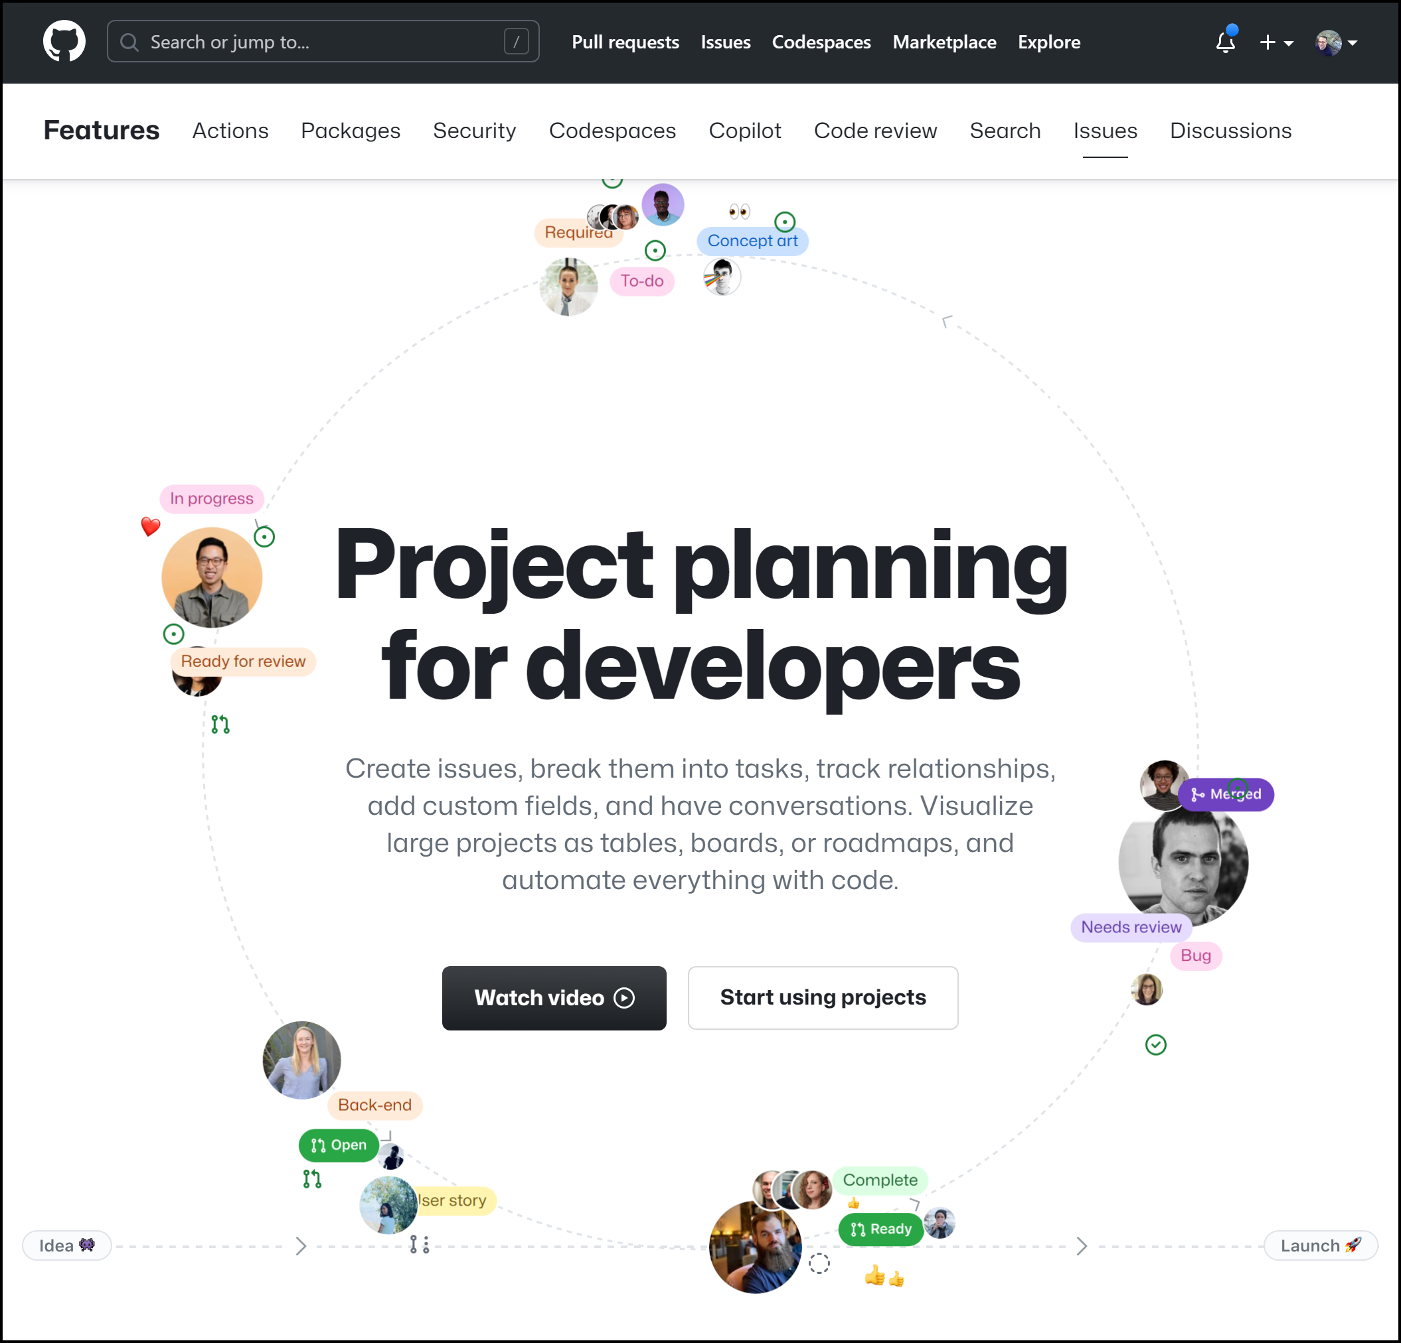
GitHub Projects

Slide 21
The Mental Model: Repos, Issues, and Projects
Repos
Issues
Pull Requests
Projects
Notes:
# Title -- The Mental Model: Repos, Issues, and Projects
# 1: Repos →
At the center of everything are repos. That's where your code lives. That's GitHub's core.
# 2: Issues →
Inside repos, you have Issues. These are your work items, your bugs, your feature requests. Issues belong to a repo.
# 3: Pull Requests →
You also have Pull Requests inside repos. PRs are how code gets reviewed and merged. And they can link back to Issues.
# 4: Projects →
And then Projects sit on top as a lens. A Project pulls Issues from one or more repos into a single place where you can organize, filter, and track them. Projects are a lens, not a container. The Issues are the source of truth.

Slide 22
GitHub is very git repository-centric.

Slide 23

Git repos are king.

Slide 24
Version control
Git repositories
Issues
Bare-bones project management
Pull requests
Code reviews
GitHub Actions
Automated build/release pipelines
GitHub Repositories

Slide 25
Project management tools
Trying to go beyond just “Issues”
GitHub Projects

Slide 26
Trying to become a full project management tool
Projects stand alone
Not part of a repository…
…until you need them to be…
…sorta kinda.
GitHub Projects

Slide 27
Answer key questions:
What do we need to do?
What order do we need to do it in?
What are we working on?
What is our progress?
What’s our “product vision” for the future?
Insights on how things are going
Reporting
What do you need for project management tools?

Slide 28
Create a project
Create a basic product backlog
Prioritize the product backlog

Slide 29
Draft Issues vs. Issues
Say what now?

Slide 30
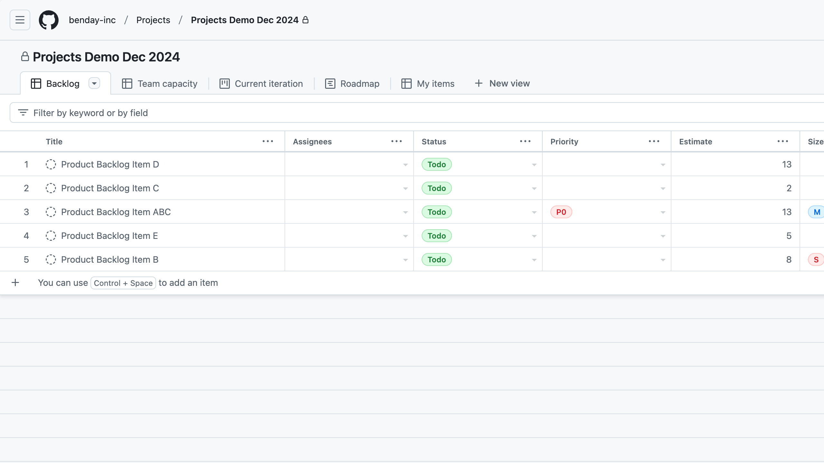
Notes:
So far our product backlog looks like this.
We’ve got five product backlog items recorded with some estimates and status values. It’s coming along.

Slide 31
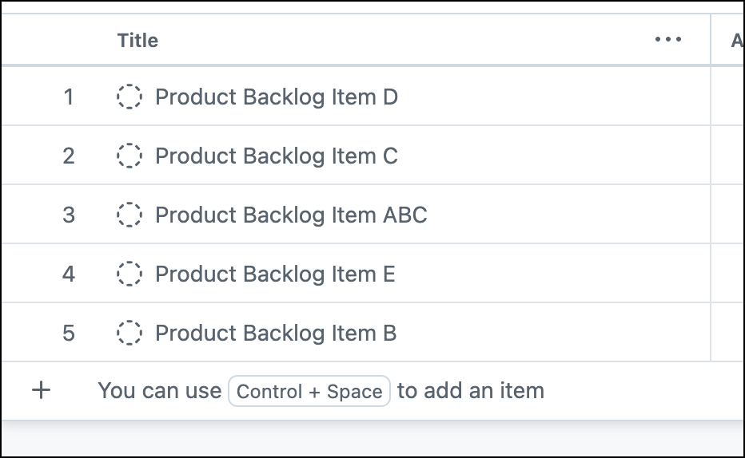
Notes:
But let’s zoom in on the title column a little bit.

Slide 32
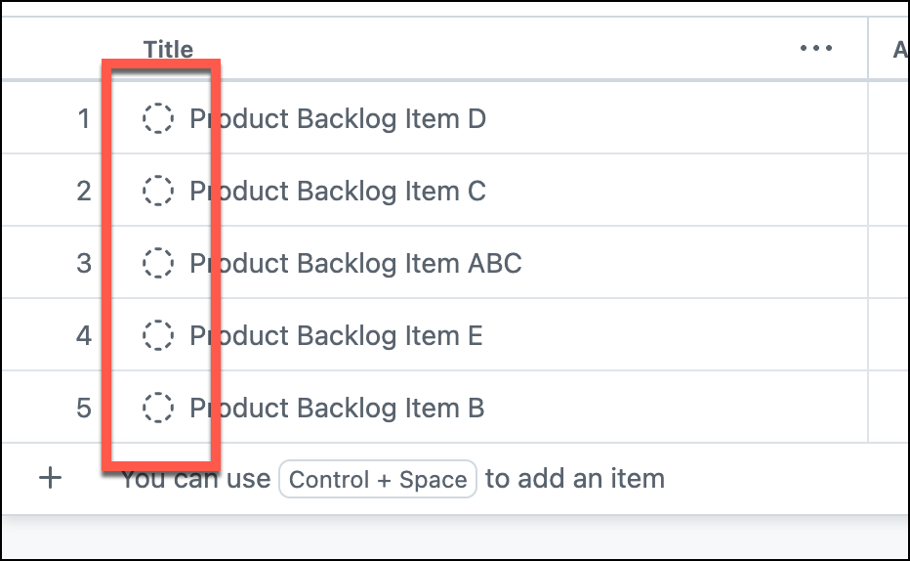
Notes:
That icon means that this is a “draft” issue.

Slide 33
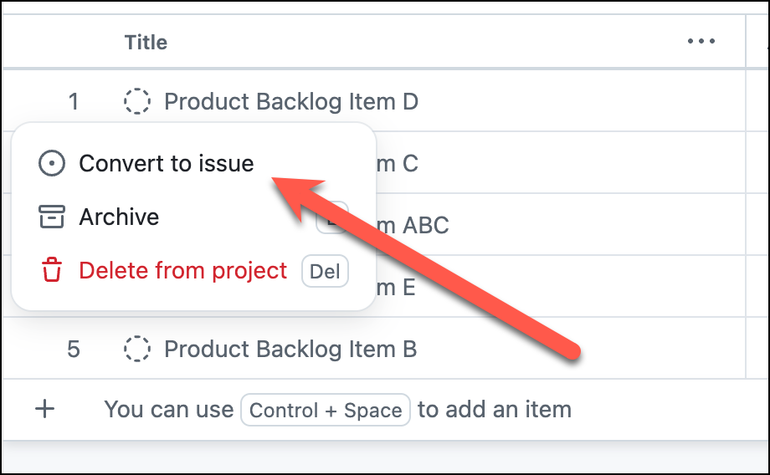
Notes:
And if you right-clicked on one of these items and brought up the context menu, you’d see that there’s an option to “Convert to issue”.

Slide 34
“Virtual” issue
Only exists in project
Different views for different roles
Notes about a requirement
Dev Team cares about Issues?
“Real” issues have MANY more features
Draft Issues
Notes:
# draft issues
so what’s the deal with these “draft issues”? I’ve got to admit that I found them pretty confusing and it took me a little while to wrap my head around them.
# Virtual
For lack of a better word, they’re kind of a virtual issue.
# project only
It exists and it doesn’t exist. Issues have been part of GitHub for years but GitHub Projects are pretty recent. These draft issues only exist inside of a project.
# different roles
In my mind, this “draft issue” versus “real issue” is based on the idea of roles on a project and that not everyone will be interested in everything.
# Notes on requirements
Draft issues give project managers and product owners a way to have notes on a requirement. A place for them to organize their thoughts.
# dev team
And if I keep thinking using this model slash mode…this theoretically leaves team members – for example, developers and testers – to only care about full-blown issues. In short, nothing is real for the development team unless it’s an Issue.
By the way, if I sound a little skeptical, it’s because…well…I’m a little skeptical.
# real issues
Anyway, as you’ll see once I start doing demos, there are a TON of features that are only available once you’ve converted a draft issue to a “real” issue.

Slide 35
You’re going to want to convert your draft issues to “real” issues.
Notes:
So you’re going to want to convert your draft issues to become real issues.

Slide 36

…but there’s an issue with issues.
Notes:
…but there’s an issue with issues.

Slide 37
If GitHub Projects are separate from Issues…
Notes:
If GitHub Projects are separated from GitHub Issues…

Slide 38
…and Issues live in a Git Repository…
Notes:
…and GitHub Issues only live inside of a Git repository…

Slide 39
…where do I store the issues?
Notes:
…then, when I convert my draft issues to ”real” issues, where I actually store the issues?

Slide 40
You’re going to need a repo.
Notes:
The answer is that you’re going to need a repo. A repository for your project stuff.

Slide 41
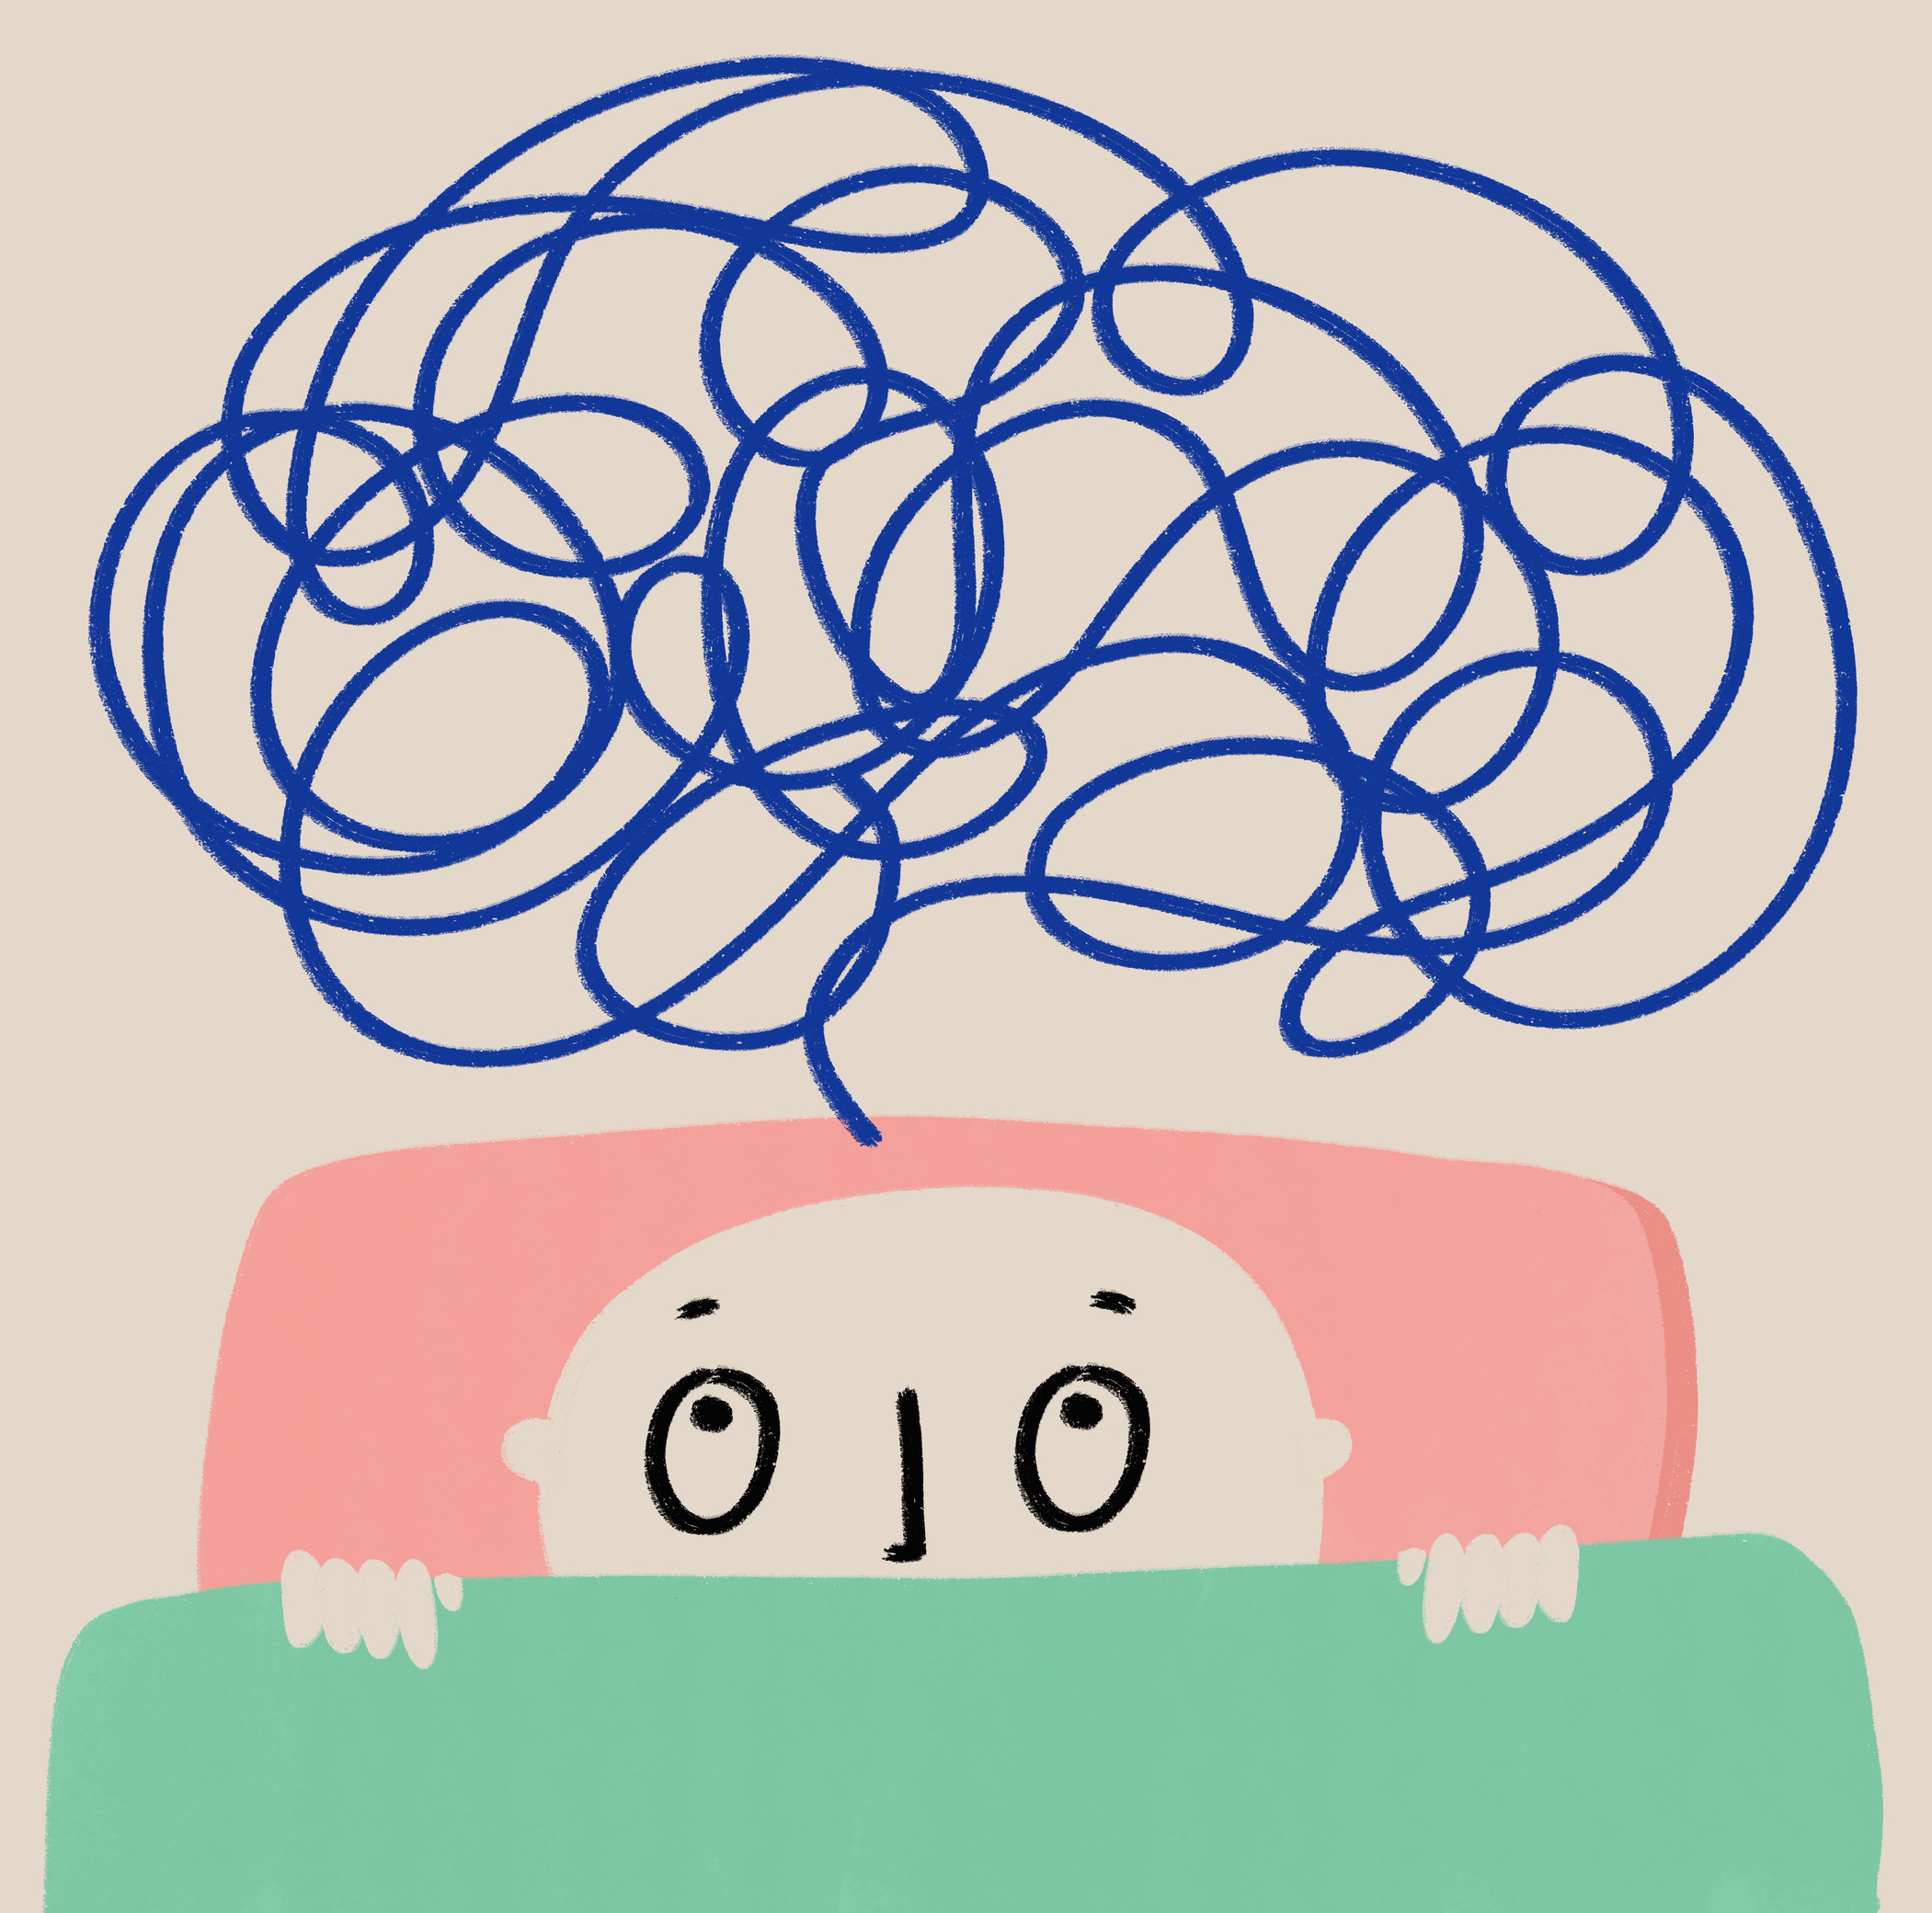
GitHub Projects are very flexible.
Notes:
So, when you go to turn the draft issues in your projects into real issues, you’re going to find that “GitHub Projects” is very flexible. They try to let you work the way that YOU want to work.

Slide 42
Projects can have issues that live in multiple repos.
Notes:
For example, they don’t try to limit you to a one-to-one mapping between issues in a project and issues in a repo.
Which makes sense because – if you’re working on a big application – there’s no guarantee that the work relates to the contents of just one Git repository.

Slide 43
It can get tangled & messy.
Notes:
On the other hand, this flexibility can get you in to trouble. You could have a sprawling mess of issues that can get super confusing.

Slide 44
Have a dedicated “project issues” repository
Make the repo the same name as the project
Project: My Project 123
Repository: My Project 123
$0.02: Suggestion
Notes:
#
My suggestion:
#
Create a dedicated git repository for your project. This takes the guess-work out of the “where do I put the issue” question.
This isn’t to say that you can’t or shouldn’t put issues in any other repo – think of this as the “default location” for where issues related to that project should go.
#
And to make your life easy, make the issue repo’s name the same name as the GitHub Project
#
So if your project is named “My Project 1 2 3”
#
Create a repository that’s named “My Project 1 2 3”
This way, it’ll be very clear where issues should be created.

Slide 45
Create an “issue repo”
Convert draft issues to issues
Issue Types

Slide 46
Draft Issues vs. Real Issues
Draft Issues
Real Issues
Quick capture — napkin ideas
Live only in the Project
No issue number, no repo link
Linked to a repo — full capabilities
Can be referenced in PRs and commits
Promote drafts when you're serious
Notes:
# Title -- Draft Issues vs. Real Issues
# Draft Issues
# Real Issues
# Quick capture — napkin ideas
Draft issues are for quick capture. Napkin ideas. You're brainstorming and you just want to get something down.
# Live only in the Project
They live only inside the Project. They're not connected to a repo yet.
# No issue number, no repo link
They don't have an issue number. You can't reference them in a PR. They're lightweight placeholders.
# Linked to a repo — full capabilities
Real issues are linked to a repo. They have an issue number, labels, assignees, the whole thing.
# Can be referenced in PRs and commits
You can reference them in PRs and commits with the hash syntax. Close them automatically when a PR merges.
# Promote drafts when you're serious
The workflow is: capture fast as drafts when you're brainstorming, then promote to real issues when you're ready to commit to the work. We'll do this in the demo.

Slide 47
Flow Metrics
Stop Estimating. Start Measuring.
Notes:
# Title -- Stop Estimating. Start Measuring.
Alright, we're back from the demo. You've now seen GitHub Projects' built-in charts, and they're fine for answering 'how's this sprint going.' But let me ask you a bigger question. What if you could predict when work will be done, without estimating a single item? What if the data you need is already sitting in your GitHub project, just waiting for you to use it?

Slide 48
Throughput: how many things you finish per week
Cycle Time: how long things take from start to finish
That's it. No story points. No velocity. Just count and measure.
Two Numbers That Tell You Almost Everything
Notes:
# Title -- Two Numbers That Tell You Almost Everything
# Throughput: how many things you finish per week
Number one: throughput. Just count how many things your team finishes each week. That's it. Last week you finished 5 items? Your throughput was 5. This week, 3. Next week, 7. Just count. No estimation meetings. No story points. Just count what gets done.
# Cycle Time: how long things take from start to finish
Number two: cycle time. How long does stuff take from when someone starts working on it to when it's done? If 85% of your work gets done in 6 days or less, then something that's been in progress for 7 days is probably in trouble. You've turned 'is this late?' from a matter of opinion into a data-driven answer.
# That's it. No story points. No velocity. Just count and measure.
That's it. Two numbers. And you're probably thinking, what about size? What about effort? For now, ignore it. There's a natural variability to the size of work your team does, and that variability isn't a bug, it's a feature. It's what makes the forecasting work.

Slide 49
What If You Already Had the Data?
Notes:
# Title -- What If You Already Had the Data?
# Stock Photo: question-yellow
Here's the thing. If your team has been using GitHub Projects or Azure DevOps for even a few weeks, you already have this data. Every time someone moves an item to 'in progress' and then to 'done,' that's a cycle time data point. Every week of completed work is a throughput data point. The data is sitting right there. You just aren't using it yet.

Slide 50
Monte Carlo simulation: 1,000 versions of your next few weeks
"We're 85% confident this will be done by March 28."
I wrote a free tool that does this.
https://www.honestcheetah.com
Predicting the Future with Monte Carlo
Notes:
# Title -- Predicting the Future with Monte Carlo
# Monte Carlo simulation: 1,000 versions of your next few weeks
There's a technique called Monte Carlo simulation. Sounds fancy. Sounds like hard math. It's not hard, but it is math, which is why you use a computer. Monte Carlo takes your historical throughput, your good weeks and your bad weeks, and puts together a thousand different versions of how your next few weeks will go.
# "We're 85% confident this will be done by March 28."
And then it tells you: we're 85% confident these 15 items will be done by March 28th. We're 50% confident by March 21st. You get a range of dates with confidence levels. No estimation required. Just based on what your team actually does, not what you hope they'll do.
# I wrote a free tool that does this. Let me show you.
Now, doing Monte Carlo by hand is no fun. So I wrote a free tool called Honest Cheetah that connects to your GitHub projects and does all of this for you. Let me show you.

Slide 51
Prioritized backlog with custom fields and real-world statuses
Iteration planning, task breakdown, and day-to-day tracking
Sprint charts AND delivery forecasting
All free tools. Set it up tonight.
What We Built Today
Notes:
# Title -- What We Built Today
# Prioritized backlog with custom fields and real-world statuses
We built a prioritized backlog with custom fields, real-world status values that actually reflect how your team works, and saved views for different audiences.
# Iteration planning, task breakdown, and day-to-day tracking
We set up iteration-based planning without rigid Scrum rules, broke features into tasks using sub-issues, and got a board view for day-to-day tracking with automations.
# Sprint charts AND delivery forecasting
We built burndown-style charts for the current sprint, and then layered on delivery intelligence with throughput, cycle time, and Monte Carlo forecasting.
# All free tools. Set it up tonight.
And all of this uses tools that are either built into GitHub or free. You can go set this up for your team tonight.

Slide 52
Save your configured project as an org template
New projects get your views, fields, and workflows out of the box
Save It as a Template
Notes:
# Title -- Save It as a Template
# Save your configured project as an org template
Once you've got your project set up the way you like it, with your custom fields, your views, your workflows, you can save it as an organization template.
# New projects get your views, fields, and workflows out of the box
Next time someone on your team creates a project, they pick your template and they get everything pre-configured. Views, fields, automations, all of it. This is a feature that shipped in mid-2025 and it's a huge time saver.

Slide 53
Item added → set Status to "Todo"
PR linked to issue → set Status to "In Progress"
Item closed → set Status to "Done"
Automations Worth Enabling
Notes:
# Title -- Automations Worth Enabling
# Item added → set Status to "Todo"
When a new item gets added to the project, automatically set its status to Todo. Saves a click every time.
# PR linked to issue → set Status to "In Progress"
When a pull request gets linked to an issue, automatically set the status to In Progress. This one is new as of late 2025 and it's great because the developer doesn't have to remember to update the board.
# Item closed → set Status to "Done"
When an issue gets closed, set it to Done. And you can set up auto-archive to clean up completed items after a certain number of days. Keeps your board tidy.

Slide 54
No native dependencies or blocking relationships
Limited charting — functional, not sophisticated
No capacity planning
Basic automation — complex workflows need Actions
What GitHub Projects Doesn't Do (Yet)
Notes:
# Title -- What GitHub Projects Doesn't Do (Yet)
# No native dependencies or blocking relationships
You can't say 'issue A blocks issue B' in GitHub Projects. There's no native dependency tracking. You can work around it with labels or custom fields, but it's not built in.
# Limited charting — functional, not sophisticated
The built-in charts are functional but not sophisticated. Which is part of why I showed you Honest Cheetah. If you need deeper analytics, you'll want something on top.
# No capacity planning
There's no 'how many hours does this person have available' view. No capacity planning. You're managing work items, not timesheets.
# Basic automation — complex workflows need Actions
And the built-in automation covers the basics. If you need complex conditional workflows, you're going to need GitHub Actions.

Slide 55
What's most important right now?
What's everyone working on?
Is anything stuck or aging?
When will it probably be done?
The Agile-ish Checklist
Notes:
# Title -- The Agile-ish Checklist
# What's most important right now?
What's most important right now? If someone joins the team tomorrow, can they find the prioritized list?
# What's everyone working on?
What's everyone working on? Can you see it without asking in Slack?
# Is anything stuck or aging?
Is anything stuck? Has something been in progress for way too long? Can you spot that without someone raising their hand in standup?
# When will it probably be done?
When will it probably be done? Can you give a data-driven answer instead of a guess?

Slide 56
What Survives Any Methodology
Know What Done Means
Finish Before You Start
Measure Outcomes, Not Outputs
Use Discomfort as a Signal
A shared, honest definition everyone can see
Stop starting, start finishing
Did it matter, not did we ship it
The oogie feeling is information, not a problem
Notes:
# Title -- What Survives Any Methodology
# 1: 1. Know What Done Means → A shared, honest definition everyone can see
First, know what done means. Have a shared, honest definition that everyone on the team and everyone who depends on the team can see. This is your diagnostic. This is where the human problems surface.
# 2: 2. Finish Before You Start → Stop starting, start finishing
Second, finish before you start. Stop starting new things and start finishing the things that are already in progress. This is the antidote to the busy trap. Lower your WIP, finish what you've started, and watch what happens to your throughput.
# 3: 3. Measure Outcomes, Not Outputs → Did it matter, not did we ship it
Third, measure outcomes, not outputs. The question isn't how much did we ship, it's did what we shipped actually matter. Did it change something for a user, for a customer, for the business?
# 4: 4. Use Discomfort as a Signal → The oogie feeling is information, not a problem
And fourth, use discomfort as a signal, not as a reason to retreat. The oogie feeling is information. It's the diagnostic working. When your process makes something uncomfortable visible, the generative response is curiosity, not avoidance.

Slide 57
YouTube Series: Scrum With GitHub Projects

Slide 58
YouTube Series: Flow Metrics Explained

Slide 59
Free Tool for GitHub & Azure DevOps honestcheetah.com

Slide 60
Thanks. benday@benday.com | www.benday.com

