Slide 1


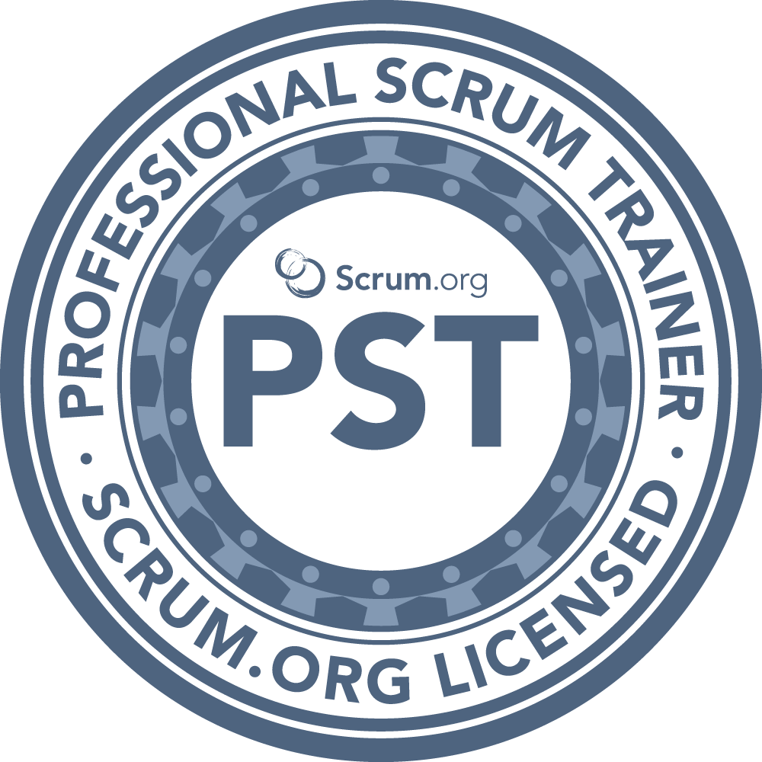

I Love YAML: Using Azure DevOps to Build and Release to Azure
Benjamin Day
www.benday.com
@benday

Slide 2




Benjamin Day
Brookline, MA
Consultant & Trainer
Rental Chief Technology Officer
Therapist for Teams
Scrum, DevOps, Azure,
Team Foundation Server,
Software Architecture & Testing
Microsoft MVP
Pluralsight Author
Scrum.org Trainer
@benday

Slide 3


slidespeaker.ai

Slide 4


https://www.youtube.com/@_benday

Slide 5


Scrum with GitHub Projects
Free on YouTube https://nday.be/go/githubscrum

Slide 6
Implementing Scrum with Azure DevOps
Azure DevOps Services Fundamentals
Scrum Master Skills

Slide 7
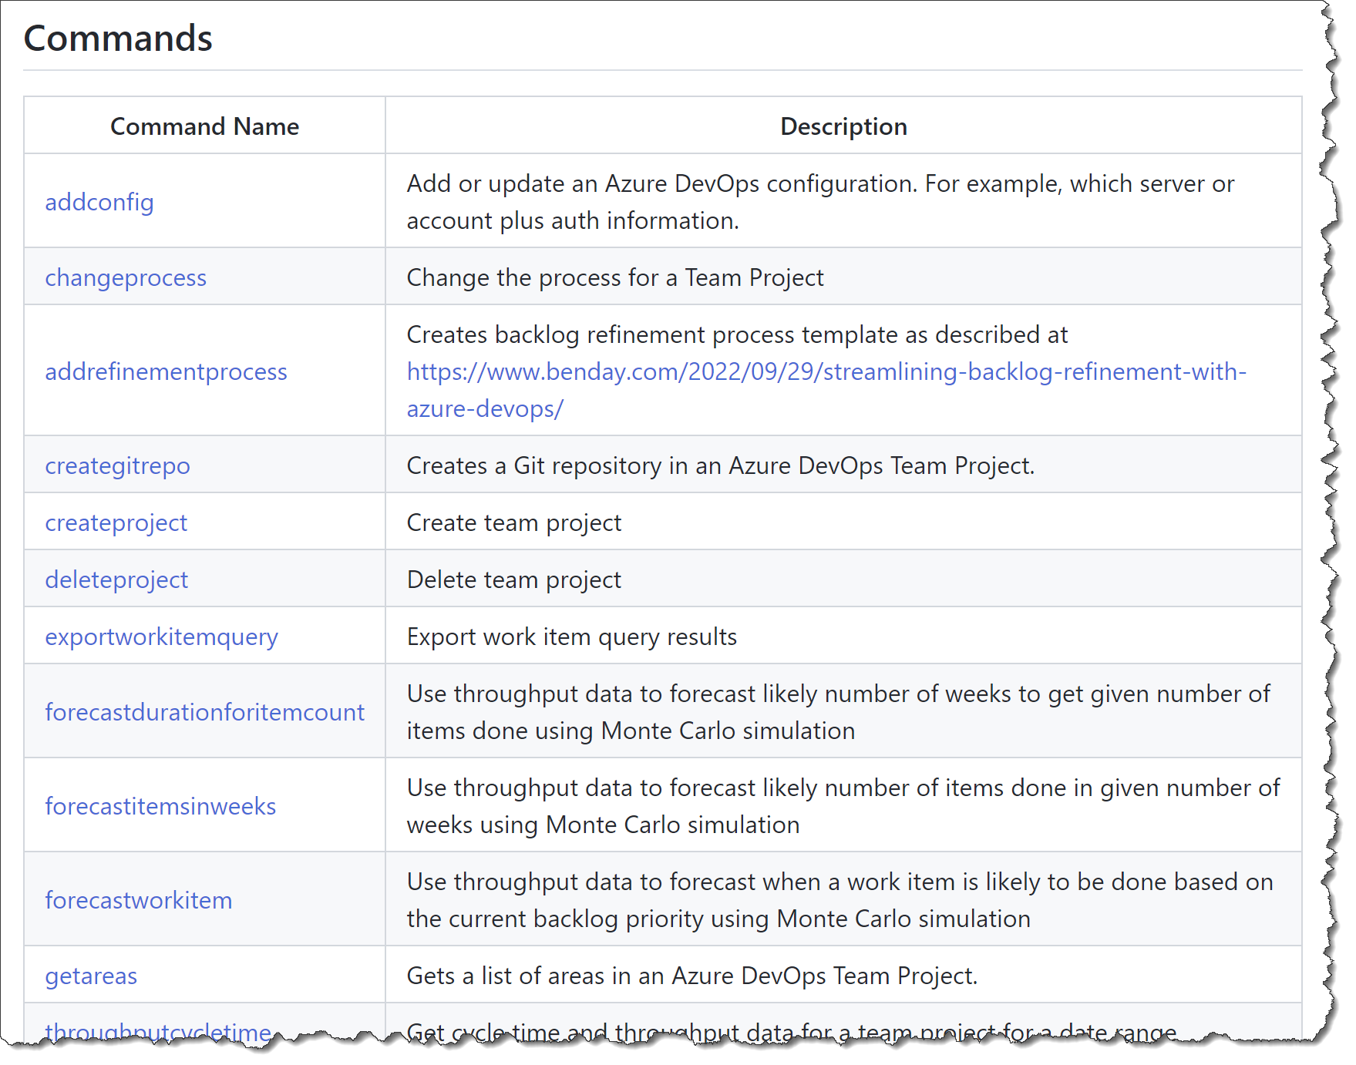
Azure DevOps Utilities (azdoutil) https://github.com/ benday-inc/azdoutil
Free!

Slide 8
Install Azure DevOps Utilities: dotnet tool install azdoutil -g

Slide 9
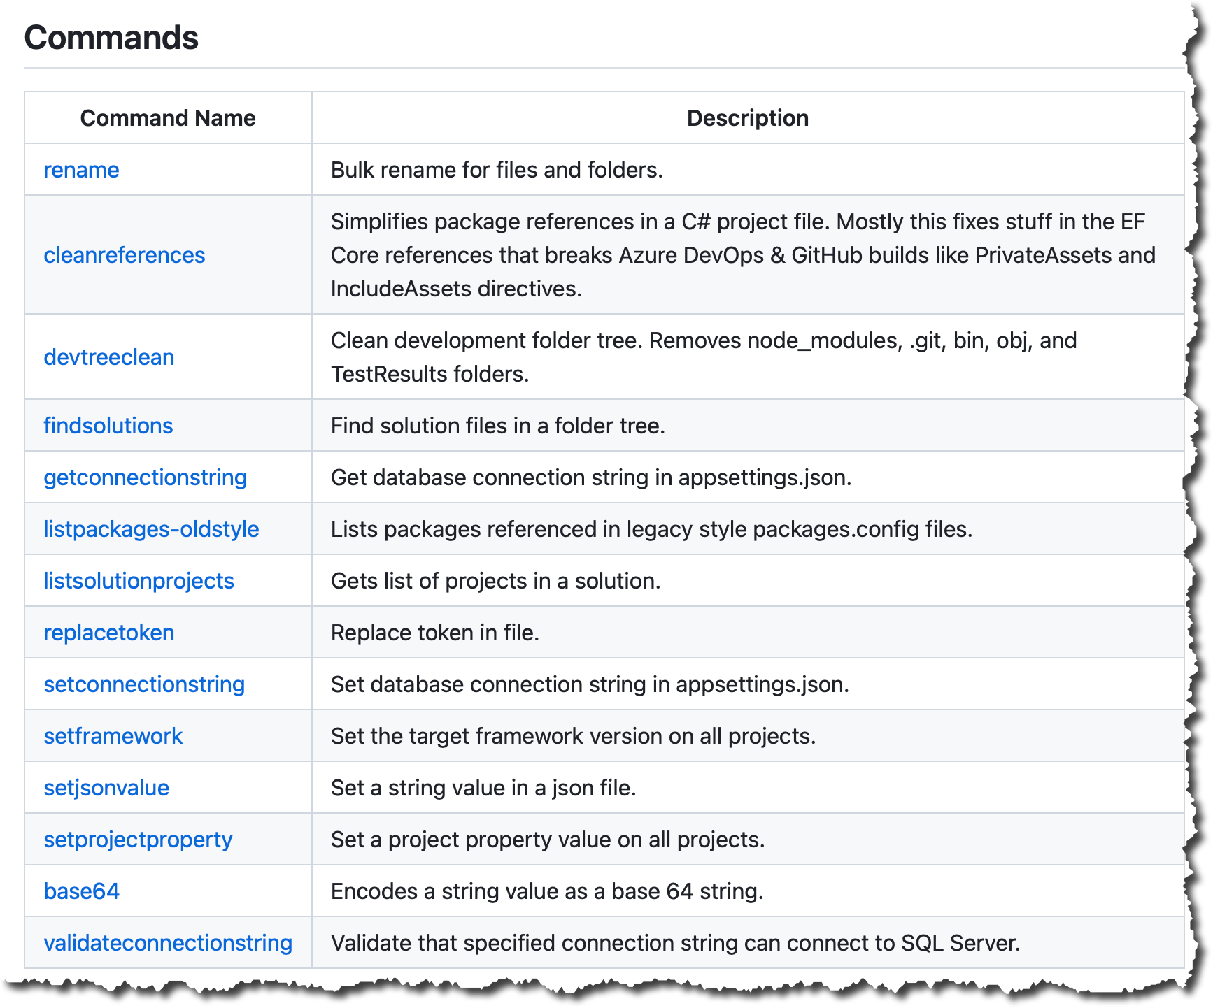
Solution Utilities
(slnutil) https://github.com/ benday-inc/slnutil
Free!

Slide 10
Install Solution Utilities: dotnet tool install slnutil -g

Slide 11
On with the show.

Slide 12
YAML-based Pipelines
Goal: Build, Test, and Deploy
with YAML Pipelines
Pools, Triggers, and Variables
Use Docker Containers in Pipelines
  SQL Server
Deploy database changes
  EF Core Migrations
Multi-environment Deploys
Multi-environment Approvals
Overview

Slide 13
Next up:
YAML-based Pipelines

Slide 14
YAML-based Pipelines

Slide 15
Classic Build & Release Pipelines
  ~10 years old
  Use a designer to describe your pipeline
  Under the surface, JSON-based
  Stored in build/release system
  Separates builds from releases
YAML-Based Pipelines
  Recent addition to the product
  Mostly text-based
  Stored in version control
  Builds & releases are “stages” in the same pipeline definition
Build & Release Pipelines in Azure DevOps

Slide 16
Yet Another Markup Language
YAML Ain’t Markup Language
Specification @ yaml.org
  “YAML is a human-friendly data serialization language for all programing languages.”
Confusing.
It’s what we’ll use to describe our release pipelines in Azure DevOps
  (It’s also what GitHub Actions uses.)
What is YAML?

Slide 17
Azure DevOps
Classic Pipelines vs YAML Pipelines
Classic Pipelines
YAML Pipelines
Uses JSON
Stored somewhere in
Azure DevOps database
Available regardless of
version control option
Splits build activities from
release activities
Nice designer
Uses YAML
Scripts are stored in Azure DevOps
Git repository
Not available in TFVC →
Requires that you use Git
Describes the entire build and release pipeline in a single file
Editable in any text editor of
your choice!

Slide 18
Giant benefit of YAML-based pipelines:
Pipeline scripts are stored in version control!

Slide 19
Powerful but subtle benefits
Versions your pipeline scripts along with your code
→ Let’s you branch & merge your pipeline scripts along with your code
YAML Pipeline scripts in Git?
Who cares?

Slide 20
Next up:
Create a YAML build

Slide 21
Create a YAML-based pipeline
  Publish an artifact

Slide 22
Create a YAML-based pipeline
  Run unit tests

Slide 23
Create a YAML-based pipeline
  Add a parameter to optionally enable/disable tests

Slide 24
Stages, Jobs, & Steps in YAML

Slide 25
Pipeline
  Stage A
    Job 1
      Step 1.1
      Step 1.n
    Job 2
      Step n
  Stage B
  Stage n
Basic Structure of an Azure DevOps YAML-based Pipeline
https://docs.microsoft.com/en-us/ azure/devops/pipelines/yaml-schema

Slide 26
Top level item
Name of the pipeline
Global variables
Agent pool
Triggers
  Manual only: “none”
  Branches
  File paths
  Tags
Pull request triggers
Has a collection of Stages
Pipeline

Slide 27
Collection of related jobs
A stage has…
  Display name
  Conditions
  Variables
  Collection of jobs
My typical stage structure:
  Build
  Deploy to test environment
  Wait for human approval
  Deploy to prod environment
Stage

Slide 28
Collection of steps
Run on the server or agent machine
Can be run in parallel within a stage
NOTE: I usually only have one Job per Stage
Jobs

Slide 29
“a linear sequence of operations that make up a job”
Basically: it does something
Think of it as a command line call
Each step runs in its own process
  (Remember this if environment variables get weird for you!)
Steps

Slide 30
Defines the agent for your pipeline jobs
Agents
  Hosted by Microsoft
  Self-hosted
Pools

Slide 31
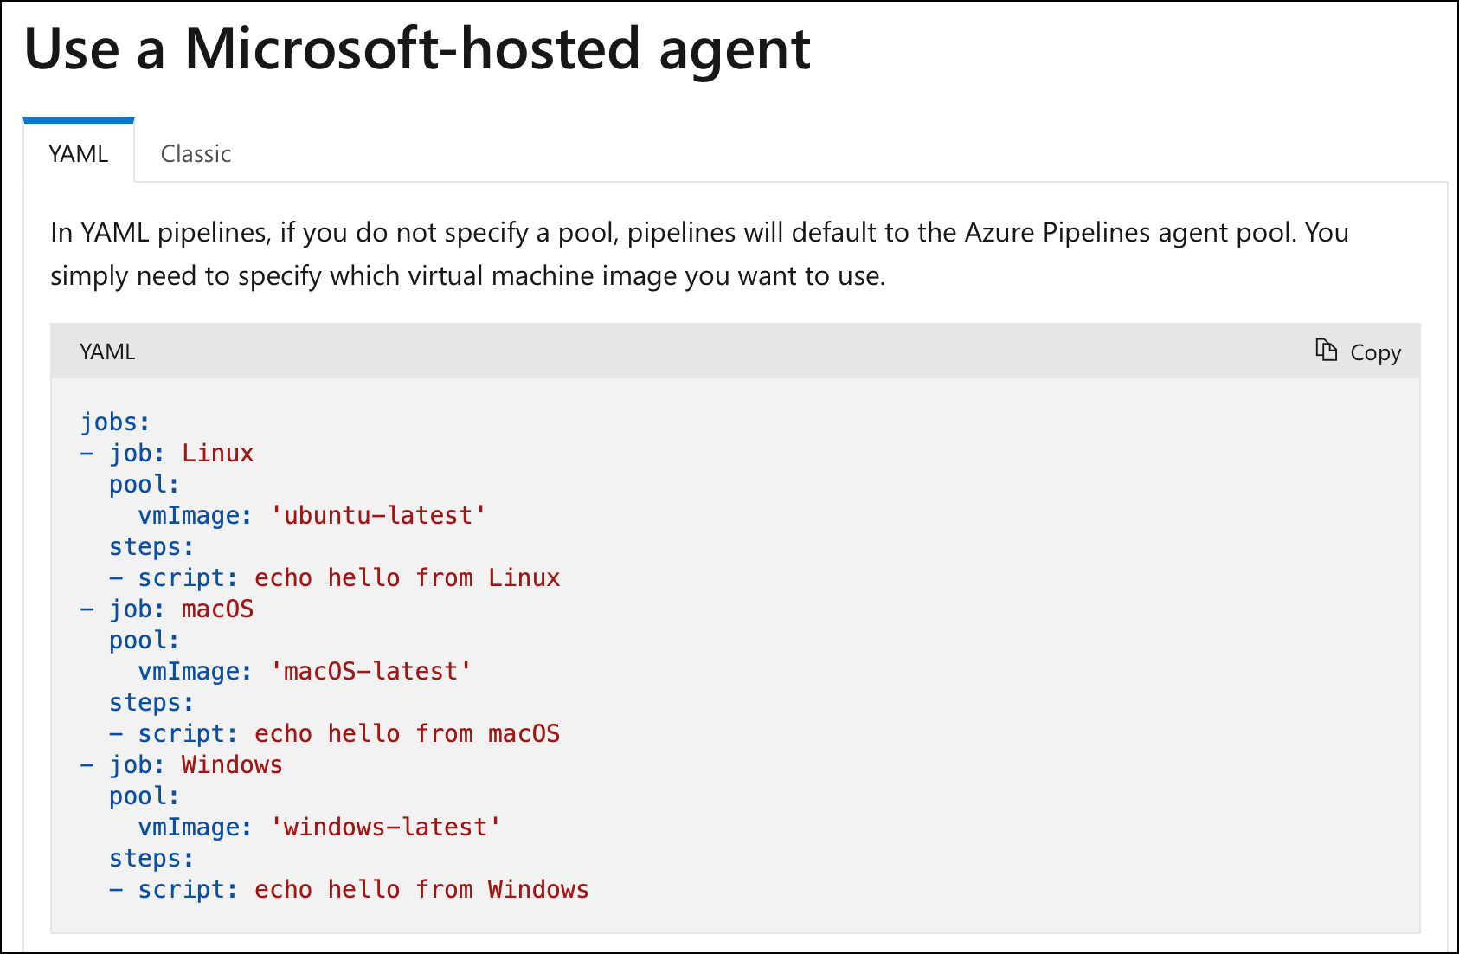
Hosted Agents
https://docs.microsoft.com/en-us/ azure/devops/pipelines/agents/hosted

Slide 32
Set the “pool → vmImage” value
Linux
  ‘ubuntu-latest’
MacOS
  ‘macOS-latest’
Windows
  ‘windows-latest’
Hosted Agent Types

Slide 33
Agents that you install & maintain
Set the “pool → name” value
Self-hosted Agents

Slide 34
Can be defined at
  Pipeline level (root, global)
  Stage level
  Job level
Variables

Slide 35
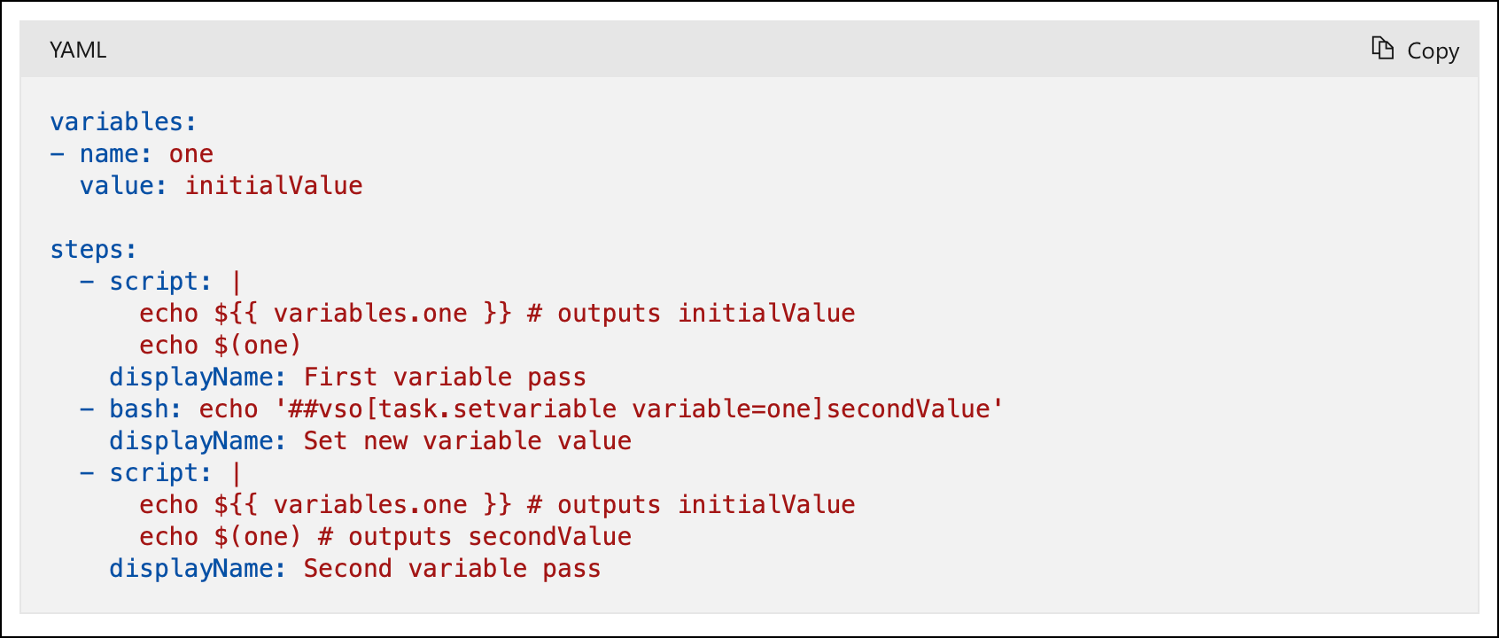
Variables
https://docs.microsoft.com/en-us/ azure/devops/pipelines/process/variables

Slide 36
Use a Docker container in the pipeline
SQL Server container
Deploy EF Core migrations
Run integration tests

Slide 37
Multiple stages in a pipeline
Part 1 of 3
Separate build from deploy

Slide 38
Multiple stages in a pipeline
Part 2 of 3
Use Marketplace Extensions in a pipeline
Server-side pipeline variables
Configure database connection strings
Deploy EF Core migrations

Slide 39
Multiple stages in a pipeline
Part 3 of 3
Deploy to an Azure App Service
  Deploy to a Deployment Slot
Set up a service connection
  From: Azure DevOps
  To: Azure Subscription

Slide 40
Review what’s in ‘test’ before deploying to ‘production’
Approvals between stages
Manual Validation Step
  Server-side step
  Pauses execution
  Accept or reject

Slide 41
Run a YAML-based pipeline using
a self-hosted agent
  Self-hosted agent setup demo
  is in the previous module
YAML conditions

Slide 42
YAML-based Pipelines
Goal: Build, Test, and Deploy
with YAML Pipelines
Pools, Triggers, and Variables
Use Docker Containers in Pipelines
  SQL Server
Deploy database changes
  EF Core Migrations
Multi-environment Deploys
Multi-environment Approvals
Summary

Slide 43
Any questions?

Slide 44
Thank you.
www.benday.com | benday@benday.com

