Slide 1
Real World Scrum with Azure DevOps
Benjamin Day
www.benday.com
@benday

Slide 2
Real World Scrum with Azure DevOps
Benjamin Day
www.benday.com
@benday

Slide 3
Real World Scrum with Azure DevOps
Benjamin Day

Slide 4
Real World Scrum with Azure DevOps
Benjamin Day

Slide 5
Benjamin Day
Brookline, MA
Consultant & Trainer
Rental Chief Technology Officer
Therapist for Teams
Scrum, DevOps, Azure, Team Foundation Server, Software Architecture & Testing
Microsoft MVP
Pluralsight Author
Scrum.org Trainer
@benday

Slide 6
Implementing Scrum with Azure DevOps New!

Slide 7
Azure DevOps Services Fundamentals Scrum Master Skills

Slide 8
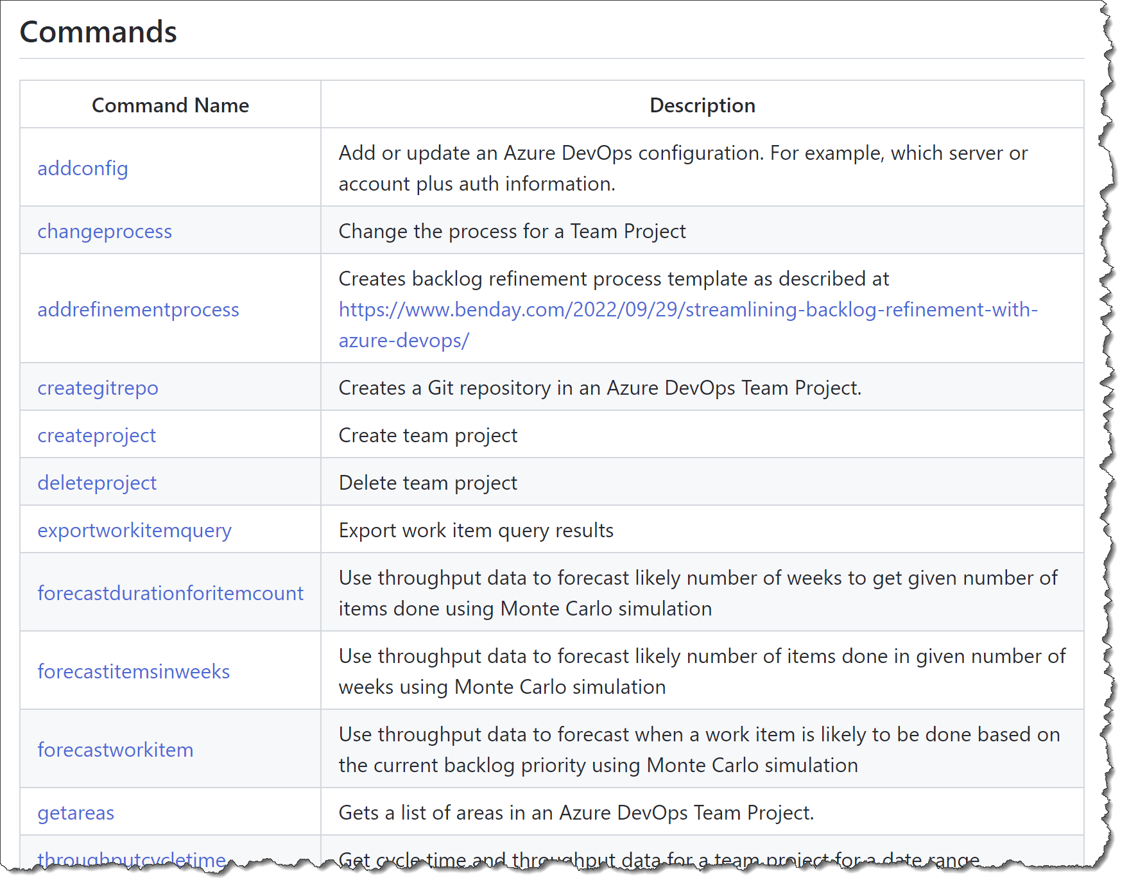
Azure DevOps Utilities (azdoutil) https://github.com/ benday-inc/azdoutil Free!

Slide 9
New Flow Metrics & Estimating Course courses.benday.com

Slide 10
On with the show.

Slide 11
And now, the fastest Scrum overview of all time...

Slide 12
The Secret of Scrum

Slide 13
The Secret of Scrum: It’s all about done, working software.

Slide 14
It’s either ‘done’ or ‘not done’.

Slide 15
The Biggest Enemy of Scrum: The “Software Development Industry”

Slide 16
We should rename our industry.

Slide 17
Software Development Delivery Industry

Slide 18
EVERYTHING in Scrum is about delivering done, working software.

Slide 20
You’re going to work in chunks of 30 days or less. Chunks = “Sprints”

Slide 21
4 Events in Scrum

Slide 22
(aka. Meetings)

Slide 23
Events
Sprint Planning
What done, working software are we going to deliver this Sprint?
How are we going to deliver it?
Daily Scrum
What’s our plan to get to Done?
Are we on-target?
Sprint Review
“Here’s the done, working software we made.”
“Here’s what we’re planning to build next.”
Sprint Retrospective
Is anything in our way?
“Any feedback?”
How did we do at delivering done, working software?
What caused us trouble?
What are we going to improve?

Slide 24
3 Roles

Slide 25
Roles
Product Owner
Keeper of the Requirements
Development Team
Should be called "Delivery Team"
Scrum Master
NOT A PROJECT MANAGER!
Provider of Goals
Answerer of Questions
People who make the done, working software
Not just developers!
“Coach” not “Boss”
Focus & Productivity
Focus on Done

Slide 26
3 Artifacts

Slide 27
Artifacts
Product Backlog
Sprint Backlog
Increment
Owned by the Product Owner
The Requirements
Prioritized
What is the team working on in this Sprint?
The done, working software

Slide 29
It’s all about done, working software.

Slide 30
You stop in order to keep yourself honest.

Slide 31
Manage your risk in the face of uncertainty.

Slide 32
Eliminate waste.

Slide 33
It’s all about done, working software.

Slide 34
Where does Azure DevOps fit in?

Slide 35
Azure DevOps + Scrum
Streamlining your way to Definition of Done

Slide 36
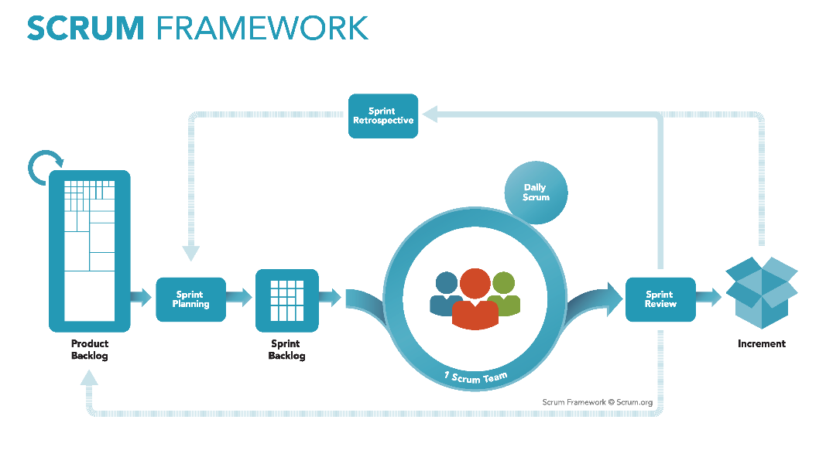
Azure DevOps + Scrum
Backlog management
Sprint Planning
Sprint Management

Slide 37
Azure DevOps + Scrum + Real World
Backlog management
Sprint Planning
Sprint Management
Definition of Done
Test Case Management
Automated Builds
Automated Testing
Release Management
Deployment

Slide 38
 |  | Scrum Events |  |  |  |  | Supporting Activities
 |  | Sprint Planning | Daily Scrum | Sprint Review | Sprint Retrospective |  | Product Ownership | DoD | Collaboration | Best Practices | Enterprise Scrum
Work Items | Backlog Manager | X |  | X | X |  | X |  |  |  | X
 | Sprint Planner | X |  | X | X
 | Scrum Board |  | X | X | X |  |  |  | X
 | Burndown Chart |  | X |  | X |  |  |  | X
 | Kanban Board |  | X |  | X |  | X |  | X
 | Work item Tracking |  |  | X | X |  |  |  | X
 | Velocity Chart | X |  | X | X |  | X
 | Cumulative Flow Diagram |  |  |  |  |  | X
 | Capacity Planner | X |  |  |  |  |  |  | X
 | Work Item Charts |  | X |  |  |  | X |  | X
Code | Source Control |  |  |  | X |  |  | X | X | X
 | Code Reviews |  |  |  | X |  |  | X | X | X
 | Lightweight Code Commenting |  |  |  |  |  |  | X | X
 | Unit Testing |  |  |  | X |  |  | X |  | X
Build | Automated Builds |  |  |  | X |  |  | X |  | X
 | Deploy w/ Lab Management |  |  |  | X |  |  | X | X
 | Deploy w/ Release Management |  |  |  | X |  |  | X | X
Collaboration | SharePoint |  |  |  | X |  |  |  | X
 | Team Rooms |  |  |  |  |  |  |  | X | X
 | Team Home Page |  |  |  |  |  |  |  | X
 | Teams |  |  |  |  |  |  |  | X |  | X
 | Feedback Manager |  |  |  | X |  | X | X | X
 | PowerPoint Storyboarding | X |  |  | X |  | X |  | X
Testing | Test Case Management |  |  | X | X |  |  | X | X
 | Defect Tracking |  |  |  | X |  |  | X | X
 | Load Testing |  |  |  | X |  |  | X |  | X

Slide 39
Do you have a Definition of Done?

Slide 40
A written DoD is a list of everything that is required before you can say a PBI is Done.

Slide 41
Here’s a hint:

Slide 42
It’s a lot more than “the code compiles and is checked in.”

Slide 43
Sample Definition of Done (DoD)
Development / Coder
Testing, Deployment, Ops
Code is written with unit tests
Unit tests have a minimum of 75% code coverage
Code has been merged to Main
Code compiles and unit tests pass when run as part of an automated build
Database schema objects are checked in to Azure DevOps
Database upgrade script is written and in Azure DevOps
Code reviewed by someone other than the original author
Written QA test plan
Tested with QA test plan by someone other than the original author
Deployed and tested in Staging environment
Automated UI tests are written and pass
No Severity 1 or 2 bugs
Reviewed by Product Owner
Passes acceptance criteria for the PBI
Known deployment & rollback plan
Deployment plan reviewed by Ops
Database changes reviewed by DBAs
Load tested
Deployed to Production

Slide 44
Why is a Written DoD so Important?
Makes it clear what all the steps are
Everyone can look at the steps → a shared understanding
Helps with team-based estimation
Helps minimize or eliminate Technical Debt
Helps to manage management expectations
Helps with the “two second change” request

Slide 45
Azure DevOps + Visual Studio help you to automate your DoD and streamline your path to DoD.

Slide 46
And now a lot of demos…

Slide 47
Demos
Backlog Management / Refinement
Sprint Planning
Daily Scrum
Situational Awareness
Charts, Dashboards
QA Test Tracking
Automated Build + DoD
Lightweight Requirements

Slide 49
Any last questions?

Slide 50
Thank you.
www.benday.com | benday@benday.com

Slide 51
Branching lets you work on similar, related code in isolation at the same time.

Slide 52
Branching is much easier to do in Git.

Slide 53
“So, I can go nuts and create 250 zillion branches now and it’s a good idea?”

Slide 54
No.

Slide 56
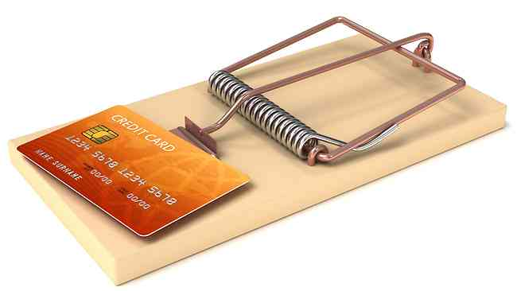
A branch is an integration credit card.

Slide 57
For every branch, there’s a merge.

Slide 58
Merging can be expensive and painful.

Slide 59
Until everything’s integrated, it’s definitely not done.

Slide 60
Keep it simple.

Slide 61
Integrate often.

Slide 62
The smaller the integration, the easier it is.

Slide 63
“You can drive with your feet. It doesn’t mean it’s a good idea.” *
* - paraphrased

Slide 64
Sprint: Day 1 of 15
 | TO DO | IN PROGRESS | DONE
PBI A
PBI B
PBI C

Slide 65
Sprint: Day 2 of 15
 | TO DO | IN PROGRESS | DONE
PBI A
PBI B
PBI C

Slide 66
Sprint: Day 5 of 15
 | TO DO | IN PROGRESS | DONE
PBI A
PBI B
PBI C

Slide 67
Sprint: Day 8 of 15
 | TO DO | IN PROGRESS | DONE
PBI A
PBI B
PBI C

Slide 68
Sprint: Day 11 of 15
 | TO DO | IN PROGRESS | DONE
PBI A
PBI B
PBI C

Slide 69
Sprint: Day 12 of 15
 | TO DO | IN PROGRESS | DONE
PBI A
PBI B
PBI C

Slide 70
Sprint: Day 13 of 15
 | TO DO | IN PROGRESS | DONE
PBI A
PBI B
PBI C

Slide 71
Sprint: Day 14 of 15
 | TO DO | IN PROGRESS | DONE
PBI A
PBI B
PBI C

Slide 72
Sprint: Day 15 of 15 (in your dreams)
 | TO DO | IN PROGRESS | DONE
PBI A
PBI B
PBI C

Slide 73
Sprint: Day 15 of 15 (in reality)
 | TO DO | IN PROGRESS | DONE
PBI A
PBI B
PBI C

Slide 74
Don’t use branches to avoid talking to your teammates.

Slide 75
Do less at once. Focus on done. Integrate often.

Slide 76
Sprint: Day 1 of 15
 | TO DO | IN PROGRESS | DONE
PBI A
PBI B
PBI C

Slide 77
Sprint: Day 2 of 15
 | TO DO | IN PROGRESS | DONE
PBI A
PBI B
PBI C

Slide 78
Sprint: Day 5 of 15
 | TO DO | IN PROGRESS | DONE
PBI A
PBI B
PBI C

Slide 79
Sprint: Day 6 of 15
 | TO DO | IN PROGRESS | DONE
PBI A
PBI B
PBI C

Slide 80
Sprint: Day 10 of 15
 | TO DO | IN PROGRESS | DONE
PBI A
PBI B
PBI C

Slide 81
Sprint: Day 11 of 15
 | TO DO | IN PROGRESS | DONE
PBI A
PBI B
PBI C

Slide 82
Sprint: Day 15 of 15
 | TO DO | IN PROGRESS | DONE
PBI A
PBI B
PBI C

