Slide 1
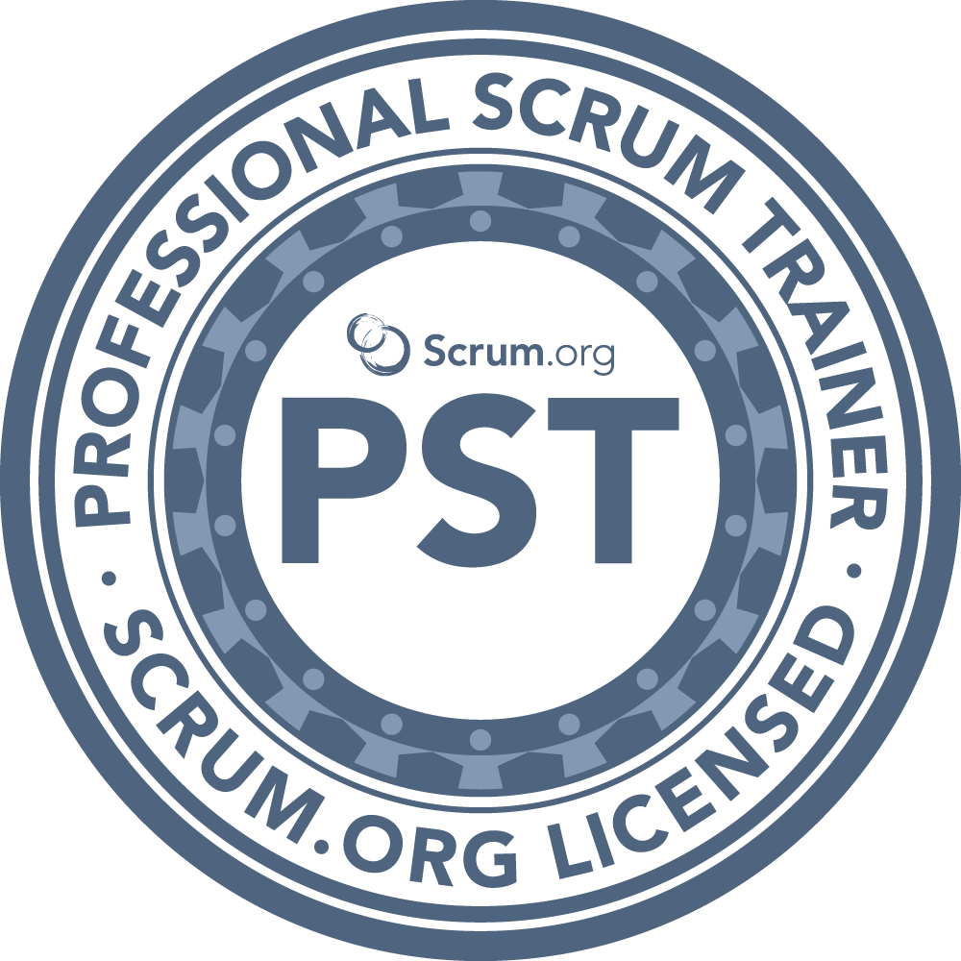
I Love YAML: Using Azure DevOps to Build and Release to Azure
Benjamin Day
www.benday.com
@benday

Slide 2
Benjamin Day
Brookline, MA
Consultant & Trainer
Rental Chief Technology Officer
Therapist for Teams
Scrum, DevOps, Azure, Team Foundation Server, Software Architecture & Testing
Microsoft MVP
Pluralsight Author
Scrum.org Trainer
@benday

Slide 3
Implementing Scrum with Azure DevOps New!

Slide 4
Azure DevOps Services Fundamentals Scrum Master Skills

Slide 5
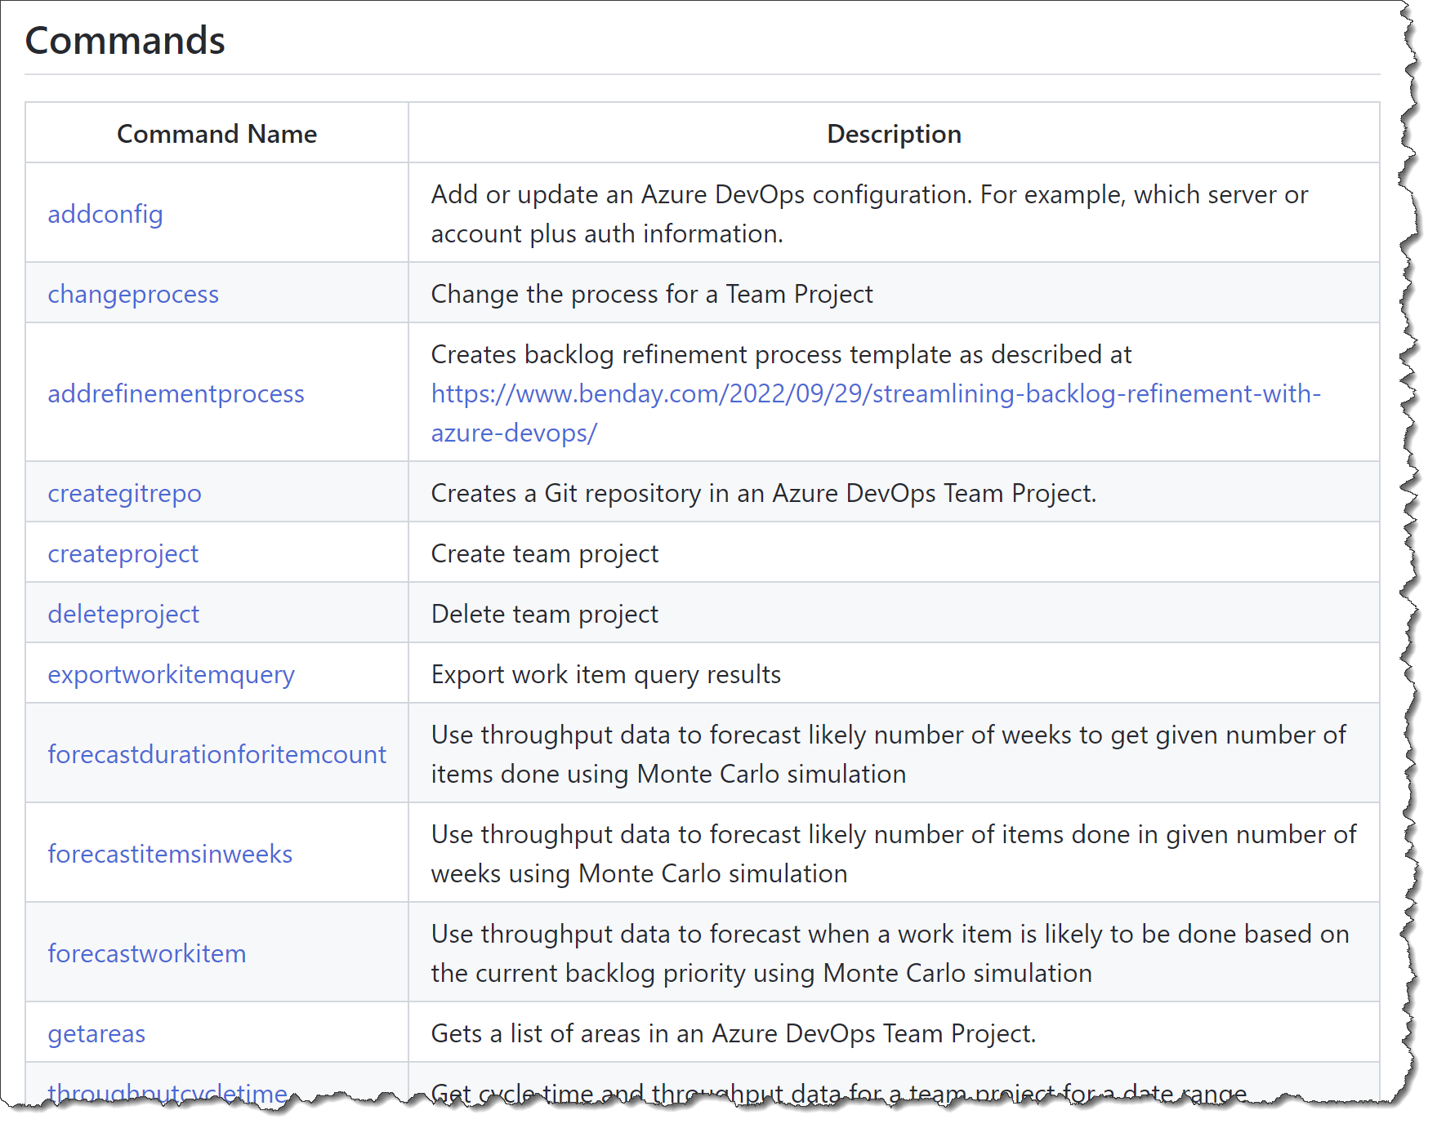
Azure DevOps Utilities (azdoutil) https://github.com/ benday-inc/azdoutil Free!

Slide 6
New Flow Metrics & Estimating Course courses.benday.com

Slide 7
On with the show.

Slide 8
YAML-based Pipelines
Goal: Build, Test, and Deploy with YAML Pipelines
Pools, Triggers, and Variables
Use Docker Containers in Pipelines
SQL Server
Deploy database changes
EF Core Migrations
Multi-environment Deploys
Multi-environment Approvals
Overview

Slide 9
Next up: YAML-based Pipelines

Slide 10
YAML-based Pipelines

Slide 11
Classic Build & Release Pipelines
~10 years old
Use a designer to describe your pipeline
Under the surface, JSON-based
Stored in build/release system
Separates builds from releases
YAML-Based Pipelines
Recent addition to the product
Mostly text-based
Stored in version control
Builds & releases are “stages” in the same pipeline definition
Build & Release Pipelines in Azure DevOps

Slide 12
Yet Another Markup Language
YAML Ain’t Markup Language
Specification @ yaml.org
“YAML is a human-friendly data serialization language for all programing languages.”
Confusing.
It’s what we’ll use to describe our release pipelines in Azure DevOps
(It’s also what GitHub Actions uses.)
What is YAML?

Slide 13
Azure DevOps Classic Pipelines vs YAML Pipelines
Classic Pipelines
YAML Pipelines
Uses JSON
Stored somewhere in Azure DevOps database
Available regardless of version control option
Splits build activities from release activities
Nice designer
Uses YAML
Scripts are stored in Azure DevOps Git repository
Not available in TFVC → Requires that you use Git
Describes the entire build and release pipeline in a single file
Editable in any text editor of your choice!

Slide 14
Giant benefit of YAML-based pipelines: Pipeline scripts are stored in version control!

Slide 15
Powerful but subtle benefits
Versions your pipeline scripts along with your code
→ Let’s you branch & merge your pipeline scripts along with your code
YAML Pipeline scripts in Git? Who cares?

Slide 16
Next up: Create a YAML build

Slide 17
Create a YAML-based pipeline
Build
Continuous integration trigger
Define a variable

Slide 18
Create a YAML-based pipeline
Publish an artifact

Slide 19
Create a YAML-based pipeline
Run unit tests

Slide 20
Create a YAML-based pipeline
Add a parameter to optionally enable/disable tests

Slide 21
Stages, Jobs, & Steps in YAML

Slide 22
Pipeline
Stage A
Job 1
Step 1.1
Step 1.n
Job 2
Step n
Stage B
Stage n
Basic Structure of an Azure DevOps YAML-based Pipeline
https://docs.microsoft.com/en-us/ azure/devops/pipelines/yaml-schema

Slide 23
Top level item
Name of the pipeline
Global variables
Agent pool
Triggers
Manual only: “none”
Branches
File paths
Tags
Pull request triggers
Has a collection of Stages
Pipeline

Slide 24
Collection of related jobs
A stage has…
Display name
Conditions
Variables
Collection of jobs
My typical stage structure:
Build
Deploy to test environment
Wait for human approval
Deploy to prod environment
Stage

Slide 25
Collection of steps
Run on the server or agent machine
Can be run in parallel within a stage
NOTE: I usually only have one Job per Stage
Jobs

Slide 26
“a linear sequence of operations that make up a job”
Basically: it does something
Think of it as a command line call
Each step runs in its own process
(Remember this if environment variables get weird for you!)
Steps

Slide 27
Defines the agent for your pipeline jobs
Agents
Hosted by Microsoft
Self-hosted
Pools

Slide 28
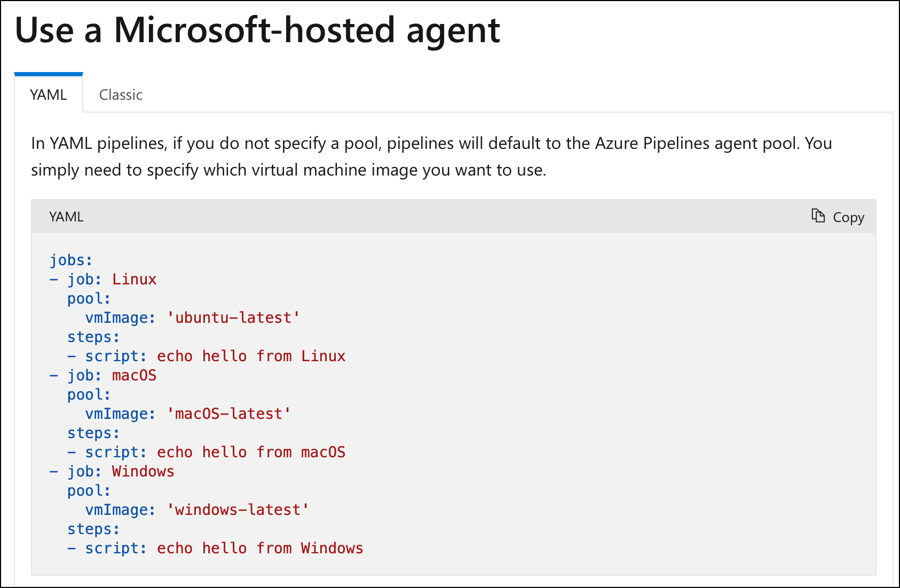
Hosted Agents
https://docs.microsoft.com/en-us/ azure/devops/pipelines/agents/hosted

Slide 29
Set the “pool → vmImage” value
Linux
‘ubuntu-latest’
MacOS
‘macOS-latest’
Windows
‘windows-latest’
Hosted Agent Types

Slide 30
Agents that you install & maintain
Set the “pool → name” value
Self-hosted Agents

Slide 31
Can be defined at
Pipeline level (root, global)
Stage level
Job level
Variables

Slide 32
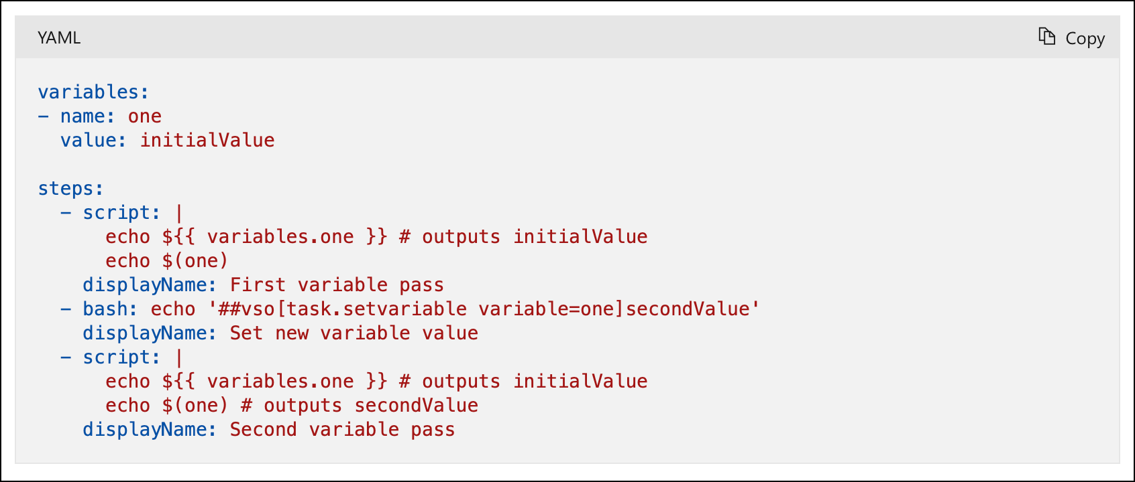
Variables
https://docs.microsoft.com/en-us/ azure/devops/pipelines/process/variables

Slide 33
Use a Docker container in the pipeline
SQL Server container
Deploy EF Core migrations
Run integration tests

Slide 34
Multiple stages in a pipeline
Part 1 of 3
Separate build from deploy

Slide 35
Multiple stages in a pipeline
Part 2 of 3
Use Marketplace Extensions in a pipeline
Server-side pipeline variables
Configure database connection strings
Deploy EF Core migrations

Slide 36
Multiple stages in a pipeline
Part 3 of 3
Deploy to an Azure App Service
Deploy to a Deployment Slot
Set up a service connection
From: Azure DevOps
To: Azure Subscription

Slide 37
Review what’s in ‘test’ before deploying to ‘production’
Approvals between stages
Manual Validation Step
Server-side step
Pauses execution
Accept or reject

Slide 38
Run a YAML-based pipeline using a self-hosted agent
Self-hosted agent setup demo is in the previous module
YAML conditions

Slide 39
YAML-based Pipelines
Goal: Build, Test, and Deploy with YAML Pipelines
Pools, Triggers, and Variables
Use Docker Containers in Pipelines
SQL Server
Deploy database changes
EF Core Migrations
Multi-environment Deploys
Multi-environment Approvals
Summary

Slide 40
Any questions?

Slide 41
Thank you.
www.benday.com | benday@benday.com

