Slide 1
Words for Leaders
Benjamin Day
www.benday.com
@benday

Slide 2
Benjamin Day
Brookline, MA
Consultant & Trainer
Rental Chief Technology Officer
Therapist for Teams
Scrum, DevOps, Azure, Team Foundation Server, Software Architecture & Testing
Microsoft MVP
Pluralsight Author
Scrum.org Trainer
@benday

Slide 3
Azure DevOps Services Fundamentals Azure DevOps Server 2020 Fundamentals Scrum Master Skills

Slide 4
On with the show.

Slide 5
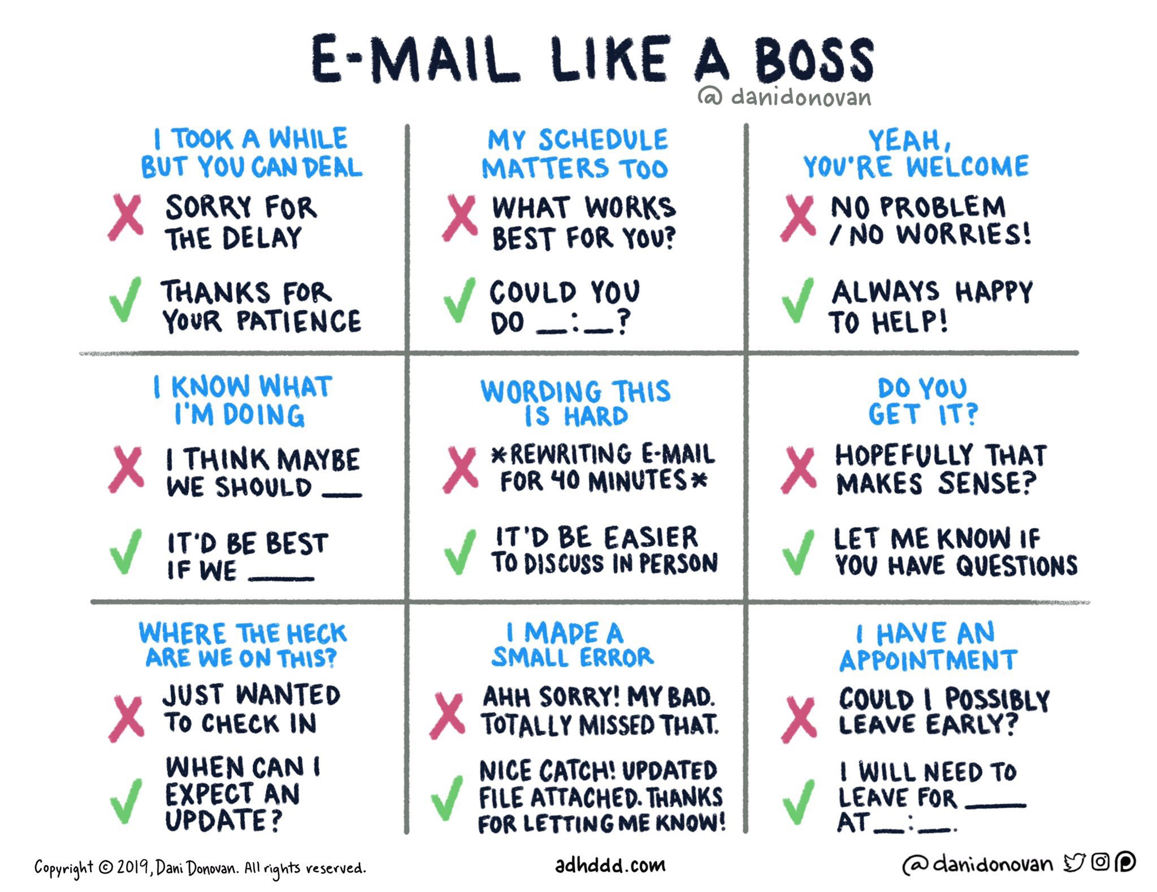

Slide 6
Words matter.

Slide 7
What you say matters.

Slide 8
How you say what you say makes a HUGE difference

Slide 9
Words matter.

Slide 10
The words you choose matter even more.

Slide 11
My Goal: Help you improve how you communicate and lead

Slide 12
The big trick as a leader is convincing people to follow you and trust you.

Slide 13
Words matter. Phrases matter.

Slide 14
Everyone wants to do a good job
Everyone wants to improve
Might not just be personal improvement
Team, Department, Division, Org, etc
Assumptions

Slide 15
Frames, Motion, and Blame
Less blame. More Frame. Pick better words.

Slide 16
”How’s the release coming? Are we on time?”
Answer version 1:
“We’re mostly on time except for a few items.”
Answer version 2:
“We have 5 features ready now. 3 more are in progress.”
Status Question

Slide 17
Team: “here’s feature XYZ. What do you think?”
Boss: “it’s mostly there by I don’t like the button being green. It needs to be orange.”
(the requirements didn’t specify and no one ever mentioned it)
Answer v1:
“Ok. We missed the orange requirement. We won’t deploy it. We’ll rework it in the next sprint.”
Answer v2:
“Oh! Good feedback. Sure. We’ll create a new requirement for that color change and put it on the backlog. In the meantime, let’s launch the feature as is.”
Getting feedback from a stakeholder on a feature

Slide 18
The differences are subtle.

Slide 19
Linguistic Frames

Slide 20
On the count of 3…

Slide 21
Don’t think of an elephant.

Slide 22
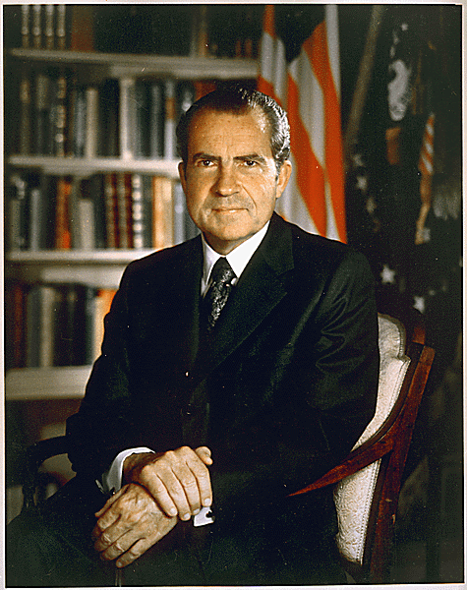
“I’m not a crook.”
Richard M. Nixon November 17, 1973
https://www.nixonfoundation.org/artifact/official-presidential-portrait/

Slide 23
Linguistic Frames

Slide 24
“Frames are mental structures that shape the way we see the world. … You can't see or hear frames. They are part of what...cognitive scientists call the 'cognitive unconscious’.”
George Lakoff,
“The ALL NEW Don't Think of an Elephant!”

Slide 25
Know what you believe
Know why you believe it
What is the goal?
Know those things and the words will follow
Be hazy on those things and the words will be hazy, too
Choose words with forward motion
Choose words that state what you believe
Use Frames to Improve Your Communication & Leadership

Slide 26
“Please hold. Your call is very important to us.”

Slide 27
“We’re currently experiencing unusually high call volume.”
Guess what. Don’t care. Just answer my call.

Slide 28
“Your call and your business is very important to us. We’ll be with you shortly.”

Slide 29
You’re probably not happy with ANY of these.

Slide 30
“Please hold. Your call is very important to us.”
Give a command
”you just sit there and wait”
THEN!
“oh and btw, your call is important”
(yeah sure it is)

Slide 31
“Your call and your business is very important to us. We’ll be with you shortly.”
Lead with your primary message
“hey…thanks for being a customer”
Second message…
“we’ll be with you shortly”

Slide 32
Ok version:
“Scrum helps teams to be productive.”
What do you believe?
What’s the goal?
Better version:
“Scrum helps organizations to clarify their priorities and helps teams to focus on delivering done, working software.”
Belief: only delivered software is valuable
Goal: deliver done, working software
Example: “Why are we doing Scrum?”

Slide 33
Choose words with forward motion
Say what you believe first
Don’t unnecessarily accept blame
Acknowledge then move to fix
Tips

Slide 34
”How’s the release coming? Are we on time?”
Answer version 1: “We’re mostly on time except for a few items.”
Wobbly answer
Points out there’s a loss
Not much motion
Answer version 2: “We have 5 features ready now. 3 more are in progress.”
Points out a gain
Says what you’re already getting
Says what is moving towards ‘done’
Status Question

Slide 35
Team: “here’s feature XYZ. What do you think?”
Boss: “it’s mostly there by I don’t like the button being green. It needs to be orange.”
(the requirements don’t specify)
Answer v1: “Ok. We missed the orange requirement. We won’t deploy it. We’ll rework it in the next sprint.”
Assumes blame unnecessarily
No motion. Has an actual ‘stop’
“we’ll go back and rework it”
Answer v2: “Oh! Good feedback. Sure. We’ll create a new requirement for that color change and put it on the backlog. In the meantime, let’s launch the feature as is.”
Starts with “thank you”
Says “yes”
Has motion – create requirement, put it on the backlog
Has motion – suggests launching as it
Doesn’t try to assume or assign blame
Getting feedback from a stakeholder on a feature

Slide 36
** IT’S NEVER ‘REWORK’ **
You didn’t miss the requirement
I don’t care if the requirement was hazy
It’s not a bug
It’s always a new requirement
Product Backlog Item, User Story, etc
Prioritize that new requirement against all existing requirements
Don’t assume that this new work gets prioritized ahead of everything else
Tip for “rework” on features

Slide 37
Assigning blame is useless
The problem already happened
Who cares who’s fault it was?
Let’s fix it
Let’s make sure it doesn’t happen again
Sprint retrospective meetings?
If something goes wrong…

Slide 38
Predicting the future
Where’s my stuff? When will I get it?

Slide 39
“Where’s my stuff?”

Slide 40
1) When will I get Product Backlog Item X?

Slide 41
2) How much done stuff will I have by Y date?

Slide 42
Product Backlog Forecasting
Name | Size
Update payment system to convert USD to Bitcoin | 8
Fix layout and click problems on Safari on iPhone 6 | 3
Update payment system to support ApplePay | 5
Request PDF receipt delivered by email for past purchase | 2
Generate report to see orders by payment type | 3
Update payment system to take PayPal payments | 5
Mark transaction for fraud audit | 8
Upgrade site layout to support Internet Explorer 11 | 8
Refund in-store mobile purchase from administrator device | 5
Fix bugs related to jQuery upgrade (Defect #123, #456, #321, etc.) | 3
Fix bugs related to declined transactions using debit cards (Defect #132, #821) | 3
Book pre-paid appointment | 2
Request PDF summary of all purchases for date range | 3
Redeem gift card for in-store purchase | 2
Redeem gift card for mobile purchase | 3
Update public-facing website to use new logo and color scheme | 5
Update paid-user website to use new logo and color scheme | 3
Update Android app to use new logo and color scheme | 2
Update iOS app to use new logo and color scheme | 1
Real-time in-store purchase notification for managers on mobile admin app | 5
Request printed receipt after in-store mobile purchase | 5
Feature XYZ | 13
Feature ABC | 13
Use mobile camera to scan UPC and do a price comparison | 21
Create a lasting world peace | 21
Feature QWERTY | 21
Reporting dashboard for iOS & Android | 40
Federated Identity using external authentication providers | 40
Add membership card to Apple Wallet | 13
Use mobile camera to scan UPC for product and add to cart for in-store purchase | 8
Complete in-store mobile purchase | 8
Teach cats to do tax preparation | 80
RFID-based inventory control system | 80
Migrate application hosting to external cloud provider | 40
Talking unicorns | 120
Sprint 1
Sprint 2
Question: When does “Update Android app to use new logo and color scheme” get done?
Sprint 3
Average Velocity = 21
→ Group PBIs into groups that total to 21
Sprint 4
Sprint Length = 2 weeks
PBI probably gets done in Sprint 4
4 sprints * 2 weeks
The Forecast for that PBI: It’s done at the end of 8 weeks
? Sprint 5 ?
? Sprint 6 ?
? Sprint 7 ?
? Sprint 8 ?
? Sprint 9+ ?

Slide 43
Product Backlog Forecasting
Name | Size
Update payment system to convert USD to Bitcoin | 8
Fix layout and click problems on Safari on iPhone 6 | 3
Update payment system to support ApplePay | 5
Request PDF receipt delivered by email for past purchase | 2
Generate report to see orders by payment type | 3
Update payment system to take PayPal payments | 5
Mark transaction for fraud audit | 8
Upgrade site layout to support Internet Explorer 11 | 8
Refund in-store mobile purchase from administrator device | 5
Fix bugs related to jQuery upgrade (Defect #123, #456, #321, etc.) | 3
Fix bugs related to declined transactions using debit cards (Defect #132, #821) | 3
Book pre-paid appointment | 2
Request PDF summary of all purchases for date range | 3
Redeem gift card for in-store purchase | 2
Redeem gift card for mobile purchase | 3
Update public-facing website to use new logo and color scheme | 5
Update paid-user website to use new logo and color scheme | 3
Update Android app to use new logo and color scheme | 2
Update iOS app to use new logo and color scheme | 1
Real-time in-store purchase notification for managers on mobile admin app | 5
Request printed receipt after in-store mobile purchase | 5
Feature XYZ | 13
Feature ABC | 13
Use mobile camera to scan UPC and do a price comparison | 21
Create a lasting world peace | 21
Feature QWERTY | 21
Reporting dashboard for iOS & Android | 40
Federated Identity using external authentication providers | 40
Add membership card to Apple Wallet | 13
Use mobile camera to scan UPC for product and add to cart for in-store purchase | 8
Complete in-store mobile purchase | 8
Teach cats to do tax preparation | 80
RFID-based inventory control system | 80
Migrate application hosting to external cloud provider | 40
Talking unicorns | 120
Sprint 1
Sprint 2
Question: What can we ship at the end of 60 days?
Sprint 3
Average Velocity = 21
Sprint Length = 3 weeks (21 days)
60 days = ~ 2.85 sprints
That’s somewhere inside of Sprint 3
(Hint: There isn’t a perfect answer.)
The 60 Day Forecast:
Sprint 1 & Sprint 2 is highly likely. Probably some of Sprint 3, too.
Sprint 4
? Sprint 5 ?
? Sprint 6 ?
? Sprint 7 ?
? Sprint 8 ?
? Sprint 9+ ?

Slide 44
Reminder: Both of these ‘tricks’ require 1) a known velocity and 2) a ready product backlog.

Slide 45
New “high priority” items

Slide 46
“I’VE GOTTA HAVE THIS!!!!”
“I NEED THIS BUG FIXED!!!”
“I WANT THAT BUTTON TO BE ORANGE!!!”
Say yes
Open your backlog
”Here’s our current priority.”
“What do you think we should bump?”
Enlist them in solving the problem
Don’t assume it’s your problem alone to solve
New, high-priority requirement?

Slide 47
Lessons from Music
Tell people what to do. Not what NOT to do.

Slide 48
It’s easy to say what NOT to do.

Slide 49
“Well, I told you not to do that.”

Slide 50
Lesson from music

Slide 51
Piano Fingerings

Slide 52
”Let’s try to play this.”

Slide 53
“Ok. Here goes…”

Slide 54
“Yeah. That sucked. Don’t do that.”
Yeah I know. Now what?!?!?

Slide 55
There are plenty of sub-optimal teachers.

Slide 56
”Don’t do that.” Not especially useful feedback.

Slide 57
“Try this instead.”

Slide 58
“Think about where you need to be to get your fingers in position for the next phrase.”

Slide 59
ACTIONABLE FEEDBACK: ”Think about where you need your fingers to be for the next phrase.”

Slide 60
You can always pull an “I told you so”
Suggesting something…
…requires actually HAVING an idea
…riskier
…requires courage
Courage to be wrong
Courage to be embarrassed
Courage to have an opinion
It’s easy to say what NOT to do.

Slide 61
“Don’t be nervous”
“Don’t worry”
“Don’t flip out”
”Don’t get upset”
“Don’t whine”
“Don’t cry”
“Don’t be so sensitive”
“Don’t take it personally”
Phrases that never work.

Slide 62
“There’s no need to X because…”
“It’s understandable that you might be feeling Y…”
Acknowledge the emotion…
…then work on disarming the situation
Remember: it’s not always about solving the problem. Sometimes it’s just listening
Phrases that sometimes work work better

Slide 63
Talk about what you want people to do rather than what you don’t want people to do.

Slide 64
Leading with Emotion & Empathy
People have emotions. Try to understand why they feel the way they feel.

Slide 65
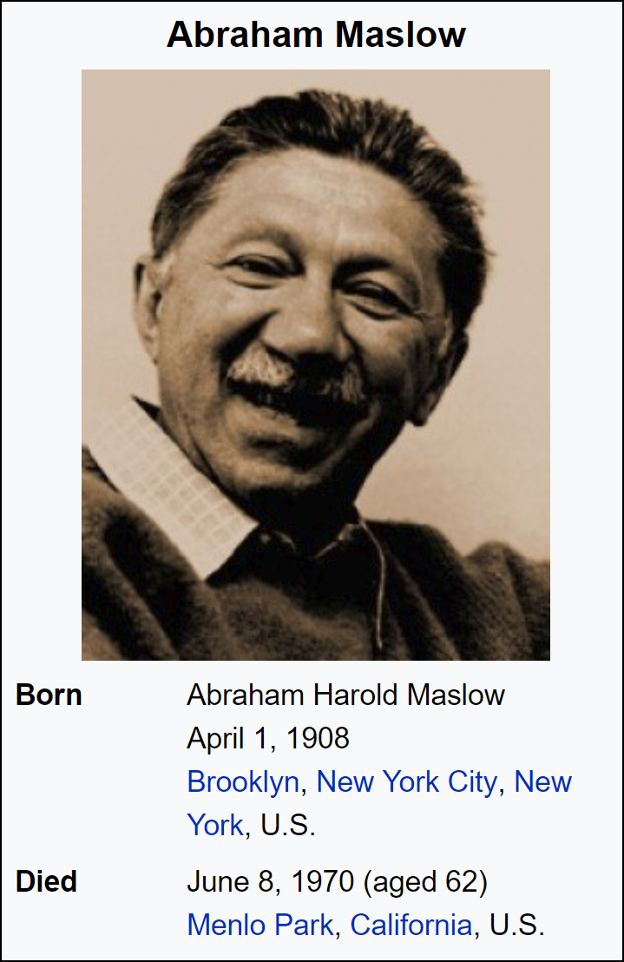
Maslow’s Hierarchy of Needs
Self- actualization
Esteem
Love / Belonging
Safety
Physiological
Become all you can be
Recognition, Status, Respect
Friendships, Family, Intimacy
Security (Personal, Financial), Health
Food, Water, Air, Sleep, Shelter, etc.
https://en.wikipedia.org/wiki/Maslow%27s_hierarchy_of_needs

Slide 66
Maslow’s Hierarchy of Needs
Lack of this correlates with loneliness, depression, and anxiety
Self- actualization
Esteem
Love / Belonging
Safety
Physiological
Room to grow & be awesome
Become all you can be
Recognition for the work / achievements
Recognition, Status, Respect
“I want to feel like I’m part of the team.”
Friendships, Family, Intimacy
“I need this job.”
Security (Personal, Financial), Health
Food, Water, Air, Sleep, Shelter, etc.
https://en.wikipedia.org/wiki/Maslow%27s_hierarchy_of_needs

Slide 67
People want to have their needs met
They want to feel valued
When they ask for something or say something…
…try to take a moment to acknowledge it
You’re being kind
(people tend to like that kind of thing)
Tip: People want to know you heard them

Slide 68
Humans fixate on loss
What am I going to lose?
When communicating, try to lead with with they’ll gain
If you can, avoid talking about the loss altogether
If you must talk about loss, talk about the gain *FIRST*
Tip: Avoid words about loss

Slide 69
Humans generally hate change
“but I like to push my boundaries”
Horsepucky!!
Yeah right…for the boundaries that aren’t important to you
Let’s try changing something that you don’t want changed and we’ll check back in
In times of change…
Acknowledge that change stinks
Acknowledge that change is scary
Emphasize what will stay the same
Emphasize what you’ll gain
Emphasize what will improve
Tip: Fear of change

Slide 70
Uncertainty & Loss
Fear.

Slide 71
Humans have a fear of loss.

Slide 72
If they’re going to get 98% ‘awesome’, they’ll tend to focus on the 2% ‘non-awesome’.

Slide 73
Software is not a ‘sure thing.’

Slide 74
When things get iffy
For example, a project is in trouble
Managers want to manage
Fear: needs are not going to be met
Fear: they’ll lose their job, bonus, etc
Typical & natural reaction is to
Have more meetings
Try to get better requirements
Try to get better estimates
Try to wring out uncertainty
Watch out for “better estimates”

Slide 75
Software always gets more complex once you start.

Slide 76
How do you walk your bosses, customers, and stakeholders through uncertainty?

Slide 77
Start saying ‘forecast’.

Slide 78
Be transparent
Change is going to happen
Complexities and setbacks will arise
Beware of the temptation to look for more accurate estimates!
Talk about your current forecast
Leading through uncertainty in IT

Slide 79
Making your teams spend extra time on ‘more accurate planning’ is usually wasteful.

Slide 80
“Forecast” vs “commitment”
No such thing as a “weather committer”
“Forecast” has the linguistic frame of uncertainty baked in
“When are we going to get our stuff?”

Slide 81
Define what ‘done’ means
*EVERYTHING* it takes to call a feature done
Make sure your backlog is up to date
Do less stuff at one time
Pick top priority thing
Drive it to done
Focus on done
Try to deliver more often
Tips for ’wobbly’ projects

Slide 82
Fear: they aren’t going to get their stuff
(They also might think your team is bad)
Focus on done
Deliver more often
Train them that done software gets delivered every sprint
”We’ll deliver done features and fixes every 2 weeks.”
Talk about priorities
“We have more work than we can easily achieve so we have to break it up.”
“We work on top priority things first and work our way down”
“Talk to the product owner about priorities”
There’s another train coming in 2 weeks
“If it doesn’t get done this sprint, it’ll come in the next sprint”
Tips for nervous stakeholders

Slide 83
Focus on ‘Done Software’.

Slide 84
“We’re going to get done software more often.”

Slide 85
Change is a feature not a bug.

Slide 86
It’s a chance to adapt. You get ‘done’ software and if you don’t like it, you can change it.

Slide 87
Positive frame: Delivering business value through done, working software.

Slide 88
Prioritization
Setting your teams up to succeed

Slide 89
You have a priority in your head. Share that vision.

Slide 90
It’s easy to say that everything is a top priority. “Just get it done.”

Slide 91
Everything has a priority.
Everything might be “on fire”…
…but there is a priority
This is a lack of courage to make a decision about priority.
“Just get it all done” is a failure of leadership.
“Everything is a top priority.”

Slide 92
Your people need known, transparent priorities in order to be successful. (This is the ‘secret sauce’ for being a great Scrum Product Owner, btw.)

Slide 93
Priorities say what you’re going to do.

Slide 94
Talk about what is important…
…to you
…to the business
…to your organization
Why is xyz a priority?
Why do you think that xyz is a priority?
Talking priorities with your team

Slide 95
What does the business need?
What is the business trying to do?
How do your priorities align with those goals?
How do the features you’re asking for align to those priorities?
If everything explodes, what do we do first?
Know your corporate goals → priorities

Slide 96
Find out if you’re wrong
Ask them to poke holes in your plans
“What am I missing?”
“How will we know if we’re succeeding?”
“How will we know if we’re failing?”
Ask people about your priorities.

Slide 97
A project is going off the rails…
What do you do?

Slide 98
Turn a troubled project around.

Slide 99
Temptation to hide
Temptation to avoid transparency
Talk about what you’re going to do
Forward motion
Communication when things aren’t going well

Slide 100
Create a written Definition of Done
Do less work
Minimize work in progress
Do less at once
Hold your team to account for delivery
DO NOT hold individuals to account
Measure how much the team can achieve in a given period of time
Velocity
Things to try when you need to turn around a troubled project

Slide 101
Include QA testers to your Sprint Planning meetings
Start writing unit tests
Minimize integration and deployment distractions
Create automated builds
Create automated releases
Azure DevOps? GitHub Actions?
Things to try when you need to turn around a troubled project

Slide 102
Focus on
what the teams have achieved
risks that have been addressed
Talk about
what you need to be successful
new problems you’ve discovered
DO NOT dwell on what didn’t happen
Let your stakeholders know…
…that you’re ACTUALLY working on stuff
…that you’re competent and you care
…that your job is HARD
Give status updates

Slide 103
Positive frame:
“In this sprint, the team delivered 3 product backlog items to done.”
Negative frame:
“The team mostly got everything done that we wanted except for 2 PBIs.”
If you use the negative frame, the stakeholders will focus on what they DIDN’T get
Give status updates

Slide 104
Only show PBIs that made it to Definition of Done (DoD)
Partially done? Don’t show it.
Distracting
Confusing to stakeholders
Tips for Sprint Review meetings

Slide 105
Gather feedback from stakeholders
Feedback on the state of the product
Including what got to done in this sprint
Feedback on the product backlog
Feedback on where the product is going
Remember the purpose of the Sprint Review!!

Slide 106
People are going to ask for dates
If your project is in trouble, it’s hard to provide dates
If you keep providing dates and they keep being wrong…
…Avoid providing any more dates
Especially when things are not in your control!
Dependency on another team?
Don’t make promises that you can’t keep
Focus on delivering done work instead
Tip:
Avoid providing dates

Slide 107
Trust
…and what do you do when you don’t trust your teams?

Slide 108
Managers tend to “clamp down”
Command & Control
Heavier process
You tend to measure their failure rather than assisting their success
Time wasted assigning blame
You’re afraid your not going to get your “needs” met
When you don’t trust your teams…

Slide 109
How to use Agile
Wrong Way
Right Way
Find out how much my team sucks
Measuring how much they disappoint you
Help them to not suck
Help them to be transparent about status/progress
Help them (and you) to get clarity on what “done” means
Focus on doing the right things

Slide 110
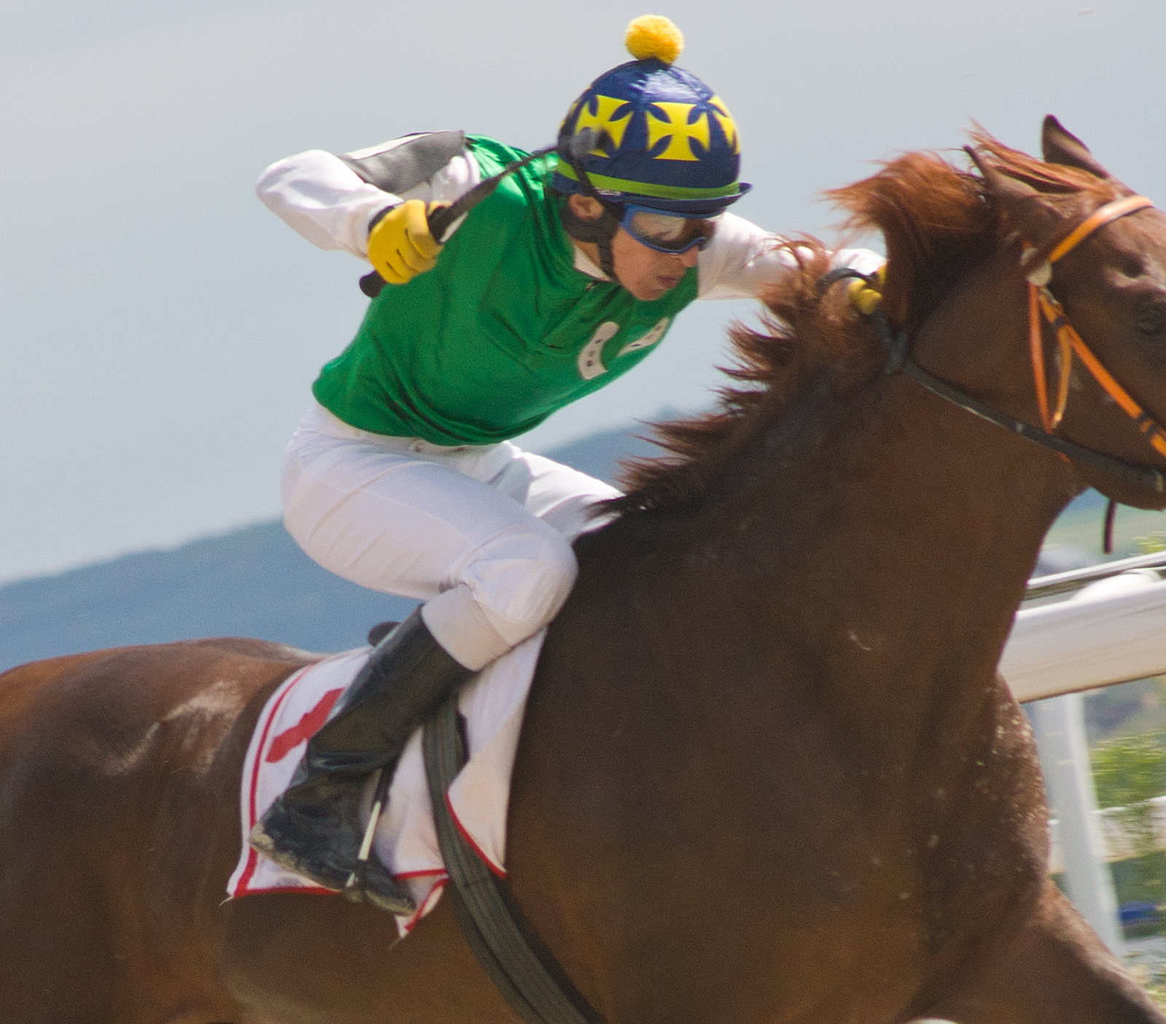
You are not there to drive the team.
Notes:
https://www.istockphoto.com/photo/horse-racing-gm176716567-26328683

Slide 111
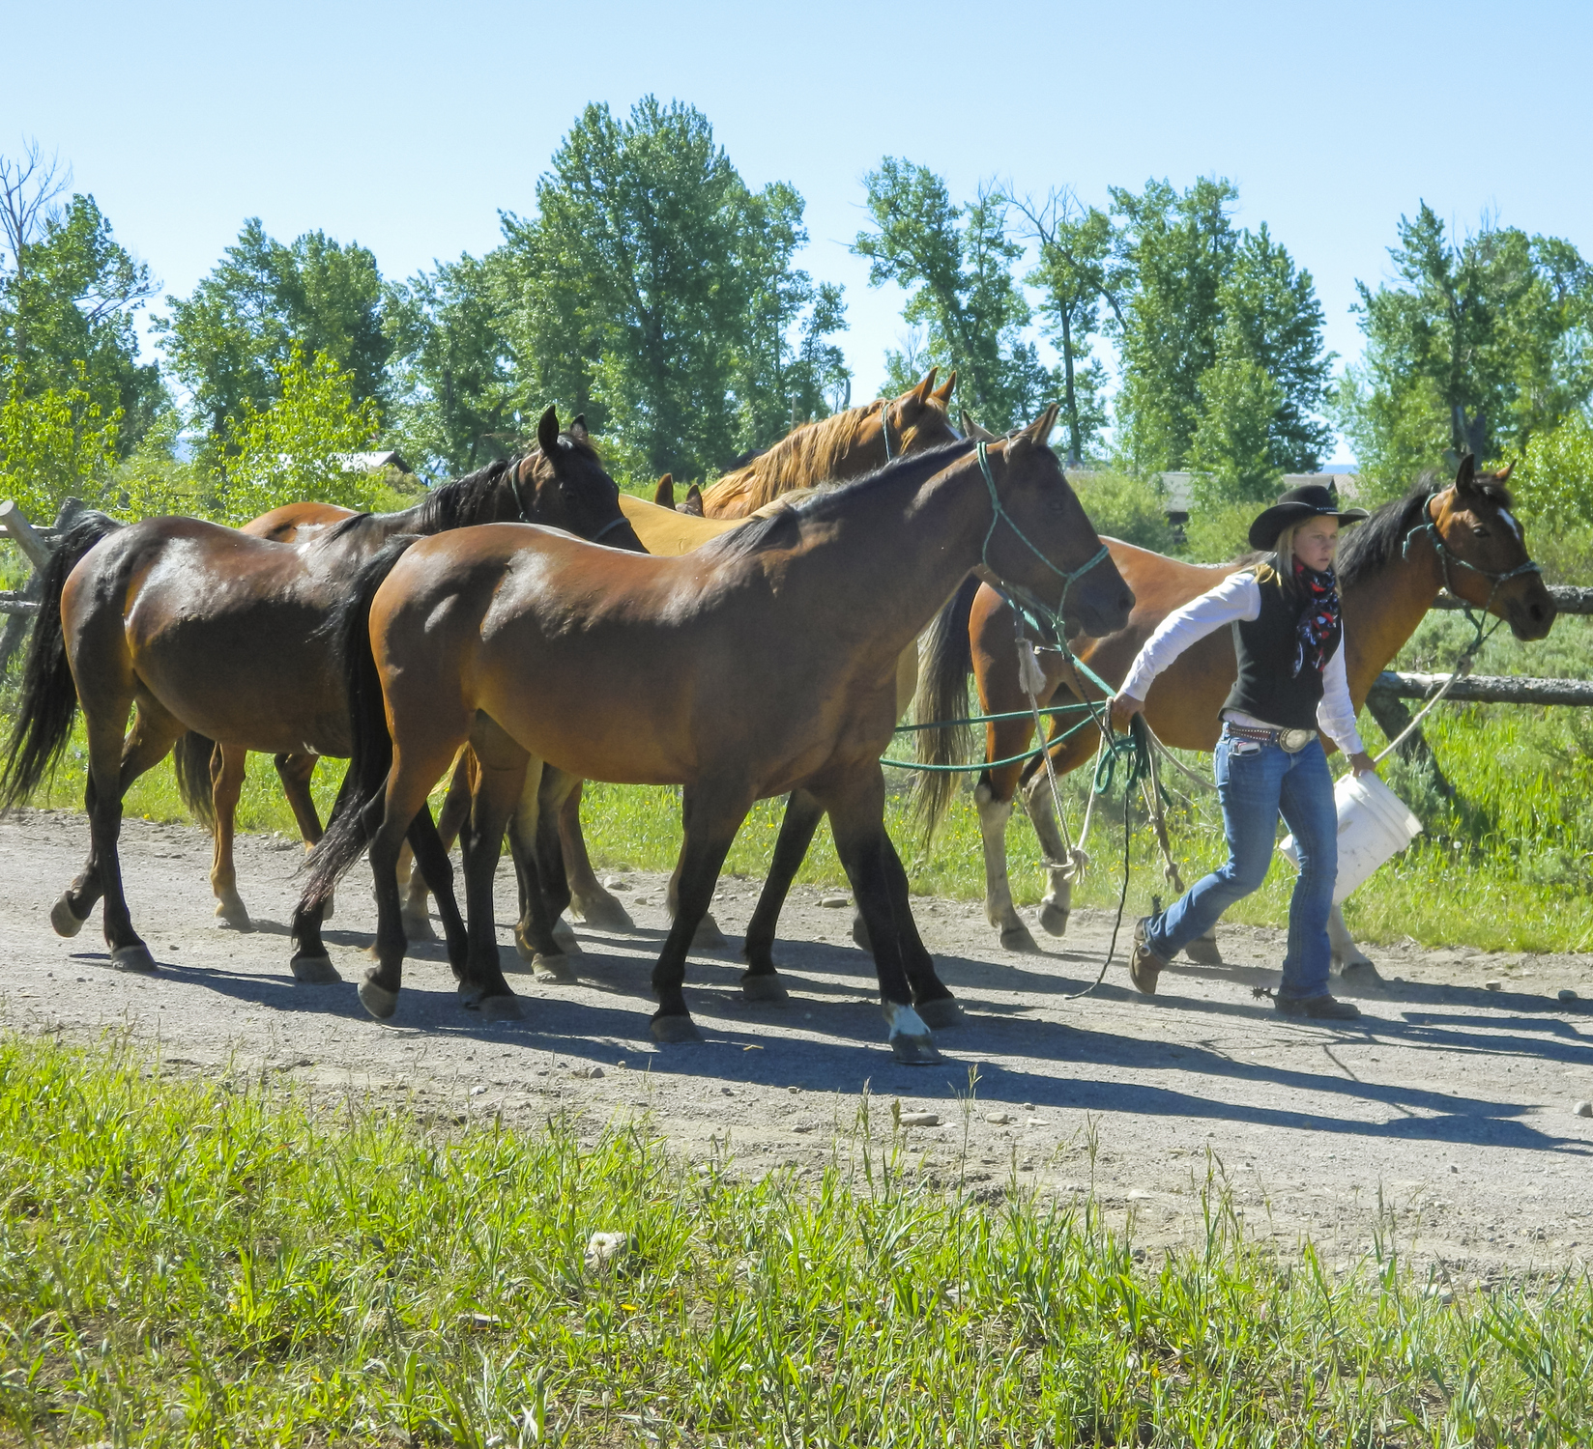
Think of it as leading them towards success.
Notes:
https://www.istockphoto.com/photo/young-woman-ranch-hand-leading-group-of-horses-on-path-gm635725572-112365253

Slide 112
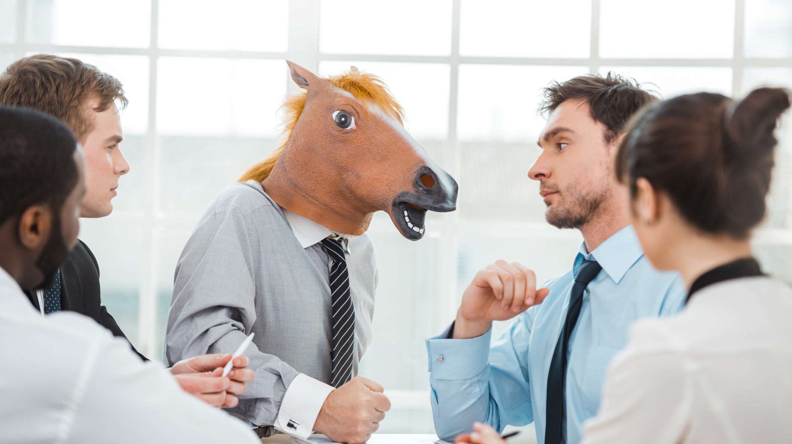
Notes:
https://www.istockphoto.com/photo/funny-concept-for-teamwork-and-knowledge-transfer-gm505598410-83751915

Slide 113
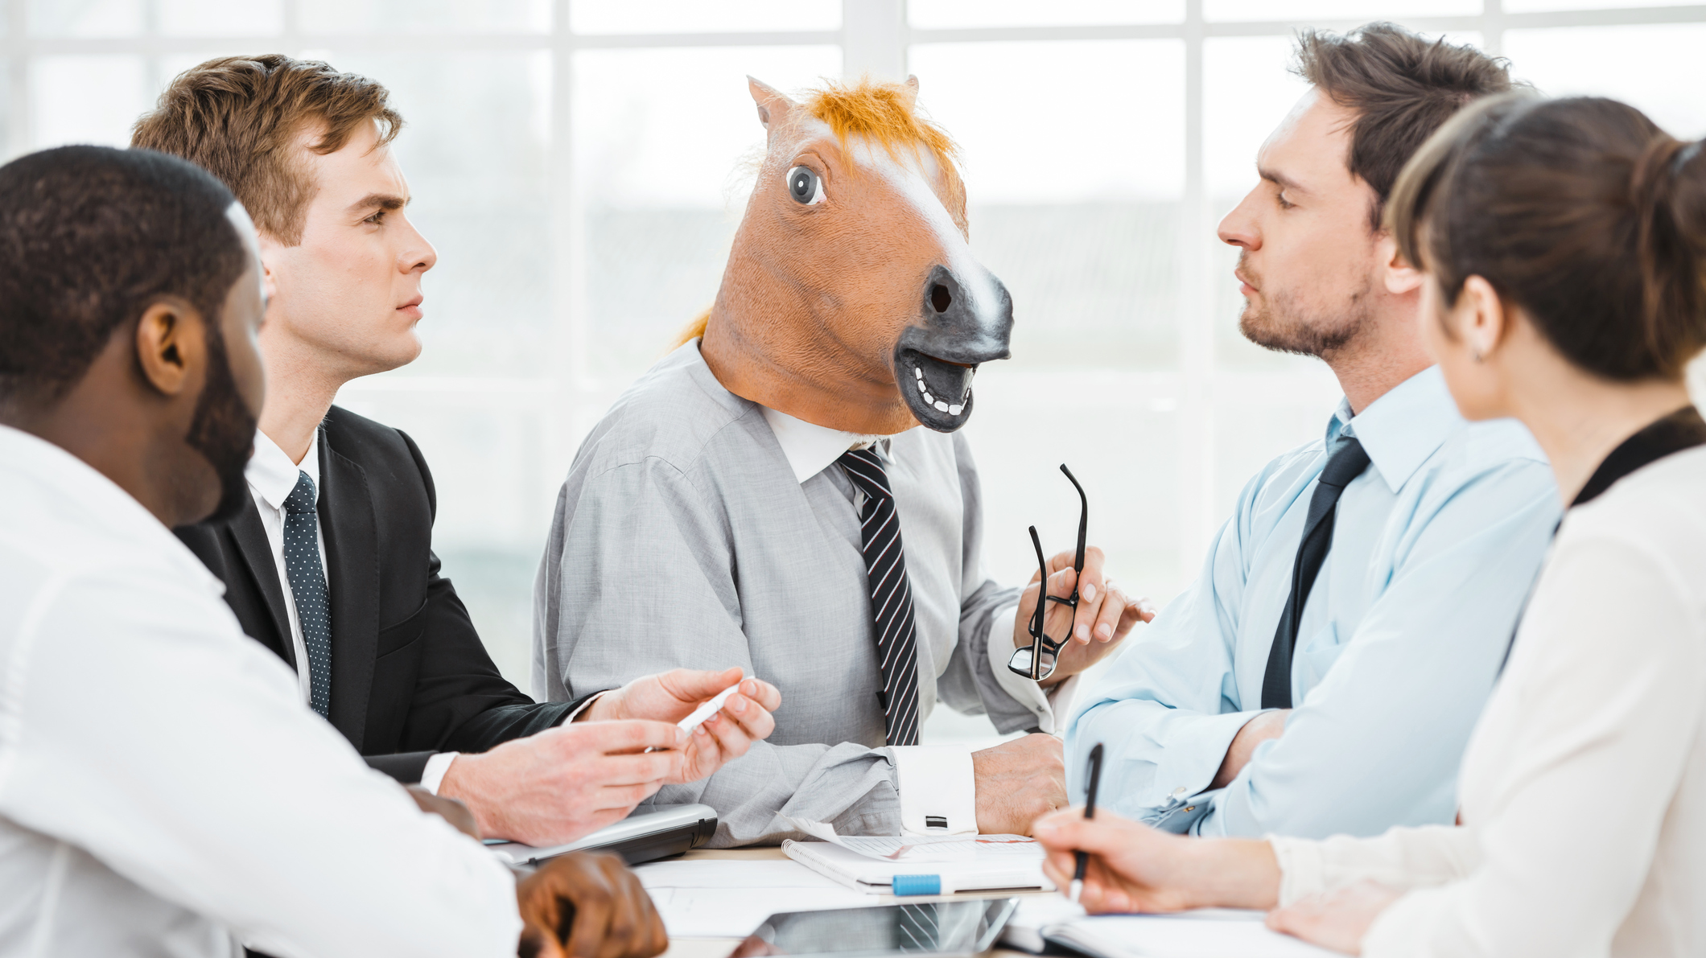
Notes:
https://www.istockphoto.com/photo/funny-concept-for-teamwork-and-knowledge-transfer-gm505598340-83751825

Slide 114
Any last questions?

Slide 115
Thank you.
www.benday.com | benday@benday.com

Slide 116
What’s Leadership?
Strategic Direction
Inspire Teams / Org
Make Sure Stuff Works Smoothly

Slide 117
Large organization:
You set the direction
You probably don’t do any of the work
Lots of delegation to employees
Small team:
Difference between “direction” and “implementation” is minimal
Probably delegating to teammates rather than employees
Large org: Inspire
Small team: “Just do it”
Leadership is about scaling.

Slide 118
I struggle with ‘hero dysfunction’.
→ http://www.pluralsight.com/courses/scrum-master-skills

Slide 119
Too much telling. Too much doing. Not enough asking. Not enough delegation.

Slide 120
Degrees of Control & Detail
Small Team
Large Organization
Lots of control
You can micromanage if you want to
Hero-mode is an option
Frustration → “Do it my way. Oh whatever. I’ll do it myself!”
Command & control is an option
Can’t get too specific
Micromanage → Lose the big picture
Micromanage → You’re a “bottleneck”
Micromanage → is your larger strategy any good?
Have to rely on trust, self-organization, & intrinsic motivation

Slide 121
Are you a ‘leader’ or a ‘boss’?

Slide 122
“Leadership” through fear is unsustainable.

Slide 123
Fear wears off
It doesn’t scale
Stress takes a while to clear
Not good for productivity
“Get this done or you’re fired.”
Unrealistic
Not good for employee retention
Us vs. Them
You get trash talked when you leave the room
“Leadership” by Fear

Slide 124
“Don’t confuse aggression with strength.”
Peggy Noonan, Wall Street Journal

Slide 125
“If the facts are on your side, pound the facts into the table. If the law is on your side, pound the law into the table. If neither the facts nor the law are on your side, pound the table.”
Alan Dershowitz, Harvard Law School

Slide 126
If someone loses their cool, it’s usually a sign of weakness.

Slide 127
Self-organization is key to scaling
Find ways to get people to feel good about themselves and their work
Get them to WANT to do a good job
Make it ok for you to be wrong
Learn how to listen
Learn how to connect with people
Leadership by Inspiration

Slide 128
My big fear: I think I’m right and everyone knows that I’m wrong…but isn’t telling me.

Slide 129
I strive for open, honest, respectful and bi-directional communication.

Slide 130
People are skeptical. In the tech world, that’s probably well-deserved.

Slide 131
You need to try to create trust.

Slide 132
You need to make it ok to be “wrong”.

Slide 133
You need to make it ok for your teams to tell you that you are wrong.

Slide 134
Suggestion: “If we wanted to ruin this project, what would we do?”

Slide 135
Suggestion: “How will we know if we’ve failed?”

Slide 136
Suggestion: “How will we know if we’ve succeeded?”

Slide 137
I want people to want to follow me. I want people to trust me and my team.

