Slide 1
GitHub Codespaces: Seriously, You Can Develop in a Browser
Benjamin Day

Slide 2
Benjamin Day
Brookline, MA
Consultant & Trainer
Rental Chief Technology Officer
Therapist for Teams
Scrum, DevOps, Azure, Team Foundation Server, Software Architecture & Testing
Microsoft MVP
Pluralsight Author
Scrum.org Trainer
@benday

Slide 3
Azure DevOps Services Fundamentals and Azure DevOps Server 2020 Fundamentals Live on Pluralsight!

Slide 4
On with the show.

Slide 5
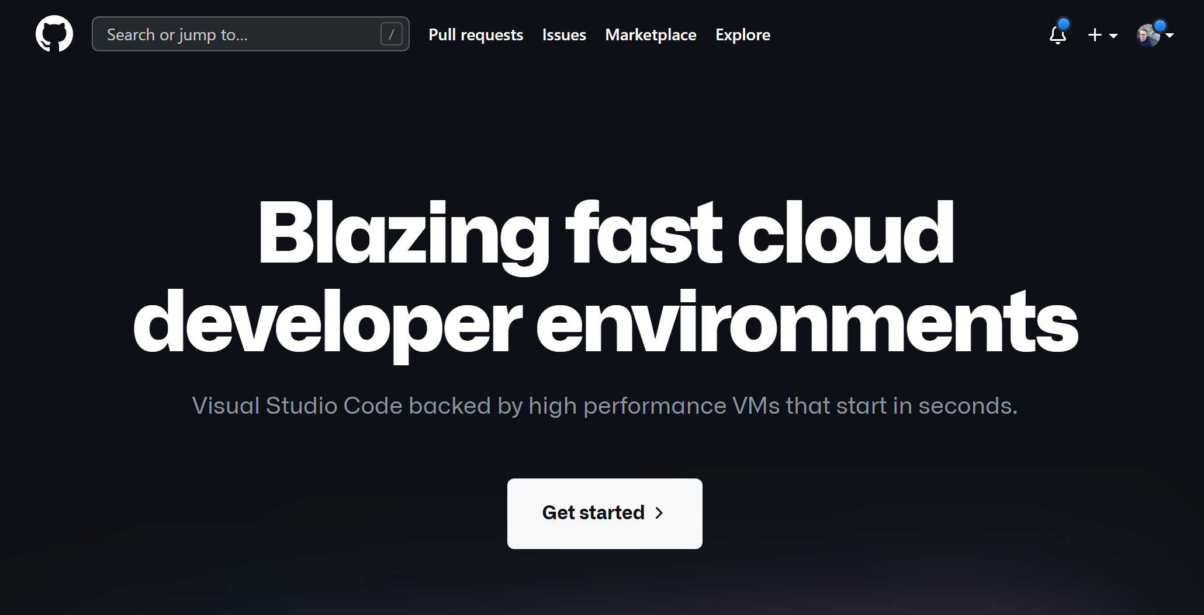

Slide 6
https://github.com/features/codespaces

Slide 7
DevOps focuses on automation and repeatability
Try to eliminate human mistakes
Try to minimize distractions
Focus on the real work
Automate deployment scripts
Put deployment scripts in version control
Use configuration-based hosting environments
Azure Resource Manager (ARM) Templates
Containers
Put those configs in version control
A few thoughts on DevOps…

Slide 8
Developer workstation setup
The “works on my box” problem
Massive hardware required for development
DevOps mostly focuses on deployment and hosting
Some big things that hurt in software development

Slide 9
Wouldn’t it be nice is your development environment could be like this, too?

Slide 10
Put the development workstation in version control
What code is required?
What tools are required?
What setup scripts need to run?
Rent your development workstation
Local machine is less important
Easy for someone to quickly be productive
Why Codespaces?

Slide 11
Container in the cloud
You connect remotely using
Visual Studio Code
Visual Studio Code on the web
Ubuntu
What is a Codespace?

Slide 12
Really nice for web apps
.NET Core / ASP.NET / Blazor
Node
Java
Run other containers
What can you do in a Codespace?

Slide 13
Must be a paid GitHub subscription
GitHub Team
GitHub Enterprise Cloud
Users need write access to the repo
Needs to be enabled
Minor Details

Slide 14
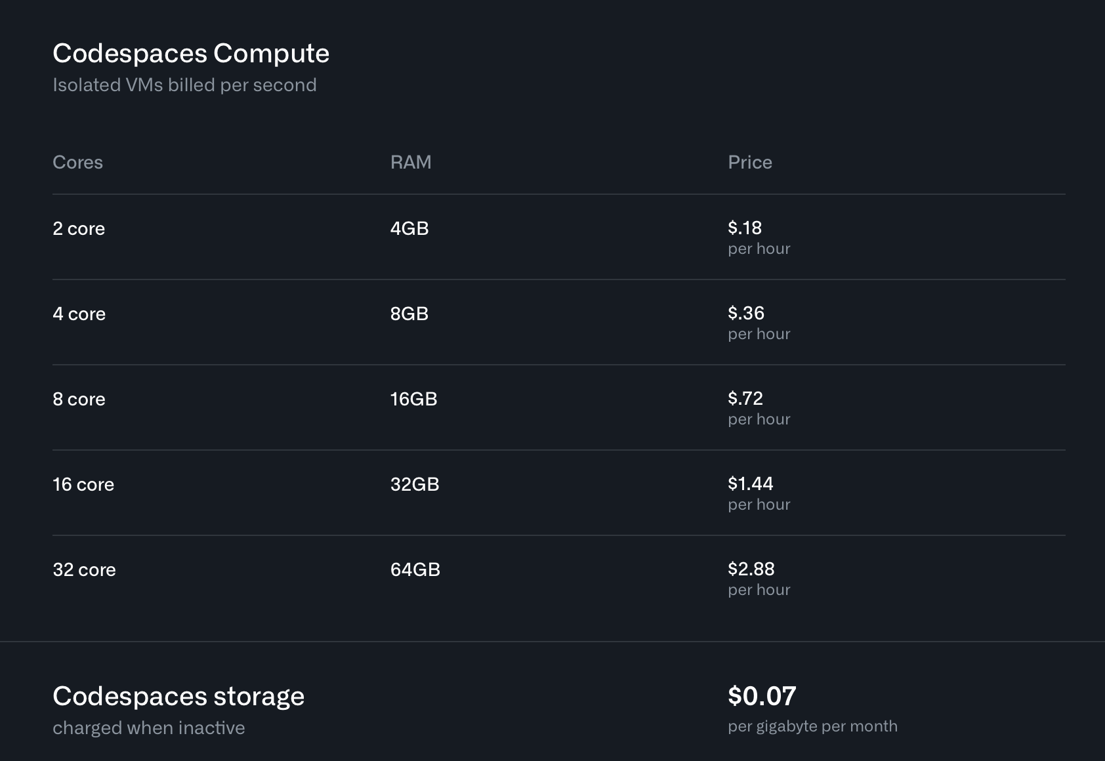
Pricing Options (3/1/2022)

Slide 15
How to enable Codespaces

Slide 16
https://docs.github.com/en/codespaces/managing-codespaces-for-your-organization/enabling-codespaces-for-your-organization
How to enable Codespaces?

Slide 17
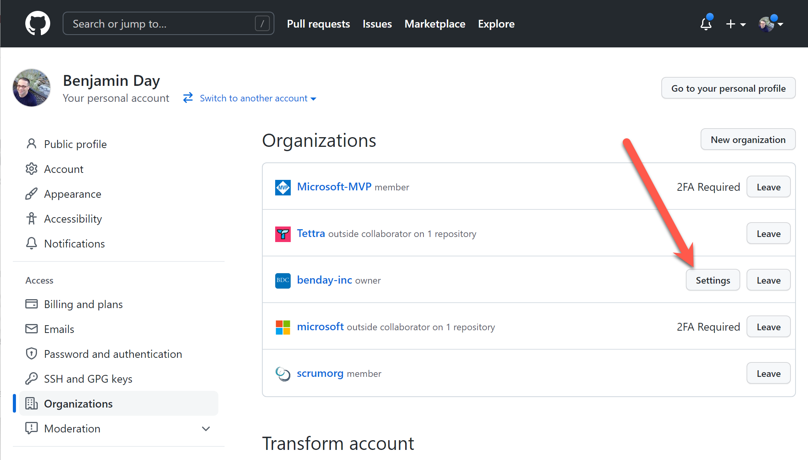
Go to Organizations, choose Settings…

Slide 18
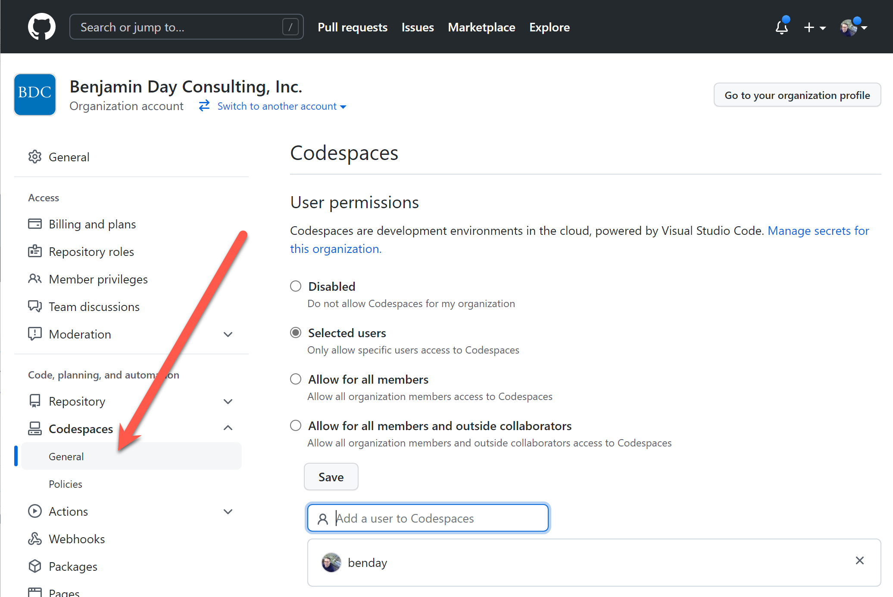
Turn on Codespaces…

Slide 19
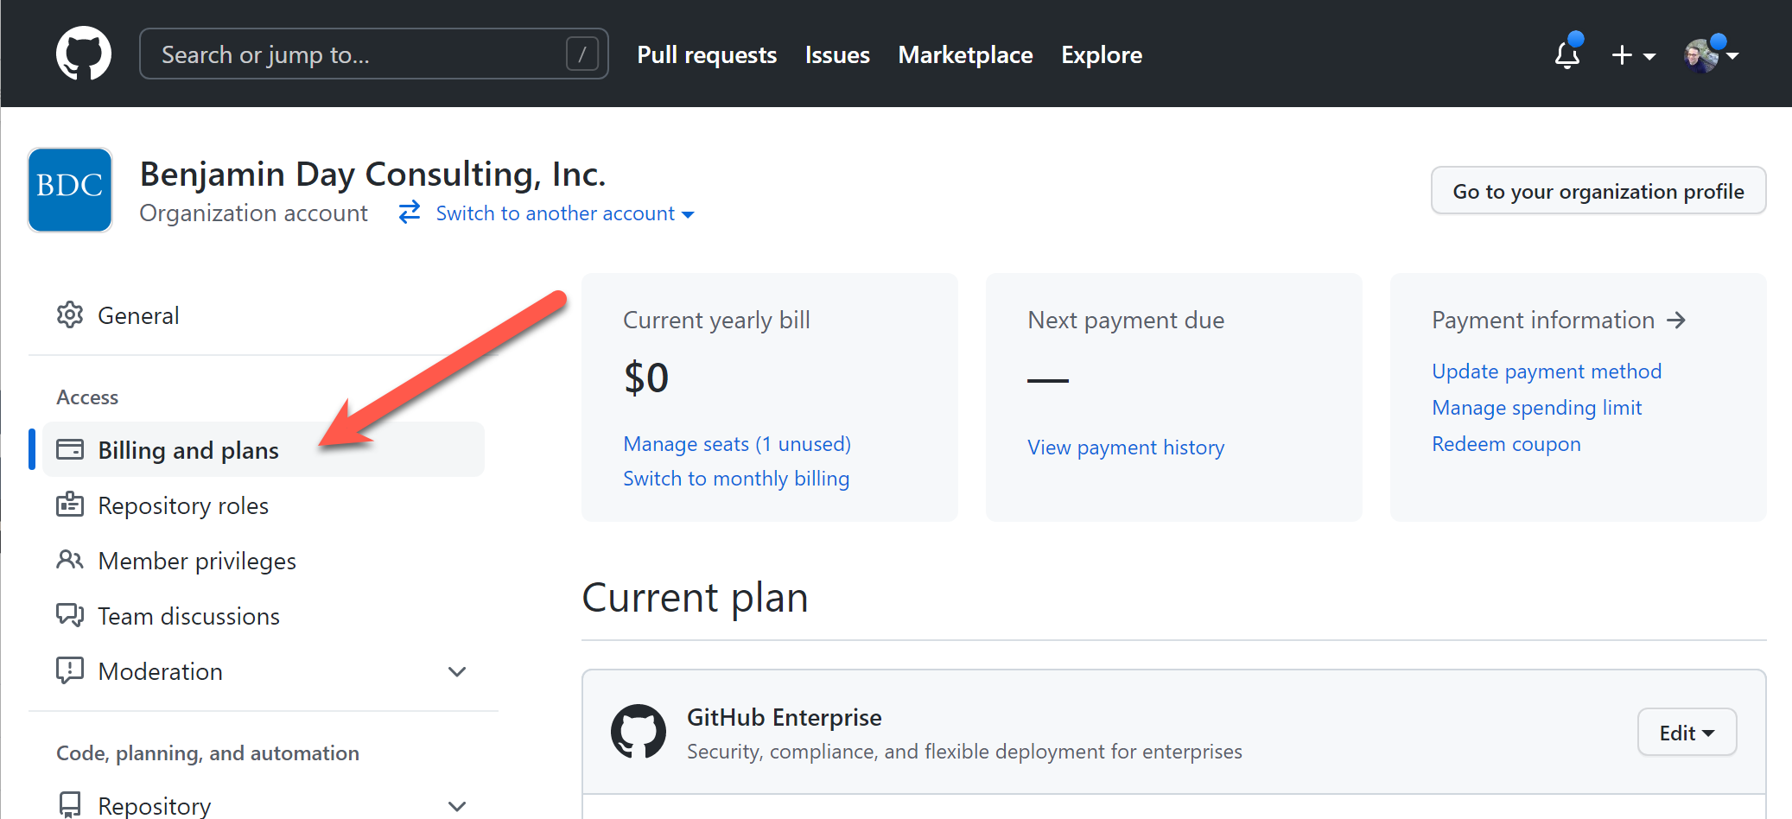
Go to Billing and plans…

Slide 20
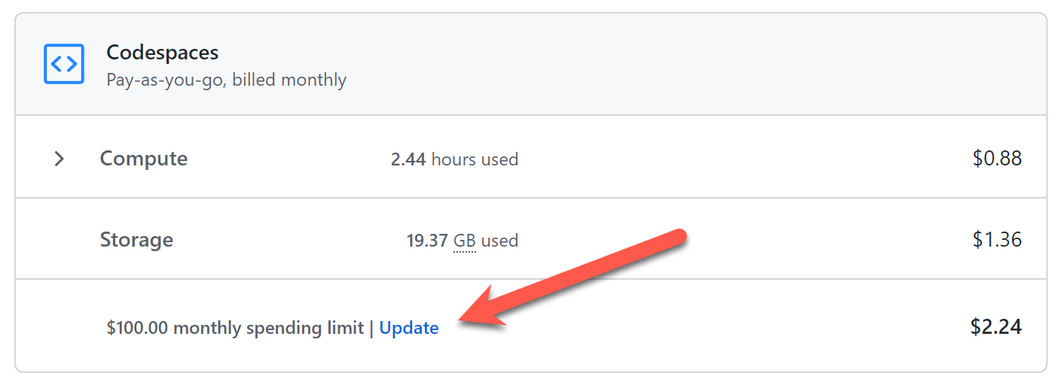
Scroll down to Codespaces, click Update…

Slide 21
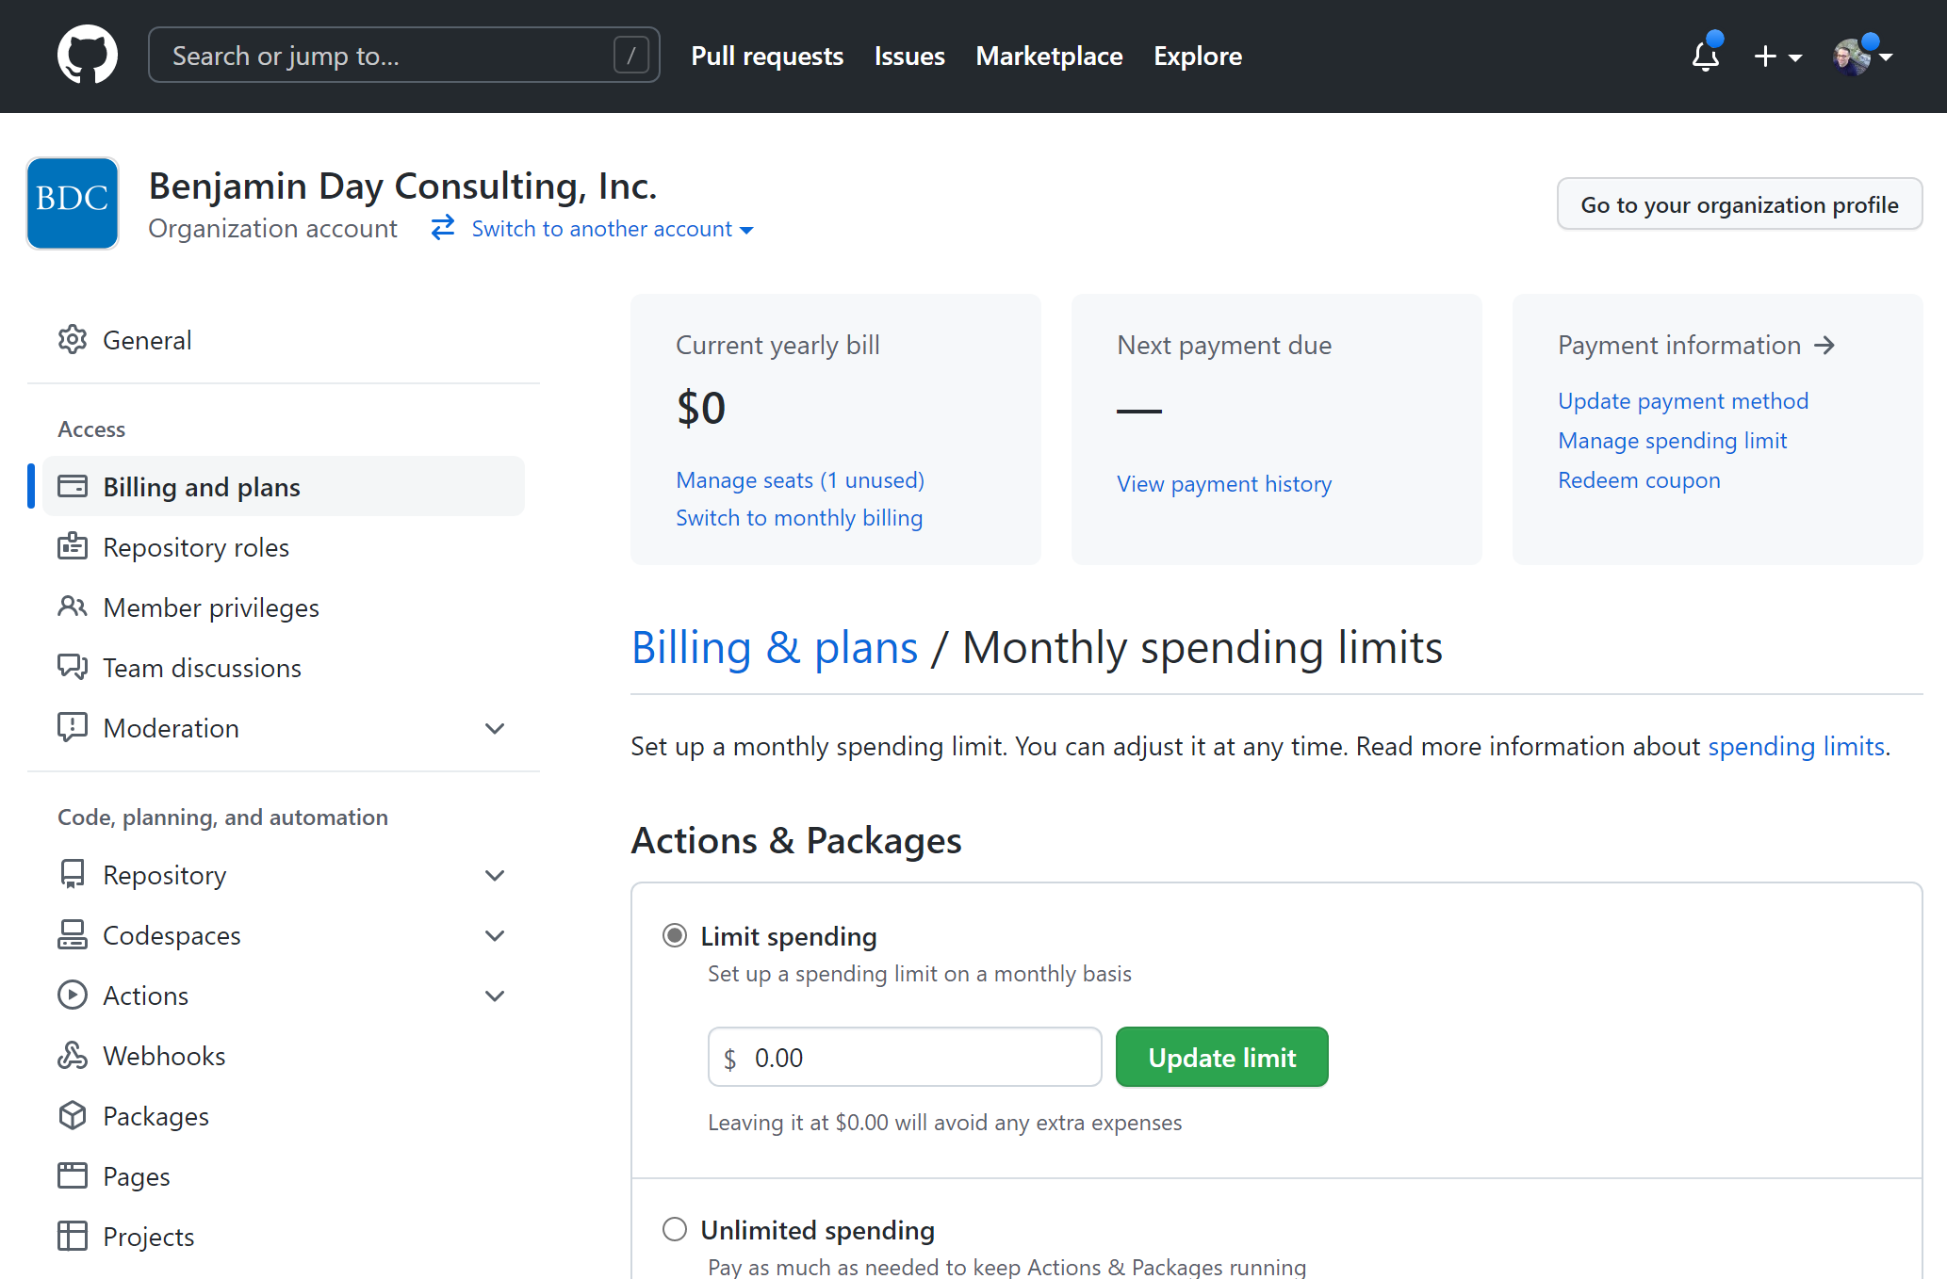
On Monthly spending limits, scroll down…

Slide 22
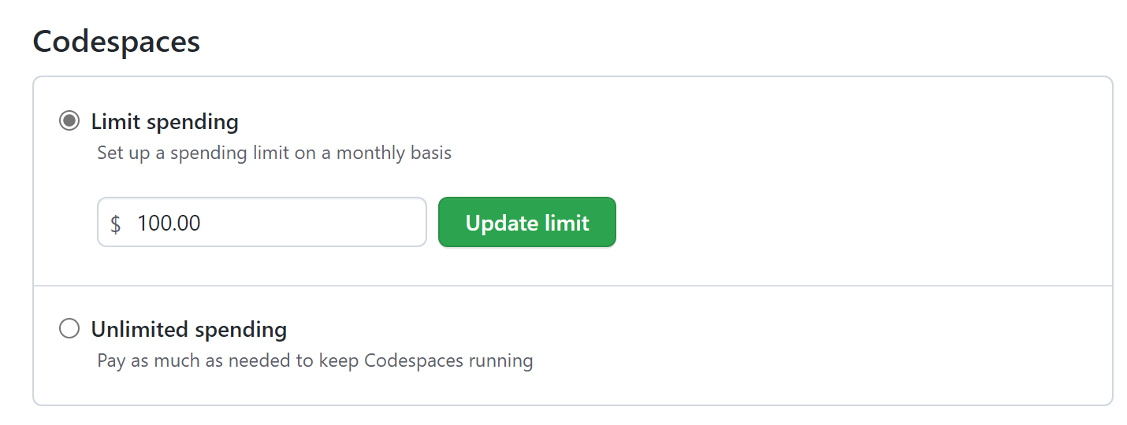
Set a Codespaces spending limit

Slide 23
Demo time.

Slide 24
Create a Codespace for a repository
Connect using the browser
Add some code
Commit to GitHub
NOTE: Settings sync “just works”

Slide 25
Continue working in the browser
Make Visual Studio Code happy
Tasks.json
Launch.json
Run the app
Map ports
Basic debugging

Slide 26
Run this in full Visual Studio Code

Slide 27
File editing using “.dev”

Slide 28
Databases in a Codespace
Pull in the SQL Server container
Create a script to run the container

Slide 29
Dig in to devcontainer.json
View the default Codespace definitions
https://github.com/microsoft/vscode-dev-containers/tree/main/containers/codespaces-linux
Customize our container to start SQL Server automatically

Slide 30
Create a Codespace for a branch

Slide 31
Use Visual Studio Code to create more complex devcontainer.json options

Slide 32
Any last questions?

Slide 33
Thank you.
www.benday.com | benday@benday.com

