Slide 1
Non-Useless Unit Testing for Entity Framework Core & ASP.NET Core
Benjamin Day @benday

Slide 2
Benjamin Day
Brookline, MA
Consultant & Trainer
Rental Chief Technology Officer
Therapist for Teams
Scrum, DevOps, Azure, Team Foundation Server, Software Architecture & Testing
Microsoft MVP
Pluralsight Author
Scrum.org Trainer
@benday

Slide 3
Getting Started with Visual Studio Team Services (VSTS)

Slide 4
Architecting an ASP.NET Core MVC Application for Unit Testability Coming soon!

Slide 5
On with the show.

Slide 6
Overview
Unit Tests vs Integration Tests
Design Patterns
Repository
Adapter
Strategy
Model-View-Controller
Entity Framework Core
ASP.NET Core MVC
Dependency Injection
Authorization

Slide 7
If you want to be successful at unit testing…

Slide 8
…you’ve got to break the problem apart.

Slide 9
Unit tests vs. Integration Tests

Slide 10
The Architecture / Design Patterns
MVC
Service Layer
Repository & Adapter
Entity Framework
Database
Strategy Pattern
Validation
Security decisions
Dependency Injection
Pull everything together
Keep it all ‘loose’

Slide 11
Databases are at the center of the coding universe.

Slide 12
Unit testing goal: Test in isolation and test without dependencies

Slide 13
Databases are the ultimate dependency.

Slide 14
The Secret: Don’t test your database

Slide 15
Code against interfaces
Code against IPerson not Person
Use dependency injection
Represent dependencies as interfaces
Pass dependencies in through the constructor of the relying class
Single Responsibility Principle (SRP)
A class should do only one thing
Unit Testing Tips

Slide 16
Databases are the ultimate dependency.

Slide 17
Hide your database behind an interface
Hide the database implementation details
Hide the database implementation details
Database Unit Testing Goals

Slide 18
Persistence = permanently stored
Persistence mechanism could be...
Relational database
NoSQL database
Document database
Web service
In-memory
File system
The “how” doesn’t matter
Think “Persistence” Not “Database”

Slide 19
Repository Pattern

Slide 20
Encapsulate persistence logic
Data access logic
Usually in the context of a single class
Need data access for a Person class?
→ IPersonRepository
SqlServerPersonRepository : IPersonRepository
CosmosDocumentDbPersonRepository : IPersonRepository
The Repository Pattern

Slide 21
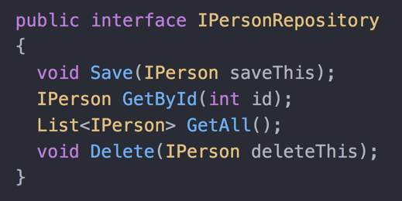
IPersonRepository

Slide 22
Next up: The Object-relational Impedance Mismatch Problem and the Adapter Pattern

Slide 23
IPersonRepository

Slide 24
The Object-relational Impedance Mismatch Problem

Slide 25
The data for an object is one thing
When stored in a database, it might be multiple things
Huge source of complexity
Complexity → Bugs
High probability of bugs → “I want to test this”
Object-relational Impedance Mismatch

Slide 26
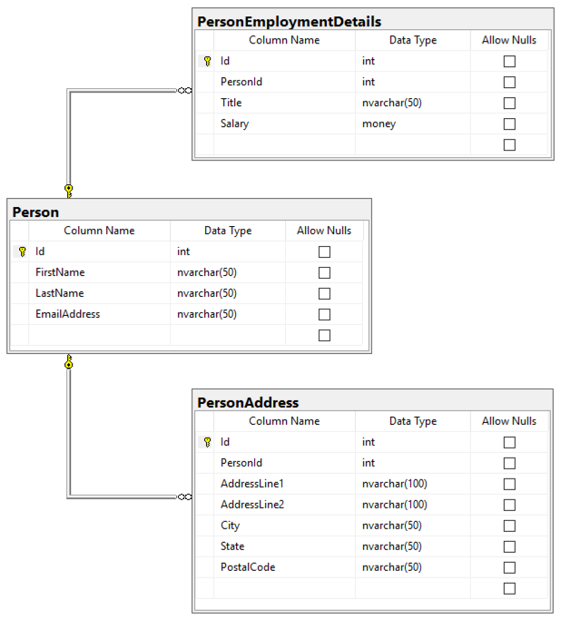
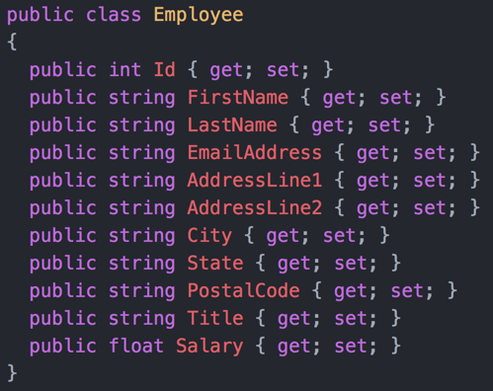
Class vs. Database

Slide 27
Class vs. Database

Slide 28
Routing all these pieces of data is a huge source of bugs.

Slide 29
Data access for Employee → EmployeeDataAccess or EmployeeRepository

Slide 30
Take the Employee object values
Generate INSERT for Person table
Run the INSERT
Get the generated Person.Id value
Generate INSERT for PersonAddress table
Generate INSERT for PersonEmploymentDetails table
Run the remaining INSERT statements
Set the generated Person.Id value back to the Employee object
SaveEmployee( Employee saveThis)

Slide 31
Generate SELECT for Person table
Generate SELECT for PersonAddress table
Generate SELECT for PersonEmploymentDetails table
Run the SELECT statements
Create an instance of Employee class
Set the values from the query results onto the Employee class
Return the Employee class
GetEmployeeById( int employeeId)

Slide 32
What’s wrong with this?

Slide 33
It violates Single Responsibility Principle (SRP).

Slide 34
“Repository Pattern = Data Access Logic Where’s the SRP violation?”

Slide 35
Two types of logic:
Data Access Logic
Make the calls to the database
Data Conversion Logic
Shape the data for the database query
Shape the results for the rest of the app
The Single Responsibility Principle Violation in a Data Access Class

Slide 36
Which has more bugs?
Data access logic works or it doesn’t
Data conversion logic has most of the bugs
Wrong value in the wrong place
Forgetting to set a value
Data Access Logic vs. Data Conversion Logic

Slide 37
Adapter Pattern

Slide 38
Logic to turn one type of data into another type of data
Adapter Pattern

Slide 39
Unit Testing and Dependency Management
Repository Pattern
Adapter Pattern
Encapsulates data access logic
Has a HUGE dependency on database
Low bug count
Converts data between objects / queries
No dependencies on the database
HUGE bug count
Hard to unit test
Low ROI for the testing effort
Easy to unit test
High ROI for the testing effort
Focus unit testing on Adapter logic
* ROI = Return on Investment

Slide 40
Goal: Break our unit testing dependency on the database

Slide 41
Best unit testing advice I ever got…

Slide 42
“Best way to avoid a fight: don’t be there.”
Pat Morita as Mr. Miyagi
Karate Kid II
1986

Slide 43
It’s really hard to write tests against a running database.

Slide 44
So don’t try to write tests against your database.

Slide 45
Mr. Miyagi’s School of Database Unit Testing
Most of your defects
Hide everything behind IRepository interfaces
Split the Repository logic from the Adapter logic
Write a lot of tests for the Adapter logic
Ignore the Repositories for unit testing

Slide 46
Next up: Unit Testing Entity Framework Core

Slide 47
Implementing Your Repositories

Slide 48
What are you going to use for data access?

Slide 49
Probably Entity Framework Core

Slide 50
Object-Relational Mapper (ORM)
ORMs try to smooth out the Object-relational Mismatch Problem
Goal: Make it easy to...
…code against classes
…do database operations with those classes
EF Core

Slide 51
Define the classes that EF Core knows about
“Entities”
Tell EF Core how to map them into database tables/columns
Or accept the defaults
Code against those classes
EF Core handles the database operations
Create, Read, Update, Delete (CRUD)
Super-fast Overview of EF Core

Slide 52
Create a DbContext for your app
MyDbContext : DbContext
Create DbSet<T> properties
One for each Entity class
DbSet<Order> Orders { get; set; }
Define relationships between Entities
Foreign keys, Collections, Inheritance
Mappings to the database are defined by…
…convention
…”fluent” mappings
…attributes on the Entities
Coding with EF Core

Slide 53
You’re probably using EF Core for data access…

Slide 54
…but there’s another option.

Slide 55
Library for doing data access
EF Core uses ADO.NET
You write everything yourself
Lots of control
Connection / SqlConnection
Command / SqlCommand
DataAdapter / SqlDataAdapter
DataSet
DataTable
DataRow
ADO.NET

Slide 56
ADO.NET is there for you if EF Core starts to get in your way or has performance problems.

Slide 57
How do you unit test EF Core?

Slide 58
You don’t.

Slide 59
How do you unit test ADO.NET?

Slide 60
You don’t.

Slide 61
Realistically, you’ll probably need to write some integration tests.

Slide 62
Remember: Split the Repository logic from the Adapter logic in order to maximize what can be unit tested.

Slide 63
...provide an interface for your persistence operations
Save(), GetById(), GetAll(), Delete(), etc.
...encapsulate EF Core / ADO.NET logic
...make the actual calls to the database
...depend on Adapter classes to
Get ready to make DB queries
Convert results of DB queries to classes used by the rest of the application
Your Repository classes will...

Slide 64
I’m going to assume you’re using EF Core.

Slide 65
Next up: Why do we even need Adapters with EF Core?

Slide 66
I can read your mind.

Slide 67
“This Ben Day guy is a complete fraud.”

Slide 68
“EF Core lets me save objects into the database...”

Slide 69
“...therefore, I can skip writing and testing Adapters. I’ll just map my business objects directly to the database. Done and done.”

Slide 70
Please don’t do that.

Slide 71
Change will happen.

Slide 72
Keep your Domain Model objects separate from your EF Core Entities
”Business objects”
The classes your app cares about
Write Adapter objects to go between those two types of classes
It might feel like extra code...
...but it’s an insurance policy
Do Yourself a Favor

Slide 73
No Adapter vs. Adapter
No Adapter Classes
Adapter Classes
Domain Model looks exactly like the database
Your enemy is change
Change gets messy
Change goes everywhere
Tight coupling between Domain Model and database schema
Change in one → change in the other
Domain Model doesn’t have to look like the database
Change is manageable
Loose coupling between Domain Model and database schema
Maintenance needs of the Domain Model and database are separate
Change in one != change in the other
Give you options for performance optimizations

Slide 74
Next up: Why did President Grover Cleveland make my demo app more complicated?

Slide 75
The Demo App: US Presidents Database

Slide 76
Searchable database of US Presidents
First name, last name
Date of birth, death
Place of birth, death
Terms in office
Eventually, a searchable database of
Presidents
Vice Presidents
Spouses
Senators, Representatives
Children
Requirements

Slide 77
The design started out simple.

Slide 78
US Presidents can only serve 2 terms in office

Slide 79
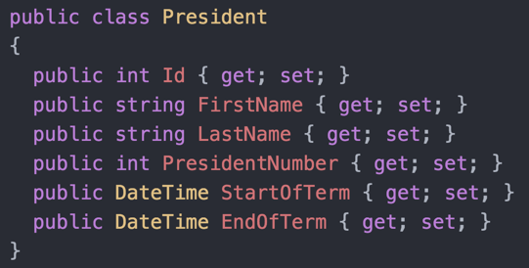
You’d Think You Could Do This

Slide 80
President Grover Cleveland ruined it.

Slide 81
Grover Cleveland is the only president to serve two non-consecutive terms.

Slide 82
Grover Cleveland, Term 1: 1885 to 1889

Slide 83
Benjamin Harrison: 1889 to 1893

Slide 84
Grover Cleveland, Term 2: 1893 to 1897

Slide 85
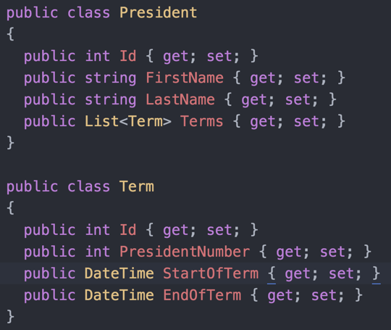
Grover Cleveland Ruins My Design

Slide 86
Domain Model / Business Objects
President
Term
Database Tables
Person
PersonFact
Database uses Entity Attribute Value Model
Very flexible
Almost no schema changes
The Design

Slide 87
Database Tables
Person
PersonFact
EF Core Entities
Person
PersonFact
Tip: Keep it simple
Heretical advice
Entities almost always look exactly like their database table
Good for performance and maintenance
EF Core Implementation

Slide 88
Person is our “Aggregate Root”
Aggregate Root
Domain Model term
The object through which you access a collection of related objects
IRepository<Person>
SqlEntityFrameworkPersonRepository
PersonToPresidentAdapter
Repositories and Adapters

Slide 89
Next up: Let’s implement the adapters

Slide 90
Implement and unit test an Adapter
PersonToPresidentAdapter
PersonToPresidentAdapterFixture
DEMO

Slide 91
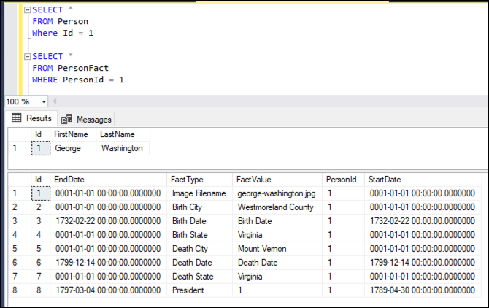
George Washington

Slide 92
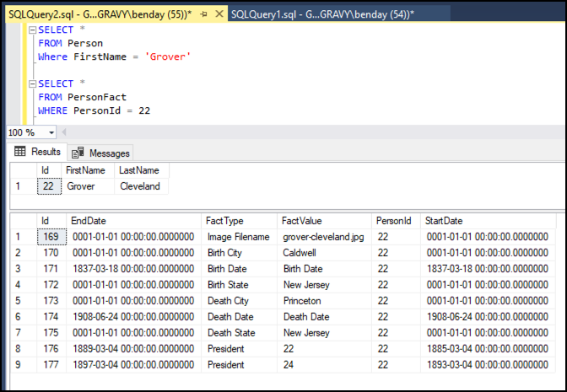
Grover Cleveland

Slide 93
Next up: Let’s implement the repositories

Slide 94
Implement a Repository
Integration Tests
SqlEntityFrameworkPersonRepository
Reusable repository classes
SqlEntityFrameworkRepositoryBase
SqlEntityFrameworkCrudRepositoryBase
DEMO

Slide 95
Next up: Tie it together with Service Layer Pattern

Slide 96
Service Layer Pattern
Implement PresidentService
Manage operations related to President
Connects logic Adapt and Repository logic
DEMO

Slide 97
Next up: Let’s mock our repositories

Slide 98
Fun with Dependency Injection and Repository interfaces
PresidentService
Rule: “No Duplicate Presidents”
Save a President to the database
Throw an error when you try to save a duplicate President
How do you test this without a real database?!?!?!
Unit test this using an In-Memory Repository
DEMO

Slide 99
Security in ASP.NET Core
IIdentity
IPrincipal
ClaimsIdentity
ClaimsPrincipal

Slide 100
Code that checks if a user is authorized
Security decisions
Code that you’re trying to authorize
Actions you’re trying to protect
Keep these separated!!!
Single Responsibility Principle
Two Types of Code Related to Authorization

Slide 101
It’s always going to be easier to unit test the code that makes the security decisions

Slide 102
If you’re trying to test the decision code and the protected code at the same time…

Slide 103
…it’s probably an integration test and not a unit test

Slide 104
Using the [Authorize] attribute
Part of ASP.NET Core
Apply to Controllers or Controller methods
Custom logic
Checks against IPrincipal yourself
Two Ways to Implement Authorization in ASP.NET Core

Slide 105
Apply it to a
Controller class
Controller method
User must be authenticated
[Authorize()]
Role-based authorization
[Authorize(Roles = "Administrator")]
Policy-based authorization
[Authorize(Policy = “AdminOnlyPolicy")]
The [Authorize] Attribute

Slide 106
Nearly impossible to unit test
It’s really hard to integration test
My recommendation:
Don’t try to test that it’s working
Use reflection to check that the attribute is there with the right value(s)
The Bad News About the [Authorize] Attribute

Slide 107
Get an instance of IPrincipal
Write checks against IPrincipal
Succeed or fail based on the checks
Recommendation:
Group the checks into methods that make the authorization decisions
Unit test the logic that makes the decisions
Checks Against IPrincipal

Slide 108
Encapsulates the authorization decision logic
[Authorize(Policy = “AdminOnlyPolicy")]
Define policies in Startup.cs
Policy has two parts:
Requirement
Handler
IAuthorizationRequirement
AuthorizationHandler<T>
ASP.NET Core Security Policies

Slide 109
IAuthorizationRequirement
Configuration information related to a Policy
Create a class
Implement the interface
(Optional) Provide properties for config values
IAuthorization Requirement

Slide 110
AuthorizationHandler<T>
T = Class the implements IAuthorizationRequirement
Implement HandleRequirementAsync( context, requirement)
AuthorizationHandlerContext
Current authorization check info
Identity, Principal
MVC Context
Make the decision
Succeed()
Fail()
Authorization Handler<T>

Slide 111
Unit test the policy handler logic in isolation
Focus testing on AuthorizationHandler<T>
Integration testing policy handlers with Controllers is HARD
Testing the Policies

Slide 112
Unit testing the [Authorize()] attribute
“Didn’t you say that was impossible?”
Testing the existence of [Authorize()] using Reflection
Avoids integration tests
Trusts that the decision implementation works
Technique is by David Pine

Slide 113
David Pine
Microsoft MVP
Google Developer Expert
Twitter: @davidpine7
https://davidpine.net/blog/ asp-net-core-security-unit-testing/
Credit for This Idea

Slide 114
Next up: Implementing AuthorizationHandler<T>

Slide 115
Multi-part demo
ASP.NET Core AuthorizationHandler and Policy-based Authorization
Part 1: The overall code structure
Part 2: Implement the unit tests
Part 3: Implement AuthorizationHandler<T>
Part 4: Create the policy
Hook it in to ASP.NET Core

Slide 116
Next up: Use the Strategy Pattern to make authorization decisions

Slide 117
The President Database is going start selling subscriptions
Basic → Search
Ultimate → Search + Images
Decide if a user is authorized to do something
Strategy Pattern
Strategy encapsulates algorithms & business logic
IUserAuthorizationStrategy
DefaultUserAuthorizationStrategy

Slide 118
Next up: Middleware

Slide 119
ASP.NET Core Middleware

Slide 120
What is middleware?

Slide 121
It’s stuff in the middle

Slide 122
Middleware lets you plug your code into the ASP.NET Core execution pipeline

Slide 123
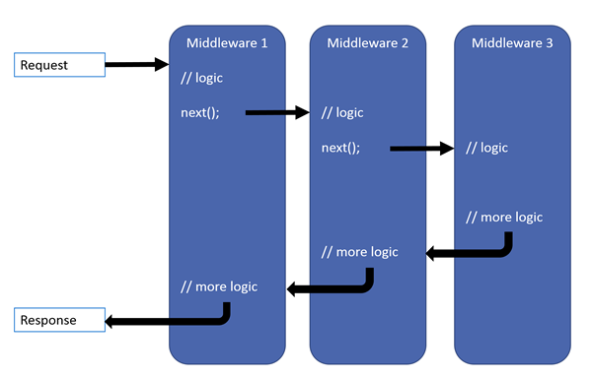
Middleware
https://docs.microsoft.com/en-us/aspnet/core/fundamentals/middleware

Slide 124
“What does middleware have to do with security?”

Slide 125
Not necessarily anything…

Slide 126
…but it can be really helpful in security scenarios

Slide 127
Use Middleware to hook into the execution pipeline and populate claims

Slide 128
Really easy
Create a class that implements Microsoft.AspNetCore.Http.IMiddleware
InvokeAsync(HttpContext context, RequestDelegate next)
Configure Startup.cs
Implementing Middleware

Slide 129
Next up: Middleware Demo

Slide 130
ASP.NET Core Middleware
Load information about user’s subscription status
Populate claims
Unit Tests

Slide 131
Any last questions?

Slide 132
Thank you.
www.benday.com | benday@benday.com

