Slide 1
Entity Framework Core for Enterprise Applications
Benjamin Day @benday

Slide 2
Benjamin Day
Brookline, MA
Consultant & Trainer
Rental Chief Technology Officer
Therapist for Teams
Scrum, DevOps, Azure, Team Foundation Server, Software Architecture & Testing
Microsoft MVP
Pluralsight Author
Scrum.org Trainer
@benday

Slide 3
Getting Started with Visual Studio Team Services (VSTS)

Slide 4
Architecting an ASP.NET Core MVC Application for Unit Testability Coming soon!

Slide 5
On with the show.

Slide 6
Overview
EF Core vs. EF Standard
Relationships
Property & Navigation Types
Querying with Shadow Properties
The Dreaded Many-to-Many
Lazy Loading
Cascading Deletes
Concurrency Management
Software Architecture
Unit Testing
Schema Management
DevOps
Performance in a Web App

Slide 7
How did we get here?

Slide 8
ADO.NET

Slide 9
Object-Relational Impedance Mismatch, Object-Relational Mappers (ORMs)

Slide 10
Anything that lets me go fast now, robs me of my ability to maintain it later.

Slide 11
Enterprise Software = Non-disposable software

Slide 12
Rule #1: You don’t work for EF. EF works for you.

Slide 13
Rule #2: Use EF for what it’s good at and be ready to bail out when it doesn’t.

Slide 14
Rule #3: Hide EF from your application.

Slide 15
Rule #4: Just because you can doesn’t mean you should.

Slide 16
.NET Core 2.2 & EF Core 2.2 released this week

Slide 17
EF Core vs. EF Standard
Full feature comparison
https://docs.microsoft.com/en-us/ef/efcore-and-ef6/index
It’s mostly the same
If you’re “code first”
Some things are missing

Slide 18
Big things that are missing (~2017 Edition)
Complex types without identity
Name, PhoneNumber
Many-to-many relationships without a JOIN entity
Inheritance mapping only does Table-per-hierarchy (TPH)
No Table-per-type (TPT)
Spatial types
Geography & Geometry
Saving using Stored Procedures
(Easily at least)
Raw SQL to anonymous types
Lazy loading

Slide 19
Big things that are missing (2018 Edition)
Complex types without identity
Name, PhoneNumber
Many-to-many relationships without a JOIN entity
Inheritance mapping only does Table-per-hierarchy (TPH)
No Table-per-type (TPT)
Spatial types
Geography & Geometry
Saving using Stored Procedures
(Easily at least)
Raw SQL to anonymous types
Lazy loading

Slide 20
Lazy Loading

Slide 21
Lazy Loading
Person has PhoneNumbers
public IList<Phone> PhoneNumbers { get; }
Phone has Owner
public Person Owner { get; set; }
In EF Standard → PhoneNumbers loaded when accessed
In EF Core → PhoneNumbers is null (by default)

Slide 22
“Lazy” Loading Options
Explicit Loading
Include()
ThenInclude()
Lazy Loading (Easy)
DbContextBuilder UseLazyLoadingProxies()
Mark ‘lazy’ properties as virtual
Lazy Loading (Harder)
ILazyLoader on Entity’s constructor
Custom logic

Slide 23
Demo: Person & PhoneNumbers

Slide 24
Owned Types

Slide 25
Owned Types
Classes that are mapped but do not have identity
How to use them?
Create a property on an entity that is an instance of an owned type
On the owned type, mark it with [Owned]
Enjoy

Slide 26
Demo: Name as an Owned Type

Slide 27
Relationships

Slide 28
Relationships
Terminology
Relationship Types
Principal Entity
Owns the primary key
Parent
Dependent Entity
Has foreign key
Child in relationship
One to One
Navigation property
One to Many
Collection navigation property
Many to One
Inverse navigation property

Slide 29
Cascading Deletes
What happens when something in a relationship is deleted?
Delete Types
Microsoft.EntityFrameworkCore.Metadata.DeleteBehavior
Cascade → Delete the dependent entity
SetNull → Delete Principal, set inverse property on Dependent to null
Restrict → Do nothing, delete is manual

Slide 30
Demo: Animals & Foods

Slide 31
Concurrency Management

Slide 32
Concurrency Management
Multiple people using your app without stomping on each other’s data
Configure using Fluent API or Attribute
[Timestamp] attribute
byte[]
[ConcurrencyCheck] attribute
DateTime, string, or int

Slide 33
Stored Procedures

Slide 34
Stored Procedures from EF Core
Better for retrieves than for saves
Single result set
Only for mapped types (not anonymous)
Has to bring back all properties/fields

Slide 35
Demo: Animals By Food Id

Slide 36
Recommended Software Architecture

Slide 37
Architecture Recommendations
Don’t try to model inheritance in EF
Hide EF behind Repository Pattern & Adapter Pattern
Code to interfaces
Treat EF entities as data access objects
Hide your data access objects
Write unit tests
Unit tests are not Integration tests
Write integration tests for the Repositories
Test your Collection saves & deletes
Test your concurrency

Slide 38
Performance Tips

Slide 39
Performance Tips
Only optimize for known performance problems!
TagWith(string)
Adds a comment to the generated T-SQL
If you don’t need to save it in the same transaction…
AsNoTracking()
Turns off change tracking
Think hard about eager loading
Minimize your use of Include(), ThenInclude()
Only bring back what you need

Slide 40
DevOps & Schema Management

Slide 41
Humans are terrible at multitasking.

Slide 42
Productivity vs. Waste
"Quality Software Management: Vol. 1 System Thinking“, Gerald Weinberg (1992)

Slide 43
To be productive, eliminate distractions.

Slide 44
Software delivery not software development.

Slide 45
Anything that slows you down, automate it.

Slide 46
What is DevOps?

Slide 47
DevOps is a mindset plus a set of practices that focuses on automation.

Slide 48
Why DevOps?
Minimize distractions
Focus on delivering software
Eliminate the tedious stuff
Bridge the divide between development, delivery, deployment, and operations

Slide 49
Make delivery & deployment easy.

Slide 50
If delivery & deployment is easy…
…it’s not a big deal
…you’ll do it more often
…you can focus more time writing & delivering features

Slide 51
DevOps Goals
Repeatable, Automated, & Version Controlled
Including configuration
Never deploy from a developer workstation
No right-click → deploy
Deploy from TFS Build
Deploy from TFS Release Management Pipeline

Slide 52
Everything happens through the “dotnet” command.

Slide 53
DevOps: Don’t Forget the Database!
Does your app use a database?
You’ll need to version control it
Automated build & deploy of database schemas
Two approaches:
SQL Server Data Tools (SSDT)
Entity Framework Migrations

Slide 54
.NET Core DevOps Tip: Learn how to do everything from the command line

Slide 55
Entity Framework Core

Slide 56
EF Core NuGet Packages
Talk to SQL Server
Microsoft.EntityFrameworkCore.SqlServer
Database Updates (“Migrations”)
Microsoft.EntityFrameworkCore.Design
Reverse Engineer a SQL Server Database
Microsoft.EntityFrameworkCore.SqlServer.Design

Slide 57
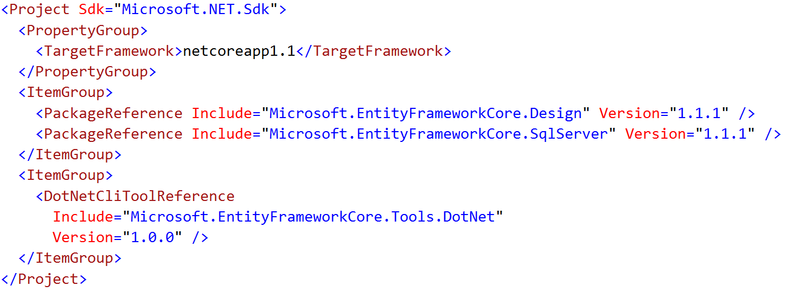
Enable the “dotnet ef” Command
Edit *.csproj
Add DotNetCliToolReference to Microsoft.EntityFrameworkCore.Tools.DotNet

Slide 58
EF Migrations = Entity Framework Version Control

Slide 59
Migrations from the Command Line
Add / Remove a Migration
dotnet ef migrations add “{name}”
dotnet ef migrations remove
Deploy an Update
dotnet ef database update

Slide 60
Demo: Migrations
Add an Initial Migration
Deploy the Database
DbContextFactory
Fix hard-coded connection strings

Slide 61
Import Existing Database to EF Core
dotnet ef dbcontext scaffold
dotnet ef dbcontext scaffold -c {dbcontext-name} "Server=(local); Database={database}; Trusted_Connection=true;" Microsoft.EntityFrameworkCore.SqlServer

Slide 62
Team Foundation Server 2017 & VSTS Demos

Slide 63
Demo: EF Core with TFS Build
Create a basic build
Edit connection strings
Deploy db changes using EF Migrations

Slide 64
Demo: EF Core with TFS Release Management
Use Release Management
Deploy to Multiple Environments
Add Environment Approvals

Slide 65
Any last questions?

Slide 66
Thank you.
www.benday.com | benday@benday.com

