Slide 1


Slide 2


Rebooting Your Agile Transformation Using Empathy
Benjamin Day
Developer | Author | Coach
@benday
www.benday.com

Slide 3




Benjamin Day
Brookline, MA
Consultant & Trainer
Rental Chief Technology Officer
Therapist for Teams
Scrum, DevOps,
Team Foundation Server,
Software Architecture & Testing
Microsoft MVP
Pluralsight Author
Scrum.org Trainer
@benday

Slide 4
Getting Started with
Visual Studio Team Services
(VSTS)

Slide 5
Architecting an
ASP.NET Core MVC Application for Unit Testability
Coming soon!

Slide 6
On with the show.

Slide 7
Empathy
Framing and Introspection
Process, Trust, and Leadership
Multitasking
Accountability
Backlog Issues
Culture Issues
Burnout
Why Agile?
Overview

Slide 8
“We decided to ‘go agile’…
…but it just didn’t take.”

Slide 9
“We do Scrum but it’s not really working that well.”

Slide 10
“We were kind of Waterfall-y.
We hired some gurus to come do an Agile transformation. Trained a bunch of people.
It worked…sort of.
Now we’re Waterfall-y / Scrum-y.
But the teams hate it.
And we’re not getting much done.”

Slide 11
Lots of reasons why organizations have trouble transitioning to
Agile / Scrum

Slide 12
Leaders often get in their own way

Slide 13
They don’t know what they’re asking for
They’re unclear what they’re asking for
They don’t understand what their teams need to be successful
They have trouble leading their organizations forward
Leaders often get in their own way

Slide 14
Empathy & Understanding

Slide 15
My Goal:
Help you improve how you lead and communicate

Slide 16
The big trick as a leader is convincing people to follow you

Slide 17
Framing & Introspection

Slide 18
How do you talk about your transformation?

Slide 19
On the count of 3…

Slide 20
Don’t think of an elephant.

Slide 21
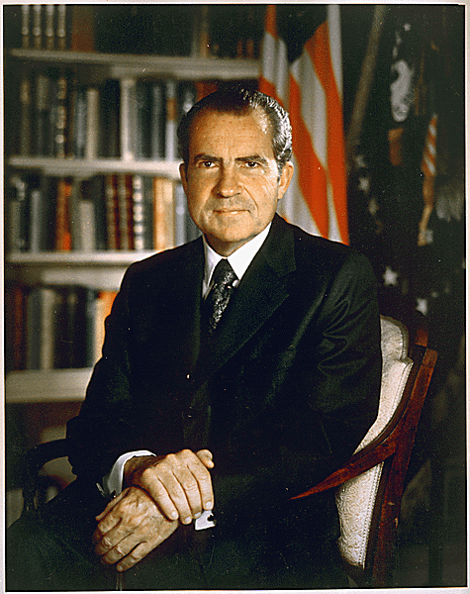
“I’m not a crook.”
Richard M. Nixon
November 17, 1973
https://www.nixonfoundation.org/artifact/official-presidential-portrait/

Slide 22
Linguistic Frames

Slide 23
“Frames are mental structures that shape the way we see the world. … You can't see or hear frames. They are part of what...cognitive scientists call the
'cognitive unconscious’.”
George Lakoff,
“The ALL NEW Don't Think of an Elephant!”

Slide 24
Know what you believe
Know why you believe it
The words will follow
Use this to lead your Agile transformation
Use Frames to Improve Your Communication & Leadership

Slide 25
A Moment of Introspection

Slide 26
What do you want?

Slide 27
What do your people want?

Slide 28
Why do you want it?

Slide 29
Process, Trust, and Leadership

Slide 30
Agile, Scrum, etc.
Why are you using a process?
Why do you care about a process?
Process

Slide 31
Why do you care about process?
To help your teams be productive?
To help your teams scale?
To measure how badly they suck and how horribly they’re screwing up?

Slide 32
This might be sub-optimal
It’s a “negative frame”
  “Don’t think of an elephant.”
To measure how badly they suck and how horribly they’re screwing up?

Slide 33
Agile Transformation Tip:
Use positive frames to discuss your transformation

Slide 34
What are we going to do?
What are we going to achieve?
How will this improve our lives, business?
Why do we want to do this?
Avoid focusing on what you’re
NOT going to do
Use Positive Frames

Slide 35
What if you don’t trust your teams?

Slide 36
It’s ok to not trust your teams…

Slide 37
…but it’s time for some introspection.

Slide 38
Managers tend to “clamp down”
  Command & Control
  Heavier process
You tend to measure their failure rather than assisting their success
Time wasted assigning blame
You’re afraid your not going to get your “needs” met
When you don’t trust your teams…

Slide 39
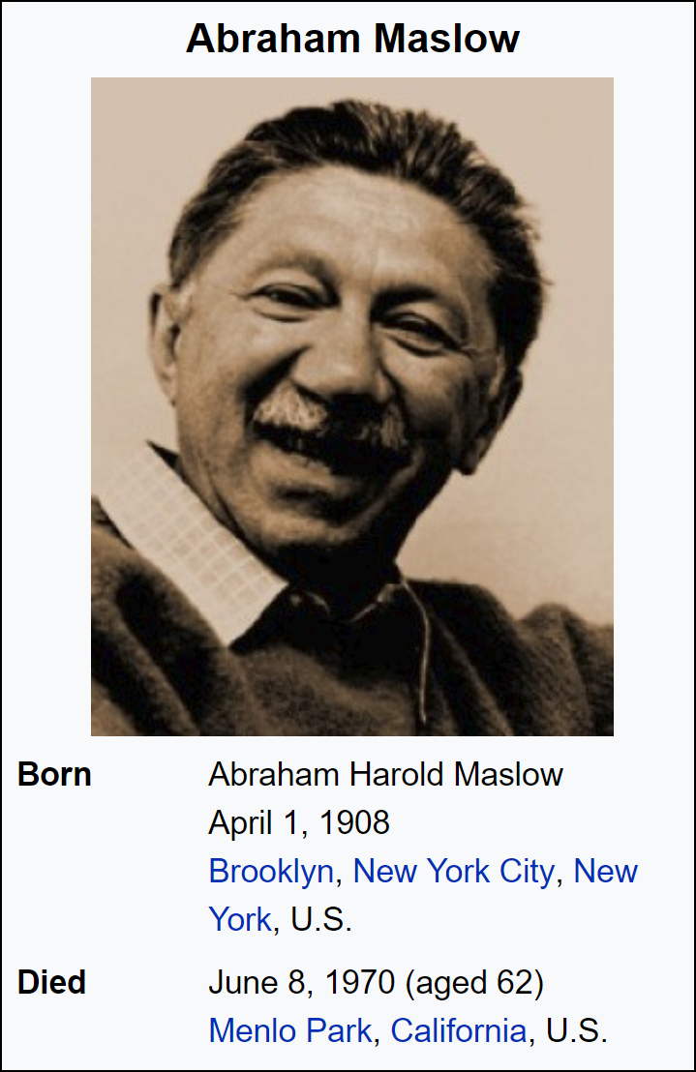
Maslow’s Hierarchy of Needs
Self-
actualization
Esteem
Love / Belonging
Safety
Physiological
Become all you can be
Recognition, Status, Respect
Friendships, Family, Intimacy
Security (Personal, Financial), Health
Food, Water, Air, Sleep, Shelter, etc.
https://en.wikipedia.org/wiki/Maslow%27s_hierarchy_of_needs

Slide 40
Maslow’s Hierarchy of Needs
Lack of this correlates with loneliness, depression, and anxiety
Self-
actualization
Esteem
Love / Belonging
Safety
Physiological
Room to grow & be awesome
Become all you can be
Recognition for the work / achievements
Recognition, Status, Respect
“I want to feel like I’m part of the team.”
Friendships, Family, Intimacy
“I need this job.”
Security (Personal, Financial), Health
Food, Water, Air, Sleep, Shelter, etc.
https://en.wikipedia.org/wiki/Maslow%27s_hierarchy_of_needs

Slide 41
How to use Agile
Wrong Way
Right Way
Find out how much my team sucks
Measuring how much they disappoint you
Help them to not suck
Help them to be transparent about status/progress
Help them (and you) to get clarity on what “done” means
Focus on doing the right things

Slide 42
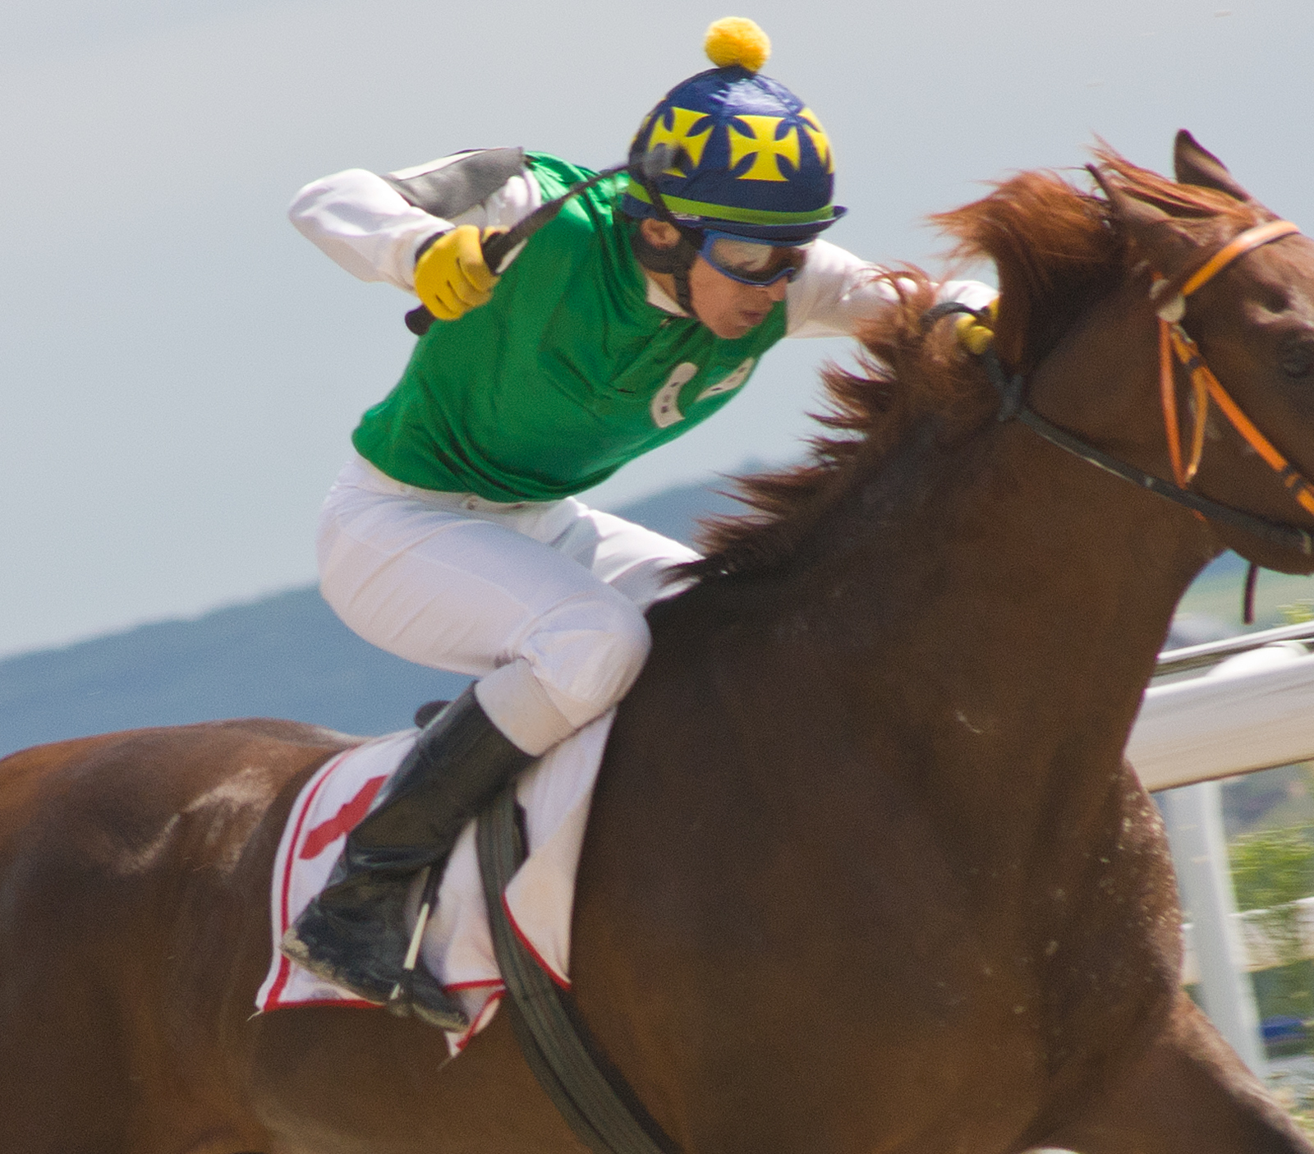
You are not there to drive the team.
Notes:
https://www.istockphoto.com/photo/horse-racing-gm176716567-26328683

Slide 43
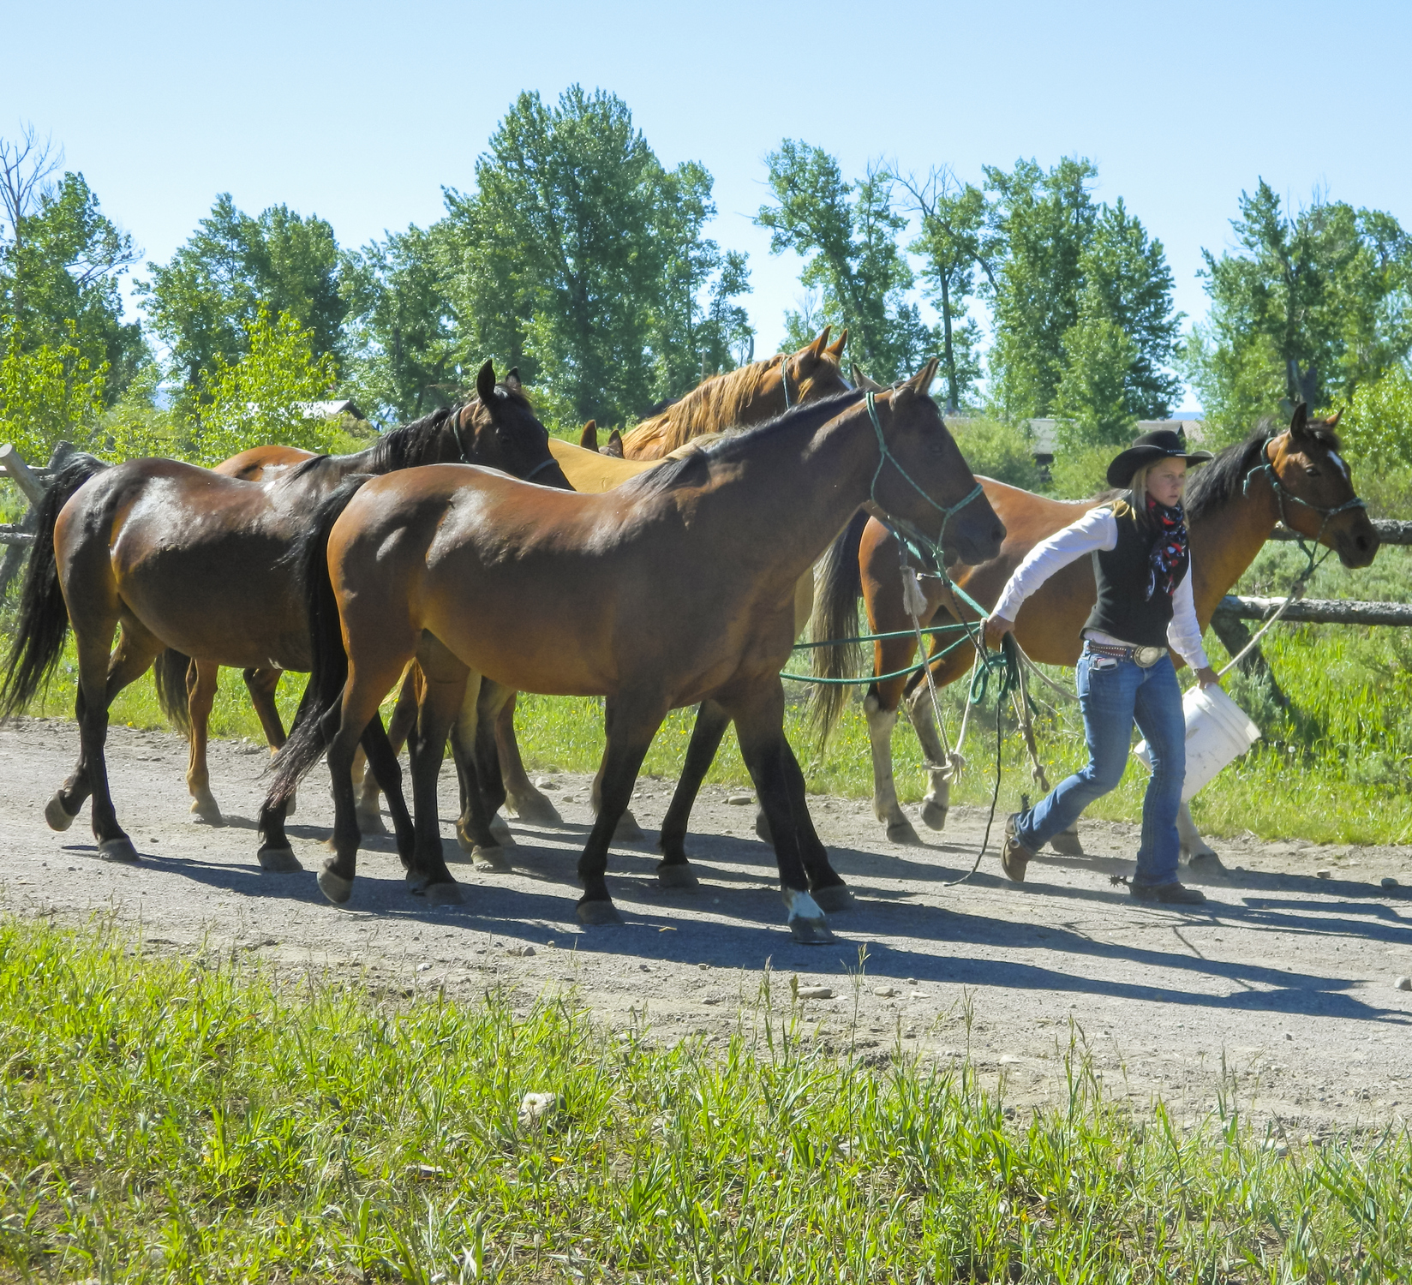
Think of it as leading them towards success.
Notes:
https://www.istockphoto.com/photo/young-woman-ranch-hand-leading-group-of-horses-on-path-gm635725572-112365253

Slide 44

Notes:
https://www.istockphoto.com/photo/funny-concept-for-teamwork-and-knowledge-transfer-gm505598410-83751915

Slide 45
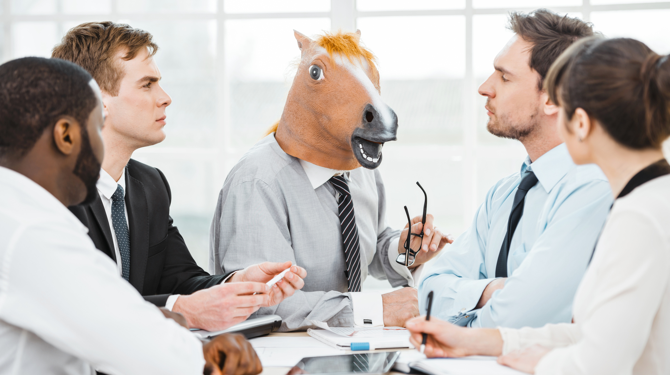
Notes:
https://www.istockphoto.com/photo/funny-concept-for-teamwork-and-knowledge-transfer-gm505598340-83751825

Slide 46
Multitasking is Expensive

Slide 47
What does the day-to-day life of your team feel like?

Slide 48
Are you asking your teams to multitask?

Slide 49
Software is creative
Don’t focus on looking / feeling busy
Focus on results
  Are you getting results?
  How long can you wait to know if you’re getting results?
Sometimes it doesn’t look like much is happening.

Slide 50
Productivity vs. Waste
"Quality Software Management: Vol. 1 System Thinking“, Gerald Weinberg (1992)

Slide 51
I think you should do less.

Slide 52
More precisely, do less at one time.

Slide 53
Leadership is about decisions and priorities.

Slide 54
Multitasking is often a symptom of leaders not making decisions.

Slide 55
Multitasking is often a symptom of weak leadership.

Slide 56
Be transparent about your priorities.
Make the tough decisions…
…even if they’re wrong.

Slide 57
Watch out for multitasking on your teams.

Slide 58
Scrum Board for the Sprint
 | TO DO | IN PROGRESS | DONE
PBI A
PBI B
PBI C
Product
Backlog Items
Tasks

Slide 59
Scrum Board for the Sprint
 | TO DO | IN PROGRESS | DONE
Product
Backlog Item A
Status
PBI A
Product
Backlog Item B
Status
PBI B
Product
Backlog Item C
Status
PBI C

Slide 60
Scrum Board for the Sprint
 | TO DO | IN PROGRESS | DONE
PBI A
PBI B
PBI C

Slide 61

Scrum Board for the Sprint
 | TO DO | IN PROGRESS | DONE
PBI A
PBI B
PBI C

Slide 62


Scrum Board Danger
 | TO DO | IN PROGRESS | DONE
PBI A
PBI B
PBI C

Slide 63
Why is that so dangerous?

Slide 64
Too much work in progress.

Slide 65
Your team is multitasking.

Slide 66
Huge risk of not delivering anything.

Slide 67
A Better Approach to Team Delivery
 | TO DO | IN PROGRESS | DONE
PBI A
PBI B
PBI C

Slide 68
Huge Benefit: Risk Management

Slide 69
Worst Case Scenario?
 | TO DO | IN PROGRESS | DONE
PBI A
PBI B
PBI C

Slide 70
Do less at once →
Decreased risk of delivering nothing in this Sprint

Slide 71
Doing less at once !=
Doing less overall

Slide 72
Same pile of work.
Different way of delivering it.

Slide 73
Whole team is going to work on one PBI as a team.

Slide 74
Helps team to focus.

Slide 75
Focus on actually delivering done, working software.

Slide 76
Accountability

Slide 77
What does the day-to-day life of your team feel like?

Slide 78
Sprint: Day 10 of 15
 | TO DO | IN PROGRESS | DONE
PBI A
PBI B
PBI C

Slide 79
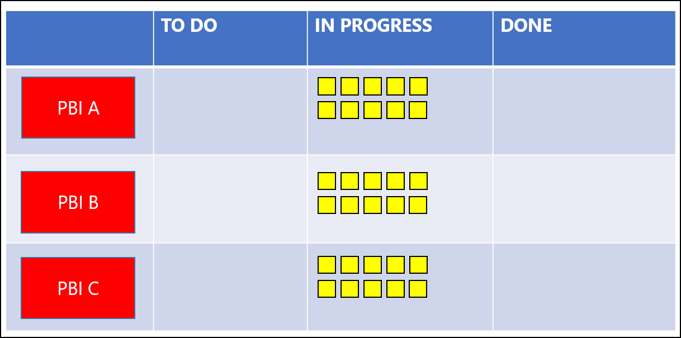
Is this a team?
Are they working together?
Where’s their incentive?
Are they evaluated as a team?
Or are they evaluated as individuals?

Slide 80
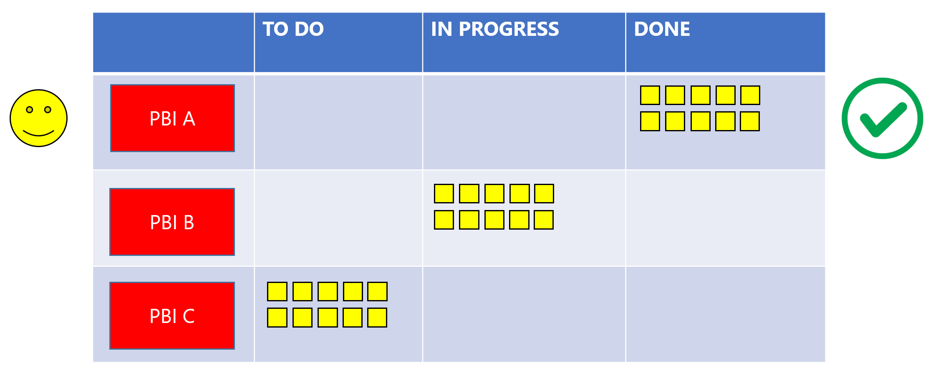
Gradual Delivery

Slide 81

Hold the team accountable as a unit
Holding individuals accountable is a recipe for “bus chucking”
Team accountability incents team members to be helpful to each other

Slide 82
Backlog & Product Vision Issues

Slide 83
What does the day-to-day life of your team feel like?

Slide 84
Are your / their goals clear?

Slide 85
Do your Product Owners actually have the authority to set priority?

Slide 86
List of everything you might ever dream of doing in your product
List of features
Prioritized
  Top priority items at the top
Product Backlog

Slide 87
Not enough backlog
  Aim for at least 2 to 3 sprints that’s well-understood
Too technical
  Backlog should be readable by a non-technical human
  Should talk about the business goals that are met (not technical goals)
Not aligned with the business goals
  How does each thing align with a corporate goal?
Common
Product Backlog Problems

Slide 88
Describes your vision
Your vision is clear for at least a few months
You’re able to understand the priorities
It’s readable by non-techies
Clear acceptance criteria
Clearly aligns with corporate goals
Signs of a Great Product Backlog

Slide 89
Culture Issues

Slide 90
What does the day-to-day life of your team feel like?

Slide 91
Can they speak freely?
Do they have autonomy?

Slide 92
Agility thrives on open communication & transparency.

Slide 93
“We like to give orders.”
“Do as I say!”
Too many natural followers
Too many people who are terrified for their jobs
Too many people who just want to be told what to do
  They’ve given up and gone limp
  Burned out
Culture of Authoritarianism

Slide 94
People are terrified
No trust
No bad news is ever delivered
  Shoot the messenger
No retrospectives
  “Retrospectives are bad because you need to point out the truth.”
Lots of time spent avoiding being wrong rather than actually being right
  Obsessed with requirements in advance
  Fear of “rework”
Unrealistic priorities
  Missed deadlines
Bus-chucking
Culture of Fear

Slide 95
Voluntold in Software:
Small & Large

Slide 96
Boss: "Hey…I need you to do yada yada yada. How long is that gunna take?"
Developer: "Uhhh…that'll be probably at least a week."
Boss: "A week's too long. I need it tomorrow morning. Thanks."
Voluntold
(Small)

Slide 97
Boss: "Hey…the sales guys promised the customer that we'd have proof that life exists on other planets as part of this release."
Team: "That's going to be a problem."
Boss: "Why's that?"
Team: "We're not sure it can be done."
Boss: "Well, the contract's already been signed soooo we need it next week. Feel free to put in all the overtime you need and come in on the weekend. Toodles!"
Voluntold (Large)

Slide 98
Other people are making promises that they expect you to make good.

Slide 99
Most often: disconnect between sales organization and implementation organization.

Slide 100
No control → Burnout

Slide 101
You need to make it ok to deliver bad news.

Slide 102
You need to make it ok to be wrong.

Slide 103
“It doesn’t make anyone look good when we miss”
“Please let me know and I’ll do my best to shape expectations.”
Important to push back
Disagree without being disagreeable
Share your Product Backlog
How do you fix this? →
Chip Away at the Problem

Slide 104
‘Culture of Fear’ tends to start from the top.

Slide 105
Culture of Fear is expensive

Slide 106
Consider making an argument based on employee retention.

Slide 107
Good people tend to leave
All the highly-motivated, top performers leave
Then the top performers recruit all the good people who are left
All the people who aren't so good and aren't so motivated, stay
You’re left with a weak team
Employee Retention Under ‘Culture of Fear’

Slide 108
Organizational Vulnerability
Culture of Experimentation
Forecast vs Commitment
Culture of Fear / Authoritarianism:
What do you do?

Slide 109
Burnout

Slide 110
Comorbidity
Medical term
A disease that exists with another disease or tends to appear with another disease
Examples:
  Substance abuse tends to go with mental health problems
  Kidney disease tends to go with diabetes

Slide 111
‘Culture of Fear’ tends to go with ‘Burnout’.

Slide 112
Burnout
“…long-term exhaustion and diminished interest in work.“
  Wikipedia
"Job burnout is a special type of job stress — a state of physical, emotional or mental exhaustion combined with doubts about your competence and the value of your work.“
  Mayo Clinic
  “Job burnout: How to spot it and take action”
  http://www.mayoclinic.org/healthy-lifestyle/adult-health/in-depth/burnout/art-20046642

Slide 113
People can get burned out.
Teams can get burned out.

Slide 114
Are You Experiencing Burnout?
Have you become cynical or critical at work?
Do you drag yourself to work and have trouble getting started once you arrive?
Have you become irritable or impatient with co-workers, customers or clients?
Do you lack the energy to be consistently productive?
Do you lack satisfaction from your achievements?
Do you feel disillusioned about your job?
Are you using food, drugs or alcohol to feel better or to simply not feel?
Have your sleep habits or appetite changed?
Are you troubled by unexplained headaches, backaches or other physical complaints?
Mayo Clinic, http://www.mayoclinic.org/healthy-lifestyle/adult-health/in-depth/burnout/art-20046642

Slide 115
What Causes Burnout?
Lack of control
  “An inability to influence decisions that affect your job — such as your schedule, assignments or workload”
  “a lack of the resources you need to do your work”
Unclear job expectations
  “If you're unclear about the degree of authority you have or what your supervisor or others expect from you, you're not likely to feel comfortable at work.”
Dysfunctional workplace dynamics
  “Perhaps you work with an office bully, you feel undermined by colleagues or your boss micromanages your work.”
Mayo Clinic, http://www.mayoclinic.org/healthy-lifestyle/adult-health/in-depth/burnout/art-20046642

Slide 116
Mismatch in values
Poor job fit
Extremes of activity
Lack of social support
Work-life imbalance
What Causes Burnout?
Mayo Clinic, http://www.mayoclinic.org/healthy-lifestyle/adult-health/in-depth/burnout/art-20046642

Slide 117
As a Leader, What Do You Do?
Be supportive
Work on the underlying causes
Or coach them to care less about the ‘irritant’
Suggest they seek support
  See a therapist?

Slide 118
“You’re more likely to develop burnout if…”
You identify so strongly with work that you lack a reasonable balance between your work life and your personal life
You try to be everything to everyone
You work in a helping profession, such as health care, counseling or teaching
You feel you have little or no control over your work
Your job is monotonous
Mayo Clinic, http://www.mayoclinic.org/healthy-lifestyle/adult-health/in-depth/burnout/art-20046642

Slide 119
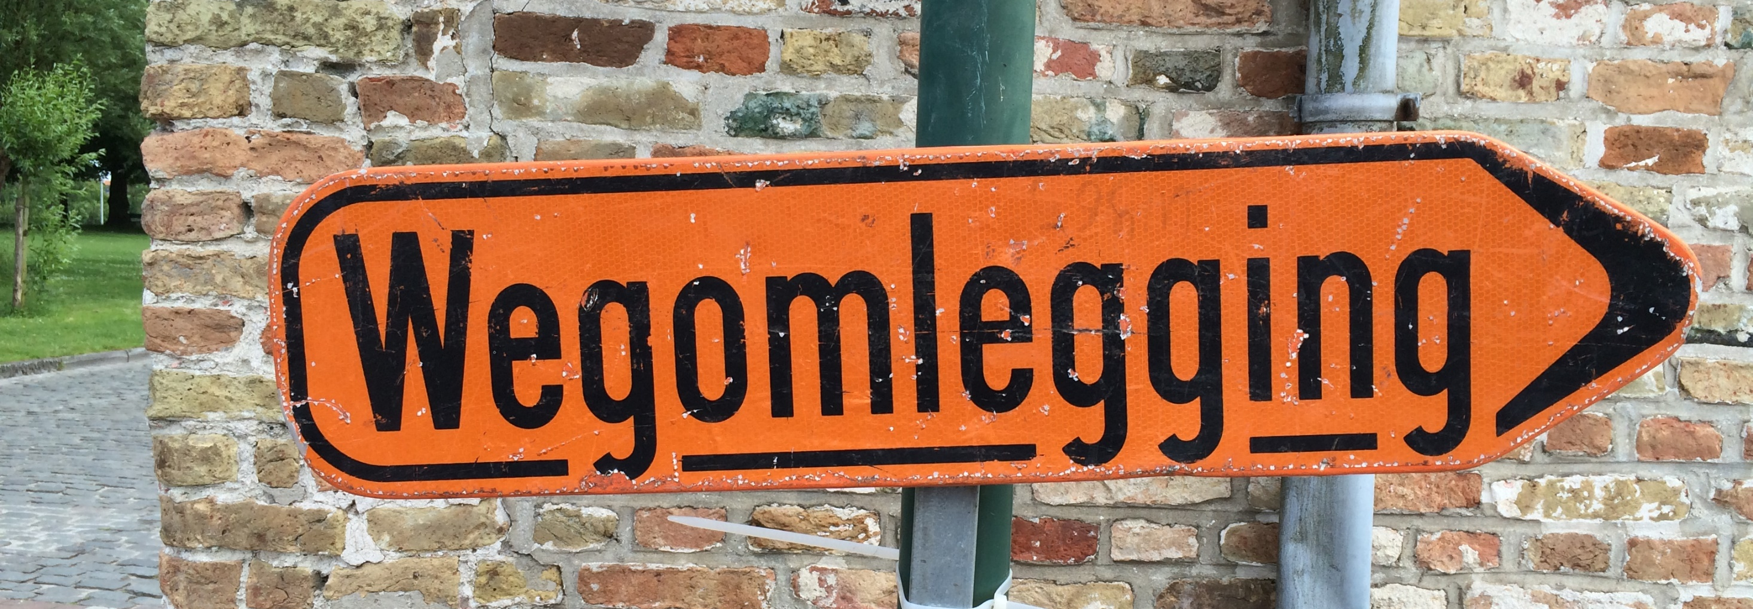
DETOUR / SUMMARY
Why bother?

Slide 120
Understand your motivations.

Slide 121
Why bother with agile?

Slide 122
“I want our team to be great with Scrum.”

Slide 123
"I want our organization to get great at efficiently delivering the right software and increasing our responsiveness to customer desires.
I think that Scrum & Agile is the way to go."

Slide 124
Focus on what you really need
  Top priority items first
  Highest value items first
High value, done, working software delivered often
Ability to change your mind and react to new business needs & opportunities
Happier people
Why Agile?

Slide 125
When you talk about agility…

Slide 126
Talk about what you want people to do rather than what you don’t want people to do.

Slide 127
Use empathy.
Try to understand what they need to be successful and what might be hindering their (aka. ‘your’) successes.

Slide 128
Any last questions?

Slide 129
THANK YOU
www.benday.com | benday@benday.com

Slide 130
Thank you.
www.benday.com | benday@benday.com

