Slide 1
10 Ways to Go from Good to Great Scrum Master
Benjamin Day

Slide 2
Benjamin Day
Brookline, MA
Consultant & Trainer
Scrum, DevOps, Team Foundation Server, Software Architecture & Testing
Microsoft MVP
Pluralsight Author
Scrum.org Trainer
@benday

Slide 3
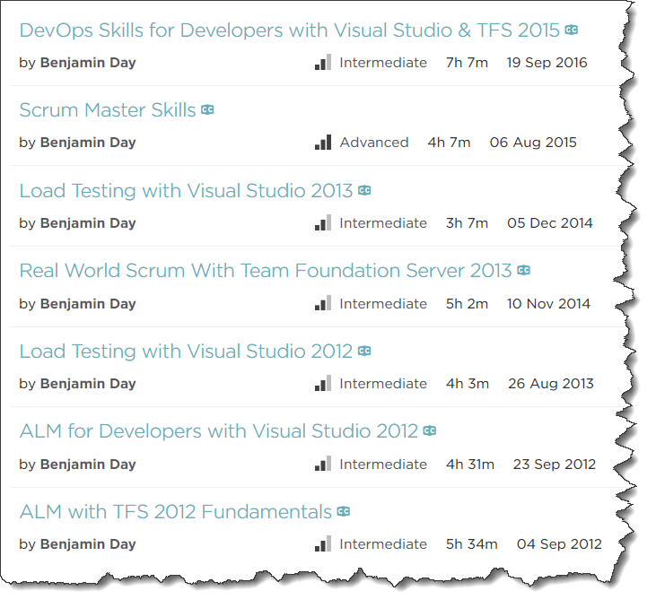
Pluralsight.com
Online courses
DevOps with TFS2015
Scrum Master Skills

Slide 4
On with the show.

Slide 5
Assumptions
You’re technical. I’m technical.
For today, we’re talking about a fairly technical Scrum Master
(Don’t forget the needs of the business though.)
This talk = Scrum Mastering + “Getting your project started right”
Notes:
Assumptions
In this case, the Scrum Master is somewhat technical
I'm technical. Right or wrong, my Scrum Mastering style tends to go deep on the technical stuff.
You have to remember the needs of the business though. You're not building this stuff for the sake of the technology. You're building this stuff for the sake of the business. In all likelyhood, it's about making money. The technology enables the making of the money which pays for you to write the software which makes more money and pays for more software. Rinse and repeat.
This talk will straddle the line between Scrum Mastering and "Getting your project started right"
Things that have caused my teams constant headaches that kill velocity

Slide 6
“What does the Scrum Master do anyway?”

Slide 7
Curling.

Slide 8
Olympic sport. Played on ice.

Slide 9
Team 1
Team 2

Slide 10
Team 1
Team 2
~148 ft / ~45 m
~15 ft / ~4.8m
Target
Target

Slide 11
Team 1
Team 2
The Curling Sheet
~148 ft / ~45 m
~15 ft / ~4.8m
Target
Target

Slide 12
Curling Stones
~40 lb. stones
Polished granite
It’s got a handle
8 stones per team

Slide 13
~148 ft / ~45 m
~15 ft / ~4.8m
Get your stones as close as possible to the center of the target
Each team takes turns
Team with the most stones closest to the center of the target wins
Note: that stone’s not to scale

Slide 14
Throwing
3 team members per throw
Thrower
Stone in hand
Pushes off with legs
Starts glide towards target
Thrower has to release stone

Slide 15
The thrower might put some spin on it…

Slide 16
…but once released, nothing can touch the stone.

Slide 17
After the release, the Sweepers take over.

Slide 18
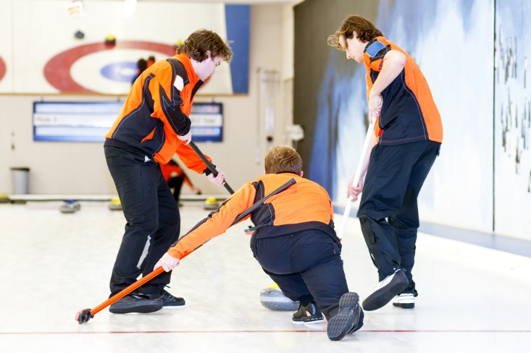
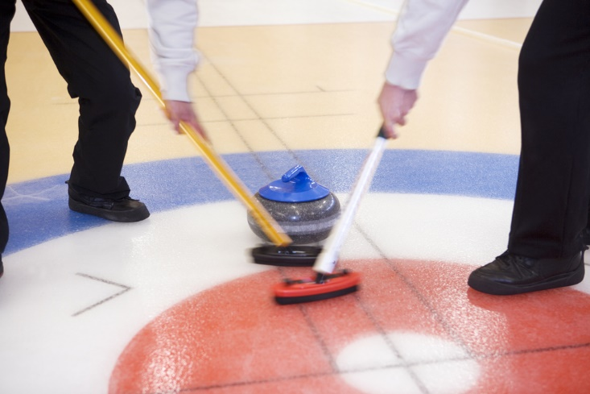
Sweepers
Two sweepers stay with the stone
Guide the stone to the target

Slide 19
Just to be 100% clear, the sweepers don’t touch the stone.

Slide 20
“So, the brushing moves the stone?”

Slide 21
The brushing doesn’t move the stone. It’s already moving.

Slide 22
The brushing subtly adjusts the ice in front of it…

Slide 23
…and that can change the speed and direction of the stone significantly.

Slide 24
The sweepers – without touching it – are helping to coax and guide the stone so it lands correctly at the target.

Slide 25
“…and this has what to do with scrum mastering?

Slide 26
Scrum Master is a Coach
Scrum Master is not a management role
Team members don’t report to the Scrum Master
Scrum Master isn’t the boss

Slide 27
Three Roles in Scrum
Product
Owner
Scrum
Master
Development
Team

Slide 28
Three Roles in Scrum
Product Owner is as close to “a boss” as you’ll get
Provides the vision & goal
Product
Owner

Slide 29
Considering the inherent bossless-ness, Scrum expects and relies on the team to self-organize.

Slide 30
To be successful, the team needs to use their creativity to deliver done, working software.

Slide 31
The team takes the Product Owner’s goal and self-organizes to figure out how to deliver done, working software at the end of the Sprint.

Slide 32
The basic idea: Give the team their goal and then get out of the way.

Slide 33
The Scrum Master helps the team to be creative and productive.

Slide 34
You can’t command someone to be creative.

Slide 35
“1…2…3…BE CREATIVE!!!!”

Slide 36
You can’t tell people exactly what to do and also expect them to figure it out for themselves at the same time.

Slide 37
And now back to curling…

Slide 38
Just like the sweepers can’t touch the stone…

Slide 39
…a successful Scrum Master doesn’t command the team.

Slide 40
The Scrum Master guides the team and helps the team without actually giving any instructions.

Slide 41
The team is the stone
The Product Owner is the thrower
The Scrum Master is a sweeper, guiding the team towards the goal

Slide 42
“What does the Scrum Master do anyway?”

Slide 43
The Scrum Master helps the team to be productive and to use their creativity in order to deliver done, working software.

Slide 44
The Big Lesson: The Scrum Master leads through influence not by command.

Slide 45
What does the Scrum Master do?
Keeper of the process
Help the team deliver
Argue for and defend the team
Help the Product Owner

Slide 46
Top 10 Ways: Things to Think About
What can you do to help your team?
What can you do to help your product owner?
What can you do to help yourself?
What can you do to help your organization?
Change your Daily Scrum

Slide 47
Here are all the things I wanted to put in this talk.
What can you do to help your team?
Written DoD
Encourage self-organization
Try to help minimize the work in progress.
Remind them to keep talking. One major downside of TFS is that people can sometimes think of it as an excuse to not talk.
Remind them about how much and how creatively you can decompose a PBI
Emergent Architecture.
Remind them they don't report to you
What can you do to help your product owner?
Product owner checklist http://productownerchecklist.org by Lare Lekman
Remind them that they need to stay engaged and that their engagement is critical for the success of the team and the effort.
Remind them to plan ahead a bit and share their vision
Help with credibility by planning 2 to 3 sprints out
What can you do to help yourself?
You can't fix everything.
Watch for burnout.
Do whatever it takes to get you to believe in self-organization
What can you do to help your organization?
Get them cozy with the fact that change will be coming.
Changing of plans is a "feature" not a "bug."
Inoculate them so that they won't panic when change inevitably happens.
Question how products align with teams. Bring work to the teams rather than bringing Teams to the work. Let the Teams stay together and focused on a limited amount of stuff and they'll go faster.
Help them think about sprint lengths. Sprints help scope risk. Sprints force you to pause from time to time to see where you actually are. It helps keep you honest. Have you *actually* delivered anything? Why and why not?
Practice explaining Story Points.
Explain that Scrum doesn't replace the existing org structure. It is a layer on top of the existing org structure. While it probably won't change anyone's job, it might change how they perform their job.
Think like a data scientist. http://blogs.hbr.org/2013/11/how-to-start-thinking-like-a-data-scientist/
Watch out for fear. Fear is *everywhere*.
Address the QA problems.
What does QA do at the front side of the sprint?
Answer collaborate with fellow team members to ensure that everyone knows how stuff is going to be tested.
Basically, front-load your quality focus.
Change your daily standup
Consider dumping "3 questions"
Consider switching who "runs" the standup
Watch for people being bored and/or tuning out
Bored people implies doing too much work and/or a wobbly sprint goal
Bored people implies multiple teams of 1 rather than a team of X. You have people who sit near each other rather than actual functional team.
What is your Velocity?
If you don't have estimates, you can't have a velocity.
If you don't have a DoD, velocity is problematic.
If you're wobbly on DoD, your velocity is suspect.
Be firm on DoD. No partial credit.
Better Retrospectives
Write them down. Review the results.
Try to walk through the sprint day by day and ask people how they felt, what was going on on this day, why is the burndown going up or down? This helps them to *remember* what was happening.
Common Objections to Scrum
Leading vs Coaching
Coaching organizations
Coaching teams
Common objections

Slide 48
Top 10 Ways
What is your DoD?
People Skills
Credibility
What is your Sprint Goal?
Do less.
Emergent Architecture
Good programming & testing practices
“Kick it over the wall to QA”
Teams : Products
Retrospective

Slide 49
Top 10 Ways
Emergent Architecture
Good programming & testing practices
“Kick it over the wall to QA”
Teams : Products
Retrospective
What is your DoD?
People Skills
Credibility
What is your Sprint Goal?
Do less.

Slide 50
Definition of Done (DoD) = Everything it takes to say something is completely done.

Slide 51
What is your DoD?
Closest thing to a “silver bullet” in Scrum
Technical Debt will ruin you.
Write it down.
Review and discuss it regularly.
Notes:
What is your Definition of Done (DoD)?
There's no magic bullet in Scrum...but this one is pretty close.
Write. Your. DoD. Down.
Discuss your DoD a lot.
Technical debt will ruin you. The little bits of not quite entirely done will crush your "agility".
If anyone says "Done vs. Done Done", hire someone to murder that person in their sleep. Ok. Well, maybe not murder them but that's a big deal.
No partial credit. It's either done or not done.

Slide 52
“Done vs. Done Done”

Slide 53
Sample Definition of Done (DoD)
Development / Coder
Testing, Deployment, Ops
Code is written with unit tests
Unit tests have a minimum of 75% code coverage
Code has been merged to Main
Code compiles and unit tests pass when run as part of an automated build
Database schema objects are under source control
Database upgrade script is under control
Code reviewed by someone other than the original author
Written QA test plan
Tested with QA test plan by someone other than the original author
Deployed and tested in Staging environment
Automated UI tests are written and pass
No Severity 1 or 2 bugs
Reviewed by Product Owner
Passes acceptance criteria for the PBI
Known deployment & rollback plan
Deployment plan reviewed by Ops
Database changes reviewed by DBAs
Load tested
Deployed to Production

Slide 54
Do not relax your DoD.

Slide 55
No partial credit…ever.

Slide 56
Partial credit usually means Technical Debt.

Slide 57
Partial Credit & Technical Debt → “Wobbly” Velocity

Slide 58
Top 10 Ways
Emergent Architecture
Good programming & testing practices
“Kick it over the wall to QA”
Teams : Products
Retrospective
What is your DoD?
People Skills
Credibility
What is your Sprint Goal?
Do less.
Notes:
People Skills
Trust your gut. Pause from time to time and ask yourself how you're feeling.
Therapy. We all have issues. Trust me...even though you *think* you know what they are, you don't really know. There are tons of issues and little stupid things you do that you could use to figure out. Getting in tune with your own inner life will help immensely.

Slide 59
99% of the time, it’s a people problem.

Slide 60
Watch for interpersonal problems.

Slide 61
Here’s a trick: “Trust your gut.”

Slide 62
Consider reading this book.

Slide 63
Want to be a super hero? Go see a therapist. (I’m not kidding.)

Slide 64
Top 10 Ways
Emergent Architecture
Good programming & testing practices
“Kick it over the wall to QA”
Teams : Products
Retrospective
What is your DoD?
People Skills
Credibility
What is your Sprint Goal?
Do less.
Notes:
Credibility is your greatest asset.
Keep your backlog ordered for at least 2 sprints worth of work. Be ready to answer at a moment's notice when a feature is forecast to be delivered.
That written DoD is your best friend when you're talking to product owners and executives and stakeholders. Make sure that they understand why DoD and Quality is in their best interest.
Be careful to not lose sight of "fit for purpose". Sometimes, you're not getting paid to create a work of art. It's a balance between "time to market" and "long term maintenance".
Do yourself a favor and say "forecast" rather than "commitment"
Try to communicate in terms that the business understands. (Answer: probably money.)

Slide 65
2 to 3 Sprints of Product Backlog
Helps give the PO “room”
Helps everyone to know what’s going on.
Be ready to answer where a PBI (aka. “feature”) is on the backlog.
How many sprints out?
Discuss your *written* DoD with the PO, executives, and stakeholders
Why is it in their best interest?

Slide 66
Fit for purpose.
Remember that not everything is, needs to be, or should be a work of art.
Balance “Time to Market” with “Long-term Maintenance”
Communicate with the business in terms they understand
(Hint: this is probably money and resources.)

Slide 67
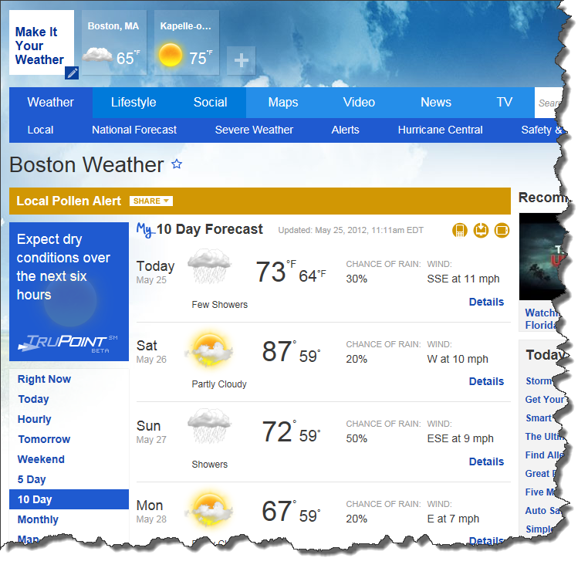
Train everyone to say “forecast” rather than “commitment”

Slide 68
Top 10 Ways
Emergent Architecture
Good programming & testing practices
“Kick it over the wall to QA”
Teams : Products
Retrospective
What is your DoD?
People Skills
Credibility
What is your Sprint Goal?
Do less.
Notes:
What's your Sprint Goal?
Review your SG in your daily standups.
If your sprint goal is simply a "select Title from SprintBacklog" you're probably doing it wrong.

Slide 69
Do you have a Sprint Goal?

Slide 70
Is it easily understood and stated?

Slide 71
Hint: Your sprint goal should not be select * from SprintBacklog

Slide 72
Review your Sprint Goal in the Daily Scrum.

Slide 73
And while we’re talking about the Daily Scrum…

Slide 74
…consider dumping the “3 questions” format.

Slide 75
Remind your team that they don’t report to you.

Slide 76
Consider switching up who “leads” that meeting.

Slide 77
Watch for people being bored and/or tuning out.

Slide 78
Bored implies a lack of focus.

Slide 79
Bored implies that people aren’t on the same team.

Slide 80
Top 10 Ways
Emergent Architecture
Good programming & testing practices
“Kick it over the wall to QA”
Teams : Products
Retrospective
What is your DoD?
People Skills
Credibility
What is your Sprint Goal?
Do less.
Notes:
Do less.
Aka. Minimize Work in Progress
If everyone on your team is working on separate PBIs, is the team really a team?
Try to craft your work so that you have more than one person working on something at a time. Drive that PBI to completion ASAP and only then move on to the next PBI.
Remember your DoD and work to drive your PBIs to DoD-compliance as soon as possible.
If something is DoD-done, you've already pretty much delivered something in that sprint.
The anti-pattern is being 2 days from the end of your sprint and nothing is DoD-done yet.

Slide 81
Minimize work in progress.

Slide 82
Put another way… don’t try to do everything at once.

Slide 83
If everyone on your team is working on separate PBIs, is the team really a team?

Slide 84
Finish one thing. Then do the next thing.
Try to craft the work so that multiple people are working on related things
Complete that thing. Move on to the next thing.
Try to drive stuff to DoD early.
This ensures that you’re delivering something in the sprint.

Slide 85
Anti-pattern: 2 days from the end of the sprint and nothing’s DoD yet.

Slide 86
Top 10 Ways
Emergent Architecture
Good programming & testing practices
“Kick it over the wall to QA”
Teams : Products
Retrospective
What is your DoD?
People Skills
Credibility
What is your Sprint Goal?
Do less.
Notes:
Do less.
Aka. Minimize Work in Progress
If everyone on your team is working on separate PBIs, is the team really a team?
Try to craft your work so that you have more than one person working on something at a time. Drive that PBI to completion ASAP and only then move on to the next PBI.
Remember your DoD and work to drive your PBIs to DoD-compliance as soon as possible.
If something is DoD-done, you've already pretty much delivered something in that sprint.
The anti-pattern is being 2 days from the end of your sprint and nothing is DoD-done yet.

Slide 87
Avoid BDUF. (Big design up-front.)

Slide 88
YAGNI. (You ain’t gunna need it.)

Slide 89
Emergent Architecture.
Build what you need.
It’s a spectrum.
Suicidal Non-Planning
Sanity & Balance
Big Design Up-Front

Slide 90
Emergent Architecture.
Build what you need.
It’s a spectrum.
Suicidal Non-Planning
Sanity & Balance
Big Design Up-Front

Slide 91
Emergent Architecture.
Build what you need.
It’s a spectrum.
Suicidal Non-Planning
Sanity & Balance
Big Design Up-Front

Slide 92
Emergent Architecture.
Build what you need.
It’s a spectrum.
Suicidal Non-Planning
Sanity & Balance
Big Design Up-Front

Slide 93
Top 10 Ways
Emergent Architecture
Good programming & testing practices
“Kick it over the wall to QA”
Teams : Products
Retrospective
What is your DoD?
People Skills
Credibility
What is your Sprint Goal?
Do less.
Notes:
Do less.
Aka. Minimize Work in Progress
If everyone on your team is working on separate PBIs, is the team really a team?
Try to craft your work so that you have more than one person working on something at a time. Drive that PBI to completion ASAP and only then move on to the next PBI.
Remember your DoD and work to drive your PBIs to DoD-compliance as soon as possible.
If something is DoD-done, you've already pretty much delivered something in that sprint.
The anti-pattern is being 2 days from the end of your sprint and nothing is DoD-done yet.

Slide 94
It’s a metaphysical *certainty* that you’ll have to change stuff.

Slide 95
You *won’t* get your “requirements” right.

Slide 96
Your customers *will* change their minds.

Slide 97
Accept that you’ll have to change.

Slide 98
The Goal: Make refactoring painless.

Slide 99
Loose coupling.
Code to interfaces.
Use the Dependency Injection Pattern
(Pass dependencies in on the constructor.)
Consider an IoC Framework
Use the Repository Pattern
Remember Single Responsibility Principle

Slide 100
Build for Testability
Unit test, unit test, unit test
Unit test != Integration Test
Test one layer at a time in isolation
No database connections from a unit test
Integration tests in a separate project
Keep yourself honest

Slide 101
For the love of all things precious & beautiful…

Slide 102
…DON’T USE A SHARED DEVELOPMENT DATABASE!!!!!!!!

Slide 103
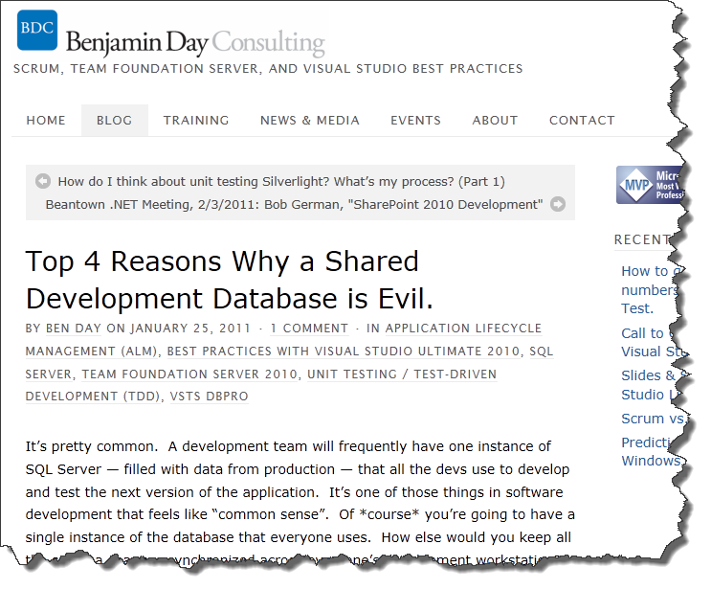
http://tinyurl.com/bqextsa

Slide 104
Eliminate the "works on my box" problem *early*.
Set up automated builds from the very beginning.
If you're using TFS, use Gated Check-in builds
Deploy your database as part of your builds.
Run your unit tests from the builds
Notes:
Good programming and unit testing practices let you worry less.
The goal is to make Refactoring as painless as possible. Refactoring should not strike terror into your soul(s).
Remember...requirements will change and people will change their minds.
Build for maintenance.
It's a metaphysical certainty that you're going to have to change stuff.
You won't get your "requirements" right.
Your customers / stakeholders *will* change their minds.
Keep things loosely coupled.
Program to interfaces
Use Dependency Injection
Read up on the Repository Pattern
Remember Single Responsibility Principle.
Build for testability.
Unit test, unit test, unit test.
And when I say *unit* test I mean *unit* not integration test.
Get comfortable with mocks, stubs, and fakes.
Unit tests should not connect to a service or a database
Unit tests should test only one "layer" at a time
Keep unit tests and integration tests in separate projects. Integration tests can talk to the database but they should also only talk to one layer at a time.
For the love of god, don't use a shared development database
No shared test data.
If at all possible, use the Visual Studio Database Projects.
Eliminate the "works on my box" problem *early*.
Set up automated builds from the very beginning.
If you're using TFS, use Gated Check-in builds
Deploy your database as part of your builds.
Run your unit tests from the builds
Think about maintain a minimal Inventory.
Inventory is sunk cost.
Anything you write has to be maintained.
Write less code. I'm not saying to use lots of frameworks like NHibernate or Entity Framework or RIA Services...I'm not saying don't use them either. Just keep in mind that everything you write you have to maintain.

Slide 105
Top 10 Ways
Emergent Architecture
Good programming & testing practices
“Kick it over the wall to QA”
Teams : Products
Retrospective
What is your DoD?
People Skills
Credibility
What is your Sprint Goal?
Do less.
Notes:
Do less.
Aka. Minimize Work in Progress
If everyone on your team is working on separate PBIs, is the team really a team?
Try to craft your work so that you have more than one person working on something at a time. Drive that PBI to completion ASAP and only then move on to the next PBI.
Remember your DoD and work to drive your PBIs to DoD-compliance as soon as possible.
If something is DoD-done, you've already pretty much delivered something in that sprint.
The anti-pattern is being 2 days from the end of your sprint and nothing is DoD-done yet.

Slide 106
Never say “Kick it over the wall to QA” again.
Us vs. Them
QA is part of the team
QA’s work should be part of the DoD

Slide 107
What does QA do at the start of a sprint?

Slide 108
Top 10 Ways
Emergent Architecture
Good programming & testing practices
“Kick it over the wall to QA”
Teams : Products
Retrospective
What is your DoD?
People Skills
Credibility
What is your Sprint Goal?
Do less.
Notes:
Do less.
Aka. Minimize Work in Progress
If everyone on your team is working on separate PBIs, is the team really a team?
Try to craft your work so that you have more than one person working on something at a time. Drive that PBI to completion ASAP and only then move on to the next PBI.
Remember your DoD and work to drive your PBIs to DoD-compliance as soon as possible.
If something is DoD-done, you've already pretty much delivered something in that sprint.
The anti-pattern is being 2 days from the end of your sprint and nothing is DoD-done yet.

Slide 109
How do Teams align to Products / Projects?
Watch out for partial allocations
Do team members have more than one Daily Scrum?
Rather than 1 team per 1 product, try 1 team that supports multiple products

Slide 110
Teams to Products
Bad
Billing System has a Billing Team
Accounting System has an Accounting Team
CRM system has a CRM Team
Website has a Website team
People are 50% allocated to multiple teams.

Slide 111
Teams to Products
Better
Team A
Billing
Accounting
Team B
CRM
Website

Slide 112
Teams to Products
Best
Team A and Team B are cross-functional
Either team can do tasks from Billing, Accounting, CRM, or Website

Slide 113
The Product Owner as a work funnel.
Medical Records Project
Accounting Project
CEO’s crazy dreams
…then the Product Owner adjusts the Product Backlog…
Product Owner has to decide priority for the team
The team can’t do everything at once
There has to be priorities
The team isn’t qualified to balance these priorities
Product
Owner
Development
Team
Entonnoir?

Slide 114
Top 10 Ways
Emergent Architecture
Good programming & testing practices
“Kick it over the wall to QA”
Teams : Products
Retrospective
What is your DoD?
People Skills
Credibility
What is your Sprint Goal?
Do less.
Notes:
The Retrospectives are the curer of all ills.
Watch for unscheduled work
Do you find yourself having to balance strategic work (long term projects) against your hair being on fire this week? Are you finding that you can't deliver anything or that you always miss your forecasts?
Do you note this unplanned work somehow?
Do you discuss this unplanned work in the retrospective.
Write down what you discussed in your retrospectives.
What went right and wrong?
What *actionable* things are you going to do for your next Sprint?

Slide 115
Retrospectives are the curer of all ills.

Slide 116
Retrospectives help keep problems contained to (hopefully) a single Sprint.

Slide 117
Tip: Watch for unscheduled work.

Slide 118
Tip: Get people REALLY thinking by trying to recreate what happened day by day.

Slide 119
Tip: If it gets heated, learn to say “Ok…and what else?”

Slide 120
Tip: Record the findings from the Retrospective

Slide 121
Tip: Review the notes from previous Retrospectives.

Slide 122
Top 10 Ways
Emergent Architecture
Good programming & testing practices
“Kick it over the wall to QA”
Teams : Products
Retrospective
What is your DoD?
People Skills
Credibility
What is your Sprint Goal?
Do less.

Slide 123
What can you do to help yourself?

Slide 124
Watch for burnout.

Slide 125
You can’t fix everything.

Slide 126
Do whatever it takes to get yourself to believe in self-organization.

Slide 127
But don’t let your team walk all over you.

Slide 128
Some teams will use self-organization against you.

Slide 129
“…but let’s remember here. This isn’t a *&^%$# democracy.” -David Starr

Slide 130
How do you help the Product Owner?

Slide 131
Remind them of how important they are to the success of the project.

Slide 132
Remind them that they need to stay engaged.

Slide 133
http://productownerchecklist.org

Slide 135
Any last questions?

Slide 136
Thanks. benday@benday.com | www.benday.com

