Slide 1
Role-Based Security Stinks: Better Authorization in ASP.NET
Benjamin Day @benday

Slide 2
Role-Based Security Stinks: Better Authorization in ASP.NET
Benjamin Day

Slide 4
Benjamin Day
Brookline, MA
Consultant & Trainer
Scrum, DevOps, Team Foundation Server, Software Architecture & Testing
Microsoft MVP
Pluralsight Author
Scrum.org Trainer
@benday

Slide 5
Pluralsight.com
Online courses
DevOps with TFS2017
Fresh!
DevOps with TFS2015
Scrum Master Skills

Slide 6
On with the show.

Slide 7
Big take away: Don’t hard-code your security

Slide 8
BTW, you’re probably hard-coding your security.

Slide 9
Simple security requirements? You’re probably fine.

Slide 10
Complex or shifting? Ouch.

Slide 11
Flexibility.

Slide 12
The Two Parts of Security
Authentication
Authorization
Who are you?
Username & Password
What can you do?
Permissions

Slide 13
Naming in the ASP.NET world has gotten fuzzy.

Slide 14
ASP.NET Versions
ASP.NET 4.6
ASP.NET Core 2.0
Been around for a long time
Not cross-platform
Windows + .NET Framework
Still very much alive
The new thing
Cross-platform
.NET Core CLI

Slide 15
Role-based Security?
Authorization based on membership in roles
Roles are strings
IPrincipal
System.Security.Principal
IsInRole(string roleName) : bool
WindowsPrincipal
Authorization based on group membership
Role name = Active Directory / Windows group name

Slide 16
Role-based Security Example
Roles
Actions
HR Associate
HR Manager
CEO
Edit Employee Info
Edit Compensation
Hire Employee

Slide 17
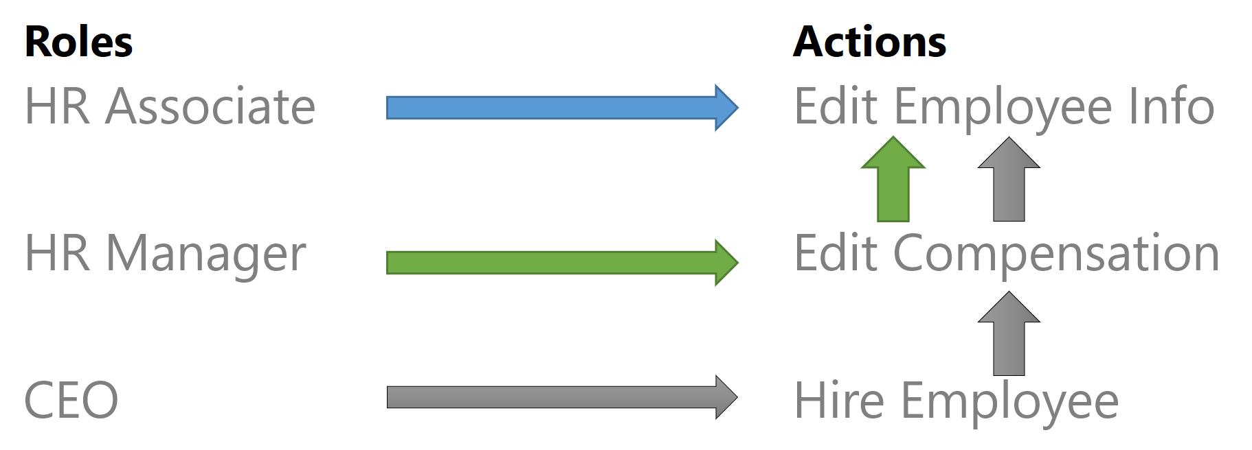
Role-based Security Example: Code
bool isAuthorized = principal.IsInRole( “HR Associate”)
bool isAuthorized = principal.IsInRole( “HR Manager”)
bool isAuthorized = principal.IsInRole( “CEO”)

Slide 18
Role-based Security Hits a Snag
New requirements…
…you buy a company in Boston
“HR Associate BOS”
“HR Manager BOS”
“HR Associate MKE”
“HR Manager MKE”
“CEO”

Slide 19
Role-based Security Hits a Snag
New requirements…
…you buy a company in NYC
“HR Associate NYC”
“HR Manager NYC”
“HR Associate BOS”
“HR Manager BOS”
“HR Associate MKE”
“HR Manager MKE”
“CEO”

Slide 20
Role-based Security Hits a Snag
New requirements…
…the org chart changes
“VP MKE”
“VP BOS”
“VP NYC”
“HR Associate NYC”
“HR Manager NYC”
“HR Associate BOS”
“HR Manager BOS”
“HR Associate MKE”
“HR Manager MKE”
“CEO”

Slide 21
So what starts simply enough as…

Slide 22
principal.IsInRole("HR Associate") principal.IsInRole("HR Manager") principal.IsInRole("CEO")

Slide 23
principal.IsInRole("HR Associate BOS") principal.IsInRole("HR Manager BOS") principal.IsInRole("HR Associate MKE") principal.IsInRole("HR Manager MKE") principal.IsInRole("CEO")

Slide 24
principal.IsInRole("HR Associate BOS") principal.IsInRole("HR Manager BOS") principal.IsInRole("HR Associate MKE") principal.IsInRole("HR Manager MKE") principal.IsInRole("HR Associate NYC") principal.IsInRole("HR Manager NYC") principal.IsInRole("CEO")

Slide 25
principal.IsInRole("HR Associate BOS") principal.IsInRole("HR Manager BOS") principal.IsInRole("HR Associate MKE") principal.IsInRole("HR Manager MKE") principal.IsInRole("HR Associate NYC") principal.IsInRole("HR Manager NYC") principal.IsInRole("VP BOS") principal.IsInRole("VP MKE") principal.IsInRole("VP NYC") principal.IsInRole("CEO")

Slide 26
What’s broken? Permissions are implied by role membership.

Slide 27
The role doesn’t mean anything.

Slide 28
What’s missing? Context.

Slide 29
Permissions in the context of a entity.

Slide 30
Everything is stuck together.

Slide 31
Changes → “Role Sprawl”

Slide 32
Role-based Security Limitations
Role-based works fine until you need context
Grant permissions to a particular “employee”
Broadness and lack of context → limited configurability
Security starts getting hard-coded
Not configurable at run-time

Slide 33
Claims-based Security
Declarative security
System.Security.Claims namespace
Name / Value Pairs

Slide 34
“Rights-based” Security?
Architecture for using Claims in the app
Breaks “what you can do” into small pieces → Rights
Rights have context
User is granted rights to perform an action on a particular item
User’s permissions (principal) becomes the set of these small granted rights
The Database Perspective → Establishes row-level permissions

Slide 35
Roles vs. Claims / Rights
Roles are broad
Secure large sections of an app
Grant blanket permissions to all securable items
No context
Rights are granular
Uses a Claim
Permissions relate to one item
Have context
Secure at the operation level
Reduce actions to the least common denominator
Store permissions as small pieces → flexibility

Slide 36
Claims-Based Security To Do’s
During development, identify
Securable Items
Securable Actions (Rights)
Broad Rights (Roles)
Keep these as actions as small (granular) as possible

Slide 37
Hooking into .NET Security
System.Security.Principal namespace
Use IIdentity to establish “who you are”
Use IPrincipal to establish “what you can do”
IPrincipal can be set onto
Thread.CurrentPrincipal
HttpContext.User
IPrincipal is available in all tiers

Slide 38
IPrincipal Through The Tiers
ASP.MVC / Web API
Should check IPrincipal to avoid giving the user an opportunity to cause security exceptions
Other Tier(s)
Makes certain that the users cannot access data or perform unauthorized operations
(Optional) Filter unauthorized records

Slide 39
ASP.NET MVC Security Schema
AspNetUsers
User account info
Local accounts
Username, password, etc
AspNetUserLogins
“Social” logins
Mappings between external logins & local info
Microsoft Account, Facebook, Twitter
AspNetRoles
List of roles in application
AspNetUserRoles
Roles per user
AspNetUserClaims
Custom claims
ClaimType
ClaimValue

Slide 40
Adjusting Claims at Login
ApplicationUser class
Extends System.Security.Claims.IdentityUser
GenerateUserIdentityAsync()
Any claims adjustments go here

Slide 41
DEMOS!
Demos in ASP.NET
Roles
Claims
Demos in ASP.NET Core
Policies
Microsoft Account Provider

Slide 42
Any last questions?

Slide 43
Thank you.
www.benday.com | benday@benday.com

