Slide 1
Learn. Imagine. Build. .NET Conf
DevOps with ASP.NET Core, EF Core, & TFS2017
Benjamin Day
@benday | www.benday.com

Slide 2
The recording of this session is available at https://channel9.msdn.com/Events/dotnetConf/2017/T219
Notes:
https://channel9.msdn.com/Events/dotnetConf/2017/T219

Slide 3
Benjamin Day
Brookline, MA
Consultant & Trainer
Scrum, DevOps, Team Foundation Server, Software Architecture & Testing
Microsoft MVP
Pluralsight Author
Scrum.org Trainer
@benday

Slide 4
New course coming soon! DevOps Skills for Developers with Visual Studio & TFS 2017

Slide 5
On with the show.

Slide 6
Busy?

Slide 7
Too busy?: Productivity vs. Waste
"Quality Software Management: Vol. 1 System Thinking“, Gerald Weinberg (1992)

Slide 8
Humans are terrible at multitasking.

Slide 9
To be productive, eliminate distractions.

Slide 10
Software delivery not software development.

Slide 11
Anything that slows you down, automate it.

Slide 12
Anything that’s painful, automate it.

Slide 13
What is DevOps?

Slide 14
DevOps is a mindset plus a set of practices that focuses on automation.

Slide 15
Why DevOps? Minimize distractions. Make delivery & deployment easy.

Slide 16
Why DevOps?
Minimize distractions
Focus on delivering software
Eliminate the tedious stuff
Bridge the divide between development, delivery, deployment, and operations

Slide 17
Hint: You want more frequent releases.

Slide 18
If delivery & deployment is easy…
…it’s not a big deal to do a release
(Hopefully, without much human involvement)
…you’ll do releases more often
…you can focus more time writing & delivering features

Slide 19
Smaller, more frequent releases → smaller batch size

Slide 20
Semi-Annual Releases
Large Batch Size
Daily / Weekly Releases
Small Batch Size

Slide 21
Smaller, more frequent releases are easier to manage & less to worry about.

Slide 22
Less to get feedback on.

Slide 23
(Smaller mistakes.)

Slide 24
DevOps for ASP.NET Core & EF Core

Slide 25
DevOps Goals
Version Controlled, Automated, Repeatable
Ideally, including hosting environment configuration
(Docker, ARM templates, etc)
Never deploy from a developer workstation
No right-click → deploy
Deploy from TFS Build
Deploy from TFS Release Management Pipeline

Slide 26
ASP.NET Core & EF Core DevOps Checklist
Code is under version control
Database schema & changes are under version control
Automated tests (unit tests, integration tests, UI tests)
Automated build
Automated release / deployment

Slide 27
DevOps: Don’t Forget the Database!
Does your app use a database?
You’ll need to version control it
Automated build & deploy of database schemas
Two approaches:
SQL Server Data Tools (SSDT)
Entity Framework Migrations

Slide 28
DevOps Tip: Learn how to do everything from the command line

Slide 29
Demo: Manage Your Database Changes with EF Core Migrations

Slide 30
EF Core & EF Core Migrations Summary

Slide 31
EF Core NuGet Packages
Talk to SQL Server
Microsoft.EntityFrameworkCore.SqlServer
Database Updates (“Migrations”)
Microsoft.EntityFrameworkCore.Design
Reverse Engineer a SQL Server Database
Microsoft.EntityFrameworkCore.SqlServer.Design

Slide 32
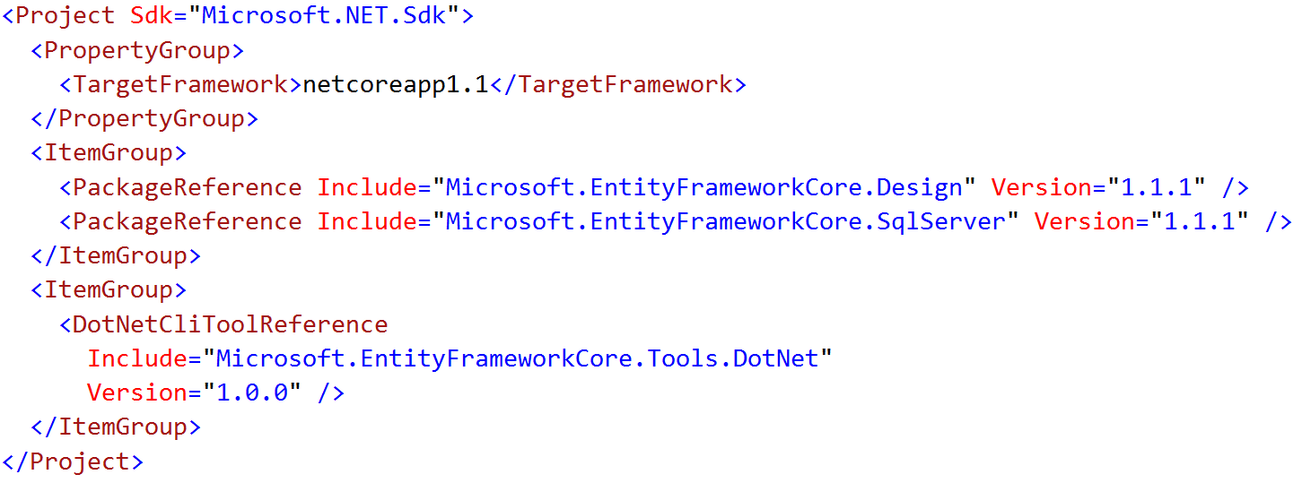
Enable the “dotnet ef” Command
Edit *.csproj
Add DotNetCliToolReference to Microsoft.EntityFrameworkCore.Tools.DotNet

Slide 33
EF Migrations = Entity Framework Version Control

Slide 34
Migrations from the Command Line
Add / Remove a Migration
dotnet ef migrations add “{name}”
dotnet ef migrations remove
Deploy an Update
dotnet ef database update

Slide 35
Things you need for EF Core
Entity Framework DB Context
Starting point for all your database operations
Microsoft.EntityFrameworkCore.DbContext
IDesignTimeDbContextFactory<T>
Handles creating instances of DbContext for doing migrations
Microsoft.EntityFrameworkCore.Design.IDesignTimeDbContextFactory

Slide 36
Hosting ASP.NET Core on IIS

Slide 37
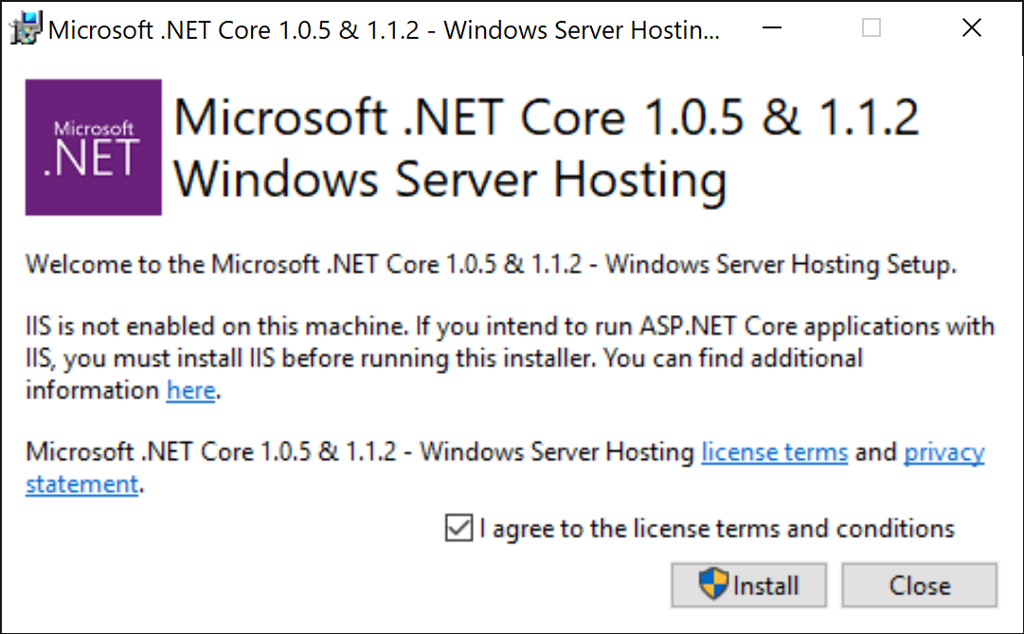
Host ASP.NET Core on IIS
Install .NET Core Windows Server Hosting Bundle
ASP.NET Core 1.* → https://go.microsoft.com/fwlink/?linkid=848766
ASP.NET Core 2.* → https://aka.ms/dotnetcore.2.0.0-windowshosting

Slide 38
TFS Build & Release

Slide 39
Demo: TFS Build

Slide 40
Monumental Gotcha: “dotnet ef database update” assumes that you have the source code…

Slide 41
(…and you won’t have your source code when you do a release.)

Slide 42
Demo: TFS Release

Slide 43
ASP.NET Core & EF Core DevOps Checklist
Code is under version control
Database schema & changes are under version control
Automated tests (unit tests, integration tests, UI tests)
Automated build
Automated release / deployment

Slide 44
Any last questions?

Slide 45
Thank you.
www.benday.com | benday@benday.com

Slide 46
.NET

