Slide 1

Entity Framework Core for Enterprise Applications
Benjamin Day
@benday

Slide 2




Benjamin Day
Brookline, MA
Consultant & Trainer
Scrum, DevOps,
Team Foundation Server,
Software Architecture & Testing
Microsoft MVP
Pluralsight Author
Scrum.org Trainer
@benday

Slide 3
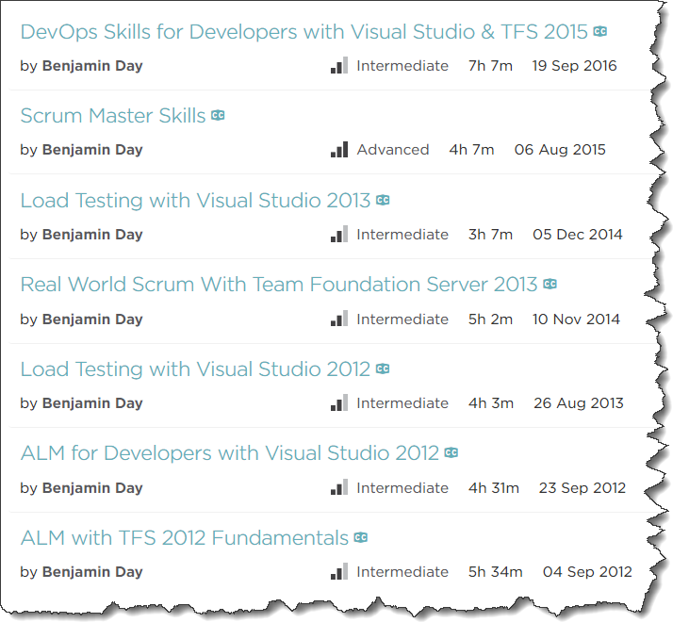
Pluralsight.com
DevOps with TFS2017
  Coming soon!
DevOps with TFS2015
Scrum Master Skills

Slide 4
Overview
EF Core vs. EF Standard
Relationships
  Property & Navigation Types
  Querying with
  Shadow Properties
  The Dreaded Many-to-Many
Lazy Loading
Cascading Deletes
Concurrency Management
Software Architecture
Unit Testing
Schema Management
DevOps
Performance in a Web App

Slide 5
On with the show.

Slide 6
How did we get here?

Slide 7
ADO.NET

Slide 8
Object-Relational Impedance Mismatch,
Object-Relational Mappers (ORMs)

Slide 9
Anything that lets me go fast now, robs me of my ability to maintain it later.

Slide 10
Enterprise Software =
Non-disposable software

Slide 11
Rule #1:
You don’t work for EF.
EF works for you.

Slide 12
Rule #2:
Use EF for what it’s good at and be ready to bail out when it doesn’t.

Slide 13
Rule #3:
Hide EF from your application.

Slide 14
Rule #4:
Just because you can doesn’t mean you should.

Slide 15
EF Core vs. EF Standard
Full feature comparison
  https://docs.microsoft.com/en-us/ef/efcore-and-ef6/index
It’s mostly the same
  If you’re “code first”
Some things are missing

Slide 16
Big things that are missing
Complex types without identity
  Name, PhoneNumber
Many-to-many relationships without a JOIN entity
Inheritance mapping only does Table-per-hierarchy (TPH)
  No Table-per-type (TPT)
Spatial types
  Geography & Geometry
Saving using Stored Procedures
  (Easily at least)
Raw SQL to anonymous types
Lazy loading

Slide 17
Lazy Loading

Slide 18
Lazy Loading
Person has PhoneNumbers
  public IList<Phone> PhoneNumbers { get; }
Phone has Owner
  public Person Owner { get; set; }
In EF Standard → PhoneNumbers loaded when accessed
In EF Core → PhoneNumbers is null

Slide 19
EF Core requires explicit loading using
Include() & ThenInclude()

Slide 20
Demo:
Person & PhoneNumbers

Slide 21
Relationships

Slide 22
Relationships
Terminology
Relationship Types
Principal Entity
  Owns the primary key
  Parent
Dependent Entity
  Has foreign key
  Child in relationship
One to One
  Navigation property
One to Many
  Collection navigation property
Many to One
  Inverse navigation property

Slide 23
Cascading Deletes
What happens when something in a relationship is deleted?
Delete Types
  Microsoft.EntityFrameworkCore.Metadata.DeleteBehavior
Cascade → Delete the dependent entity
SetNull → Delete Principal, set inverse property on Dependent to null
Restrict → Do nothing, delete is manual

Slide 24
Demo:
Animals & Foods

Slide 25
Concurrency Management

Slide 26
Concurrency Management
Multiple people using your app without stomping on each other’s data
Configure using Fluent API or Attribute
[Timestamp] attribute
  byte[]
[ConcurrencyCheck] attribute
  DateTime, string, or int

Slide 27
Stored Procedures

Slide 28
Stored Procedures from EF Core
Better for retrieves than for saves
Single result set
Only for mapped types (not anonymous)
Has to bring back all properties/fields

Slide 29
Demo:
Animals By Food Id

Slide 30
Recommended Software Architecture

Slide 31
Architecture Recommendations
Don’t try to model inheritance in EF
Hide EF behind Repository Pattern & Adapter Pattern
  Code to interfaces
  Treat EF entities as data access objects
  Hide your data access objects
Write unit tests
  Unit tests are not Integration tests
Write integration tests for the Repositories
  Test your Collection saves & deletes
  Test your concurrency

Slide 32
Performance Tips

Slide 33
Performance Tips
Only optimize for known performance problems!
If you don’t need to save it in the same transaction…
  AsNoTracking()
  Turns off change tracking
Think hard about eager loading
  Minimize your use of Include(), ThenInclude()
  Only bring back what you need

Slide 34
DevOps & Schema Management

Slide 35
Humans are terrible at multitasking.

Slide 36
Productivity vs. Waste
"Quality Software Management: Vol. 1 System Thinking“, Gerald Weinberg (1992)

Slide 37
To be productive, eliminate distractions.

Slide 38
Software delivery not software development.

Slide 39
Anything that slows you down, automate it.

Slide 40
What is DevOps?

Slide 41
DevOps is a mindset plus a set of practices that focuses on automation.

Slide 42
Why DevOps?
Minimize distractions
Focus on delivering software
Eliminate the tedious stuff
Bridge the divide between development, delivery, deployment, and operations

Slide 43
Make delivery & deployment easy.

Slide 44
If delivery & deployment is easy…
…it’s not a big deal
…you’ll do it more often
…you can focus more time writing & delivering features

Slide 45
DevOps Goals
Repeatable, Automated, & Version Controlled
  Including configuration
Never deploy from a developer workstation
  No right-click → deploy
Deploy from TFS Build
Deploy from TFS Release Management Pipeline

Slide 46
Everything happens through the
“dotnet” command.

Slide 47
DevOps: Don’t Forget the Database!
Does your app use a database?
  You’ll need to version control it
Automated build & deploy of database schemas
Two approaches:
  SQL Server Data Tools (SSDT)
  Entity Framework Migrations

Slide 48
.NET Core DevOps Tip:
Learn how to do everything from the command line

Slide 49
Entity Framework Core

Slide 50
EF Core NuGet Packages
Talk to SQL Server
Microsoft.EntityFrameworkCore.SqlServer
Database Updates (“Migrations”)
Microsoft.EntityFrameworkCore.Design
Reverse Engineer a SQL Server Database
Microsoft.EntityFrameworkCore.SqlServer.Design

Slide 51
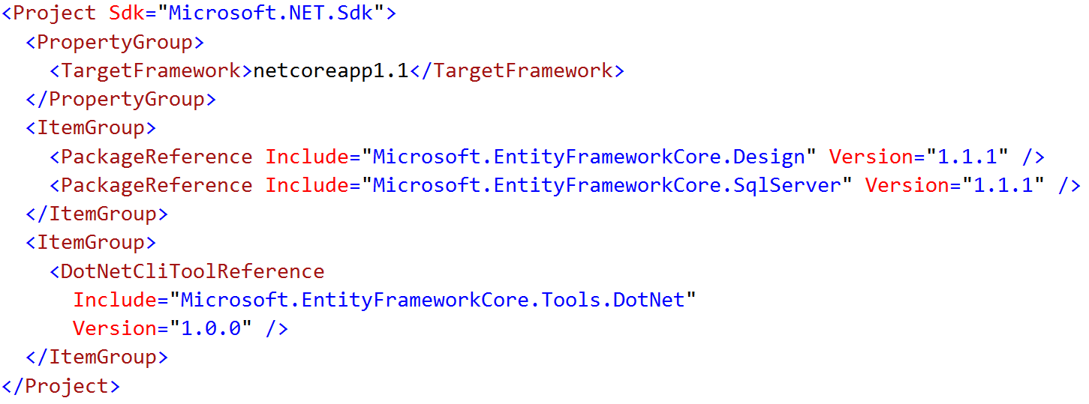
Enable the “dotnet ef” Command
Edit *.csproj
Add DotNetCliToolReference to
Microsoft.EntityFrameworkCore.Tools.DotNet

Slide 52
EF Migrations =
Entity Framework Version Control

Slide 53
Migrations from the Command Line
Add / Remove a Migration
dotnet ef migrations add “{name}”
dotnet ef migrations remove
Deploy an Update
dotnet ef database update

Slide 54
Demo: Migrations
Add an Initial Migration
Deploy the Database
DbContextFactory
Fix hard-coded connection strings

Slide 55
Import Existing Database to EF Core
dotnet ef dbcontext scaffold
dotnet ef dbcontext scaffold -c {dbcontext-name} "Server=(local); Database={database}; Trusted_Connection=true;" Microsoft.EntityFrameworkCore.SqlServer

Slide 56
Team Foundation Server 2017 & VSTS
Demos

Slide 57
Demo: EF Core with TFS Build
Create a basic build
Edit connection strings
Deploy db changes using EF Migrations

Slide 58
Demo: EF Core with TFS Release Management
Use Release Management
Deploy to Multiple Environments
Add Environment Approvals

Slide 59
Any last questions?

Slide 60
Thank you.
www.benday.com | benday@benday.com

