Slide 1
DevOps with ASP.NET Core and Entity Framework Core
Benjamin Day

Slide 2




Benjamin Day
Brookline, MA
Consultant & Trainer
Scrum, DevOps,
Team Foundation Server,
Software Architecture & Testing
Microsoft MVP
Pluralsight Author
Scrum.org Trainer
@benday

Slide 3
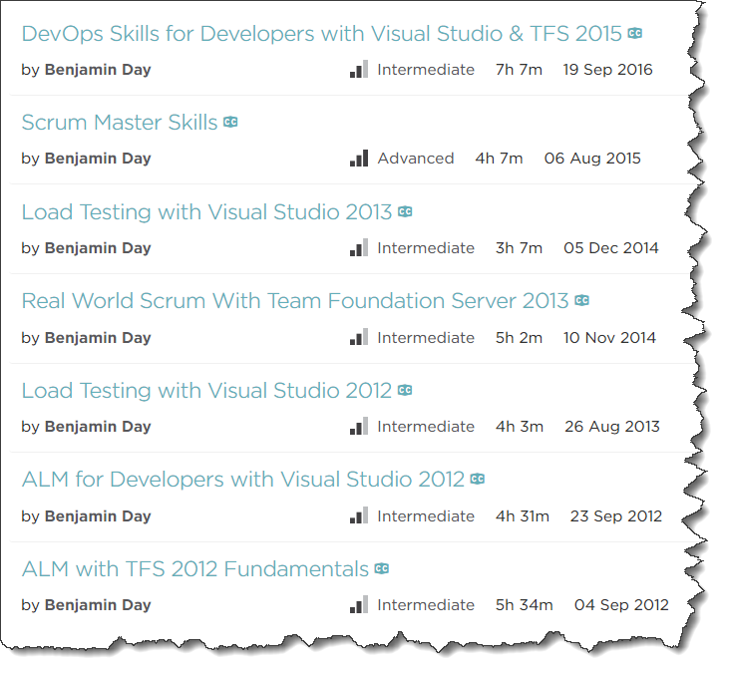
Pluralsight.com
Online courses
DevOps with TFS2015
Scrum Master Skills

Slide 4
On with the show.

Slide 5
Humans are terrible at multitasking.

Slide 6
Productivity vs. Waste
"Quality Software Management: Vol. 1 System Thinking“, Gerald Weinberg (1992)

Slide 7
To be productive, eliminate distractions.

Slide 8
Software delivery not software development.

Slide 9
Anything that slows you down, automate it.

Slide 10
What is DevOps?

Slide 11
DevOps is a mindset plus a set of practices that focuses on automation.

Slide 12
Why DevOps?
Minimize distractions
Focus on delivering software
Eliminate the tedious stuff
Bridge the divide between development, delivery, deployment, and operations

Slide 13
Make delivery & deployment easy.

Slide 14
If delivery & deployment is easy…
…it’s not a big deal
…you’ll do it more often
…you can focus more time writing & delivering features

Slide 15
DevOps Goals
Repeatable, Automated, & Version Controlled
  Including configuration
Never deploy from a developer workstation
  No right-click → deploy
Deploy from TFS Build
Deploy from TFS Release Management Pipeline

Slide 16
ASP.NET Core &
Entity Framework Core

Slide 17
DevOps with ASP.NET Core & EF Core
Tricky
Cross-platform
Windows, Mac, & Linux
More frameworks to target
New config files
New project format
New IDEs
  Visual Studio 2017
  Visual Studio for Mac
  Visual Studio Code

Slide 18
DevOps: Don’t Forget the Database!
Does your app use a database?
  You’ll need to version control it
Automated build & deploy of database schemas
Two approaches:
  SQL Server Data Tools (SSDT)
  Entity Framework Migrations

Slide 19
.NET Core DevOps Tip:
Learn how to do everything from the command line

Slide 20
.NET Core Command Line Cheat Sheets

Slide 21
Everything happens through the
“dotnet” command.

Slide 22
dotnet =
.NET Core CLI

Slide 23
Go to http://dot.net
Download the .NET Core SDK https://www.microsoft.com/net/download/core

Slide 24
Create Solutions & Projects
dotnet new
  sln
  classlib
  mvc
  mstest
dotnet sln {solution-filename} add {path-to-csproj}

Slide 25
Add References
Add a Project Reference
dotnet add {from-csproj-file} reference {to-csproj-file}
Add a NuGet Package
dotnet add {from-csproj-file} package {package-name}

Slide 26
Compile
Restore all dependencies
dotnet restore
Build the project or solution
dotnet build
Clean the folder structure
dotnet clean

Slide 27
Entity Framework Core

Slide 28
EF Core NuGet Packages
Talk to SQL Server
Microsoft.EntityFrameworkCore.SqlServer
Database Updates (“Migrations”)
Microsoft.EntityFrameworkCore.Design
Reverse Engineer a SQL Server Database
Microsoft.EntityFrameworkCore.SqlServer.Design

Slide 29
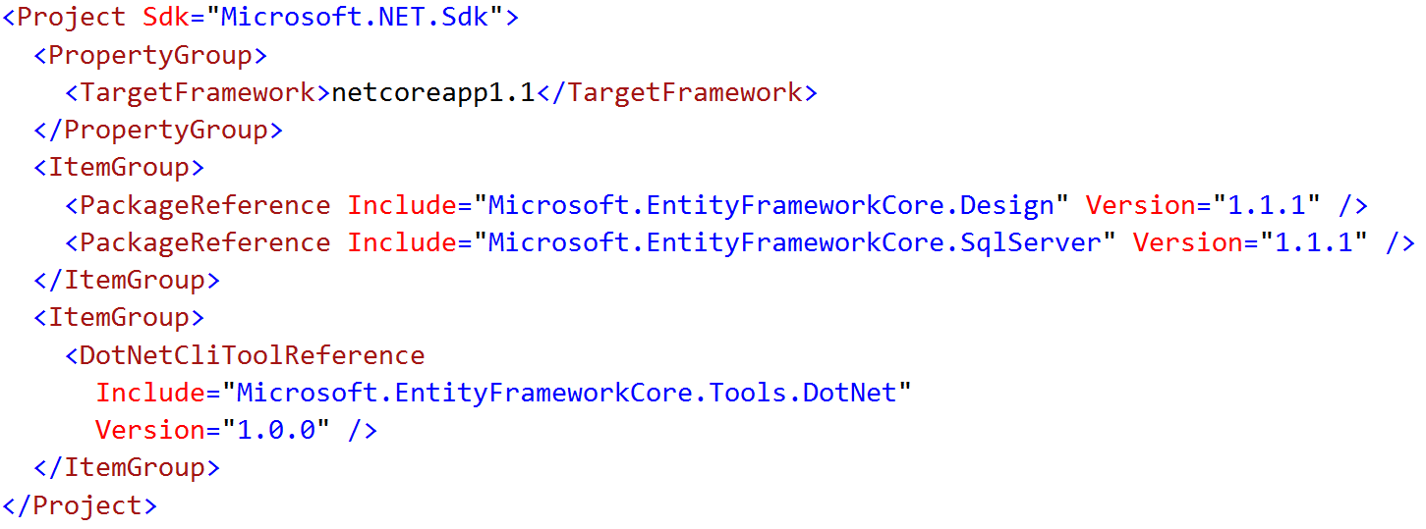
Enable the “dotnet ef” Command
Edit *.csproj
Add DotNetCliToolReference to
Microsoft.EntityFrameworkCore.Tools.DotNet

Slide 30
EF Migrations =
Entity Framework Version Control

Slide 31
Migrations from the Command Line
Add / Remove a Migration
dotnet ef migrations add “{name}”
dotnet ef migrations remove
Deploy an Update
dotnet ef database update

Slide 32
Import Existing Database to EF Core
dotnet ef dbcontext scaffold
dotnet ef dbcontext scaffold -c {dbcontext-name} "Server=(local); Database={database}; Trusted_Connection=true;" Microsoft.EntityFrameworkCore.SqlServer

Slide 33
Hosting ASP.NET Core on IIS

Slide 34
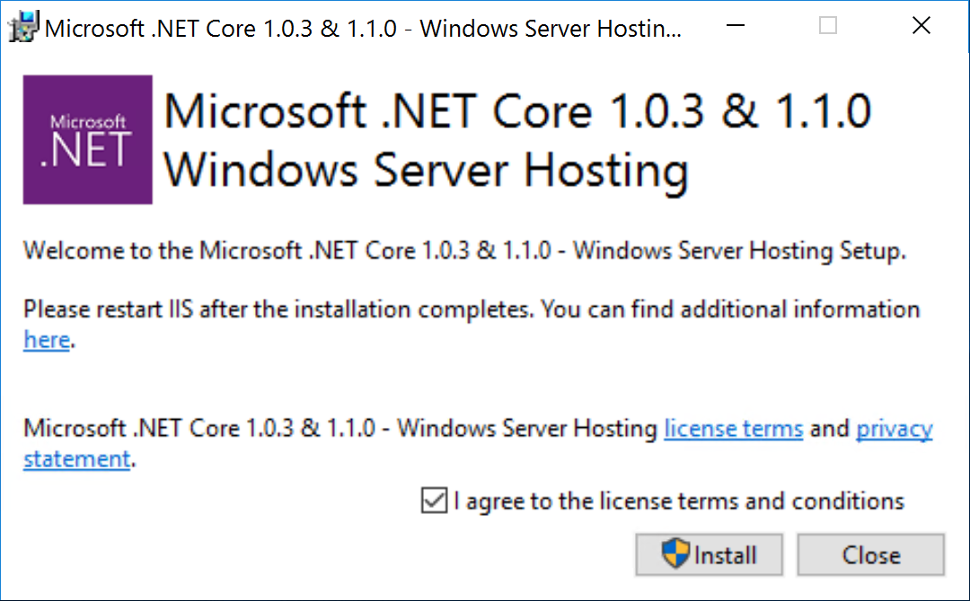
Host ASP.NET Core on IIS
Install .NET Core Windows Server Hosting Bundle
https://go.Microsoft.com/fwlink/?linked=837808

Slide 35
Demos

Slide 36
Demo 1
Create a Solution
Create Projects
Create References

Slide 37
Demo 2
Add Entity Framework Core NuGet Libraries
Add DbContext & Entity
Add an Initial Migration
Deploy the Database

Slide 38
Demo 3
DbContextFactory
Fix hard-coded connection strings
Add unit test

Slide 39
Demo 4
Add ASP.NET Core Web Interface

Slide 40
Demo 5
Create Team Project
Add to TFS Version Control

Slide 41
Demo 6
Create a basic build
Edit connection strings
Deploy db changes using EF Migrations

Slide 42
Demo 7
Use Release Management
Deploy to Multiple Environments
Add Environment Approvals

Slide 43
Any last questions?

Slide 44
Thank you.
www.benday.com | benday@benday.com

