Slide 1
Real World Scrum with
TFS 2015 & VSTS
Benjamin Day
www.benday.com @benday

Slide 2
Real World Scrum with
TFS 2015 & VSTS
Benjamin Day
www.benday.com @benday

Slide 3
Real World Scrum with
TFS 2015 & VSTS
Benjamin Day @benday

Slide 4
Benjamin Day
Brookline, MA
Consultant, Coach, & Trainer
Microsoft MVP for Visual Studio ALM
Scrum, Team Foundation Server, Software Testing, Software Architecture
Scrum.org Classes
Professional Scrum Master (PSM)
Professional Scrum Developer (PSD)
Professional Scrum Foundations (PSF)
www.benday.com, benday@benday.com, @benday

Slide 5
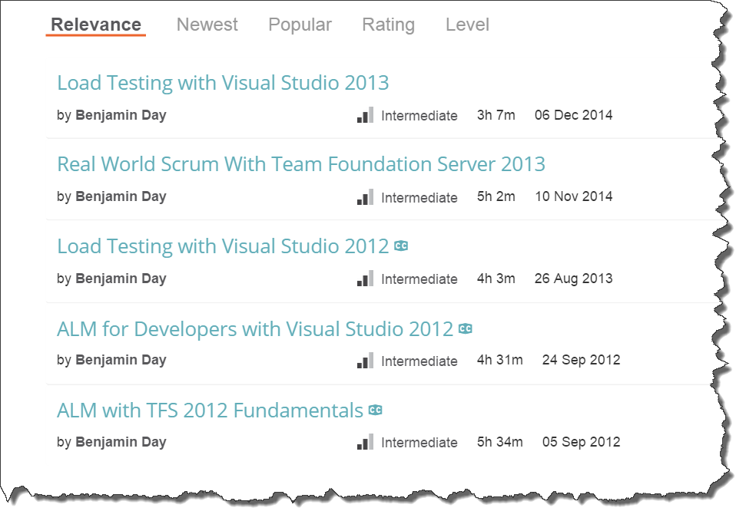
Got ?

Slide 6
Hot off the presses!
DevOps Skills for Developers with Visual Studio & TFS 2015

Slide 7
Scrum Overviews in the Pluralsight Library
Scrum Master Skills
Module 1 | Chapter 2 | Scrum Overview
6 min
Real World Scrum With Team Foundation Server 2013
Module 1 | Chapter 2 | Scrum Overview
43 min
Scrum Fundamentals
by David Starr
3.5 hours

Slide 8
Get “people Scrum” right before “TFS Scrum”

Slide 9
TFS will help you do good Scrum but won’t make you do good Scrum.

Slide 10
Do you have a Definition of Done?

Slide 11
A written DoD is a list of everything that is required before you can say a PBI is Done.

Slide 12
Here’s a hint:

Slide 13
It’s a lot more than “the code compiles and is checked in.”

Slide 14
Sample Definition of Done (DoD)
Development / Coder
Testing, Deployment, Ops
Code is written with unit tests
Unit tests have a minimum of 75% code coverage
Code has been merged to Main
Code compiles and unit tests pass when run as part of an automated build
Database schema objects are checked in to TFS
Database upgrade script is written and in TFS
Code reviewed by someone other than the original author
Written QA test plan
Tested with QA test plan by someone other than the original author
Deployed and tested in Staging environment
Automated UI tests are written and pass
No Severity 1 or 2 bugs
Reviewed by Product Owner
Passes acceptance criteria for the PBI
Known deployment & rollback plan
Deployment plan reviewed by Ops
Database changes reviewed by DBAs
Load tested
Deployed to Production

Slide 15
Why is a Written DoD so Important?
Makes it clear what all the steps are
Everyone can look at the steps → a shared understanding
Helps with team-based estimation
Helps minimize or eliminate Technical Debt
Helps to manage management expectations
Helps with the “two second change” request

Slide 16
TFS + Visual Studio help you to automate your DoD and streamline your path to DoD.

Slide 17
And now, the fastest Scrum overview of all time...

Slide 18
Scrum: The Big Picture
Stakeholders
Sprint Planning
Meeting
Sprint Review
Product
Owner
Retrospective
Sprint
Increment
Daily
Scrum
Product
Backlog
Sprint
Backlog
Product
Owner
Development
Team
Scrum
Master
Stakeholder

Slide 19
It’s all about done, working software.

Slide 20
You stop in order to keep yourself honest.

Slide 21
Manage your risk in the face of uncertainty.

Slide 22
Eliminate waste.

Slide 23
It’s all about done, working software.

Slide 24
Scrum: The Big Picture
Stakeholders
Sprint Planning
Meeting
Sprint Review
Product
Owner
Retrospective
Sprint
Increment
Daily
Scrum
Product
Backlog
Sprint
Backlog
Product
Owner
Development
Team
Scrum
Master
Stakeholder

Slide 25
Where does TFS fit in?

Slide 26
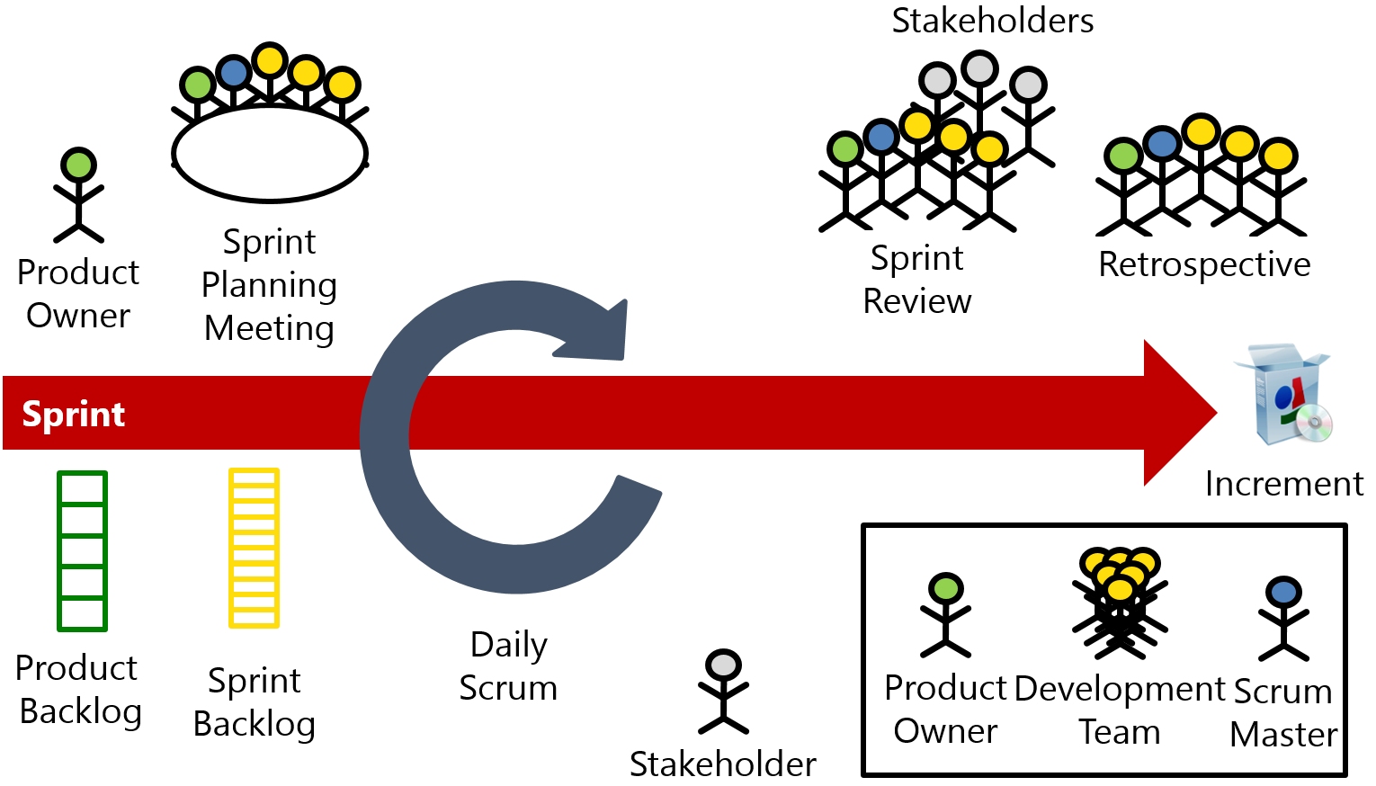
TFS + Scrum
Backlog management
Sprint Planning
Sprint Management

Slide 27
TFS + Scrum + Real World
Backlog management
Sprint Planning
Sprint Management
Definition of Done
Test Case Management
Automated Builds
Automated Testing
Release Management
Deployment
Feedback Management

Slide 28
 |  | Scrum Events |  |  |  |  | Supporting Activities
 |  | Sprint Planning | Daily Scrum | Sprint Review | Sprint Retrospective |  | Product Ownership | DoD | Collaboration | Best Practices | Enterprise Scrum
Work Items | Backlog Manager | X |  | X | X |  | X |  |  |  | X
 | Sprint Planner | X |  | X | X
 | Scrum Board |  | X | X | X |  |  |  | X
 | Burndown Chart |  | X |  | X |  |  |  | X
 | Kanban Board |  | X |  | X |  | X |  | X
 | Work item Tracking |  |  | X | X |  |  |  | X
 | Velocity Chart | X |  | X | X |  | X
 | Cumulative Flow Diagram |  |  |  |  |  | X
 | Capacity Planner | X |  |  |  |  |  |  | X
 | Work Item Charts |  | X |  |  |  | X |  | X
Code | Source Control |  |  |  | X |  |  | X | X | X
 | Code Reviews |  |  |  | X |  |  | X | X | X
 | Lightweight Code Commenting |  |  |  |  |  |  | X | X
 | Unit Testing |  |  |  | X |  |  | X |  | X
Build | Automated Builds |  |  |  | X |  |  | X |  | X
 | Deploy w/ Lab Management |  |  |  | X |  |  | X | X
 | Deploy w/ Release Management |  |  |  | X |  |  | X | X
Collaboration | SharePoint |  |  |  | X |  |  |  | X
 | Team Rooms |  |  |  |  |  |  |  | X | X
 | Team Home Page |  |  |  |  |  |  |  | X
 | Teams |  |  |  |  |  |  |  | X |  | X
 | Feedback Manager |  |  |  | X |  | X | X | X
 | PowerPoint Storyboarding | X |  |  | X |  | X |  | X
Testing | Test Case Management |  |  | X | X |  |  | X | X
 | Defect Tracking |  |  |  | X |  |  | X | X
 | Load Testing |  |  |  | X |  |  | X |  | X

Slide 29
And now a lot of demos…

Slide 30
Demos
Backlog Management / Refinement
Sprint Planning
Daily Scrum
Situational Awareness
Home Page
Team Rooms
Charting
“QA” Test Tracking
Automated Build + DoD
Lightweight Requirements

Slide 32
Any last questions?

Slide 33
Thanks. benday@benday.com | www.benday.com

Slide 34
Branching lets you work on similar, related code in isolation at the same time.

Slide 35
Branching is much easier to do in Git.

Slide 36
“So, I can go nuts and create 250 zillion branches now and it’s a good idea?”

Slide 37
No.

Slide 39
A branch is an integration credit card.

Slide 40
For every branch, there’s a merge.

Slide 41
Merging can be expensive and painful.

Slide 42
Until everything’s integrated, it’s definitely not done.

Slide 43
Keep it simple.

Slide 44
Integrate often.

Slide 45
The smaller the integration, the easier it is.

Slide 46
“You can drive with your feet. It doesn’t mean it’s a good idea.” *
* - paraphrased

Slide 47
Sprint: Day 1 of 15
 | TO DO | IN PROGRESS | DONE
PBI A
PBI B
PBI C

Slide 48
Sprint: Day 2 of 15
 | TO DO | IN PROGRESS | DONE
PBI A
PBI B
PBI C

Slide 49
Sprint: Day 5 of 15
 | TO DO | IN PROGRESS | DONE
PBI A
PBI B
PBI C

Slide 50
Sprint: Day 8 of 15
 | TO DO | IN PROGRESS | DONE
PBI A
PBI B
PBI C

Slide 51
Sprint: Day 11 of 15
 | TO DO | IN PROGRESS | DONE
PBI A
PBI B
PBI C

Slide 52
Sprint: Day 12 of 15
 | TO DO | IN PROGRESS | DONE
PBI A
PBI B
PBI C

Slide 53
Sprint: Day 13 of 15
 | TO DO | IN PROGRESS | DONE
PBI A
PBI B
PBI C

Slide 54
Sprint: Day 14 of 15
 | TO DO | IN PROGRESS | DONE
PBI A
PBI B
PBI C

Slide 55
Sprint: Day 15 of 15 (in your dreams)
 | TO DO | IN PROGRESS | DONE
PBI A
PBI B
PBI C

Slide 56
Sprint: Day 15 of 15 (in reality)
 | TO DO | IN PROGRESS | DONE
PBI A
PBI B
PBI C

Slide 57
Don’t use branches to avoid talking to your teammates.

Slide 58
Do less at once. Focus on done. Integrate often.

Slide 59
Sprint: Day 1 of 15
 | TO DO | IN PROGRESS | DONE
PBI A
PBI B
PBI C

Slide 60
Sprint: Day 2 of 15
 | TO DO | IN PROGRESS | DONE
PBI A
PBI B
PBI C

Slide 61
Sprint: Day 5 of 15
 | TO DO | IN PROGRESS | DONE
PBI A
PBI B
PBI C

Slide 62
Sprint: Day 6 of 15
 | TO DO | IN PROGRESS | DONE
PBI A
PBI B
PBI C

Slide 63
Sprint: Day 10 of 15
 | TO DO | IN PROGRESS | DONE
PBI A
PBI B
PBI C

Slide 64
Sprint: Day 11 of 15
 | TO DO | IN PROGRESS | DONE
PBI A
PBI B
PBI C

Slide 65
Sprint: Day 15 of 15
 | TO DO | IN PROGRESS | DONE
PBI A
PBI B
PBI C

