Slide 1
Get Good at DevOps: Feature Flag Deployments with ASP.NET, WebAPI, & JavaScript
Benjamin Day
www.benday.com @benday

Slide 2
Get Good at DevOps: Feature Flag Deployments with ASP.NET, WebAPI, & JavaScript
Benjamin Day
www.benday.com @benday

Slide 3
Benjamin Day
Brookline, MA
Consultant, Coach, & Trainer
Microsoft MVP for Visual Studio ALM
Scrum, Team Foundation Server, Software Testing, Software Architecture
Scrum.org Classes
Professional Scrum Master (PSM)
Professional Scrum Developer (PSD)
Professional Scrum Foundations (PSF)
www.benday.com, benday@benday.com, @benday

Slide 4
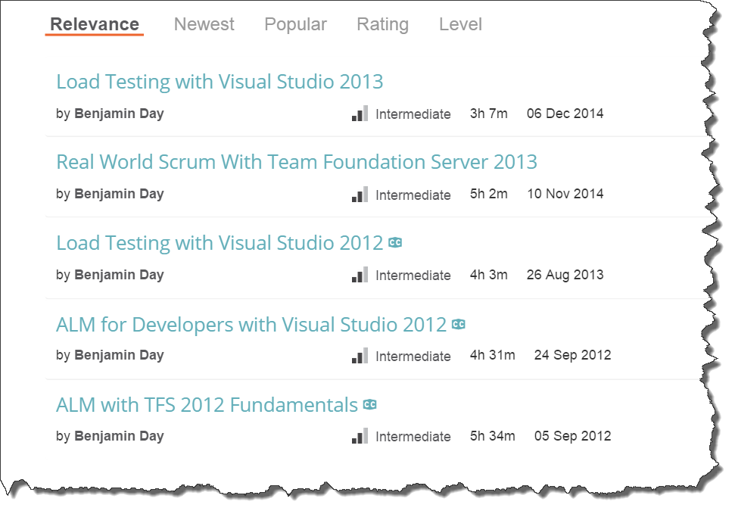
Got ?

Slide 5
Fresh from Pluralsight HQ!
DevOps Skills for Developers with Visual Studio & TFS 2015

Slide 6
Software development is hard.

Slide 7
Software delivery is hard.

Slide 8
How do you get a feature into production?

Slide 9
Branching & Merging

Slide 10
Branching lets you work on similar, related code in isolation at the same time.

Slide 11
“So, I can go nuts and create 250 zillion branches and it’s a good idea?”

Slide 12
No.

Slide 13
A branch is an integration credit card.

Slide 14
For every branch, there’s a merge.

Slide 15
Merging can be expensive and painful.

Slide 16
Until everything’s integrated, it’s definitely not done.

Slide 17
Keep it simple.

Slide 18
Best Practice: Don’t Branch *
* - unless you absolutely have to

Slide 19
Integrate often.

Slide 20
The smaller the integration, the easier it is.

Slide 21
Typical Branching Structure
Main, Trunk, Origin, $/TeamProject/
Dev
Feature-x
Releases
v.1
v.2
v.3..n
Feature-y
Feature-z

Slide 22
Typical Branching Structure
Main, Trunk, Origin, $/TeamProject/
Dev
Feature-x
Feature-y
Feature-z
Releases
v.1
v.2
v.3..n
Main
Beginning of everything
Ultimate integration point
Dev
Integration point for a release
Feature-*
Features are developed here
Releases (v.*)
Snapshot of what goes to production
Source of hot fixes

Slide 23
Typical Release Flow
MERGE
Main, Trunk, Origin, $/TeamProject/
Dev
Feature-x
Feature-y
Feature-z
Releases
v.*
Merge Features to Dev
Verify / fix whatever is in Dev
Merge to Main
Create new Release branch
V.1123414
2016.03.15
Deploy to production servers
MERGE
BRANCH

Slide 24
Typical Release Flow
MERGE
Main, Trunk, Origin, $/TeamProject/
Dev
Feature-x
Feature-y
Feature-z
Releases
v.*
Whatever gets merged to Main gets released
Code-based release model
MERGE
BRANCH

Slide 25
Typical Release Flow: Bad News
MERGE
Main, Trunk, Origin, $/TeamProject/
Dev
Feature-x
Feature-y
Feature-z
Releases
v.*
Merge Feature X
Easy
Commit the merge
Merge Feature Y
Ok
Commit the merge
Merge Feature Z
HARD
REALLY REALLY HARD
Turns out that Feature X isn’t done
Major surgery to get this undone

Slide 26
Typical Release Flow: Bad News
MERGE
Main, Trunk, Origin, $/TeamProject/
Dev
Feature-x
Feature-y
Feature-z
Releases
v.*
Feature branch integrations are not going well
Getting merged code to “play nice” means manually un-doing work that’s already been committed
Cherry picking
DELAYS

Slide 27
Typical Release Flow: Bad News, Change of plans
MERGE
Main, Trunk, Origin, $/TeamProject/
Dev
Feature-x
Feature-y
Feature-z
Releases
v.*
Merge Features to Dev
Commit the merge
Boss wants only Feature X and Z to go live
Merge Feature X and Z to Main
Painful, annoying, & tedious
Commit the merge

Slide 28
Releases based on source control can be a real drag.

Slide 29
Releases based on Source Control
Whatever is in the branch goes to production
Whatever is in production is live
Pros:
Simple to understand
Cons
Coordination can be a real headache

Slide 30
Feature flags

Slide 31
Feature Flags
“Feature toggles”
Configuration-based releases
Define configuration values for features
This is a feature flag
On / Off
Wrap feature code inside of checks for feature flag
If it’s on, it runs
Deploy whatever doesn’t cause problems
Turn on whatever is ready
Much less emphasis on branching & merging
Easier to schedule
The features are already deployed
Turn them on when you’re ready

Slide 32
Feature Flag: Benefits
New levels of flexibility
Deploy multiple versions of the same feature side-by-side
New user interfaces and old user interfaces at same time
Private betas
New features for only certain users
A/B testing
Which version do people prefer?
Rollback
Not working?
Performance problems?
Great for Scrum & DevOps

Slide 33
Feature Flag: Drawbacks
Adds complexity to the code
Can get confusing
Technical debt
Should be removed at some point
For example, running two version of a feature should be temporary
Sometimes turns into an excuse to ship garbage
Lack of focus on being truly “Done”

Slide 34
DevOps?

Slide 35
DevOps
How are you developing, delivering, deploying, & monitoring?
“What is the process of getting a developer’s changeset from check-in to production? How long does that take?”
If you want to go fast, start automating
Automation removes hard / tedious stuff
Automation provides reliability
Automation helps you do more and go faster
Stability, Reliability, Repeatability, Release-ability

Slide 36
DevOps increases the speed of feedback.

Slide 37
DevOps increases the speed of mistakes.

Slide 38
DevOps increases the speed of feedback.
Product Ownership in an Agile world is all about experimentation
Each new feature is an experiment
Build as little code as possible → Minimum Viable Product (MVP)
Ship it & gather feedback
That’s the experiment
You don't always want to commit to these experiments.

Slide 39
“Go big or go home” vs. “Go small and quietly and go home if it doesn’t work”

Slide 40
Technical Stuff

Slide 41
Implementation Tips
Create an IFeatureManager interface
Each feature flag should be a Boolean property
NO MAGIC STRINGS!
Use Dependency Injection for your IFeatureManager
Makes it very easy to find and remove later

Slide 42
DEMOS
Basic feature flag
Search
Two features side-by-side
Undeploy a feature that’s getting bad reviews
Private beta

Slide 43
A feature flag is (probably) technical debt.

Slide 44
Any specific feature flag should eventually be removed.

Slide 45
Your feature flag system is forever. The individual feature flags are temporary.

Slide 46
Watch out for technical debt.

Slide 47
Any last questions?

Slide 48
Thanks. benday@benday.com | www.benday.com

