Slide 1
Real World Scrum with
TFS 2015 & VSTS
Benjamin Day
www.benday.com @benday

Slide 2
Real World Scrum with
TFS 2015 & VSTS
Benjamin Day @benday

Slide 3
Benjamin Day
Brookline, MA
Consultant, Coach, & Trainer
Microsoft MVP for Visual Studio ALM
Scrum, Team Foundation Server, Software Testing, Software Architecture
Scrum.org Classes
Professional Scrum Master (PSM)
Professional Scrum Developer (PSD)
Professional Scrum Foundations (PSF)
www.benday.com, benday@benday.com, @benday

Slide 4
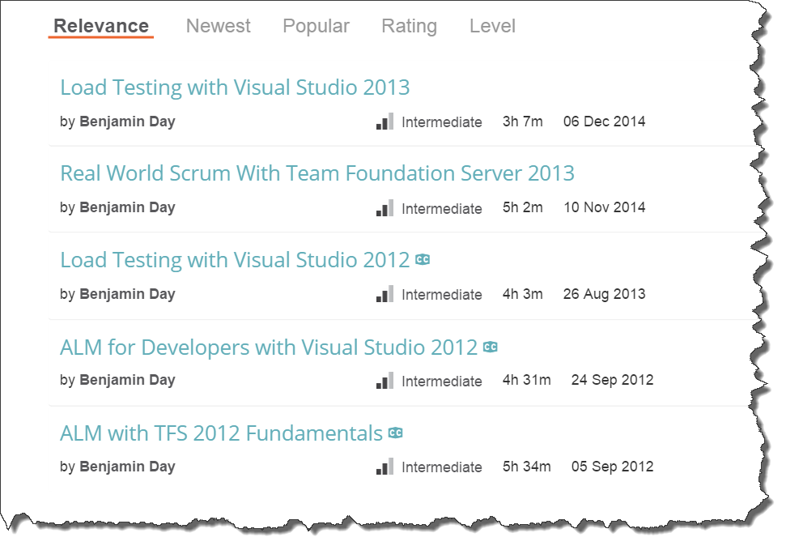
Got ?

Slide 5
Scrum Overviews in the Pluralsight Library
Scrum Master Skills
Module 1 | Chapter 2 | Scrum Overview
6 min
Real World Scrum With Team Foundation Server 2013
Module 1 | Chapter 2 | Scrum Overview
43 min
Scrum Fundamentals
by David Starr
3.5 hours

Slide 6
And now, the fastest Scrum overview of all time...

Slide 7
Scrum: The Big Picture
Stakeholders
Sprint Planning
Meeting
Sprint Review
Product
Owner
Retrospective
Sprint
Increment
Daily
Scrum
Product
Backlog
Sprint
Backlog
Product
Owner
Development
Team
Scrum
Master
Stakeholder

Slide 8
It’s all about done, working software.

Slide 9
You stop in order to keep yourself honest.

Slide 10
Manage your risk in the face of uncertainty.

Slide 11
Eliminate waste.

Slide 12
It’s all about done, working software.

Slide 13
Scrum: The Big Picture
Stakeholders
Sprint Planning
Meeting
Sprint Review
Product
Owner
Retrospective
Sprint
Increment
Daily
Scrum
Product
Backlog
Sprint
Backlog
Product
Owner
Development
Team
Scrum
Master
Stakeholder

Slide 14
Where does TFS fit in?

Slide 15
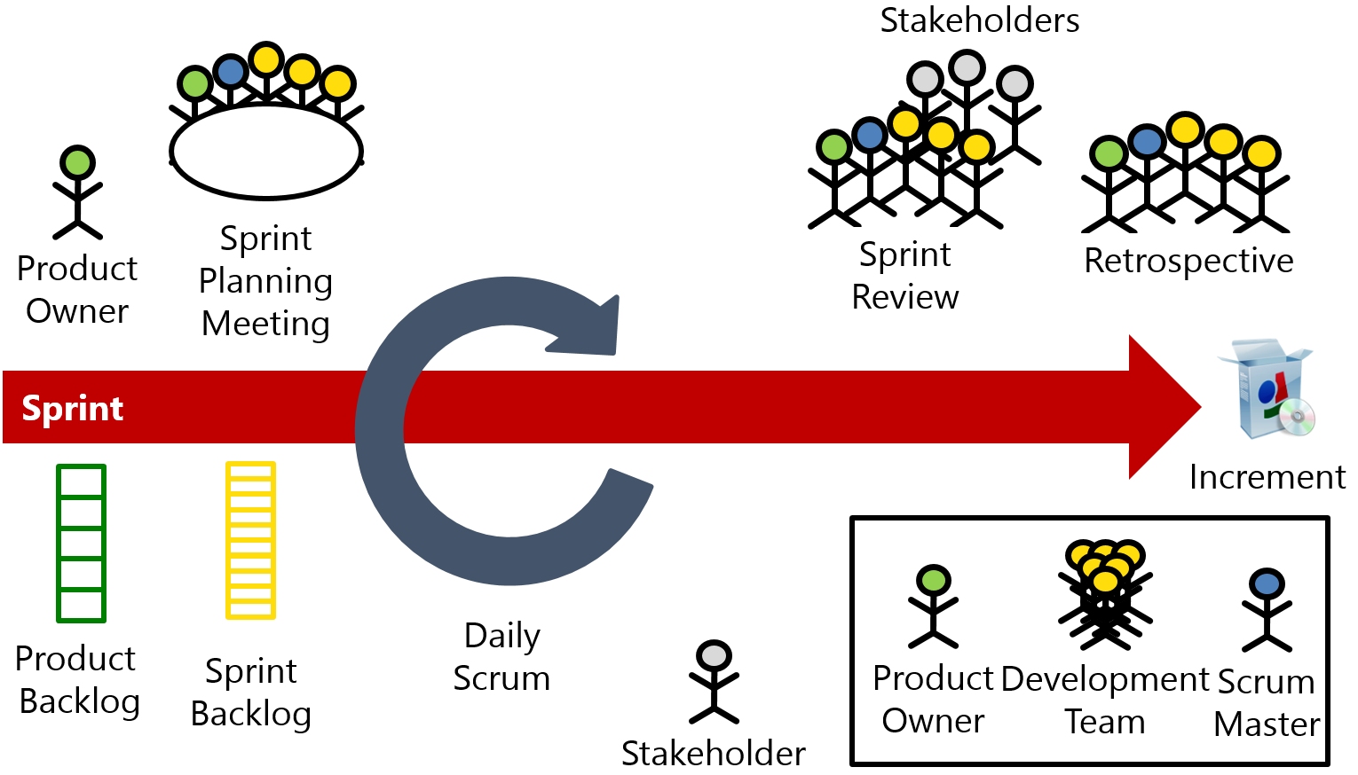
TFS + Scrum
Backlog management
Sprint Planning
Sprint Management

Slide 16
TFS + Scrum + Real World
Backlog management
Sprint Planning
Sprint Management
Definition of Done
Test Case Management
Automated Builds
Automated Testing
Release Management
Deployment
Feedback Management

Slide 17
 |  | Scrum Events |  |  |  |  | Supporting Activities
 |  | Sprint Planning | Daily Scrum | Sprint Review | Sprint Retrospective |  | Product Ownership | DoD | Collaboration | Best Practices | Enterprise Scrum
Work Items | Backlog Manager | X |  | X | X |  | X |  |  |  | X
 | Sprint Planner | X |  | X | X
 | Scrum Board |  | X | X | X |  |  |  | X
 | Burndown Chart |  | X |  | X |  |  |  | X
 | Kanban Board |  | X |  | X |  | X |  | X
 | Work item Tracking |  |  | X | X |  |  |  | X
 | Velocity Chart | X |  | X | X |  | X
 | Cumulative Flow Diagram |  |  |  |  |  | X
 | Capacity Planner | X |  |  |  |  |  |  | X
 | Work Item Charts |  | X |  |  |  | X |  | X
Code | Source Control |  |  |  | X |  |  | X | X | X
 | Code Reviews |  |  |  | X |  |  | X | X | X
 | Lightweight Code Commenting |  |  |  |  |  |  | X | X
 | Unit Testing |  |  |  | X |  |  | X |  | X
Build | Automated Builds |  |  |  | X |  |  | X |  | X
 | Deploy w/ Lab Management |  |  |  | X |  |  | X | X
 | Deploy w/ Release Management |  |  |  | X |  |  | X | X
Collaboration | SharePoint |  |  |  | X |  |  |  | X
 | Team Rooms |  |  |  |  |  |  |  | X | X
 | Team Home Page |  |  |  |  |  |  |  | X
 | Teams |  |  |  |  |  |  |  | X |  | X
 | Feedback Manager |  |  |  | X |  | X | X | X
 | PowerPoint Storyboarding | X |  |  | X |  | X |  | X
Testing | Test Case Management |  |  | X | X |  |  | X | X
 | Defect Tracking |  |  |  | X |  |  | X | X
 | Load Testing |  |  |  | X |  |  | X |  | X

Slide 18
Do you have a Definition of Done?

Slide 19
A written DoD is a list of everything that is required before you can say a PBI is Done.

Slide 20
Here’s a hint:

Slide 21
It’s a lot more than “the code compiles and is checked in.”

Slide 22
Sample Definition of Done (DoD)
Development / Coder
Testing, Deployment, Ops
Code is written with unit tests
Unit tests have a minimum of 75% code coverage
Code has been merged to Main
Code compiles and unit tests pass when run as part of an automated build
Database schema objects are checked in to TFS
Database upgrade script is written and in TFS
Code reviewed by someone other than the original author
Written QA test plan
Tested with QA test plan by someone other than the original author
Deployed and tested in Staging environment
Automated UI tests are written and pass
No Severity 1 or 2 bugs
Reviewed by Product Owner
Passes acceptance criteria for the PBI
Known deployment & rollback plan
Deployment plan reviewed by Ops
Database changes reviewed by DBAs
Load tested
Deployed to Production

Slide 23
Why is a Written DoD so Important?
Makes it clear what all the steps are
Everyone can look at the steps → a shared understanding
Helps with team-based estimation
Helps minimize or eliminate Technical Debt
Helps to manage management expectations
Helps with the “two second change” request

Slide 24
TFS + Visual Studio help you to automate your DoD and streamline your path to DoD.

Slide 25
And now a lot of demos…

Slide 26
Demos
Backlog Management / Refinement
Sprint Planning
Daily Scrum
Situational Awareness
Home Page
Team Rooms
Charting
“QA” Test Tracking
Automated Build + DoD
Lightweight Requirements

Slide 28
Any last questions?

Slide 29
Thank you.
www.benday.com | benday@benday.com

Slide 30
Branching lets you work on similar, related code in isolation at the same time.

Slide 31
Branching is much easier to do in Git.

Slide 32
“So, I can go nuts and create 250 zillion branches now and it’s a good idea?”

Slide 33
No.

Slide 35
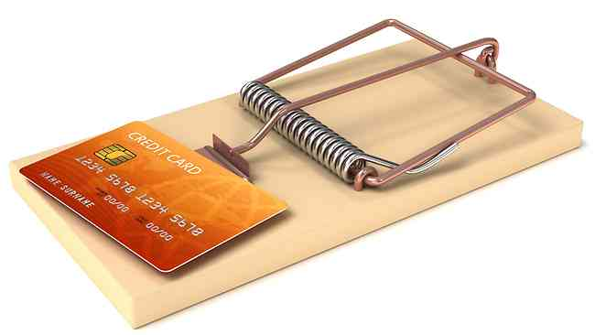
A branch is an integration credit card.

Slide 36
For every branch, there’s a merge.

Slide 37
Merging can be expensive and painful.

Slide 38
Until everything’s integrated, it’s definitely not done.

Slide 39
Keep it simple.

Slide 40
Integrate often.

Slide 41
The smaller the integration, the easier it is.

Slide 42
“You can drive with your feet. It doesn’t mean it’s a good idea.” *
* - paraphrased

Slide 43
Sprint: Day 1 of 15
 | TO DO | IN PROGRESS | DONE
PBI A
PBI B
PBI C

Slide 44
Sprint: Day 2 of 15
 | TO DO | IN PROGRESS | DONE
PBI A
PBI B
PBI C

Slide 45
Sprint: Day 5 of 15
 | TO DO | IN PROGRESS | DONE
PBI A
PBI B
PBI C

Slide 46
Sprint: Day 8 of 15
 | TO DO | IN PROGRESS | DONE
PBI A
PBI B
PBI C

Slide 47
Sprint: Day 11 of 15
 | TO DO | IN PROGRESS | DONE
PBI A
PBI B
PBI C

Slide 48
Sprint: Day 12 of 15
 | TO DO | IN PROGRESS | DONE
PBI A
PBI B
PBI C

Slide 49
Sprint: Day 13 of 15
 | TO DO | IN PROGRESS | DONE
PBI A
PBI B
PBI C

Slide 50
Sprint: Day 14 of 15
 | TO DO | IN PROGRESS | DONE
PBI A
PBI B
PBI C

Slide 51
Sprint: Day 15 of 15 (in your dreams)
 | TO DO | IN PROGRESS | DONE
PBI A
PBI B
PBI C

Slide 52
Sprint: Day 15 of 15 (in reality)
 | TO DO | IN PROGRESS | DONE
PBI A
PBI B
PBI C

Slide 53
Don’t use branches to avoid talking to your teammates.

Slide 54
Do less at once. Focus on done. Integrate often.

Slide 55
Sprint: Day 1 of 15
 | TO DO | IN PROGRESS | DONE
PBI A
PBI B
PBI C

Slide 56
Sprint: Day 2 of 15
 | TO DO | IN PROGRESS | DONE
PBI A
PBI B
PBI C

Slide 57
Sprint: Day 5 of 15
 | TO DO | IN PROGRESS | DONE
PBI A
PBI B
PBI C

Slide 58
Sprint: Day 6 of 15
 | TO DO | IN PROGRESS | DONE
PBI A
PBI B
PBI C

Slide 59
Sprint: Day 10 of 15
 | TO DO | IN PROGRESS | DONE
PBI A
PBI B
PBI C

Slide 60
Sprint: Day 11 of 15
 | TO DO | IN PROGRESS | DONE
PBI A
PBI B
PBI C

Slide 61
Sprint: Day 15 of 15
 | TO DO | IN PROGRESS | DONE
PBI A
PBI B
PBI C

