Slide 1


Get Good at DevOps:
Feature Flag Deployments with ASP.NET, WebAPI, & JavaScript
Benjamin Day
www.benday.com
@benday

Slide 2





Benjamin Day
Brookline, MA
Consultant, Coach, & Trainer
Microsoft MVP for Visual Studio ALM
Scrum, Team Foundation Server, Software Testing,
Software Architecture
Scrum.org Classes
  Professional Scrum Master (PSM)
  Professional Scrum Developer (PSD)
  Professional Scrum Foundations (PSF)
www.benday.com, benday@benday.com, @benday

Slide 3
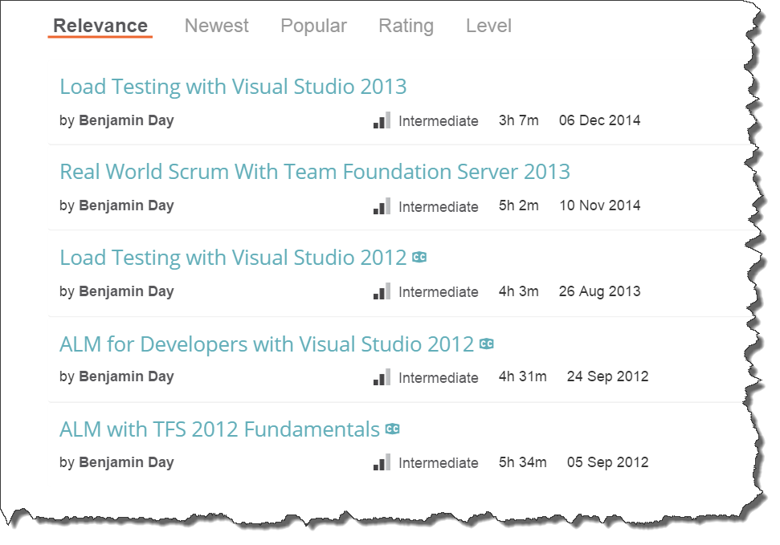
Got ?

Slide 4
Software development is hard.

Slide 5
Software delivery is hard.

Slide 6
How do you get a feature into production?

Slide 7
Branching & Merging

Slide 8
Branching lets you work on similar, related code in isolation at the same time.

Slide 9

“So, I can go nuts and create
250 zillion branches now and it’s a good idea?”

Slide 10
No.

Slide 11

A branch is an integration credit card.

Slide 12
For every branch, there’s a merge.

Slide 13
Merging can be expensive and painful.

Slide 14
Until everything’s integrated, it’s definitely not done.

Slide 15
Keep it simple.

Slide 16
Best Practice: Don’t Branch *
* - unless you absolutely have to

Slide 17
Integrate often.

Slide 18
The smaller the integration, the easier it is.

Slide 19
Typical Branching Structure
Main, Trunk, Origin,
$/TeamProject/
Dev
Feature-x
Releases
v.1
v.2
v.3..n
Feature-y
Feature-z

Slide 20
Typical Branching Structure
Main, Trunk, Origin,
$/TeamProject/
Dev
Feature-x
Feature-y
Feature-z
Releases
v.1
v.2
v.3..n
Main
  Beginning of everything
  Ultimate integration point
Dev
  Integration point for a release
Feature-*
  Features are developed here
Releases (v.*)
  Snapshot of what goes to production
  Source of hot fixes

Slide 21
Typical Release Flow
MERGE
Main, Trunk, Origin,
$/TeamProject/
Dev
Feature-x
Feature-y
Feature-z
Releases
v.*
Merge Features to Dev
Verify / fix whatever is in Dev
Merge to Main
Create new Release branch
  V.1123414
  2016.03.15
Deploy to production servers
MERGE
BRANCH

Slide 22
Typical Release Flow
MERGE
Main, Trunk, Origin,
$/TeamProject/
Dev
Feature-x
Feature-y
Feature-z
Releases
v.*
Whatever gets merged to Main gets released
Code-based release model
MERGE
BRANCH

Slide 23
Typical Release Flow: Bad News
MERGE
Main, Trunk, Origin,
$/TeamProject/
Dev
Feature-x
Feature-y
Feature-z
Releases
v.*
Merge Feature X
  Easy
Commit the merge
Merge Feature Y
  Ok
Commit the merge
Merge Feature Z
  HARD
  REALLY REALLY HARD
Turns out that Feature X isn’t done
Major surgery to get this undone

Slide 24
Typical Release Flow: Bad News
MERGE
Main, Trunk, Origin,
$/TeamProject/
Dev
Feature-x
Feature-y
Feature-z
Releases
v.*
Feature branch integrations
are not going well
Getting merged code to
“play nice” means manually
un-doing work that’s already been committed
Cherry picking
DELAYS

Slide 25
Typical Release Flow: Bad News,
Change of plans
MERGE
Main, Trunk, Origin,
$/TeamProject/
Dev
Feature-x
Feature-y
Feature-z
Releases
v.*
Merge Features to Dev
Commit the merge
Boss wants only Feature X and Z to go live
Merge Feature X and Z to Main
  Painful, annoying, & tedious
Commit the merge

Slide 26
Releases based on source control can be a real drag.

Slide 27
Releases based on Source Control
Whatever is in the branch goes to production
Whatever is in production is live
Pros:
  Simple to understand
Cons
  Coordination can be a real headache

Slide 28
Feature flags

Slide 29
Feature Flags
“Feature toggles”
Configuration-based releases
Define configuration values for features
  This is a feature flag
  On / Off
Wrap feature code inside of checks for feature flag
  If it’s on, it runs
Deploy whatever doesn’t cause problems
Turn on whatever is ready
Much less emphasis on branching & merging
Easier to schedule
  The features are already deployed
  Turn them on when you’re ready

Slide 30
Feature Flag: Benefits
New levels of flexibility
Deploy multiple versions of the same feature side-by-side
  New user interfaces and old user interfaces at same time
Private betas
  New features for only certain users
A/B testing
  Which version do people prefer?
Rollback
  Not working?
  Performance problems?
Great for Scrum & DevOps

Slide 31
Feature Flag: Drawbacks
Adds complexity to the code
Can get confusing
Technical debt
Should be removed at some point
  For example, running two version of a feature should be temporary
Sometimes turns into an excuse to ship garbage
  Lack of focus on being truly “Done”

Slide 32
DevOps?

Slide 33
DevOps
How are you developing, delivering, deploying, & monitoring?
“What is the process of getting a developer’s changeset from check-in to production? How long does that take?”
If you want to go fast, start automating
  Automation removes hard / tedious stuff
  Automation provides reliability
  Automation helps you do more and go faster
Stability, Reliability, Repeatability, Release-ability

Slide 34
DevOps increases the speed of feedback.

Slide 35
DevOps increases the speed of mistakes.

Slide 36
DevOps increases the speed of feedback.
Product Ownership in an Agile world is all about experimentation
Each new feature is an experiment
Build as little code as possible → Minimum Viable Product (MVP)
Ship it & gather feedback
  That’s the experiment
You don't always want to commit to these experiments.

Slide 37
“Go big or go home” vs.
“Go small and quietly and go home if it doesn’t work”

Slide 38
Technical Stuff

Slide 39
Implementation Tips
Create an IFeedbackManager interface
Each feature flag should be a Boolean property
  NO MAGIC STRINGS!
Use Dependency Injection for your IFeedbackManager
Makes it very easy to find and remove later

Slide 40
DEMOS
Basic feature flag
  Search
Two features side-by-side
Undeploy a feature that’s getting bad reviews
Private beta

Slide 41
A feature flag is (probably) technical debt.

Slide 42
Any specific feature flag should eventually be removed.

Slide 43
Your feature flag system is forever.
The individual feature flags are temporary.

Slide 44
Watch out for technical debt.

Slide 45
Any last questions?

Slide 46
Thanks. benday@benday.com | www.benday.com

