Slide 1
Role-based Security Stinks: Better Authorization in ASP.NET
Benjamin Day
www.benday.com @benday

Slide 2
Benjamin Day
Brookline, MA
Consultant, Coach, & Trainer
Microsoft MVP for Visual Studio ALM
Scrum, Team Foundation Server, Software Testing, Software Architecture
Scrum.org Classes
Professional Scrum Master (PSM)
Professional Scrum Developer (PSD)
Professional Scrum Foundations (PSF)
www.benday.com, benday@benday.com, @benday

Slide 3
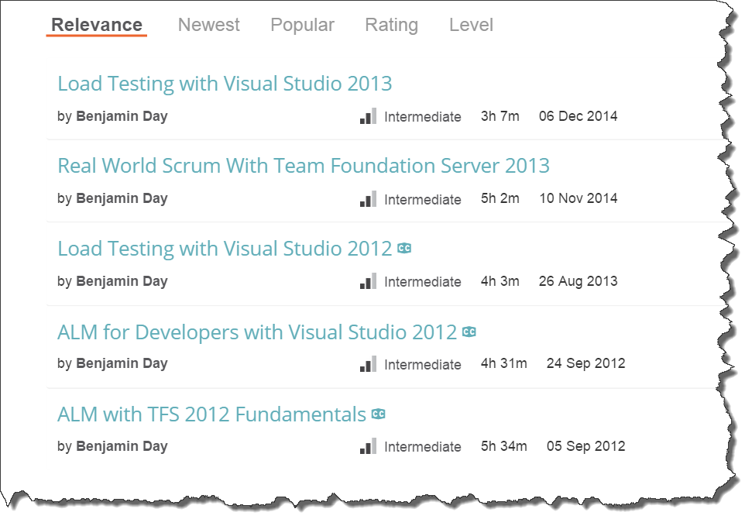
Got ?

Slide 4
The Goal
Design a flexible authorization framework
Security constraints within the application should be configurable at runtime
User permissions can vary between different instances of the same object
Works with .NET Security
Easy to administer

Slide 5
What is “Role-based” Security?
Application authorization is based on membership in roles
Based on IPrincipal
System.Security.Principal
IsInRole(string roleName)
WindowsPrincipal
Role Name = Group Name
Uses user’s Windows group membership to do authorization

Slide 6
HR Application
Hire Employee –
CreateEmployee.aspx
Edit Compensation –
EditSalary.aspx, EditVacationTime.aspx
Edit Employee Info –
ViewEmployee.aspx, EditContactInfo.aspx

Slide 7
What if you start adding new offices?
New Requirement:
HR Managers & HR Associates have permissions only for their office → “context”
How to implement this using IsInRole()?
You could add the additional groups (roles) but your app will have to know what office the employee is in

Slide 8
More Complexity
What happens when even more offices are added?
What if you need to start adding new roles?
What if you want to create groups of employees for someone in HR to manage?
Arbitrary groupings of employees across locations
One person becomes the “HR Manager” for that group

Slide 9
Role-based Security Limitations
Role-based works well until you need context
Granting permissions to a particular “employee”
Broadness and lack of context → limited configurability
Security starts getting hard-coded
Not configurable at run-time

Slide 10
Claims-based Security
Declarative security
System.Security.Claims namespace
Name / Value Pairs

Slide 11
“Rights-based” Security?
Architecture for using Claims in the app
Breaks “what you can do” into small pieces → Rights
Rights have context
User is granted rights to perform an action on a particular item
User’s permissions (principal) becomes the set of these small granted rights
The Database Perspective → Establishes row-level permissions

Slide 12
Roles vs. Claims / Rights
Roles are broad
Secure large sections of an app
Grant blanket permissions to all securable items
No context
Rights are granular
Uses a Claim
Permissions relate to one item
Have context
Secure at the operation level
Reduce actions to the least common denominator
Store permissions as small pieces → flexibility

Slide 13
Claims-Based Security To Do’s
During development, identify
Securable Items
Securable Actions (Rights)
Broad Rights (Roles)
Keep these as actions as small (granular) as possible

Slide 14
Ease of Administration
User Groups
Group similar users together
Assign rights / roles for the group
Eliminates the bother of administering users individually
Item Groups
Group similar securable items
Like a “folder”
Minimizes the number of “right grants” you need
Library has thousands of items (entries)
Rights are granted at run-time

Slide 15
Hooking into .NET Security
System.Security.Principal namespace
Use IIdentity to establish “who you are”
Use IPrincipal to establish “what you can do”
IPrincipal can be set onto
Thread.CurrentPrincipal
HttpContext.User
IPrincipal is available in all tiers

Slide 16
IPrincipal Through The Tiers
ASP.MVC / Web API
Should check IPrincipal to avoid giving the user an opportunity to cause security exceptions
Other Tier(s)
Makes certain that the users cannot access data or perform unauthorized operations
(Optional) Filter unauthorized records

Slide 17
ASP.NET MVC Security Schema
AspNetUsers
User account info
Local accounts
Username, password, etc
AspNetUserLogins
“Social” logins
Mappings between external logins & local info
Microsoft Account, Facebook, Twitter
AspNetRoles
List of roles in application
AspNetUserRoles
Roles per user
AspNetUserClaims
Custom claims
ClaimType
ClaimValue

Slide 18
Adjusting Claims at Login
ApplicationUser class
Extends System.Security.Claims.IdentityUser
GenerateUserIdentityAsync()
Any claims adjustments go here

Slide 19
DEMOS!
Demos in ASP.NET
Roles
Claims
Demos in ASP.NET Core
Policies
Microsoft Account Provider

Slide 20
Any last questions?

Slide 21
Thank you.
www.benday.com | benday@benday.com

