Slide 1
Unit Testing & Test-Driven Development for Mere Mortals
Benjamin Day @benday

Slide 2
Benjamin Day
Brookline, MA
Consultant, Coach, & Trainer
Microsoft MVP for Visual Studio ALM
Scrum, Team Foundation Server, Software Testing, Software Architecture
Scrum.org Classes
Professional Scrum Master (PSM)
Professional Scrum Developer (PSD)
Professional Scrum Foundations (PSF)
www.benday.com, benday@benday.com, @benday

Slide 3
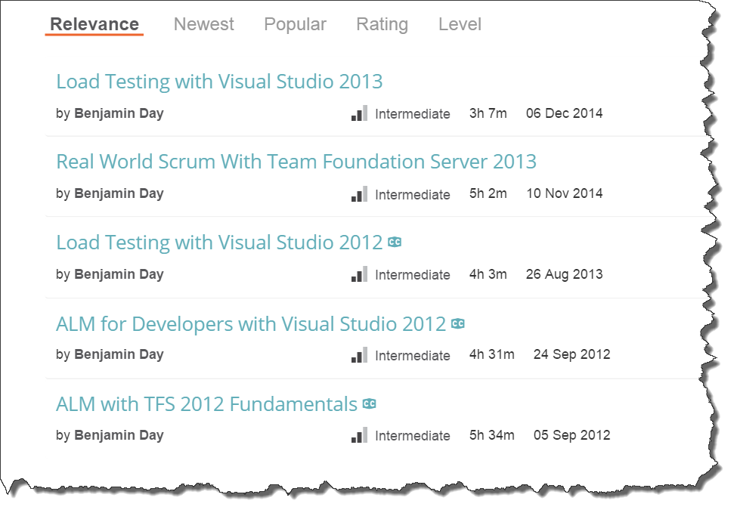
Got ?

Slide 4
Overview
What is a unit test?
What is unit testing?
Why do I care?
How do I justify it to my self/boss/team?
Design for testability
Demos

Slide 5
Unit tests = Small chunks of code that test other small chunks of code

Slide 6
Typical Unit Testing Flow
You’re writing a feature
You’re also writing tests
Feature code = the “System Under Test”
(aka. “SUT”)
At least one unit test method per public method on the SUT
Asserts

Slide 7
Demo: Calculator Unit Tests

Slide 8
Why use unit tests?

Slide 9
Typical Development Flow
You write code
It appears to work
You check it in
You send it to QA
QA sends back bugs
You fix
(repeat)

Slide 10
Typical Refactoring Flow
You refactor code
You write some new code, too
You check it in
It appears to work
You send it to QA
They send bugs
You fix bugs
You deploy to production
The world lights on fire

Slide 11
$$$

Slide 12
$1m for IT to support an application.
That’s looking grim.

Slide 13
Technical Debt

Slide 14
Technical Debt
Little bits of not-quite-done
Low-quality code
8 million line methods
Coding standards violations
Classes with unclear names and intent
Buggy & Brittle

Slide 15
Unit tests can help tackle technical debt

Slide 16
Unit tests can help tackle technical debt
That’s looking grim.

Slide 17
Unit Tests
Proof that the code you’re writing actually works
Run-able by a computer
Proof that the code you wrote a long time ago still works
Automated regression tests
Proof that bugs are still fixed

Slide 18
Awesome side effects of unit tests
Focus on quality early
Don’t rely on QA to tell you your code is broken
Fewer low-value bugs coming back from QA
NullReferenceException
QA can focus on “exploratory testing”
Better use of QA’s time
Refactor with confidence
Keep your code clean
Clean code is easier to read
% time reading code vs. % time writing code
Clean code is easier to build on top of

Slide 19
How I structure a unit test
Unit test class tests a class in the system under test
{NameOfSystemUnderTestClass}Fixture.cs
Has a property called SystemUnderTest
Typeof {NameOfSystemUnderTestClass}
[TestInitialize] method called OnTestInitialize()
One or more [TestMethod]
Arrange
Act
Assert

Slide 20
Unit Tests vs. Integration Tests

Slide 21
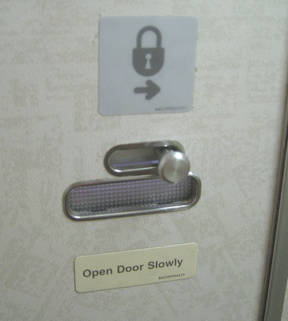
How would you test this?

Slide 22
What is Design For Testability?
Build it so you can test it.
How would you test this?
Do you have to take the plane up for a spin?

Slide 23
Interfaces, Dependency Injection, & Mocks
Code against interfaces
Dependency Injection
“Advertise” your dependencies on the constructor
Dependencies are references to interfaces
Use mock classes to provide fake data

Slide 24
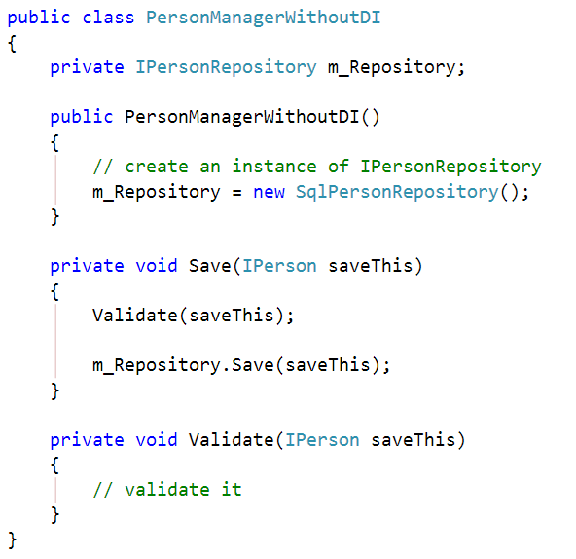
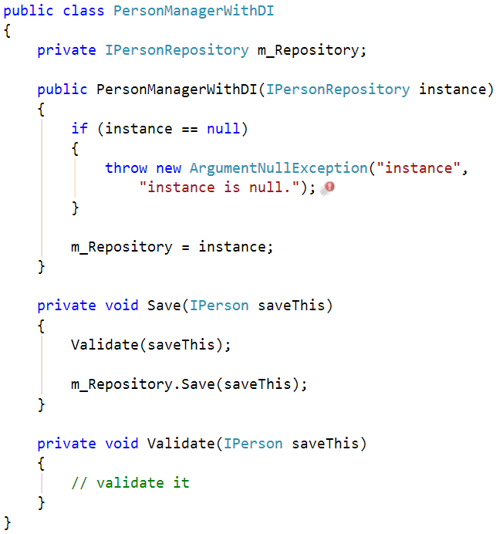
Advertise Dependencies on Constructor
Less Awesome
Now With More Awesome

Slide 25
Hard to test usually also means hard to maintain.

Slide 26
Design Patterns will help you to create a more testable & maintainable application.

Slide 27
What’s a Design Pattern?
Well-known and accepted solution to a common problem
Avoid re-inventing the wheel

Slide 28
Design patterns in architecture.

Slide 29
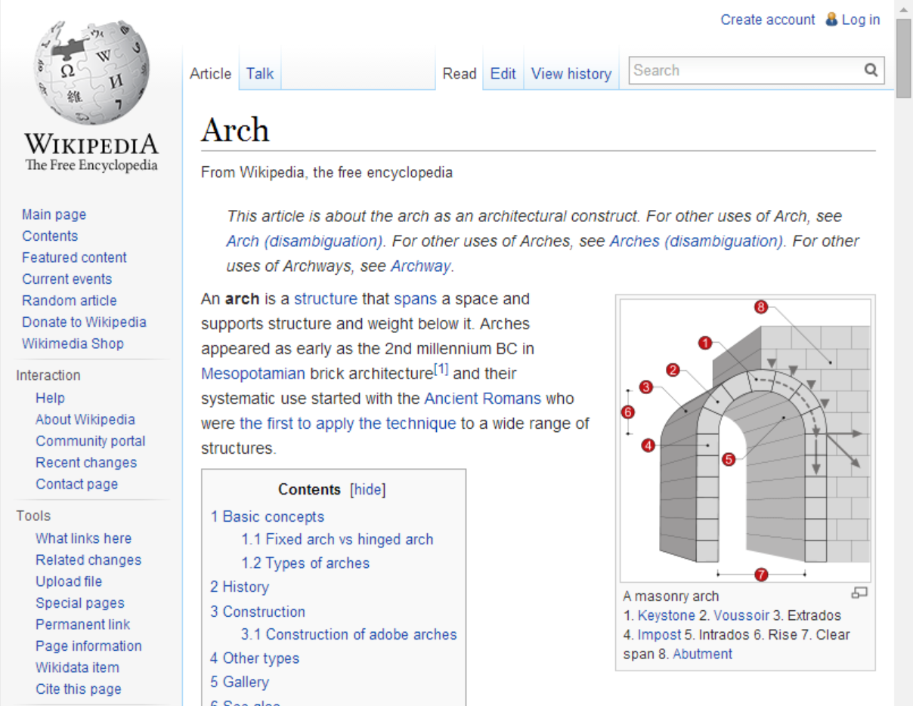

Slide 30
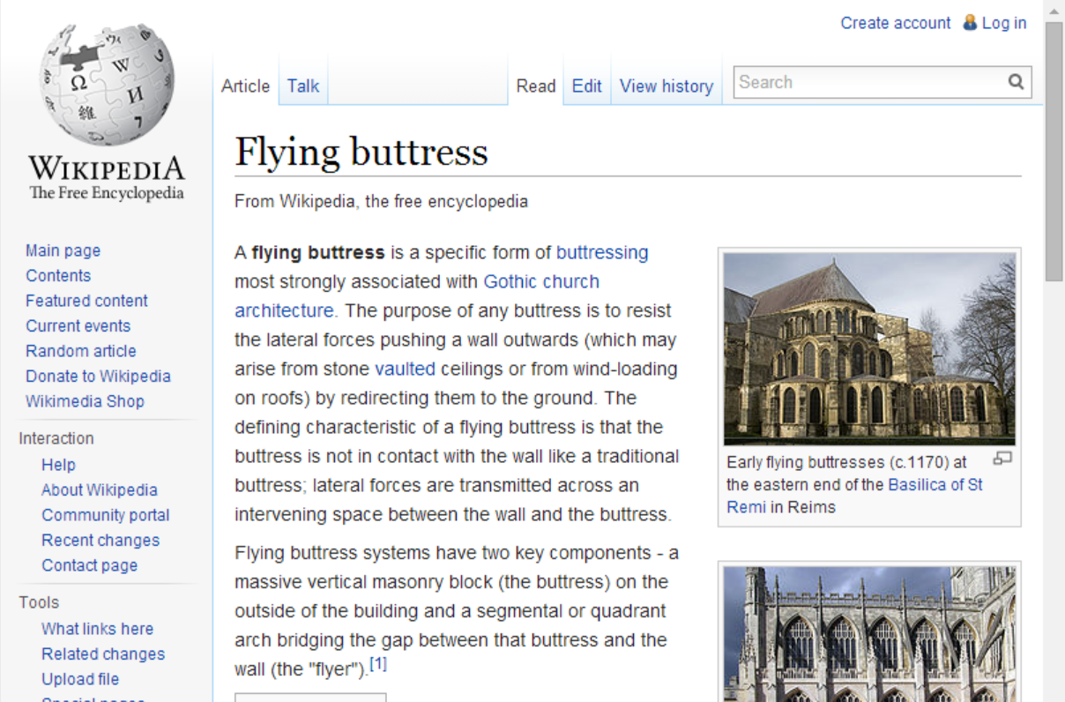

Slide 31
Popularized in Software by this book…

Slide 32
Design Patterns for this talk
Dependency Injection
Flexibility
Repository
Data access details
Adapter
Keeps tedious, bug-prone code contained
Strategy
Encapsulates algorithms & business logic
Model-View-Controller
Isolates User Interface Implementation from the User Interface Logic
Testable User Interfaces
Model-View-ViewModel

Slide 33
Repository Pattern
Hide the existence of databases and services
Hide the existence of Entity Framework & ADO.NET
Code against an interface
Allows you to use mock data without an actual database
Separate Unit Tests from Integration Tests

Slide 34
Adapter Pattern
Isolate the details of turning one object into another object
To / from Entity Framework entities
To / from WebAPI message types
To / from ASP.NET MVC ViewModels and Models

Slide 35
Model-View-Controller (MVC)
Test user interfaces without having to run an actual user interface
ASP.NET MVC
WPF / XAML
Model-View-ViewModel (MVVM)

Slide 36
Strategy Pattern
Isolate and test algorithms
Validation
Business rules

Slide 37
Demos

Slide 38
Thank you.
www.benday.com | benday@benday.com

