Slide 1
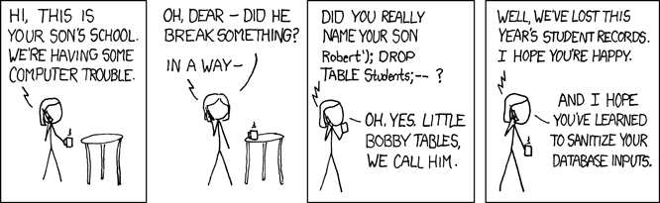

Slide 2

10 Ways to Go from
Good to Great
Scrum Master

Slide 3


Benjamin Day
Brookline, MA
Consultant, Coach, & Trainer
Microsoft MVP for Visual Studio ALM
Team Foundation Server, Software Testing,
Scrum, Software Architecture
Scrum.org Classes
  Professional Scrum Foundations (PSF)
  Professional Scrum Master (PSM)
  Professional Scrum Developer (PSD)
www.benday.com, benday@benday.com, @benday

Slide 4
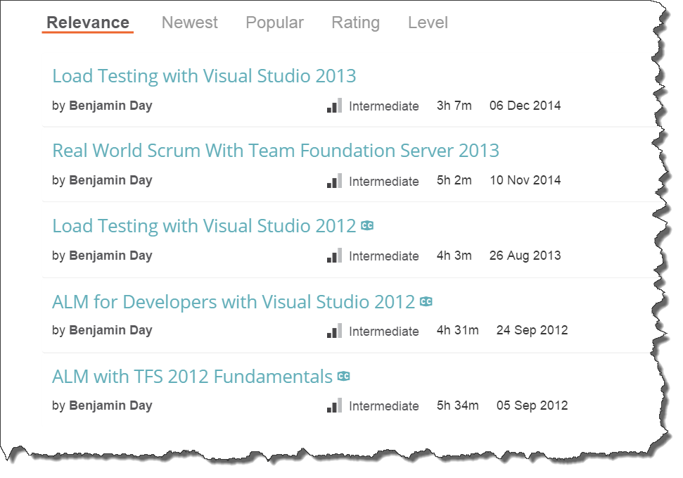
Online courses at Pluralsight.com

Slide 5
Warning: Shameless Plug

Slide 6

Professional Scrum Master (PSM) training on May 20 & 21 in
Brookline, MA http://bendayscrum.eventbrite.com

Slide 7
On with the show.

Slide 8
Assumptions
You’re technical. I’m technical.
For today, we’re talking about a fairly technical Scrum Master
  (Don’t forget the needs of the business though.)
This talk =
Scrum Mastering + “Getting your project started right”
Notes:
Assumptions
In this case, the Scrum Master is somewhat technical
I'm technical. Right or wrong, my Scrum Mastering style tends to go deep on the technical stuff.
You have to remember the needs of the business though. You're not building this stuff for the sake of the technology. You're building this stuff for the sake of the business. In all likelyhood, it's about making money. The technology enables the making of the money which pays for you to write the software which makes more money and pays for more software. Rinse and repeat.
This talk will straddle the line between Scrum Mastering and "Getting your project started right"
Things that have caused my teams constant headaches that kill velocity

Slide 9
Top 10 Ways: Things to Think About
What can you do to help your team?
What can you do to help your product owner?
What can you do to help yourself?
What can you do to help your organization?
Change your Daily Scrum

Slide 10
Here are all the things I wanted to put in this talk.
What can you do to help your team?
  Written DoD
  Encourage self-organization
  Try to help minimize the work in progress.
  Remind them to keep talking. One major downside of TFS is that people can sometimes think of it as an excuse to not talk.
  Remind them about how much and how creatively you can decompose a PBI
  Emergent Architecture.
  Remind them they don't report to you
What can you do to help your product owner?
  Product owner checklist
  http://productownerchecklist.org by Lare Lekman
  Remind them that they need to stay engaged and that their engagement is critical for the success of the team and the effort.
  Remind them to plan ahead a bit and share their vision
  Help with credibility by planning 2 to 3 sprints out
What can you do to help yourself?
  You can't fix everything.
  Watch for burnout.
  Do whatever it takes to get you to believe in self-organization
What can you do to help your organization?
  Get them cozy with the fact that change will be coming.
  Changing of plans is a "feature" not a "bug."
  Inoculate them so that they won't panic when change inevitably happens.
  Question how products align with teams. Bring work to the teams rather than bringing Teams to the work. Let the Teams stay together and focused on a limited amount of stuff and they'll go faster.
  Help them think about sprint lengths. Sprints help scope risk. Sprints force you to pause from time to time to see where you actually are. It helps keep you honest. Have you *actually* delivered anything? Why and why not?
  Practice explaining Story Points.
  Explain that Scrum doesn't replace the existing org structure. It is a layer on top of the existing org structure. While it probably won't change anyone's job, it might change how they perform their job.
  Think like a data scientist.
  http://blogs.hbr.org/2013/11/how-to-start-thinking-like-a-data-scientist/
  Watch out for fear. Fear is *everywhere*.
Address the QA problems.
  What does QA do at the front side of the sprint?
    Answer collaborate with fellow team members to ensure that everyone knows how stuff is going to be tested.
    Basically, front-load your quality focus.
Change your daily standup
  Consider dumping "3 questions"
  Consider switching who "runs" the standup
  Watch for people being bored and/or tuning out
    Bored people implies doing too much work and/or a wobbly sprint goal
    Bored people implies multiple teams of 1 rather than a team of X. You have people who sit near each other rather than actual functional team.
What is your Velocity?
  If you don't have estimates, you can't have a velocity.
  If you don't have a DoD, velocity is problematic.
  If you're wobbly on DoD, your velocity is suspect.
  Be firm on DoD. No partial credit.
Better Retrospectives
  Write them down. Review the results.
  Try to walk through the sprint day by day and ask people how they felt, what was going on on this day, why is the burndown going up or down? This helps them to *remember* what was happening.
Common Objections to Scrum
Leading vs Coaching
Coaching organizations
Coaching teams
Common objections

Slide 11
Top 10 Ways
What is your DoD?
People Skills
Credibility
What is your Sprint Goal?
Do less.
Emergent Architecture
Good programming & testing practices
“Kick it over the wall to QA”
Teams : Products
Retrospective

Slide 12
Top 10 Ways
Emergent Architecture
Good programming & testing practices
“Kick it over the wall to QA”
Teams : Products
Retrospective
What is your DoD?
People Skills
Credibility
What is your Sprint Goal?
Do less.

Slide 13
Definition of Done (DoD) =
Everything it takes to say something is completely done.

Slide 14
What is your DoD?
Closest thing to a “silver bullet” in Scrum
Technical Debt will ruin you.
Write it down.
Review and discuss it regularly.
Notes:
What is your Definition of Done (DoD)?
There's no magic bullet in Scrum...but this one is pretty close.
Write. Your. DoD. Down.
Discuss your DoD a lot.
Technical debt will ruin you. The little bits of not quite entirely done will crush your "agility".
If anyone says "Done vs. Done Done", hire someone to murder that person in their sleep. Ok. Well, maybe not murder them but that's a big deal.
No partial credit. It's either done or not done.

Slide 15
“Done vs. Done Done”

Slide 16
Do not relax your DoD.

Slide 17
No partial credit…ever.

Slide 18
Partial credit usually means
Technical Debt.

Slide 19
Partial Credit & Technical Debt →
“Wobbly” Velocity

Slide 20
Top 10 Ways
Emergent Architecture
Good programming & testing practices
“Kick it over the wall to QA”
Teams : Products
Retrospective
What is your DoD?
People Skills
Credibility
What is your Sprint Goal?
Do less.
Notes:
People Skills
Trust your gut. Pause from time to time and ask yourself how you're feeling.
Therapy. We all have issues. Trust me...even though you *think* you know what they are, you don't really know. There are tons of issues and little stupid things you do that you could use to figure out. Getting in tune with your own inner life will help immensely.

Slide 21
99% of the time, it’s a people problem.

Slide 22
Watch for interpersonal problems.

Slide 23
Here’s a trick:
“Trust your gut.”

Slide 24

Consider reading this book.

Slide 25
Want to be a super hero?
Go see a therapist.
(I’m not kidding.)

Slide 26
Top 10 Ways
Emergent Architecture
Good programming & testing practices
“Kick it over the wall to QA”
Teams : Products
Retrospective
What is your DoD?
People Skills
Credibility
What is your Sprint Goal?
Do less.
Notes:
Credibility is your greatest asset.
Keep your backlog ordered for at least 2 sprints worth of work. Be ready to answer at a moment's notice when a feature is forecast to be delivered.
That written DoD is your best friend when you're talking to product owners and executives and stakeholders. Make sure that they understand why DoD and Quality is in their best interest.
Be careful to not lose sight of "fit for purpose". Sometimes, you're not getting paid to create a work of art. It's a balance between "time to market" and "long term maintenance".
Do yourself a favor and say "forecast" rather than "commitment"
Try to communicate in terms that the business understands. (Answer: probably money.)

Slide 27
2 to 3 Sprints of Product Backlog
Helps give the PO “room”
Helps everyone to know what’s going on.
Be ready to answer where a PBI (aka. “feature”) is on the backlog.
  How many sprints out?
Discuss your *written* DoD with the PO, executives, and stakeholders
  Why is it in their best interest?

Slide 28
Fit for purpose.
Remember that not everything is, needs to be, or should be a work of art.
Balance “Time to Market” with “Long-term Maintenance”
Communicate with the business in terms they understand
  (Hint: this is probably money and resources.)

Slide 29
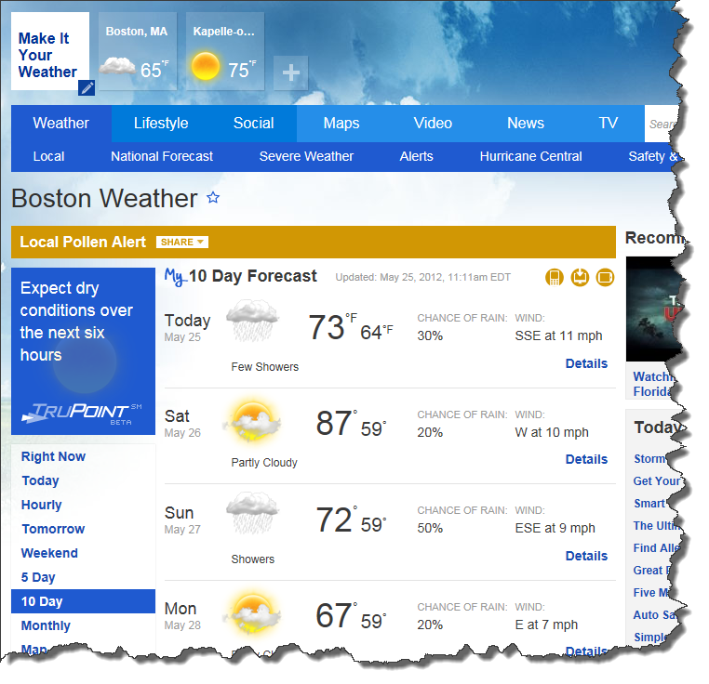
Train everyone to say
“forecast” rather than “commitment”

Slide 30
Top 10 Ways
Emergent Architecture
Good programming & testing practices
“Kick it over the wall to QA”
Teams : Products
Retrospective
What is your DoD?
People Skills
Credibility
What is your Sprint Goal?
Do less.
Notes:
What's your Sprint Goal?
Review your SG in your daily standups.
If your sprint goal is simply a "select Title from SprintBacklog" you're probably doing it wrong.

Slide 31
Do you have a Sprint Goal?

Slide 32
Is it easily understood and stated?

Slide 33
Hint:
Your sprint goal should not be select * from SprintBacklog

Slide 34
Review your Sprint Goal in the Daily Scrum.

Slide 35
And while we’re talking about the Daily Scrum…

Slide 36
…consider dumping the
“3 questions” format.

Slide 37
Remind your team that they don’t report to you.

Slide 38
Consider switching up who
“leads” that meeting.

Slide 39
Watch for people being bored and/or tuning out.

Slide 40
Bored implies a lack of focus.

Slide 41
Bored implies that people aren’t on the same team.

Slide 42
Top 10 Ways
Emergent Architecture
Good programming & testing practices
“Kick it over the wall to QA”
Teams : Products
Retrospective
What is your DoD?
People Skills
Credibility
What is your Sprint Goal?
Do less.
Notes:
Do less.
Aka. Minimize Work in Progress
If everyone on your team is working on separate PBIs, is the team really a team?
Try to craft your work so that you have more than one person working on something at a time. Drive that PBI to completion ASAP and only then move on to the next PBI.
Remember your DoD and work to drive your PBIs to DoD-compliance as soon as possible.
If something is DoD-done, you've already pretty much delivered something in that sprint.
The anti-pattern is being 2 days from the end of your sprint and nothing is DoD-done yet.

Slide 43
Minimize work in progress.

Slide 44
Put another way… don’t try to do everything at once.

Slide 45
If everyone on your team is working on separate PBIs, is the team really a team?

Slide 46
Finish one thing. Then do the next thing.
Try to craft the work so that multiple people are working on related things
Complete that thing. Move on to the next thing.
Try to drive stuff to DoD early.
This ensures that you’re delivering something in the sprint.

Slide 47
Anti-pattern:
2 days from the end of the sprint and nothing’s DoD yet.

Slide 48
Top 10 Ways
Emergent Architecture
Good programming & testing practices
“Kick it over the wall to QA”
Teams : Products
Retrospective
What is your DoD?
People Skills
Credibility
What is your Sprint Goal?
Do less.
Notes:
Do less.
Aka. Minimize Work in Progress
If everyone on your team is working on separate PBIs, is the team really a team?
Try to craft your work so that you have more than one person working on something at a time. Drive that PBI to completion ASAP and only then move on to the next PBI.
Remember your DoD and work to drive your PBIs to DoD-compliance as soon as possible.
If something is DoD-done, you've already pretty much delivered something in that sprint.
The anti-pattern is being 2 days from the end of your sprint and nothing is DoD-done yet.

Slide 49
Avoid BDUF.
(Big design up-front.)

Slide 50
YAGNI.
(You ain’t gunna need it.)

Slide 51
Emergent Architecture.
Build what you need.
It’s a spectrum.
Suicidal
Non-Planning
Sanity
&
Balance
Big
Design
Up-Front

Slide 52
Emergent Architecture.
Build what you need.
It’s a spectrum.
Suicidal
Non-Planning
Sanity
&
Balance
Big
Design
Up-Front

Slide 53
Emergent Architecture.
Build what you need.
It’s a spectrum.
Suicidal
Non-Planning
Sanity
&
Balance
Big
Design
Up-Front

Slide 54
Emergent Architecture.
Build what you need.
It’s a spectrum.
Suicidal
Non-Planning
Sanity
&
Balance
Big
Design
Up-Front

Slide 55
Top 10 Ways
Emergent Architecture
Good programming & testing practices
“Kick it over the wall to QA”
Teams : Products
Retrospective
What is your DoD?
People Skills
Credibility
What is your Sprint Goal?
Do less.
Notes:
Do less.
Aka. Minimize Work in Progress
If everyone on your team is working on separate PBIs, is the team really a team?
Try to craft your work so that you have more than one person working on something at a time. Drive that PBI to completion ASAP and only then move on to the next PBI.
Remember your DoD and work to drive your PBIs to DoD-compliance as soon as possible.
If something is DoD-done, you've already pretty much delivered something in that sprint.
The anti-pattern is being 2 days from the end of your sprint and nothing is DoD-done yet.

Slide 56
It’s a metaphysical *certainty* that you’ll have to change stuff.

Slide 57
You *won’t* get your
“requirements” right.

Slide 58
Your customers
*will* change their minds.

Slide 59
Accept that you’ll have to change.

Slide 60
The Goal:
Make refactoring painless.

Slide 61
Loose coupling.
Code to interfaces.
Use the Dependency Injection Pattern
  (Pass dependencies in on the constructor.)
  Consider an IoC Framework
Use the Repository Pattern
Remember Single Responsibility Principle

Slide 62
Build for Testability
Unit test, unit test, unit test
Unit test != Integration Test
Test one layer at a time in isolation
No database connections from a unit test
Integration tests in a separate project
  Keep yourself honest

Slide 63
For the love of all things precious & beautiful…

Slide 64


…DON’T USE A SHARED DEVELOPMENT DATABASE!!!!!!!!

Slide 65
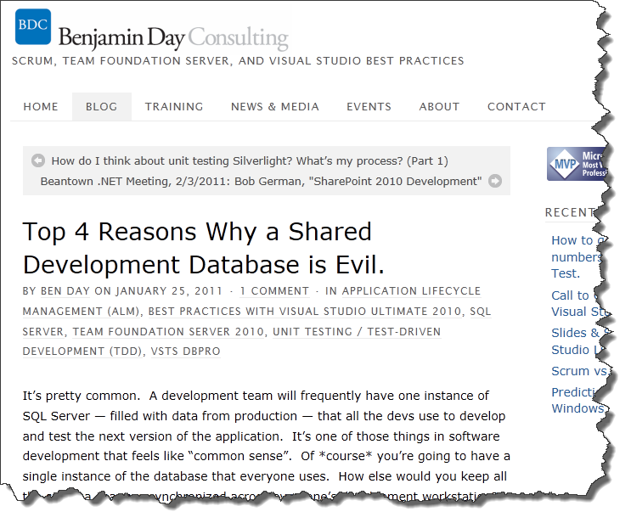
http://tinyurl.com/bqextsa

Slide 66
Eliminate the "works on my box" problem *early*.
Set up automated builds from the very beginning.
If you're using TFS, use Gated Check-in builds
Deploy your database as part of your builds.
Run your unit tests from the builds
Notes:
Good programming and unit testing practices let you worry less.
The goal is to make Refactoring as painless as possible. Refactoring should not strike terror into your soul(s).
Remember...requirements will change and people will change their minds.
Build for maintenance.
It's a metaphysical certainty that you're going to have to change stuff.
You won't get your "requirements" right.
Your customers / stakeholders *will* change their minds.
Keep things loosely coupled.
Program to interfaces
Use Dependency Injection
Read up on the Repository Pattern
Remember Single Responsibility Principle.
Build for testability.
Unit test, unit test, unit test.
And when I say *unit* test I mean *unit* not integration test.
Get comfortable with mocks, stubs, and fakes.
Unit tests should not connect to a service or a database
Unit tests should test only one "layer" at a time
Keep unit tests and integration tests in separate projects. Integration tests can talk to the database but they should also only talk to one layer at a time.
For the love of god, don't use a shared development database
No shared test data.
If at all possible, use the Visual Studio Database Projects.
Eliminate the "works on my box" problem *early*.
Set up automated builds from the very beginning.
If you're using TFS, use Gated Check-in builds
Deploy your database as part of your builds.
Run your unit tests from the builds
Think about maintain a minimal Inventory.
Inventory is sunk cost.
Anything you write has to be maintained.
Write less code. I'm not saying to use lots of frameworks like NHibernate or Entity Framework or RIA Services...I'm not saying don't use them either. Just keep in mind that everything you write you have to maintain.

Slide 67
Top 10 Ways
Emergent Architecture
Good programming & testing practices
“Kick it over the wall to QA”
Teams : Products
Retrospective
What is your DoD?
People Skills
Credibility
What is your Sprint Goal?
Do less.
Notes:
Do less.
Aka. Minimize Work in Progress
If everyone on your team is working on separate PBIs, is the team really a team?
Try to craft your work so that you have more than one person working on something at a time. Drive that PBI to completion ASAP and only then move on to the next PBI.
Remember your DoD and work to drive your PBIs to DoD-compliance as soon as possible.
If something is DoD-done, you've already pretty much delivered something in that sprint.
The anti-pattern is being 2 days from the end of your sprint and nothing is DoD-done yet.

Slide 68
Never say
“Kick it over the wall to QA” again.
Us vs. Them
QA is part of the team
QA’s work should be part of the DoD

Slide 69
What does QA do at the start of a sprint?

Slide 70
Top 10 Ways
Emergent Architecture
Good programming & testing practices
“Kick it over the wall to QA”
Teams : Products
Retrospective
What is your DoD?
People Skills
Credibility
What is your Sprint Goal?
Do less.
Notes:
Do less.
Aka. Minimize Work in Progress
If everyone on your team is working on separate PBIs, is the team really a team?
Try to craft your work so that you have more than one person working on something at a time. Drive that PBI to completion ASAP and only then move on to the next PBI.
Remember your DoD and work to drive your PBIs to DoD-compliance as soon as possible.
If something is DoD-done, you've already pretty much delivered something in that sprint.
The anti-pattern is being 2 days from the end of your sprint and nothing is DoD-done yet.

Slide 71
How do Teams align to Products / Projects?
Watch out for partial allocations
Do team members have more than one Daily Scrum?
Rather than 1 team per 1 product,
try 1 team that supports multiple products

Slide 72
Teams to Products
Bad
  Billing System has a Billing Team
  Accounting System has an Accounting Team
  CRM system has a CRM Team
  Website has a Website team
  People are 50% allocated to multiple teams.

Slide 73
Teams to Products
Better
  Team A
    Billing
    Accounting
  Team B
    CRM
    Website

Slide 74
Teams to Products
Best
  Team A and Team B are cross-functional
  Either team can do tasks from Billing, Accounting, CRM, or Website

Slide 75
The Product Owner as a work funnel.
Medical Records Project
Accounting Project
CEO’s crazy dreams
…then the Product Owner adjusts the Product Backlog…
Product Owner has to decide priority for the team
The team can’t do everything at once
There has to be priorities
The team isn’t qualified to balance these priorities
Product
Owner
Development
Team
Entonnoir?

Slide 76
Top 10 Ways
Emergent Architecture
Good programming & testing practices
“Kick it over the wall to QA”
Teams : Products
Retrospective
What is your DoD?
People Skills
Credibility
What is your Sprint Goal?
Do less.
Notes:
The Retrospectives are the curer of all ills.
Watch for unscheduled work
Do you find yourself having to balance strategic work (long term projects) against your hair being on fire this week? Are you finding that you can't deliver anything or that you always miss your forecasts?
Do you note this unplanned work somehow?
Do you discuss this unplanned work in the retrospective.
Write down what you discussed in your retrospectives.
What went right and wrong?
What *actionable* things are you going to do for your next Sprint?

Slide 77
Retrospectives are the curer of all ills.

Slide 78
Retrospectives help keep problems contained to (hopefully) a single Sprint.

Slide 79
Tip:
Watch for unscheduled work.

Slide 80
Tip:
Get people REALLY thinking by trying to recreate what happened day by day.

Slide 81
Tip:
If it gets heated, learn to say
“Ok…and what else?”

Slide 82
Tip:
Record the findings from the Retrospective

Slide 83
Tip:
Review the notes from previous Retrospectives.

Slide 84
Top 10 Ways
Emergent Architecture
Good programming & testing practices
“Kick it over the wall to QA”
Teams : Products
Retrospective
What is your DoD?
People Skills
Credibility
What is your Sprint Goal?
Do less.

Slide 85
What can you do to help yourself?

Slide 86
Watch for burnout.

Slide 87
You can’t fix everything.

Slide 88
Do whatever it takes to get yourself to believe in self-organization.

Slide 89
But don’t let your team walk all over you.

Slide 90
Some teams will use self-organization against you.

Slide 91
“…but let’s remember here.
This isn’t a *&^%$# democracy.”
-David Starr

Slide 92
How do you help the
Product Owner?

Slide 93
Remind them of how important they are to the success of the project.

Slide 94
Remind them that they need to stay engaged.

Slide 95
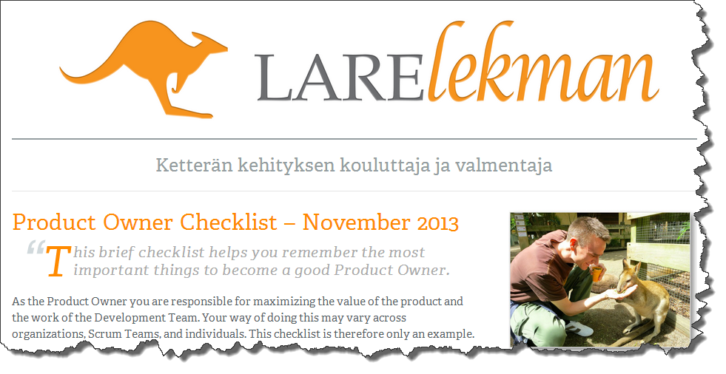
http://productownerchecklist.org

Slide 96
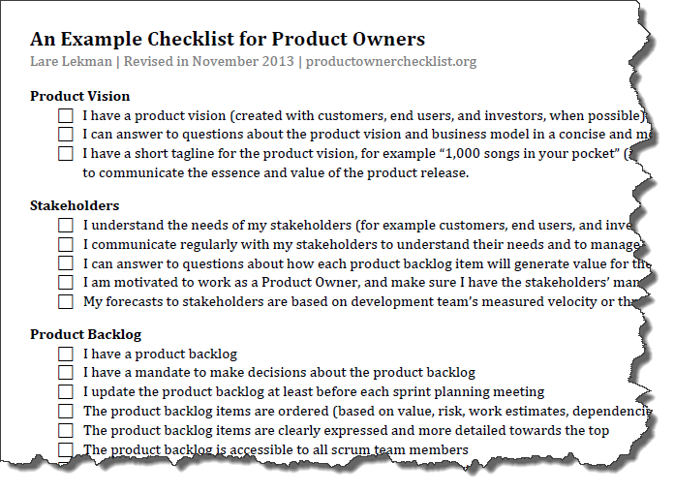

Slide 97
Any last questions?

Slide 98
Thanks. benday@benday.com | www.benday.com

