Slide 1

Coaching Skills for Scrum Masters & The Self-Organizing Team

Slide 2




Benjamin Day
Brookline, MA
Consultant, Coach, & Trainer
Microsoft MVP for Visual Studio ALM
Scrum, Team Foundation Server, Software Testing,
Software Architecture
Scrum.org Classes
  Professional Scrum Master (PSM)
  Professional Scrum Developer (PSD)
  Professional Scrum Foundations (PSF)
www.benday.com, benday@benday.com, @benday

Slide 3
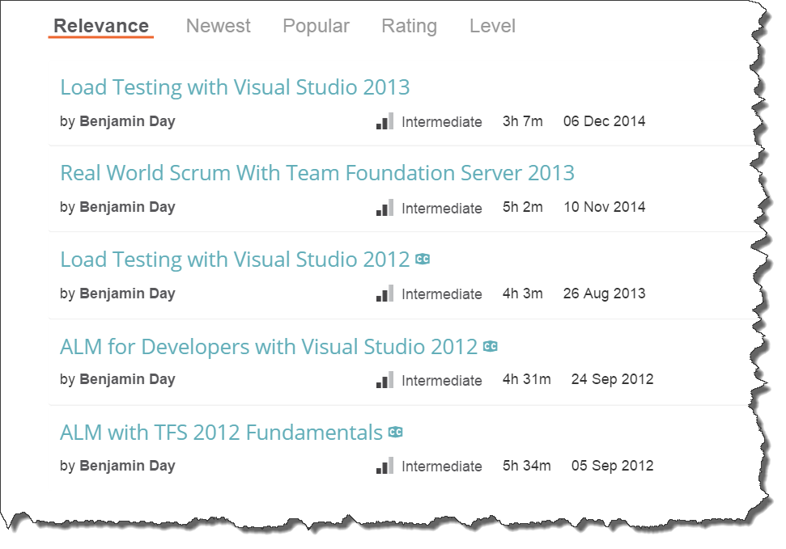
Got ?

Slide 4
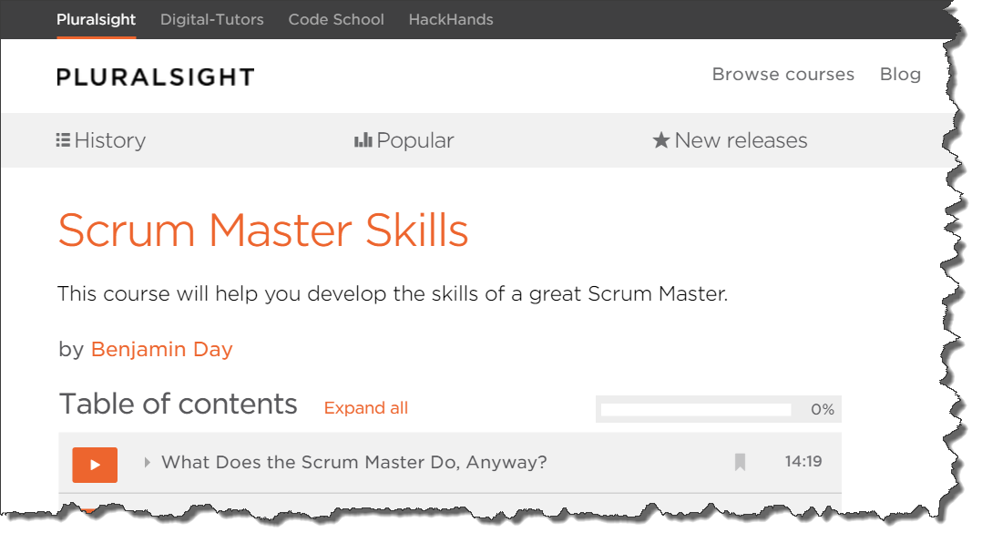
Got ?
Fresh! Just released in August!

Slide 5
Overview
What does the Scrum Master do?
“Clearing the brush” toward self-organization
Coaching the team
Difficult Conversations
The Zen of Self-Organization
Notes:
Assumptions
In this case, the Scrum Master is somewhat technical
I'm technical. Right or wrong, my Scrum Mastering style tends to go deep on the technical stuff.
You have to remember the needs of the business though. You're not building this stuff for the sake of the technology. You're building this stuff for the sake of the business. In all likelyhood, it's about making money. The technology enables the making of the money which pays for you to write the software which makes more money and pays for more software. Rinse and repeat.
This talk will straddle the line between Scrum Mastering and "Getting your project started right"
Things that have caused my teams constant headaches that kill velocity

Slide 6
“What does the Scrum Master do anyway?”

Slide 7
Curling.

Slide 8
Olympic sport. Played on ice.

Slide 9
Team 1
Team 2
The Curling Sheet
~148 ft / ~45 m
~15 ft / ~4.8m
Target
Target

Slide 10

Curling Stones
~40 lb. stones
Polished granite
It’s got a handle
8 stones per team

Slide 11
~148 ft / ~45 m
~15 ft / ~4.8m
Get your stones as close as possible to the center of the target
Each team takes turns
Team with the most stones closest to the center of the target wins
Note: that stone’s not to scale

Slide 12

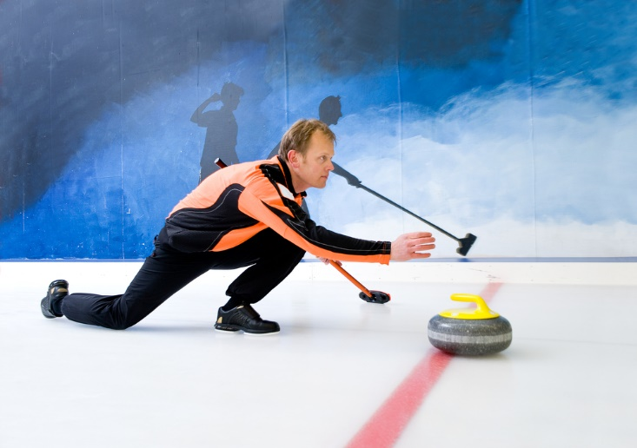
Throwing
3 team members per throw
Thrower
  Stone in hand
  Pushes off with legs
Starts glide towards target
Thrower has to release stone

Slide 13
The thrower might put some spin on it…

Slide 14
…but once released, nothing can touch the stone.

Slide 15
After the release, the Sweepers take over.

Slide 16
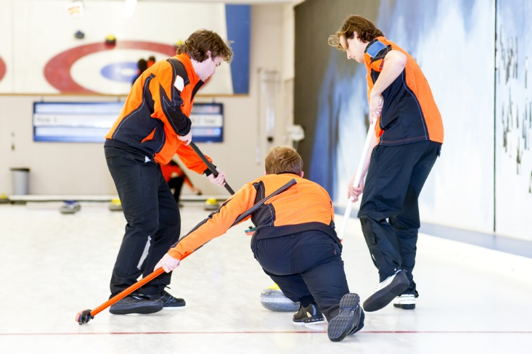

Sweepers
Two sweepers stay with the stone
Guide the stone to the target

Slide 17
Just to be 100% clear, the sweepers don’t touch the stone.

Slide 18
“So, the brushing moves the stone?”

Slide 19
The brushing doesn’t move the stone.
It’s already moving.

Slide 20
The brushing subtly adjusts the ice in front of it…

Slide 21
…and that can change the speed and direction of the stone significantly.

Slide 22
The sweepers – without touching it – are helping to coax and guide the stone so it lands correctly at the target.

Slide 23
“…and this has what to do with scrum mastering?

Slide 24
Scrum Master is a Coach
Scrum Master is not a management role
Team members don’t report to the Scrum Master
Scrum Master isn’t the boss

Slide 25
Three Roles in Scrum
Product
Owner
Scrum
Master
Development
Team

Slide 26
Three Roles in Scrum
Product Owner is as close to “a boss” as you’ll get
Provides the vision & goal
Product
Owner

Slide 27
Considering the inherent bossless-ness,
Scrum expects and relies on the team to self-organize.

Slide 28
To be successful, the team needs to use their creativity to deliver done, working software.

Slide 29
The team takes the Product Owner’s goal and self-organizes to figure out how to deliver done, working software at the end of the Sprint.

Slide 30
The basic idea:
Give the team their goal and then get out of the way.

Slide 31
The Scrum Master helps the team to be creative and productive.

Slide 32
You can’t command someone to be creative.

Slide 33
“1…2…3…BE CREATIVE!!!!”

Slide 34
You can’t tell people exactly what to do and also expect them to figure it out for themselves at the same time.

Slide 35
And now back to curling…

Slide 36
Just like the sweepers can’t touch the stone…

Slide 37
…a successful Scrum Master doesn’t command the team.

Slide 38
The Scrum Master guides the team and helps the team without actually giving any instructions.

Slide 39

The team is the stone
The Product Owner is the thrower
The Scrum Master is a sweeper, guiding the team towards the goal

Slide 40
“What does the Scrum Master do anyway?”

Slide 41
The Scrum Master helps the team to be productive and to use their creativity in order to deliver done, working software.

Slide 42
The Big Lesson:
The Scrum Master leads through influence not by command.

Slide 43
Suggestion:
Stop being a boss.

Slide 44
One of the most common & frequent moments of Scrum Master Bossitosity is the
Daily Scrum.

Slide 45
The Daily Scrum is not a status meeting.

Slide 46
The team does not report to you.

Slide 47
Remind them of this if it happens.

Slide 48
If it still happens, break eye contact.

Slide 49
Encourage them to talk to one another.

Slide 50
Remind them that the
Daily Scrum is for them.

Slide 51
Consider having someone else run that meeting.

Slide 52
(Which is good…because it frees you up to do other things.)

Slide 53
Suggestion:
Think like and/or be the team’s therapist.

Slide 54
Consider going to see a therapist yourself.

Slide 55
Read their emotional minds.

Slide 56
Try that at the Daily Scrum.

Slide 57
Hang back and read the room.

Slide 58
Idea:
Levels of Listening

Slide 59
Levels of Listening
Level 1
  “me me me”
Level 2
  Laser-focus on the other person
Level 3
  “meta”
  The vibe of the conversation

Slide 60
Arguably, the emotional reading trick is a level 3 technique.

Slide 61
When you’re in a meeting with your team, listen to the contents of the conversations.

Slide 62
What “level” are they communicating on?

Slide 63
Lots of “level 1” and they might be talking past each other.

Slide 64
Suggestion:
Observe to the room

Slide 65
Let’s say you noticed something.

Slide 66
The “level 3” just changed.

Slide 67
It got tense.

Slide 68
It got boring, exhausted, defeated.

Slide 69
Observe that to the room.

Slide 70
“Hey. What just happened there?
It feels like we just got socks for Christmas.”

Slide 71
As Scrum Master, your job is to help the team be productive. It’s your job to notice this stuff.

Slide 72
When that kind of stuff happens, it’s a great topic for conversation.
(And people probably didn’t notice it either.)

Slide 73
Suggestion:
Get curious.

Slide 74
Embrace your inner “dumb”.

Slide 75
Ask a lot of follow-up questions.

Slide 76
Even if I *think* I know the answer,
I want to hear the answer come out of someone else’s mouth.

Slide 77
I also want conversation.

Slide 78
Try to ask open-ended questions.

Slide 79
Closed-ended:
“Are you going to get that SQL code done?”
Open-ended:
“How’s that SQL code doing?
Can you give me an update?”

Slide 80
I really really want to avoid injecting my own opinion.

Slide 81
If you have a theory, give yourself an out.

Slide 82
If you need to say something try…
“Check this out…could it possibly be xyz?”
“Try this on for size. What if we asdf?”
“I could be wrong but what do you think about zxcvasdf?”

Slide 83
Sometimes you have to inject
“alternate theories of mind.”

Slide 84
Alternate Theories of Mind
Teams sometimes get hooked on what someone *might* be thinking
“Is it possible that XYZ is thinking something else”
Never ascribe to malice what could just as easily be attributed to incompetence.

Slide 85
Suggestion:
“Difficult Conversations”

Slide 86

Read this.

Slide 87
When things get heated…
…one or both sides do not understand
  Their contribution to the disagreement
  That their interpretation of someone else’s motivation is not actually correct
…there is often a difference between what is felt/thought vs. stated

Slide 88
A difficult conversation is 3 conversations
The “What Happened?” Conversation
  Disagreement about what should or has happened
  Who’s right or wrong?
  Who deserves the blame?
The Feelings Conversation
  What are people feeling?
  Are my feelings valid? Should I just suck it up?
  What about the other person’s feelings?
The Identity Conversation
  What does this situation mean to me?
  Am I good/bad at my job?
  Worthy
  Self-esteem

Slide 89
So what do we do with this?

Slide 90
You’ll be coaching to all 3 sub-conversations.

Slide 91
“Difficult conversations are almost never about getting the facts right. They are about conflicting perceptions, interpretations, and values.”

Slide 92
To the “What happened?” Conversation
Coach that “we might not want to assume we know the truth”
Ask “do we have all the information?”
Try to drill into “what were the intentions?”
Try to avoid “blame”
  Focus on what went wrong
  Focus on how to avoid it in the future

Slide 93
To the “Feelings” Conversation
This is hard in business because often feelings “don’t exist”
“99% of the time it’s not a technical problem”
Remember it’s about feelings even if it’s not ok to say that

Slide 94
To the “Identity” Conversation
Listen for the hint that there’s something else at stake
The disagreement might be chipping at self-perception
“I’m not the kind of person who lets people down…”
“I’m not the bad guy…I’m always one of the good guys!”

Slide 95
Suggestion:
Coaching Self-Organization

Slide 96

“Fake it ‘til you make it.”
-Lyssa Adkins

Slide 97
Get comfy with silence.

Slide 98
Ask the team what they want to do.

Slide 99
"It looks like X is happening.
What do you want to do about it?"

Slide 100
Any last questions?

Slide 101
Overview
What does the Scrum Master do?
“Clearing the brush” toward self-organization
Coaching the team
Difficult Conversations
The Zen of Self-Organization
Notes:
Assumptions
In this case, the Scrum Master is somewhat technical
I'm technical. Right or wrong, my Scrum Mastering style tends to go deep on the technical stuff.
You have to remember the needs of the business though. You're not building this stuff for the sake of the technology. You're building this stuff for the sake of the business. In all likelyhood, it's about making money. The technology enables the making of the money which pays for you to write the software which makes more money and pays for more software. Rinse and repeat.
This talk will straddle the line between Scrum Mastering and "Getting your project started right"
Things that have caused my teams constant headaches that kill velocity

Slide 102
Thanks. benday@benday.com | www.benday.com

