Slide 1
Real World SQL Server Data Tools
Benjamin Day
@benday

Slide 2
Benjamin Day
Brookline, MA
Consultant, Coach, & Trainer
Microsoft MVP for Visual Studio ALM
Scrum, Team Foundation Server, Software Testing, Software Architecture
Scrum.org Classes
Professional Scrum Master (PSM)
Professional Scrum Developer (PSD)
Professional Scrum Foundations (PSF)
www.benday.com, benday@benday.com, @benday

Slide 3
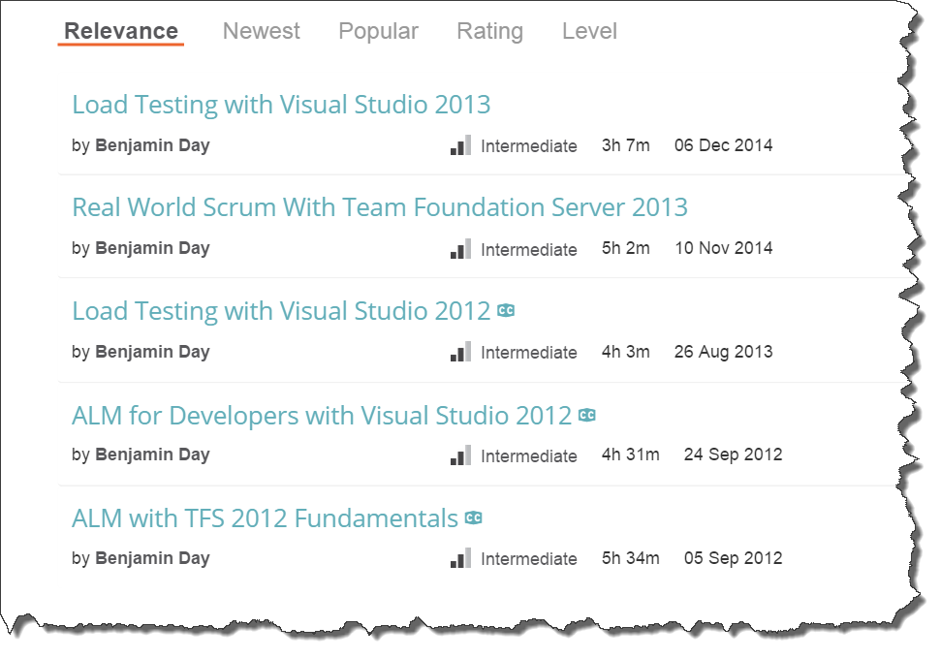
Got ?

Slide 4
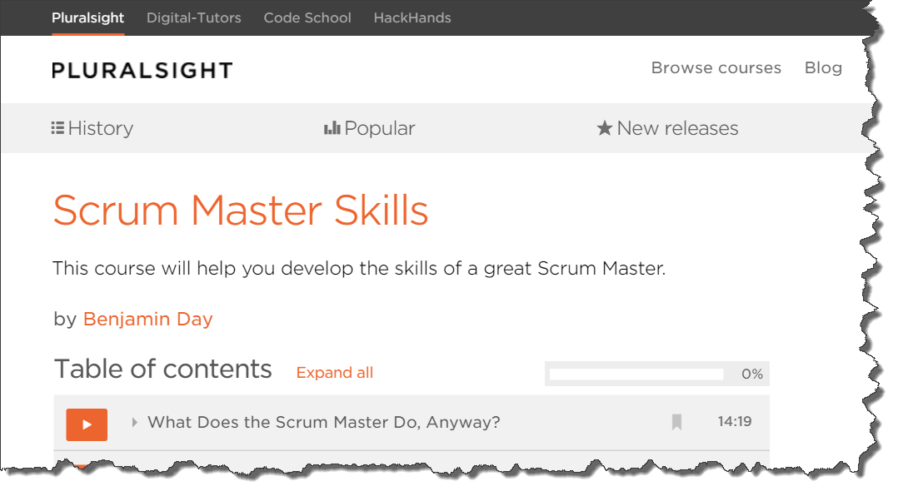
Got ?
Fresh! Just released in August!

Slide 5
SQL Server Data Tools = SSDT

Slide 6
SSDT = Version Control for SQL Server Schemas

Slide 7
Demo: Import & Build a Database; What’s under the hood?; Put it under version control;

Slide 8
Why is this interesting?
DevOps
Stability
Reliability
Repeatability
Release-ability
Sanity
Starts breaking the tyranny of the shared dev database

Slide 9
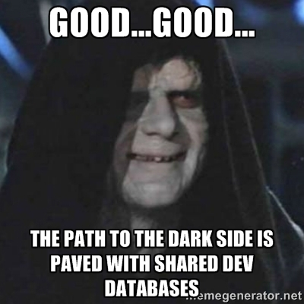
Shared Development Databases are Pure Evil
Fuzzy version control
Encourages terrible and/or wobbly testing practices
Devs are on top of each other
Permissions problems
HIPAA? Customer data? Privacy?

Slide 10
Application Code is Half the Battle
C#, VB.NET, ASP.NET, XAML, JavaScript, etc.
You’d never develop these without source control
Almost every application writes into a database
In most companies, the database isn’t under source control

Slide 11
The Application Breaks with the Wrong Version of the Database
Wrong tables
Wrong columns
Wrong data types
Wrong stored procedures
Wrong stored procedure parameters
Wrong views
Wrong functions
Wrong permissions
Wrong lookup data
Etc etc etc

Slide 12
You can’t release the application without the database.

Slide 13
You can’t say that you’ve tested the application without the database.

Slide 14
A good testing strategy requires knowing what you’re actually testing.

Slide 15
So how do you know what you’re testing?

Slide 16
So how do you know what you’re testing?
Part 1: Version Control
Version your app code and database code together
Part 2: Automated Build
Integrates your code
Packages your code
Provides a build number for your code
Part 2 requires Part 1

Slide 17
You need SSDT to get your database under source control. Track it. Build it. Release it.

Slide 18
DevOps?

Slide 19
DevOps
How are you developing, delivering, deploying, & monitoring?
(How much time are you wasting?)
“What is the process of getting a developer’s changeset from check-in to production? How long does that take?”
If you want to go fast, start automating
Automation removes tedious stuff
Automation provides reliability
Automation helps you do more and go faster

Slide 20
Got a database? Then SSDT is essential to your DevOps “story”.

Slide 21
SSDT & TFS Build
TFS Build compiles your code
App code
Database code
TFS Build runs tests & verifies
TFS Build can deploy your stuff
SSDT gives you a way to do incremental deploys

Slide 22
SqlPackage.exe
SSDT command line tool
C:\Program Files (x86)\Microsoft Visual Studio 14.0\ Common7\IDE\Extensions\Microsoft\SQLDB\DAC\120
Actions:
Extract, DeployReport, DriftReport, Publish, Script, Export, Import, Pipe
Publish = deploy your database

Slide 23
sqlpackage /action:Publish /sourceFile:"$dacpacPath" /targetconnectionstring:"$connectionString"

Slide 24
Demo: Deploy to production; Insert some data; Make a change in the db schema; Do an incremental deploy;

Slide 25
Demo: Create a TFS build; Deploy the database as part of the build;

Slide 26
What about schema comparisons?

Slide 27
What about lookup data?

Slide 28
What about database references?

Slide 29
What about build variables?

Slide 30
What about cleaning up nasty old databases?

Slide 31
Demo

Slide 32
Any last questions?

Slide 33
Thanks. benday@benday.com | www.benday.com

