Slide 1


Better Unit Tests through Design Patterns: Repository, Adapter, Mocks, and more…
Benjamin Day
@benday

Slide 2

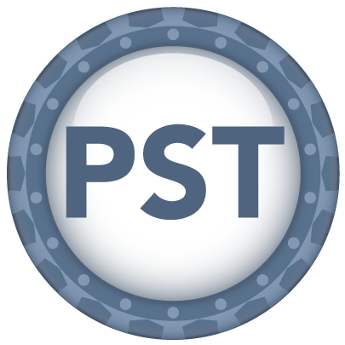


Benjamin Day
Brookline, MA
Consultant, Coach, & Trainer
Microsoft MVP for Visual Studio ALM
Team Foundation Server, Software Testing, Scrum, Software Architecture
Scrum.org Classes
  Professional Scrum Foundations (PSF)
  Professional Scrum Master (PSM)
  Professional Scrum Developer (PSD)
www.benday.com, benday@benday.com, @benday

Slide 3
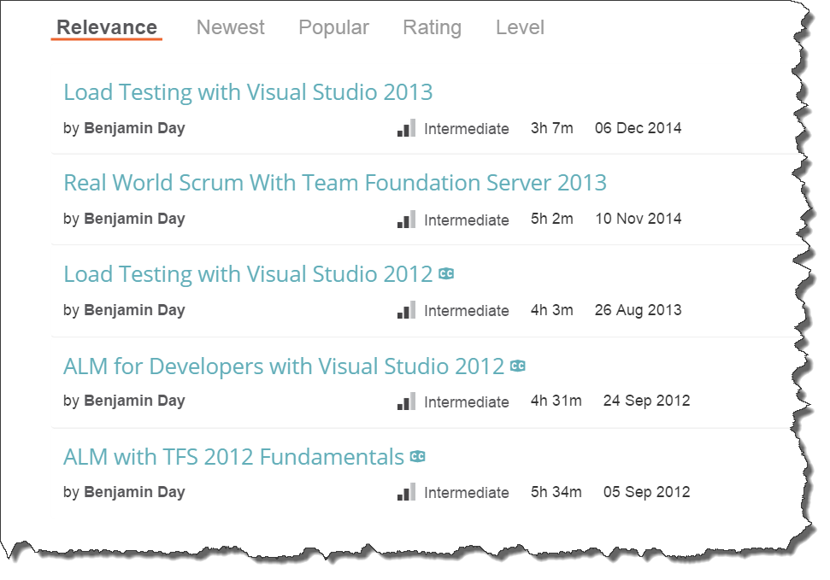
Online courses at Pluralsight.com

Slide 4
Agenda / Overview
Quick Review
Design for Testability
What’s a Design Pattern?
Design Patterns for Testability
Patterns for User Interface Testing
  Server-side web apps
  JavaScript apps

Slide 5
This talk is about unit testing & test-driven development.

Slide 6
What is Test-Driven Development?
Develop code with proof that it works
  Code that validates other code
  Small chunks of “is it working?”
Small chunks = Unit Tests
“Never write a single line of code unless you have a failing automated test.”
  Kent Beck, “Test-Driven Development”,
  Addison-Wesley

Slide 7
Why Use TDD?
High-quality code
  Fewer bugs
  Bugs are easier to diagnose
Encourages you to think about…
  …what you’re building
  …how you know you’re done
  …how you know it works
Less time in the debugger
Tests that say when something works →
  Easier maintenance, refactoring
  Self-documenting
Helps you to know if it’s working a lot faster.
Tends to push you into better/cleaner architecture.

Slide 8
You shouldn’t need QA to tell you that your stuff doesn’t work.

Slide 9
Your apps need to be tested.

Slide 10
Your apps need to be testable.

Slide 11
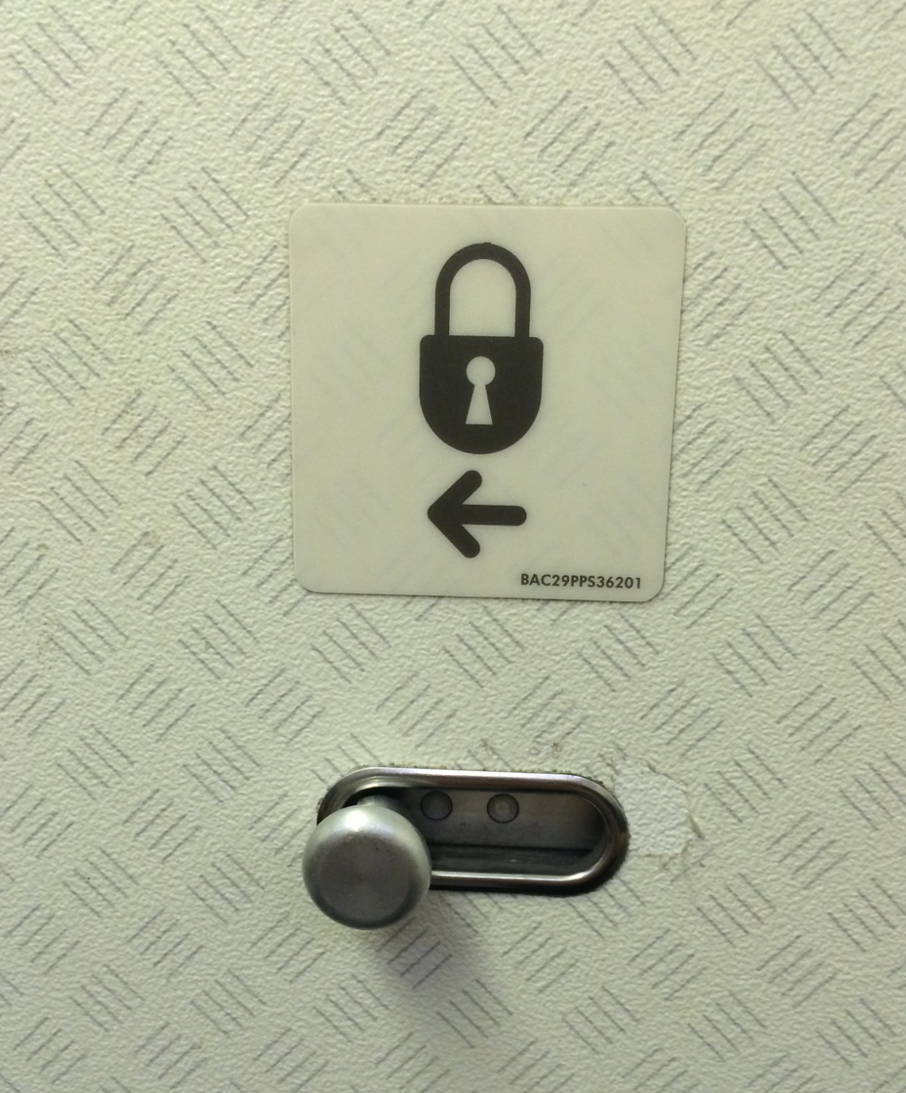
How would you test this?

Slide 12
What is Design For Testability?
How would you test this?
Do you have to take the plane up for a spin?
Build it so you can test it.

Slide 13
Your apps need to be testable.
You need to design for testability.

Slide 14
A unit test is not the same as an integration test.

Slide 15
Avoid End-to-End Integration Tests
Does a good test…
…really have to write all the way to the database?
…really have to have a running REST service on the other end of that call?
…really need to make a call to the mainframe?

Slide 16
It’s called a unit test.
Small units of functionality
Tested in isolation
If you designed for testability, you (probably) can test in isolation.
If you didn’t, you probably have a monolithic app.

Slide 17

“How am I supposed to test THAT?!”
http://www.pdphoto.org/PictureDetail.php?mat=&pg=8307

Slide 18
It’ll be a lot easier if you design for testability.

Slide 19
What makes an app hard to test?
Tightly coupled
Hidden or embedded dependencies
Required data & databases
Insane amounts of setup code for the test

Slide 20
Hard to test usually also means hard to maintain.

Slide 21
Design Patterns will help you to create a more testable & maintainable application.

Slide 22
What’s a Design Pattern?
Well-known and accepted solution to a common problem
Avoid re-inventing the wheel

Slide 23
Design patterns in architecture.

Slide 24
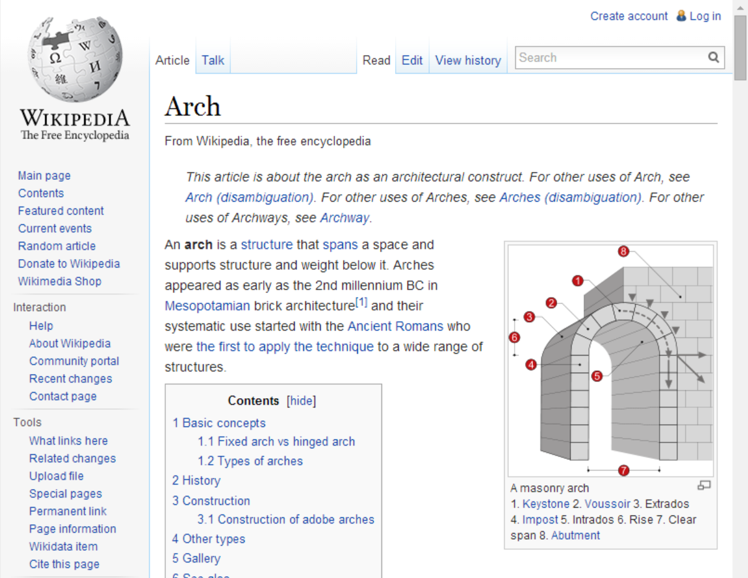

Slide 25
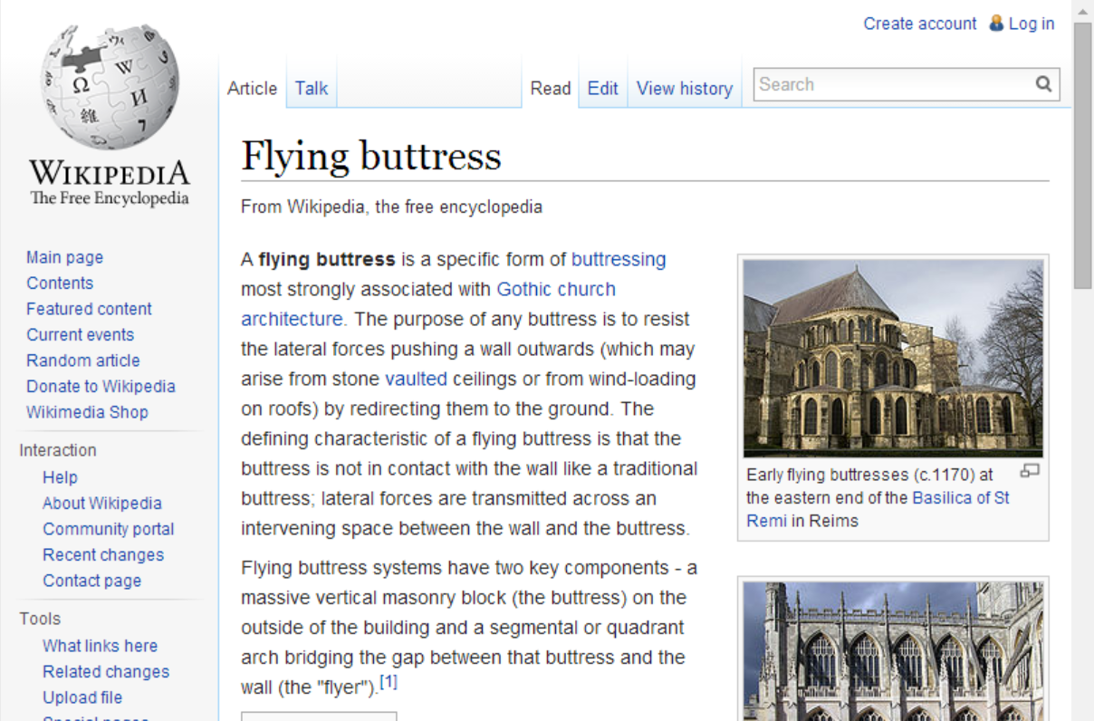


Slide 26

Popularized in Software by this book…

Slide 27
Design Patterns for this talk
Dependency Injection
  Flexibility
Repository
  Data Access
Adapter
  Single-Responsibility Principle
  Keeps tedious, bug-prone code contained
Strategy
  Encapsulates algorithms & business logic
Model-View-Controller
  Isolates User Interface Implementation from
  the User Interface Logic
  Testable User Interfaces
  Model-View-ViewModel

Slide 28
Design goals in a testable system
(Testable, obviously.)
Well-organized
Flexible

Slide 29
Design goals in a testable system
(Testable, obviously.)
Well-organized
  Single Responsibility Principle (SRP)
  Layered (example: n-tier)
Flexible
  Code to interfaces rather than concrete types
  Dependency Injection
  Interface Segregation Principle (ISP)

Slide 30
Single Responsibility Principle:
An object should have only one reason to change.

Slide 31
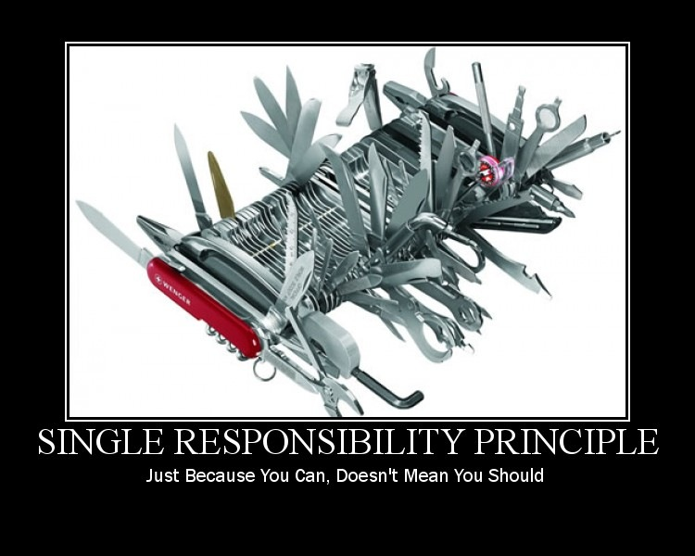

http://lostechies.com/derickbailey/files/2011/03/SingleResponsibilityPrinciple2_71060858.jpg

Slide 32
Interface Segregation Principle:
“no client should be forced to depend on methods it does not use.”

Slide 33
Dependency Injection:
“Don’t get too attached.”

Slide 34
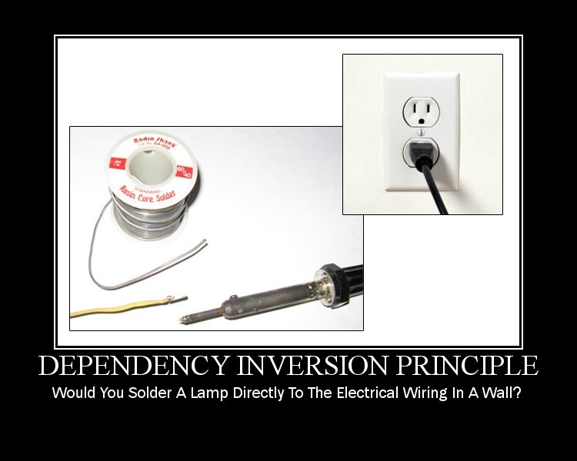
http://lostechies.com/derickbailey/files/2011/03/DependencyInversionPrinciple_0278F9E2.jpg

Slide 35
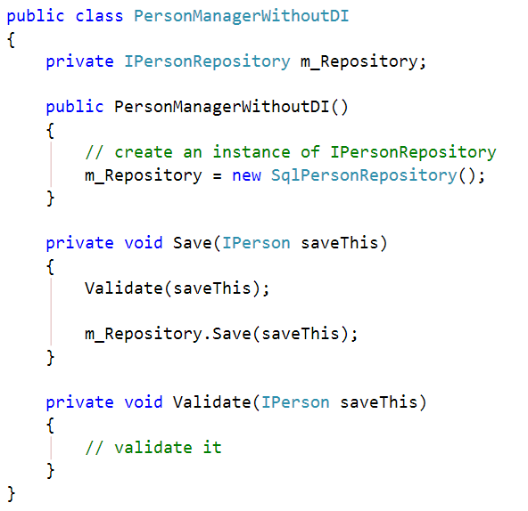
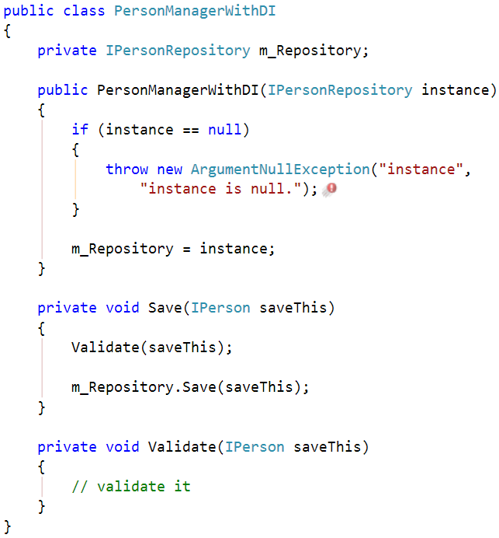
Advertise Dependencies on Constructor
Less Awesome
Now With More Awesome

Slide 36
Why does DI help with testability?
Helps you focus on the testing task at hand
  Only test what you’re trying to test. Skip everything else.
Makes interface-driven programming simple
Interface-driven programming + DI lets you use mocks and stubs in your tests.

Slide 37
“Mocks & Stubs?”

Slide 38
Mocks vs. Stubs vs.
Dummies vs. Fakes
Martin Fowler
http://martinfowler.com/articles/mocksArentStubs.html
Dummy = passed but not used
Fake = “shortcut” implementation
Stub = Only pretends to work, returns pre-defined answer
Mock = Used to test expectations, requires verification at the end of test

Slide 39
Demos:
PersonService saves valid person objects with unique user names.

Slide 40
Strategy Pattern encapsulates an algorithm behind an interface.

Slide 41
Repository Pattern encapsulates data access logic.

Slide 42
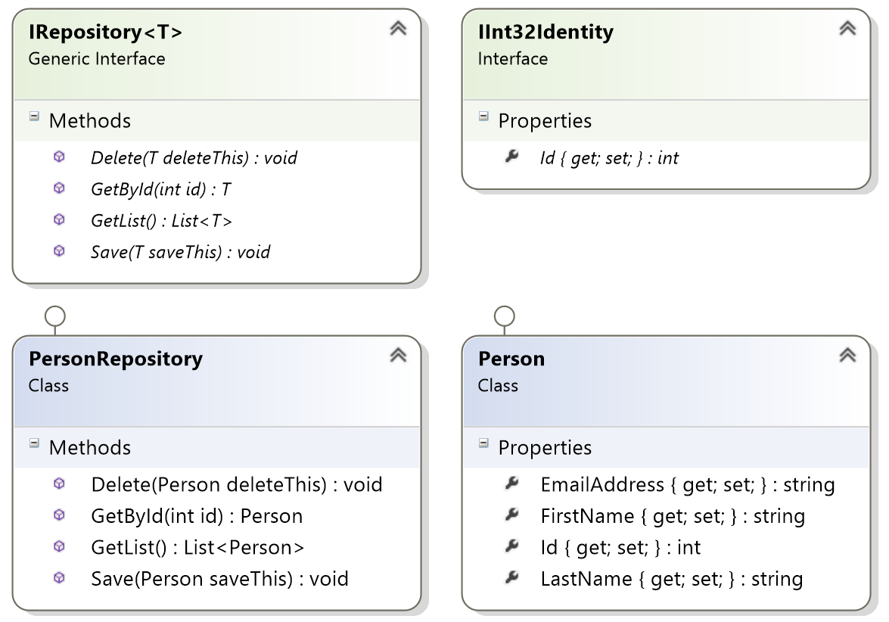

Slide 43
Demo:
Mocks for code coverage

Slide 44
User Interface Testing

Slide 45
User Interfaces: The Redheaded Stepchild of the Unit Testing World
Not easy to automate the UI testing
Basically, automating button clicks
UI’s almost have to be tested by a human
  Computers don’t understand the “visual stuff”
  Colors, fonts, etc are hard to unit test for
  “This doesn’t look right” errors
The rest is:
  Exercising the application
  Checking that fields have the right data
  Checking field visibility

Slide 46
My $0.02.
Solve the problem by not solving the problem
Find a way to minimize what you can’t automate

Slide 47
The Solution.
Keep as much logic as possible out of the UI
  Shouldn’t be more than a handful of assignments
  Nothing smart
  Real work is handled by the “business” tier
Test the UI separate from everything else

Slide 48
Design Patterns for UI Testability
Model-View-Controller (MVC)
  ASP.NET MVC
Model-View-Presenter (MVP)
  Windows Forms
  ASP.NET Web Forms
Model-View-ViewModel (MVVM)
  AngularJS
  Silverlight
  WPF
  Windows Phone

Slide 49
The idea is that the user interface becomes an abstraction.

Slide 50
Demo:
Search for a president using
Model-View-Controller (MVC)

Slide 51
This is also relevant in the JavaScript world.

Slide 52
MVC / MVVM with AngularJS, tested by Jasmine

Slide 53
What is AngularJS?
JavaScript library for data binding
Logic goes into Controllers
  (ViewModel?)
HTML becomes a thin layer over the Controllers
  “Views”
Testing effort is focused on the Controller

Slide 54
AngularJS is easily, readily tested by
Jasmine tests.

Slide 55
Demo:
A simple calculator with
AngularJS and Jasmine Tests

Slide 56
“Ok. Great.
But what about something useful with data?”

Slide 57
Tip:
Service-oriented applications are two apps.

Slide 58
Dependency Injection is built in to AngularJS.

Slide 59
Calls to back-end services get wrapped in classes called “Services”.

Slide 60
Demo:
President Search with a REST-based service, AngularJS, & Jasmine

Slide 61
Summary, Part 1: The Patterns
Dependency Injection
  Flexibility
Repository
  Data Access
Adapter
  Single-Responsibility Principle
  Keeps tedious, bug-prone code contained
Strategy
  Encapsulates algorithms & business logic
Model-View-Controller
  Isolates User Interface Implementation from
  the User Interface Logic
  Testable User Interfaces
  Model-View-ViewModel

Slide 62
Summary, Part 2: The Big Picture
Quick Review
Design for Testability
What’s a Design Pattern?
Design Patterns for Testability
Patterns for User Interface Testing
  Server-side web apps
  JavaScript apps

Slide 63
Any last questions?

Slide 64
Thanks. benday@benday.com | www.benday.com
@benday

