Slide 1
Automated Build, Test & Deploy with TFS, ASP.NET, and SQL Server
Benjamin Day
@benday

Slide 2
Benjamin Day
Brookline, MA
Consultant, Coach, & Trainer
Microsoft MVP for Visual Studio ALM
Scrum, Team Foundation Server, Software Testing, Software Architecture
Scrum.org Classes
Professional Scrum Master (PSM)
Professional Scrum Developer (PSD)
Professional Scrum Foundations (PSF)
www.benday.com, benday@benday.com, @benday

Slide 3
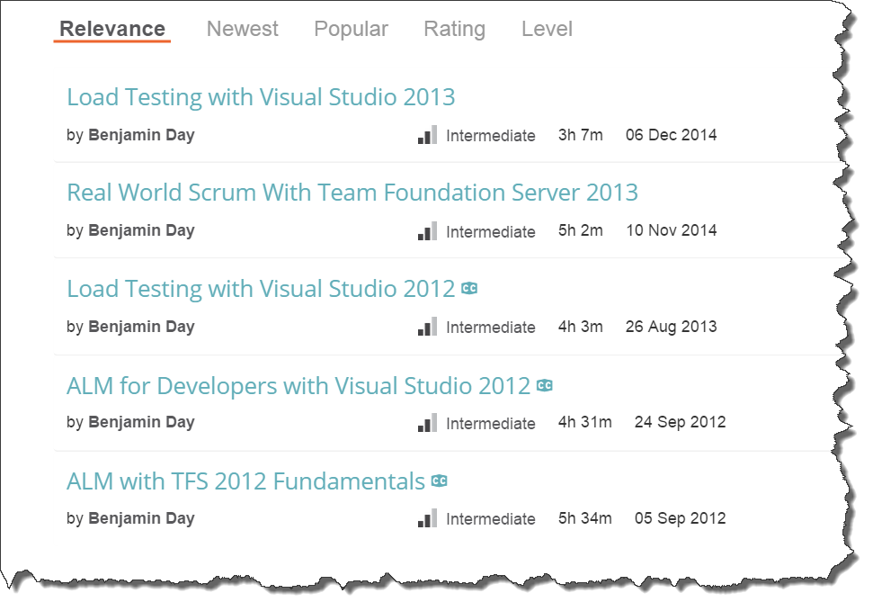
Got ?

Slide 4
On with the show.

Slide 5
Working backwards…

Slide 6
Why do you care about automated deploy?
You don’t have to do the deploys yourself
It’s the ultimate in deployment documentation
You don’t have to think about it
You’ve scripted it…and therefore deployment isn’t painful
You can deploy more often

Slide 7
Why deploy more often?
The team can check their stuff more often
Focus on quality early
Makes QA testing easier
Makes gathering feedback easier
Continuous Delivery

Slide 8
The Continuous Delivery Mindset: If something’s done, why wait to release it?

Slide 9
Automated deploy and continuous deploy need an automated build.

Slide 10
Why do I care about automated builds?
You want automated deploy
You want to focus on quality early
You want to make sure your stuff works
You want to make sure that your team can integrate

Slide 11
“Integrate?”

Slide 12
Ever had this happen?

Slide 13
Everyone’s working on stuff.

Slide 14
Someone finishes their stuff.

Slide 15
That person checks in their changes.

Slide 16
They’re happy.

Slide 17
“High five, me. I’m awesome.”

Slide 18
They move on to something else.

Slide 19
You then do a ‘get latest’.

Slide 20
Nothing works.

Slide 21
800 compilation errors.

Slide 22
“Works on my box.”

Slide 23
If someone says “well, it works on my box” you can safely translate that to “it doesn’t work.”

Slide 24
An automated build helps fix the “works on my box” problem.

Slide 25
TFS Build Is a Neutral 3rd Party
Install the build service
Create a build definition in TFS
When the build runs it…
…does a ‘Get Latest’
…labels the code in version control
…compiles the code
… (optionally) runs tests
…copies the binaries to a “drop” directory

Slide 26
Things the Build Tells You
If the compile fails, you have integration problems.
If the test don’t pass, you have quality problems.
If your automated deploy passes, you know for sure that you know how to deploy the app.
Integration
Bring your code together
Quality
Make sure code works
Deployment
Make sure it compiles
Version code as a unit
Measure how well it’s been tested
Make sure you can verify your code
Know what’s been deployed
Know what’s been tested

Slide 27
Build Types
Anarchy
Nothing is automated
“Works fine on my box.”
Manual
Not automated
“Don’t make plans. We’re doing a build tonight.”
A build is a special event.
Continuous Integration
Automated
Each check-in triggers a build
If the build works, you’re happy.
If the build breaks, fix it now.

Slide 28
The Prime Directive: The Build Shall Always Pass

Slide 29
The Prime Directive, Part B: And if thine build doth not pass, thou shalt fix thine build ASAP.

Slide 30
DEMO: Create an automated build

Slide 31
3 Big Automation Wins

Slide 32
3 big automation wins
Integration
Bring your code together
Quality
Make sure code works
Deployment
Make sure it compiles
Version code as a unit
Measure how well it’s been tested
Make sure you can verify your code
Know what’s been deployed
Know what’s been tested

Slide 33
Build Server Architecture
Controller
Coordinates builds for a Team Project Collection (TPC)
Assigns work to Agents
Agent(s)
1+ agent per controller
Use “Tags” to define capabilities of each Agent
Installer is on the TFS DVD / ISO
Controllers and Agents don't have to be on the same box

Slide 34
TFS Build Triggers
Manual
Someone has to run it
Scheduled
Runs automatically based on a schedule
Continuous Build
Each time someone checks in
Gated Check-in
Each time someone checks in
No direct check-ins to version control
Based off of a shelveset
Doesn’t work with Git

Slide 36
Unit Tests, Code Coverage, SQL Server Data Tools, and Customized TFS Builds

Slide 37
What is Test-Driven Development (TDD)?
Develop code with proof that it works
Code that validates other code
Code that validates the “System Under Test” or SUT
Small chunks of “is it working?”
Small chunks = Unit Tests
“Never write a single line of code unless you have a failing automated test.”
Kent Beck, “Test-Driven Development”, Addison-Wesley

Slide 38
Code Coverage
Keeps track of which lines of code are run
More importantly, NOT run
Shows you which code your tests aren’t exercising
Shows you all the spots you missed
Helps find unused code
Especially after refactoring
“Dead” code

Slide 39
TFS Build Will Run Your Tests
.NET code?
MSTest-based tests
NUnit-based tests
Java code?
JUnit
ANT
Maven

Slide 40
DEMO: Unit Tests & Code Coverage with TFS Build

Slide 41
If you want to get serious about automation, you need to be able to version your database & compiled code together.

Slide 42
Your application code almost definitely depends on a database schema.

Slide 43
You can’t deploy one without the other.

Slide 44
They need to be versioned and tracked together.

Slide 45
SQL Server Database Tools (SSDT)
Put your schema under source control
You can version your app code and schema at the same time
(Branching & Merging, too!)
Lets your team members work in isolation
No more need for that shared development database
No one sees your check-in until they do a ‘get latest’
Database code participates in the same lifecycle as the rest of the code

Slide 46
DEMO: Basic SSDT

Slide 47
What about lookup data?

Slide 48
SSDT Post-Deploy Scripts + T-SQL ‘MERGE INTO’ Command

Slide 49
DEMO: SSDT Lookup Values

Slide 50
Deploy the Database From a Build

Slide 51
Team Foundation Server Build Customization

Slide 52
TFS Build helps you pull it all together with some customization.

Slide 53
TFS Build Customization
Build script is XAML
Pre-TFS2013 simple customizations were painful
TFS2013 now has simple PowerShell-based customizations
PowerShell Build Events
Pre-build / Post-build
Pre-test / Post-test
Don’t worry. You can still do complex XAML customizations.

Slide 54
Customizations Using PowerShell Build Events
Pre-build
Environment-based config scripts?
Post-build
Deploy / configure for tests?
Deploy web app?
Deploy database?
Pre-test
Deploy / configure for tests?
Post-test
Deploy to production?
Compile
Unit Test

Slide 55
Tip: Start with a simple *.ps1 script

Slide 57
DEMO: Simple *.ps1 script

Slide 58
DEMO: Deploy a database using SSDT and deploy the app with a *.ps1 script

Slide 59
Any last questions?

Slide 60
Thank you.
http://www.benday.com | benday@benday.com

