Slide 1


Load Testing ASP.NET & WebAPI with Visual Studio
Benjamin Day
@benday

Slide 2





Benjamin Day
Brookline, MA
Consultant, Coach, & Trainer
Microsoft MVP for Visual Studio ALM
Scrum, Team Foundation Server, Software Testing,
Software Architecture
Scrum.org Classes
  Professional Scrum Master (PSM)
  Professional Scrum Developer (PSD)
  Professional Scrum Foundations (PSF)
www.benday.com, benday@benday.com, @benday

Slide 3
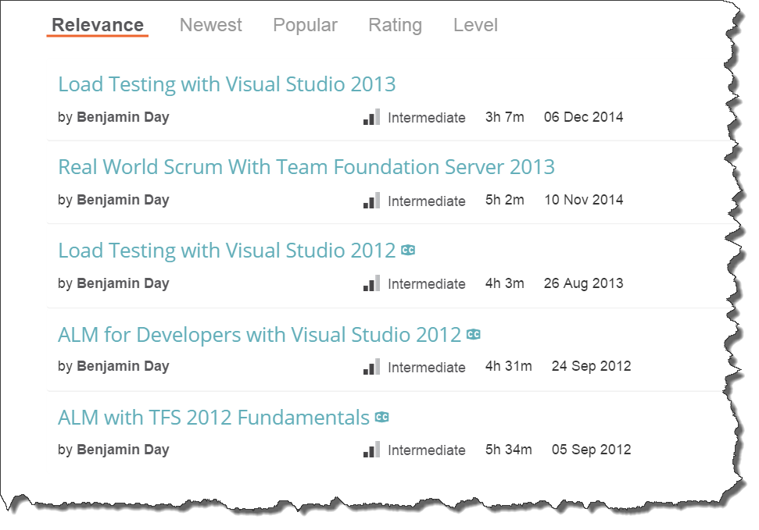
Got ?

Slide 4
The Agenda
Basics of
  Web Performance Tests
  Load Tests
  Load Test Rigs
  Performance Explorer
Existing application
  Identify performance problems
  Go from bad performance to good

Slide 5
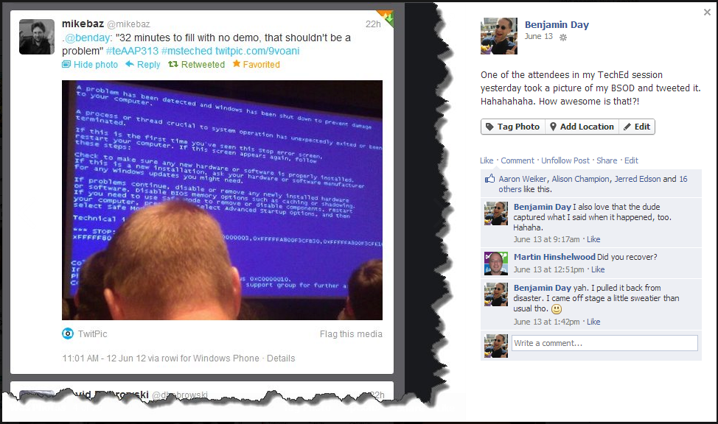

Slide 6
The Purpose of Load Testing
Identify the capabilities of your application
Possible goals
  Explore
  Verify
  Find the limits
  Crush

Slide 7
The Obligatory “Eat Your Vegetables” Slide
Load test throughout the development cycle.
Catch problems early
Establish performance baseline
Watch for performance trends
Cheaper to fix early
Plan for performance

Slide 8
Cheaper to Fix Early

Slide 9
Dose Of Reality
You know you should work that way.
You probably don’t.
This talk is for you.
You have problems.
How do you figure out what’s going wrong?

Slide 10
Inspiration for this talk
Real customer engagement
Spent years developing a web application
Released it
Seriously grumpy customers
Huge hardware
~20 simultaneous users
Fixed it
  4000+ simultaneous users
  Reduced hardware

Slide 11
The Tools
Load Testing
Web Performance Tests
Code
Profiling
Profiling Tools
Performance Wizard
Load Tests
Load Test Rigs

Slide 12
Demo:
A tour of the application.

Slide 13
Disaster Strikes
The application is deployed to production.
Users are losing their minds.
  Intermittent errors on the site.
  Site is slow.
Your boss is seriously angry.
  “Fix it!”

Slide 14
The Problem
“No Repro”
  “Works on my box.”
  You don’t know what the errors are.
  The site seems to work fine.
Wild guess: it dies under load.
You need to create some load.

Slide 15
The Plan
Script user activity with Web Performance Tests
Simulate a mix of users using Load Tests
Simulate lots of users with a Load Test Rig
Reproduce the errors...hopefully
Find code problems with the Performance Wizard
Fix the code

Slide 16
Web Performance Tests.

Slide 17
The Plan
Script user activity with Web Performance Tests
Simulate a mix of users using Load Tests
Simulate lots of users with a Load Test Rig
Reproduce the errors...hopefully
Find code problems with the Performance Wizard
Fix the code

Slide 18
What is a Web Performance Test?
Test type in Visual Studio
Simulate a user using an ASP.NET application
  HTTP traffic
Building block of Load Tests

Slide 19
Tip: Web Tests & User Stories
Web Tests should simulate a User Story
Example:
  As an administrator, I need to search for a person by username so that I can deactivate that person’s account.
  As a customer, I want to order a pizza and pay with a credit card.
Helps to organize your suite

Slide 20
Demo:
Create a basic Web Test

Slide 21
Data-driven Web Tests
Run web test once per row in data source
Simulate multiple users doing *similar* actions
Data source types
  OLE DB, CSV, XML
Parameterization
Better tests, better coverage

Slide 22
Demo:
Web Tests in the underperforming app

Slide 23
Load Tests

Slide 24
The Plan
Script user activity with Web Performance Tests
Simulate a mix of users using Load Tests
Simulate lots of users with a Load Test Rig
Reproduce the errors...hopefully
Find code problems with the Performance Wizard
Fix the code

Slide 25
What are Load Tests?
Mix of Web Performance and Unit Tests
Simulates a mix of users doing a mix of things
Simulate
  Network speeds
  Different browsers
  Varying user activity loads

Slide 26
Why would you want to call a
Unit Test from a load test?

Slide 27
It’s a great way to call code that doesn’t easily fit in a Web Performance Test.

Slide 28
Things I’d Consider Calling from a Load Tested Unit Test
Web Services
  WCF
  WebAPI
Databases
  SQL Queries
  Stored Procedures
Message Queues
“Ambient Noise”
  Miscellaneous traffic
  Scheduled jobs

Slide 29
Demo:
Let’s create some load tests.

Slide 30
Demo:
Running load tests.

Slide 31
The Plan
Script user activity with Web Performance Tests
Simulate a mix of users using Load Tests
Simulate lots of users with a Load Test Rig
Reproduce the errors...hopefully
Find code problems with the Performance Wizard
Fix the code

Slide 32
Load Test Rigs

Slide 33
Three ways to run Load Tests

Slide 34
Three Ways to Run Load Tests
Desktop, single machine
  Everything runs out of Visual Studio
Load Test Rig
  Initiated from Visual Studio
  Load generation & monitoring
  done by other servers
  Load Controllers & Agents
  On premise applications
Cloud-based Load Testing
  Initiated from Visual Studio
  Load generation & monitoring
  done by other servers
  Visual Studio Online
  Microsoft Azure
  Application Insights
  Cloud-based applications

Slide 35
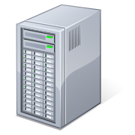




Visual Studio 2013 vs. the App
Visual Studio 2013
(your machine)
The System Under Test
(aka. “The App”)

Slide 36


A Load Test Rig vs. The App
Your machine
Load Controller
The System Under Test
(aka. “The App”)
Load Agents
On Premise
The Load Test Rig

Slide 37

Cloud-based Load Testing vs. The App
Your machine
The System Under Test
(aka. “The App on the Internet”)
Cloud-based
Cloud-based Load Testing

Slide 38
Running it on one box is simple but there’s only so much load that you can generate.

Slide 39

Load Test Rig & The Application
Controller
  Orchestrates
  PerfMon Counters
Agent (1..n)
  Simulates users
Controller
Agent 1
Web Server
Database
Agent 2
Coordinates & Gathers Information
Generates Load
Application Under Test
Agent n

Slide 40
Configure the Controller
Install SQL Express or SQL Server
  Stores collected test run data
Install Visual Studio 2013 Test Controller
Run the process as an ActiveDirectory domain user
  Example: domain\LoadTestController
Configure for Load Testing
  Creates a database
Service account needs to be member of
“Performance Monitor Users” on any server that will be profiled

Slide 41
Configure the Agent(s)
Install the Agent
Installation will ask which Controller
Tip: Run the Agent service using an Active Directory user
  Example: domain\LoadAgent
(Optional) If you’re using Network Emulation,
the service account needs to be a member of the
Administrators group on each agent machine
Service account may need permissions on servers under test depending on contents of the tests.

Slide 42
The Plan
Script user activity with Web Performance Tests
Simulate a mix of users using Load Tests
Simulate lots of users with a Load Test Rig
Reproduce the errors...hopefully
Find code problems with the Performance Wizard
Fix the code

Slide 43
Demo:
Run Load Tests on the Rig

Slide 44
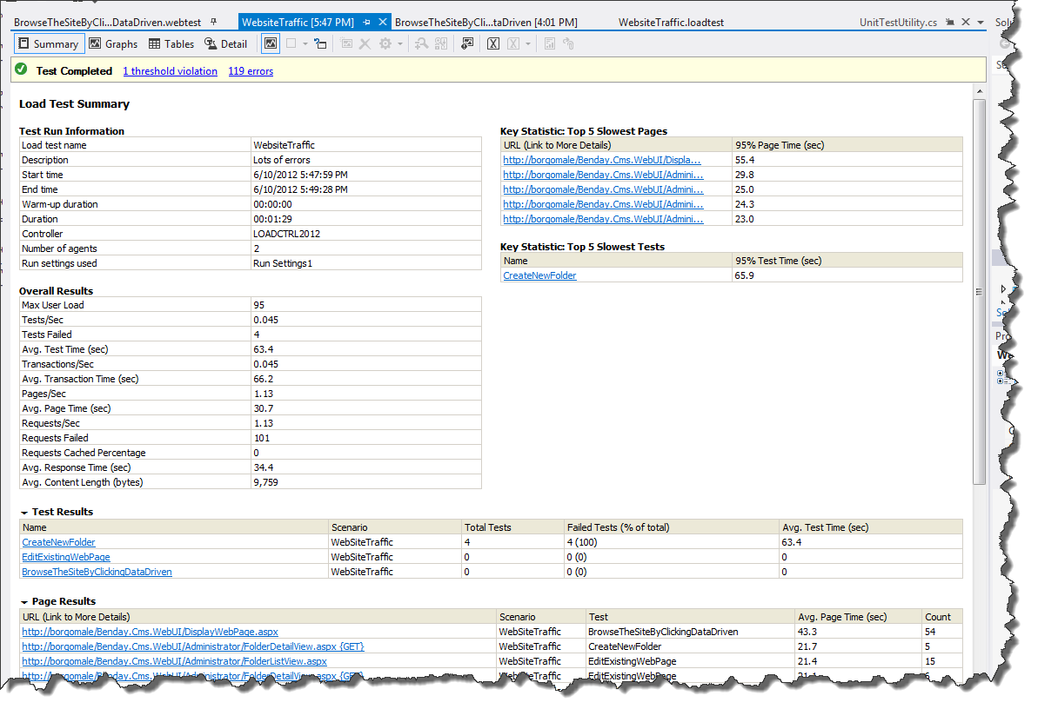
Before: Load Test Summary

Slide 45
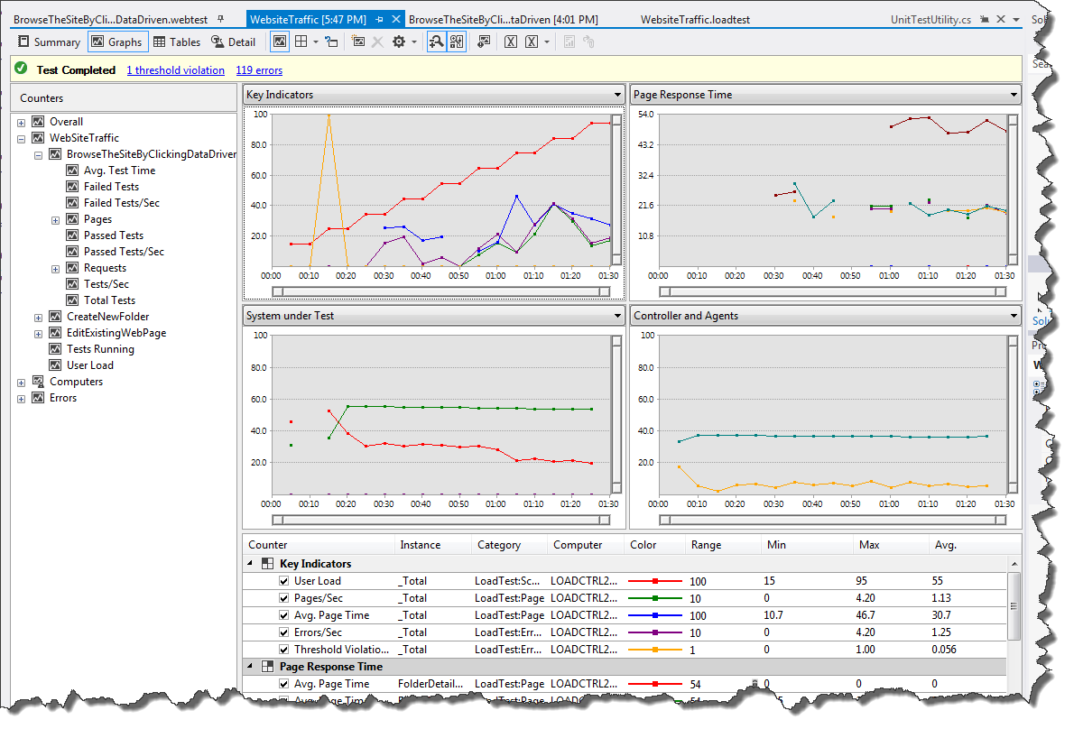
Before: Load Test Graphs

Slide 46
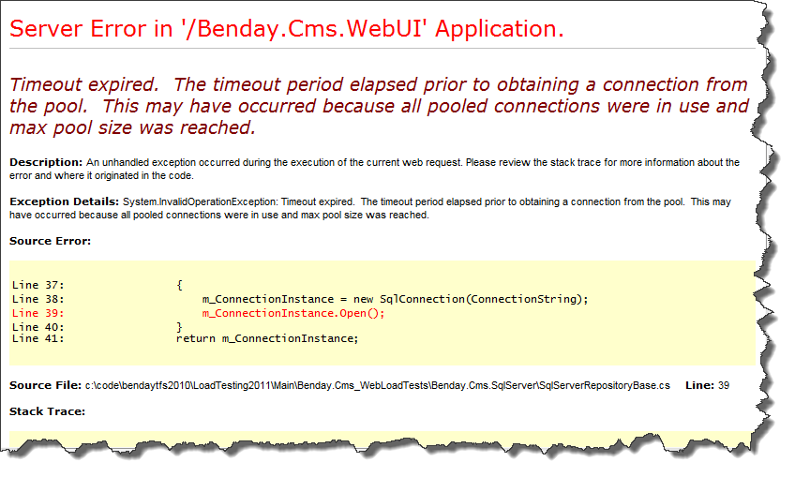
The Core Problem.

Slide 47
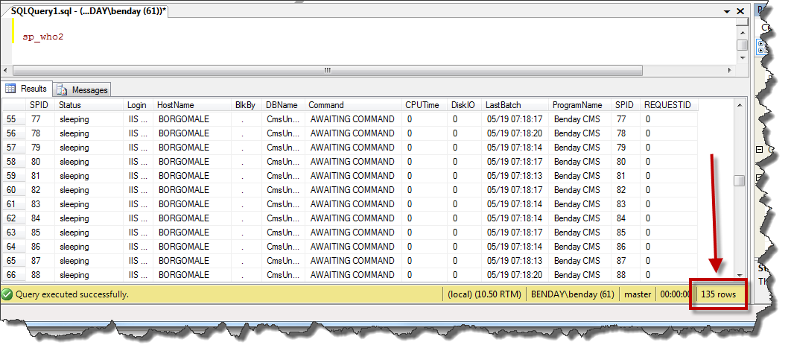
‘sp_who2’ says lots of open connections.

Slide 48
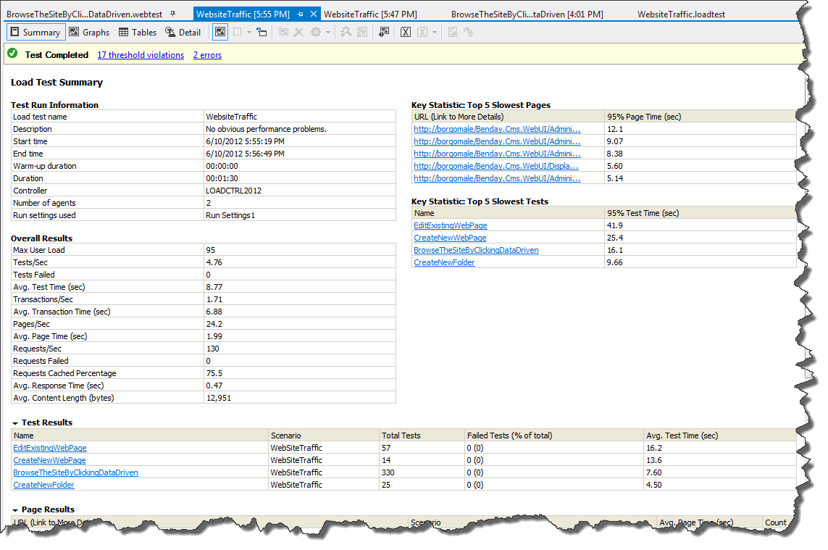
After: Load Test Summary

Slide 49
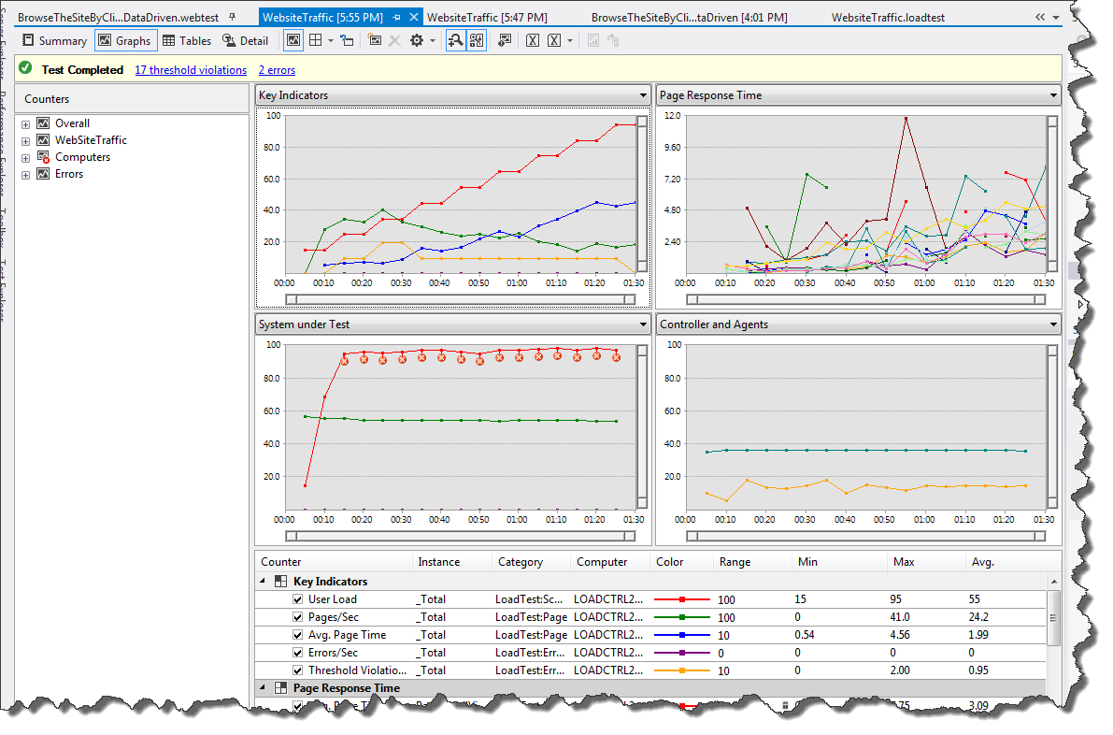
After: Load Test Graphs

Slide 50
Performance Profiling

Slide 51
Custom Performance Monitor Counters

Slide 52
Load Tests Capture Perfmon Counters

Slide 53
By default, they capture just the ones in the out-of-the-box Counter Sets.

Slide 54
Here’s a Load Testing anti-pattern...

Slide 55
You’ve got an app with some kind of performance problem.

Slide 56
You can roughly re-create it with your Load Tests…

Slide 57
…but you don’t know what’s actually going wrong.

Slide 58
You tweek your tests and tweek your tests…

Slide 59
…and tweek your tests and tweek your tests…

Slide 60
…and tweek your tests and tweek your tests and tweek your tests and tweek your tests and tweek your tests and tweek your tests and tweek your tests and tweek your tests and tweek your tests and tweek your tests and tweek your tests and tweek your tests and tweek your tests and tweek your tests and tweek your tests and tweek your tests and tweek your tests and tweek your tests and tweek your tests and tweek your tests and tweek your tests and tweek your tests and tweek your tests and tweek your tests and tweek your tests and tweek your tests…

Slide 61
…and still you have no idea.

Slide 62
You’re looking at anything and everything.

Slide 63
But have you asked your application “how it’s doing”?

Slide 64
(No. Probably not.)

Slide 65
SQL Server, Windows, .NET, ASP.NET, and IIS all have perfmon counters that report application health.

Slide 66
Why doesn’t your app have performance counters?

Slide 67
Here’s a real question from a customer with a performance problem.

Slide 68
“If I don’t put custom performance counters in my app, am I wasting my time?”

Slide 69
The answer: “Yes.”

Slide 70
Custom performance counters are simple to implement.

Slide 71
I tend to think of them in terms of ‘operations’.

Slide 72
An operation is something my application does.

Slide 73
Load a person, save a person, delete a person, etc.

Slide 74
For each operation, I’ll create three counters.

Slide 75
Three Counters Per Operation
Operation Count
  How many have run?
Operations Per Second
  How many per second?
Average Operation Time
  How long do they take?

Slide 76
Sounds repetitive, right?

Slide 77
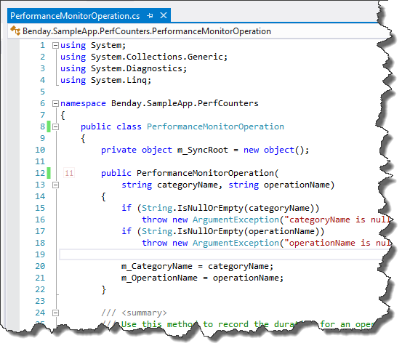
PerformanceMonitorOperation.cs

Slide 78
Implementation in Your App
Create a Class Library project in your solution
Add PerformanceMonitorOperation.cs
Create a PerformanceMonitorLocator class
Define your operations in PerformanceMonitorLocator
Implement calls to the operations in your code
Create a console app for installing/uninstalling the
performance counter definitions on your servers

Slide 79
Implementation in Your Load Test
Add a Counter Set
  Example: “My Application Counters”
Add Counters to the set
Choose the counters
Add the counters to the Counter Set Mappings in the
load test’s Run Settings

Slide 80
The Plan
Script user activity with Web Performance Tests
Simulate a mix of users using Load Tests
Simulate lots of users with a Load Test Rig
Reproduce the errors...hopefully
Find code problems with the Performance Wizard
Fix the code

Slide 81
Profiling Tools
Load Tests help you find issues in a system
  “Surface” issues
Profiling helps you find issues in the code
Unit Tests, Web Tests, Load Tests
  Repeatable
  Good for targeted tuning
System under “natural” load
  Not repeatable
  Looking for rough patterns

Slide 82
Profiling Methods
Sampling
Gathers information at intervals (clock cycles)
Instrumentation
Modifies your code
Concurrency
Multi-threaded code profiling
.NET Memory
Tier Interaction
Use this for first pass explorations
No code modifications
Gathers detailed timing and count information
Object creation
Garbage collection
Interaction between your application and SQL Server via ADO.NET

Slide 83
Demo:
Let’s go profile some stuff.

Slide 84
The Plan
Script user activity with Web Performance Tests
Simulate a mix of users using Load Tests
Simulate lots of users with a Load Test Rig
Reproduce the errors...hopefully
Find code problems with the Performance Wizard
Fix the code

Slide 85
Any last questions?

Slide 86
Thank you.
http://www.benday.com | benday@benday.com

