Slide 1
Coaching Skills for Scrum Masters & The Self-Organizing Team

Slide 2
Benjamin Day
Brookline, MA
Consultant, Coach, & Trainer
Microsoft MVP for Visual Studio ALM
Team Foundation Server, Software Testing, Scrum, Software Architecture
Scrum.org Classes
Professional Scrum Foundations (PSF)
Professional Scrum Master (PSM)
Professional Scrum Developer (PSD)
www.benday.com, benday@benday.com, @benday

Slide 4
Online courses at Pluralsight.com

Slide 5
Warning: Shameless Plug

Slide 6
Professional Scrum Master (PSM) training on May 20 & 21 in Brookline, MA http://bendayscrum.eventbrite.com

Slide 7
On with the show.

Slide 8
Overview
What does the Scrum Master do?
“Clearing the brush” toward self-organization
Coaching the team
Difficult Conversations
The Zen of Self-Organization
Notes:
Assumptions
In this case, the Scrum Master is somewhat technical
I'm technical. Right or wrong, my Scrum Mastering style tends to go deep on the technical stuff.
You have to remember the needs of the business though. You're not building this stuff for the sake of the technology. You're building this stuff for the sake of the business. In all likelyhood, it's about making money. The technology enables the making of the money which pays for you to write the software which makes more money and pays for more software. Rinse and repeat.
This talk will straddle the line between Scrum Mastering and "Getting your project started right"
Things that have caused my teams constant headaches that kill velocity

Slide 9
“What does the Scrum Master do anyway?”

Slide 10
Curling.

Slide 11
Olympic sport. Played on ice.

Slide 12
Team 1
Team 2
The Curling Sheet
~148 ft / ~45 m
~15 ft / ~4.8m
Target
Target

Slide 13
Curling Stones
~40 lb. stones
Polished granite
It’s got a handle
8 stones per team

Slide 14
~148 ft / ~45 m
~15 ft / ~4.8m
Get your stones as close as possible to the center of the target
Each team takes turns
Team with the most stones closest to the center of the target wins
Note: that stone’s not to scale

Slide 15
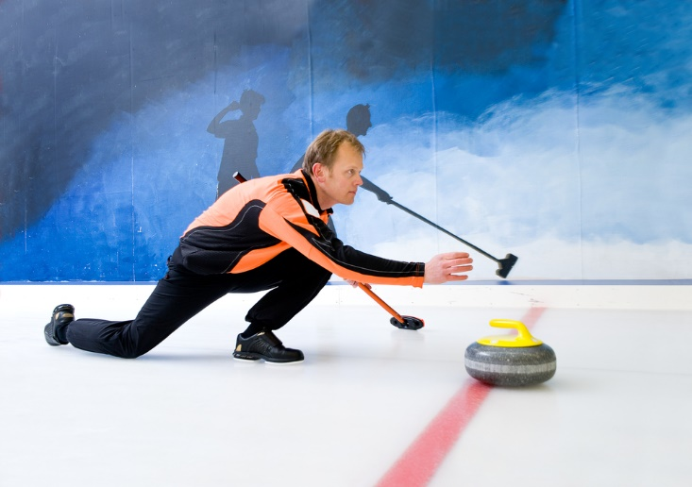
Throwing
3 team members per throw
Thrower
Stone in hand
Pushes off with legs
Starts glide towards target
Thrower has to release stone

Slide 16
The thrower might put some spin on it…

Slide 17
…but once released, nothing can touch the stone.

Slide 18
After the release, the Sweepers take over.

Slide 19
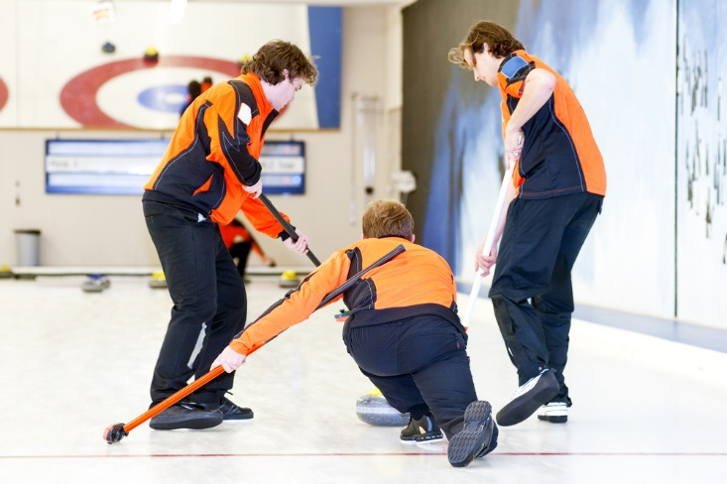
Sweepers
Two sweepers stay with the stone
Guide the stone to the target

Slide 20
Just to be 100% clear, the sweepers don’t touch the stone.

Slide 21
“So, the brushing moves the stone?”

Slide 22
The brushing doesn’t move the stone. It’s already moving.

Slide 23
The brushing subtly adjusts the ice in front of it…

Slide 24
…and that can change the speed and direction of the stone significantly.

Slide 25
The sweepers – without touching it – are helping to coax and guide the stone so it lands correctly at the target.

Slide 26
“…and this has what to do with scrum mastering?

Slide 27
Scrum Master is a Coach
Scrum Master is not a management role
Team members don’t report to the Scrum Master
Scrum Master isn’t the boss

Slide 28
Three Roles in Scrum
Product
Owner
Scrum
Master
Development
Team

Slide 29
Three Roles in Scrum
Product Owner is as close to “a boss” as you’ll get
Provides the vision & goal
Product
Owner

Slide 30
Considering the inherent bossless-ness, Scrum expects and relies on the team to self-organize.

Slide 31
To be successful, the team needs to use their creativity to deliver done, working software.

Slide 32
The team takes the Product Owner’s goal and self-organizes to figure out how to deliver done, working software at the end of the Sprint.

Slide 33
The basic idea: Give the team their goal and then get out of the way.

Slide 34
The Scrum Master helps the team to be creative and productive.

Slide 35
You can’t command someone to be creative.

Slide 36
“1…2…3…BE CREATIVE!!!!”

Slide 37
You can’t tell people exactly what to do and also expect them to figure it out for themselves at the same time.

Slide 38
And now back to curling…

Slide 39
Just like the sweepers can’t touch the stone…

Slide 40
…a successful Scrum Master doesn’t command the team.

Slide 41
The Scrum Master guides the team and helps the team without actually giving any instructions.

Slide 42
The team is the stone
The Product Owner is the thrower
The Scrum Master is a sweeper, guiding the team towards the goal

Slide 43
“What does the Scrum Master do anyway?”

Slide 44
The Scrum Master helps the team to be productive and to use their creativity in order to deliver done, working software.

Slide 45
The Big Lesson: The Scrum Master leads through influence not by command.

Slide 46
Suggestion: Stop being a boss.

Slide 47
One of the most common & frequent moments of Scrum Master Bossitosity is the Daily Scrum.

Slide 48
The Daily Scrum is not a status meeting.

Slide 49
The team does not report to you.

Slide 50
Remind them of this if it happens.

Slide 51
If it still happens, break eye contact.

Slide 52
Encourage them to talk to one another.

Slide 53
Remind them that the Daily Scrum is for them.

Slide 54
Consider having someone else run that meeting.

Slide 55
(Which is good…because it frees you up to do other things.)

Slide 56
Suggestion: Think like and/or be the team’s therapist.

Slide 57
Consider going to see a therapist yourself.

Slide 58
Read their emotional minds.

Slide 59
Try that at the Daily Scrum.

Slide 60
Hang back and read the room.

Slide 61
Idea: Levels of Listening

Slide 62
Levels of Listening
Level 1
“me me me”
Level 2
Laser-focus on the other person
Level 3
“meta”
The vibe of the conversation

Slide 63
Arguably, the emotional reading trick is a level 3 technique.

Slide 64
When you’re in a meeting with your team, listen to the contents of the conversations.

Slide 65
What “level” are they communicating on?

Slide 66
Lots of “level 1” and they might be talking past each other.

Slide 67
Suggestion: Observe to the room

Slide 68
Let’s say you noticed something.

Slide 69
The “level 3” just changed.

Slide 70
It got tense.

Slide 71
It got boring, exhausted, defeated.

Slide 72
Observe that to the room.

Slide 73
“Hey. What just happened there? It feels like we just got socks for Christmas.”

Slide 74
As Scrum Master, your job is to help the team be productive. It’s your job to notice this stuff.

Slide 75
When that kind of stuff happens, it’s a great topic for conversation. (And people probably didn’t notice it either.)

Slide 76
Suggestion: Get curious.

Slide 77
Embrace your inner “dumb”.

Slide 78
Ask a lot of follow-up questions.

Slide 79
Even if I *think* I know the answer, I want to hear the answer come out of someone else’s mouth.

Slide 80
I also want conversation.

Slide 81
Try to ask open-ended questions.

Slide 82
Closed-ended: “Are you going to get that SQL code done?” Open-ended: “How’s that SQL code doing? Can you give me an update?”

Slide 83
I really really want to avoid injecting my own opinion.

Slide 84
If you have a theory, give yourself an out.

Slide 85
If you need to say something try…
“Check this out…could it possibly be xyz?”
“Try this on for size. What if we asdf?”
“I could be wrong but what do you think about zxcvasdf?”

Slide 86
Sometimes you have to inject “alternate theories of mind.”

Slide 87
Alternate Theories of Mind
Teams sometimes get hooked on what someone *might* be thinking
“Is it possible that XYZ is thinking something else”
Never ascribe to malice what could just as easily be attributed to incompetence.

Slide 88
Suggestion: “Difficult Conversations”

Slide 89
Read this.

Slide 90
When things get heated…
…one or both sides do not understand
Their contribution to the disagreement
That their interpretation of someone else’s motivation is not actually correct
…there is often a difference between what is felt/thought vs. stated

Slide 91
A difficult conversation is 3 conversations
The “What Happened?” Conversation
Disagreement about what should or has happened
Who’s right or wrong?
Who deserves the blame?
The Feelings Conversation
What are people feeling?
Are my feelings valid? Should I just suck it up?
What about the other person’s feelings?
The Identity Conversation
What does this situation mean to me?
Am I good/bad at my job?
Worthy
Self-esteem

Slide 92
So what do we do with this?

Slide 93
You’ll be coaching to all 3 sub-conversations.

Slide 94
“Difficult conversations are almost never about getting the facts right. They are about conflicting perceptions, interpretations, and values.”

Slide 95
To the “What happened?” Conversation
Coach that “we might not want to assume we know the truth”
Ask “do we have all the information?”
Try to drill into “what were the intentions?”
Try to avoid “blame”
Focus on what went wrong
Focus on how to avoid it in the future

Slide 96
To the “Feelings” Conversation
This is hard in business because often feelings “don’t exist”
“99% of the time it’s not a technical problem”
Remember it’s about feelings even if it’s not ok to say that

Slide 97
To the “Identity” Conversation
Listen for the hint that there’s something else at stake
The disagreement might be chipping at self-perception
“I’m not the kind of person who lets people down…”
“I’m not the bad guy…I’m always one of the good guys!”

Slide 98
Suggestion: Coaching Self-Organization

Slide 99
“Fake it ‘til you make it.” -Lyssa Adkins

Slide 100
Get comfy with silence.

Slide 101
Ask the team what they want to do.

Slide 102
"It looks like X is happening. What do you want to do about it?"

Slide 103
Any last questions?

Slide 104
Overview
What does the Scrum Master do?
“Clearing the brush” toward self-organization
Coaching the team
Difficult Conversations
The Zen of Self-Organization
Notes:
Assumptions
In this case, the Scrum Master is somewhat technical
I'm technical. Right or wrong, my Scrum Mastering style tends to go deep on the technical stuff.
You have to remember the needs of the business though. You're not building this stuff for the sake of the technology. You're building this stuff for the sake of the business. In all likelyhood, it's about making money. The technology enables the making of the money which pays for you to write the software which makes more money and pays for more software. Rinse and repeat.
This talk will straddle the line between Scrum Mastering and "Getting your project started right"
Things that have caused my teams constant headaches that kill velocity

Slide 105
Thanks. benday@benday.com | www.benday.com

