Slide 1
Real World Scrum with Team Foundation Server 2013
Benjamin Day
@benday

Slide 2
Benjamin Day
Brookline, MA
Consultant, Coach, & Trainer
Microsoft MVP for Visual Studio ALM
Scrum, Team Foundation Server, Software Testing, Software Architecture
Scrum.org Classes
Professional Scrum Master (PSM)
Professional Scrum Developer (PSD)
Professional Scrum Foundations (PSF)
www.benday.com, benday@benday.com, @benday

Slide 3
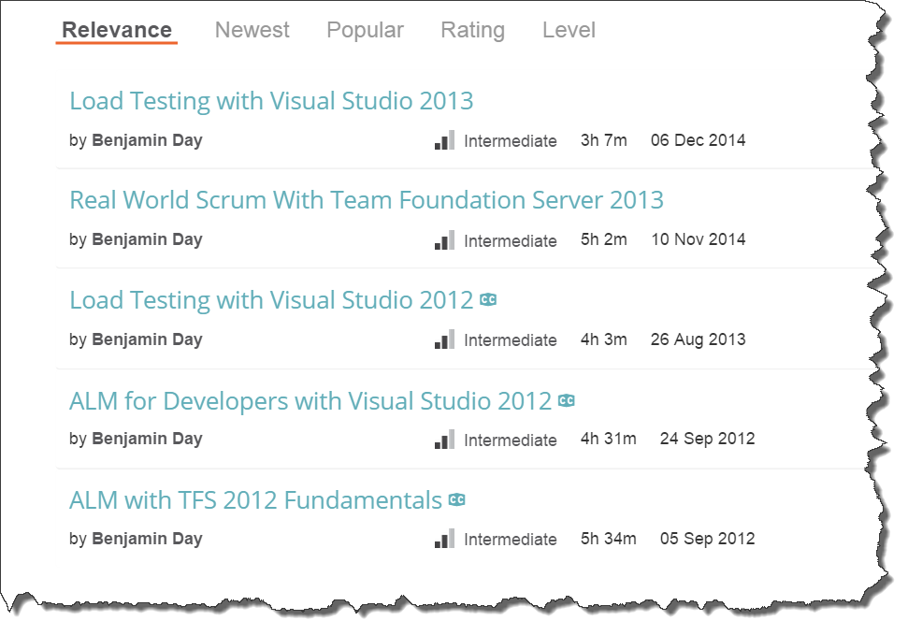
Got ?

Slide 4
And now, the fastest Scrum overview of all time...

Slide 5
Scrum: The Big Picture
Stakeholders
Sprint Planning
Meeting
Sprint Review
Product
Owner
Retrospective
Sprint
Increment
Daily
Scrum
Product
Backlog
Sprint
Backlog
Product
Owner
Development
Team
Scrum
Master
Stakeholder

Slide 6
It’s all about done, working software.

Slide 7
Keep yourself honest.

Slide 8
Manage your risk in the face of uncertainty.

Slide 9
Eliminate waste.

Slide 10
It’s all about done, working software.

Slide 11
Scrum: The Big Picture
Stakeholders
Sprint Planning
Meeting
Sprint Review
Product
Owner
Retrospective
Sprint
Increment
Daily
Scrum
Product
Backlog
Sprint
Backlog
Product
Owner
Development
Team
Scrum
Master
Stakeholder

Slide 12
Where does TFS fit in?

Slide 13
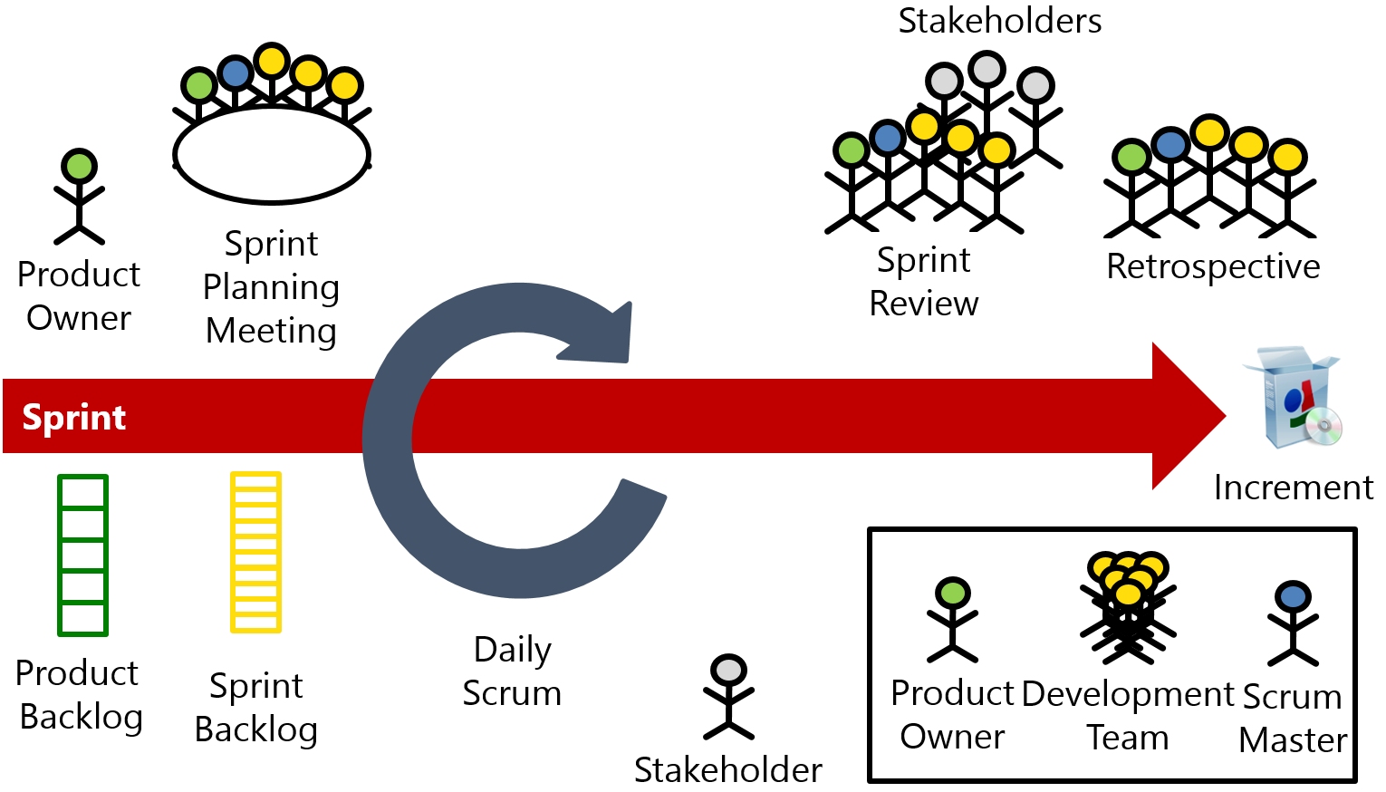
TFS + Scrum
Backlog management
Sprint Planning
Sprint Management

Slide 14
TFS + Scrum + Real World
Backlog management
Sprint Planning
Sprint Management
Definition of Done
Test Case Management
Automated Builds
Automated Testing
Release Management
Deployment
Feedback Management

Slide 15
 |  | Scrum Events |  |  |  |  | Supporting Activities
 |  | Sprint Planning | Daily Scrum | Sprint Review | Sprint Retrospective |  | Product Ownership | DoD | Collaboration | Best Practices | Enterprise Scrum
Work Items | Backlog Manager | X |  | X | X |  | X |  |  |  | X
 | Sprint Planner | X |  | X | X
 | Scrum Board |  | X | X | X |  |  |  | X
 | Burndown Chart |  | X |  | X |  |  |  | X
 | Kanban Board |  | X |  | X |  | X |  | X
 | Work item Tracking |  |  | X | X |  |  |  | X
 | Velocity Chart | X |  | X | X |  | X
 | Cumulative Flow Diagram |  |  |  |  |  | X
 | Capacity Planner | X |  |  |  |  |  |  | X
 | Work Item Charts |  | X |  |  |  | X |  | X
Code | Source Control |  |  |  | X |  |  | X | X | X
 | Code Reviews |  |  |  | X |  |  | X | X | X
 | Lightweight Code Commenting |  |  |  |  |  |  | X | X
 | Unit Testing |  |  |  | X |  |  | X |  | X
Build | Automated Builds |  |  |  | X |  |  | X |  | X
 | Deploy w/ Lab Management |  |  |  | X |  |  | X | X
 | Deploy w/ Release Management |  |  |  | X |  |  | X | X
Collaboration | SharePoint |  |  |  | X |  |  |  | X
 | Team Rooms |  |  |  |  |  |  |  | X | X
 | Team Home Page |  |  |  |  |  |  |  | X
 | Teams |  |  |  |  |  |  |  | X |  | X
 | Feedback Manager |  |  |  | X |  | X | X | X
 | PowerPoint Storyboarding | X |  |  | X |  | X |  | X
Testing | Test Case Management |  |  | X | X |  |  | X | X
 | Defect Tracking |  |  |  | X |  |  | X | X
 | Load Testing |  |  |  | X |  |  | X |  | X

Slide 16
Do you have a Definition of Done?

Slide 17
A written DoD is a list of everything that is required before you can say a PBI is Done.

Slide 18
Here’s a hint:

Slide 19
It’s a lot more than “the code compiles and is checked in.”

Slide 20
Sample Definition of Done (DoD)
Development / Coder
Testing, Deployment, Ops
Code is written with unit tests
Unit tests have a minimum of 75% code coverage
Code has been merged to Main
Code compiles and unit tests pass when run as part of an automated build
Database schema objects are checked in to TFS
Database upgrade script is written and in TFS
Code reviewed by someone other than the original author
Written QA test plan
Tested with QA test plan by someone other than the original author
Deployed and tested in Staging environment
Automated UI tests are written and pass
No Severity 1 or 2 bugs
Reviewed by Product Owner
Passes acceptance criteria for the PBI
Known deployment & rollback plan
Deployment plan reviewed by Ops
Database changes reviewed by DBAs
Load tested
Deployed to Production

Slide 21
Why is a Written DoD so Important?
Makes it clear what all the steps are
Everyone can look at the steps → a shared understanding
Helps with team-based estimation
Helps minimize or eliminate Technical Debt
Helps to manage management expectations
Helps with the “two second change” request

Slide 22
TFS + Visual Studio + MTM help you to automate your DoD.

Slide 23
And now a lot of demos…

Slide 24
Demos
Backlog Management / Refinement
Sprint Planning
Daily Scrum
Situational Awareness
Home Page
Team Rooms
Charting
“QA” Test Tracking
Automated Build + DoD
Lightweight Requirements

Slide 26
Any last questions?

Slide 27
Thank you.
www.benday.com | benday@benday.com

