Slide 2

Agile Under a Waterfall
Benjamin Day
benday.com

Slide 3

About Me
Cambridge, MA
Consultant, Coach, & Trainer
Microsoft MVP for Visual Studio ALM
Team Foundation Server,
Software Testing, Scrum,
Software Architecture
Scrum.org Classes
  Professional Scrum Developer (PSD)
  Professional Scrum Foundations (PSF)
www.benday.com, benday@benday.com, @benday

Slide 4
Introductory Thoughts.

Slide 5
What do I mean by “waterfall”?
Waterfall = plan-driven
Gaant charts
Microsoft Project
Start Dates & End Dates
Phases

Slide 6
What is Scrum Under a Waterfall?
“Agile Under a Waterfall”
Scrum + plan-driven
Agile + plan-driven
SUW

Slide 7
Assumptions
SUW exists
Value of Agile / Scrum is…
  Settled
  A good thing

Slide 8
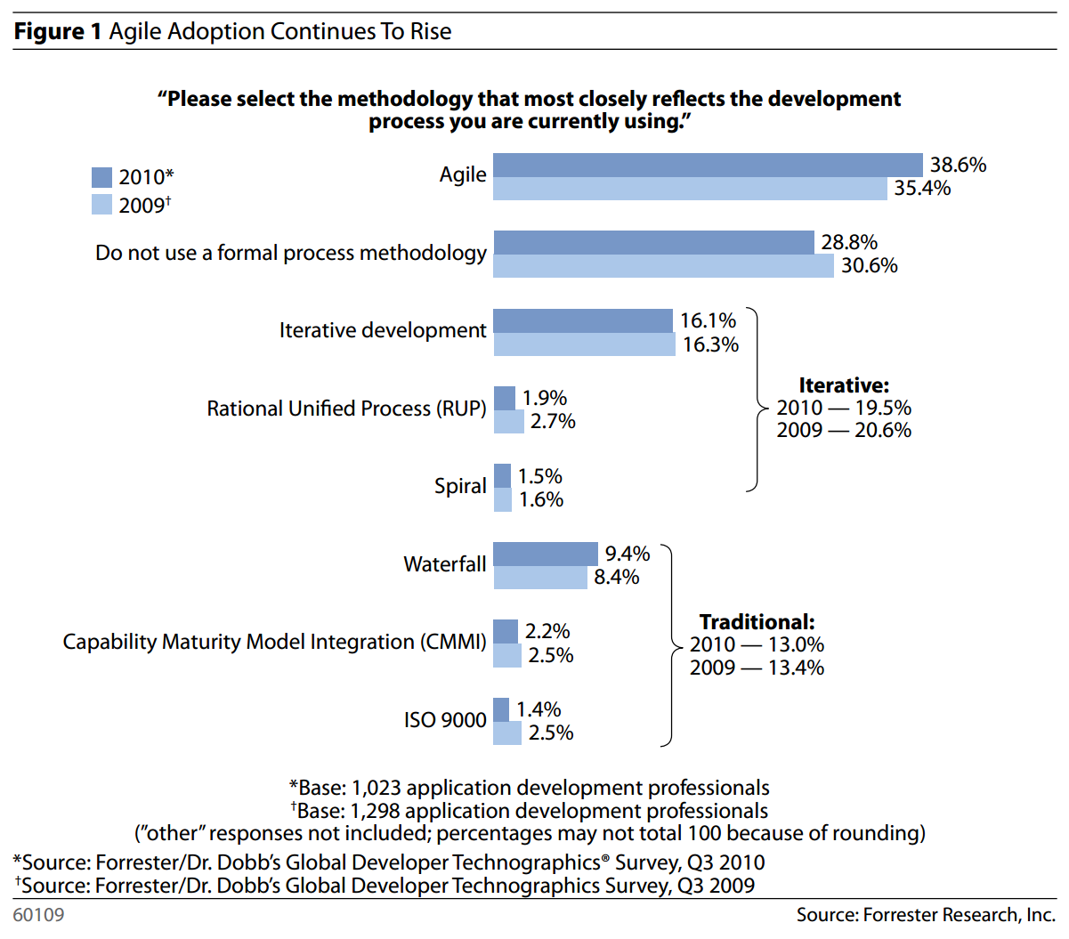
Agile is popular.
“Water-Scrum-Fall Is The Reality Of Agile For Most Organizations Today”
by Dave West
Forrester Research
July 26, 2011

Slide 9
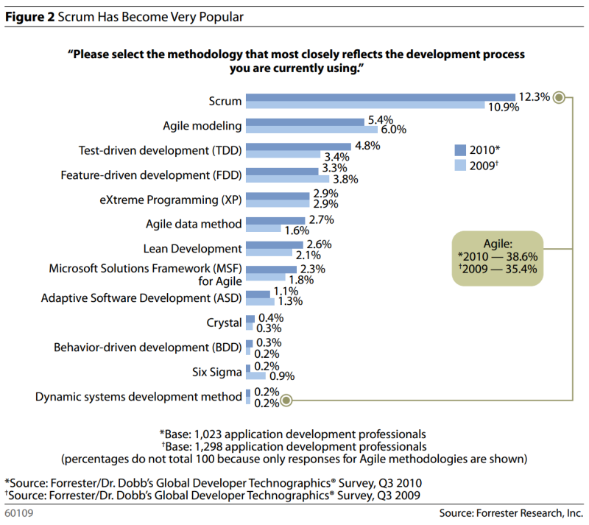
Scrum is arguably the dominant Agile flavor.
“Water-Scrum-Fall Is The Reality Of Agile For Most Organizations Today”
by Dave West
Forrester Research
July 26, 2011

Slide 10
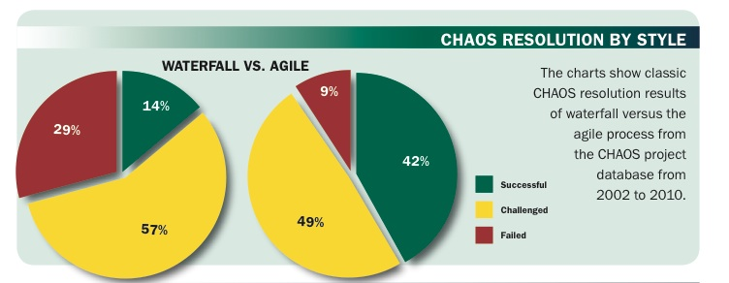
Agile seems to get results.
The CHAOS Manifesto, Copyright 2011

Slide 11
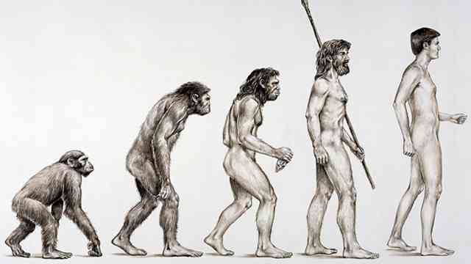
My $0.02 on SUW
It’s a difficult place to be.
It’s a transitional form.

Slide 12
…and now a quote by a leading project management expert.

Slide 13

“You can drive with your feet. It doesn’t mean it’s a good idea.” *
* - paraphrased

Slide 14
So what do you do if your company does SUW?

Slide 15
Two options.
Quit in protest. Get a new job.
Try to make it work.
  Someone else is paying.
  Make informed decisions.
  Lead the transition.

Slide 16
Goal for this talk
Be practical
Try to see both sides
Acknowledge that change takes time

Slide 17
Comparisons & Motivations.

Slide 18
Waterfall vs. Scrum
Waterfall | Scrum / Agile
Requirements docs | Just-in-time, informal requirements
Occasional “customer” involvement | Frequent “customer” involvement
Start-to-finish Project Plan | Product Backlog. Plan for Sprint. Details are sketchy beyond that. Priorities shift based on new data.
Tasks are assigned | Assigned tasks are a bottleneck
Potentially large team size | Teams of 3 – 9 people
Multiple phases, eventual delivery | Working software each Sprint / Iteration
Resistant to change | Change is expected
Contract says what we build, deliver | Contract is a lot closer to T&E

Slide 19
Why Waterfall?
Comes naturally
Feels good
  We’ve got a plan.
  We’ve got dates.
  What could possibly go wrong?
Helps managers manage
Pin down what’s going to be built
Minimize uncertainty
Notes:
Waterfall
comes naturally to people
Feels good. We've got that plan with the date on it and, well, the team wrote that date down in that project plan so we're all set and my work it done here.
It's a plan that's developed by the managers to coordinate what's going on.

Slide 20
Why Scrum / Agile?
Embraces uncertainty
Empirical
“Forecast” rather than “commitment”
Self-organization and estimation
by the “do-ers”
Notes:
Agile
Best summed up by someone throwing up their hands and saying "damned if I know"
Throw in the ideas of emergent architecture and it looks like we have no idea and no plan.
About self organizing teams and is by its nature driven by the "do-ers". The architects, developers, and testers.

Slide 21
Who is Waterfall for?

Slide 22
Ever seen a company that is
Agile at the top and
Waterfall at the bottom?

Slide 23
Do managers trust their team?
What does the team think about the managers?

Slide 24
Why Waterfall people think
Agile-ists are nuts
Sandal-wearing anarchists
Their estimates are always wrong
They’re always late
They’re lazy
The plan is flawless.
Devs write crummy, buggy code
“Too complex to not plan.”
Notes:
Why Waterfall people think Agile people are FOS
Our estimates are always wrong
We're always late
Those developers are totally lazy. If we didn't hit them with a cattle prod on a bi-daily basis, they'd look at facebook or ESPN.com until their eyes chapped over.
My plan was awesome. It's the developers who are incompetent boobs. Look at this Gaant chart! It's a think of beauty.
Why did the developers put so many bugs into the code? We should be almost done with the Testing phase by now and our bug count is astounding!
We are the PMO. We know all. We see all.

Slide 25
Why Agile-ists think Waterfall people are nuts
The plan is largely imposed
  “Voluntold”
What we told them was bogus.
  Haven’t the foggiest clue
  Just enough to make them go away
Didn’t have anything real to estimate anyway
“Too complex to plan.”
Notes:
Why Agile people think Waterfall people are FOS
The plan is pretty much imposed on them with input from the team
They're "voluntold" to be done by a date
We told them what they wanted to hear to make them go away
We haven't got the *foggiest* clue if we're right about the pieces, the amount of work, the order of work, the requirements, or the estimates. In fact, we're pretty sure -- no -- almost POSITIVE -- that the estimates are junk.
We know that the requirements that we were "asked" to "estimate" are going to change a BILLION times before we get anywhere close to executing on them.

Slide 26
Point of agreement #1:
Each thinks the other side is wrong.

Slide 27
Point of agreement #2:
The work is complex.

Slide 28
Making it work.

Slide 29
SUW is the grumpy marriage of two processes.

Slide 30
Why SUW?
Required by contract
Required by law
The Agile Experiment
Just cuz.

Slide 31
Leverage the strengths of each
Scrum for day-to-day dev/test activities
Detect problems with Sprints
Focus on DoD & working software
Waterfall for multi-team coordination
Waterfall for release planning

Slide 32
Differences for Scrum / Agile
Same
Changed
Focus on ‘Definition of Done’
Daily Scrum
Sprint Burndown
Sprint Review
Retrospective
Backlog = Project Plan
Less emphasis on Backlog Grooming & Sprint planning
Less negotiation during Sprint

Slide 33
Some of the risks of SUW.

Slide 34
Impedance mismatch leads to poor communication.

Slide 35
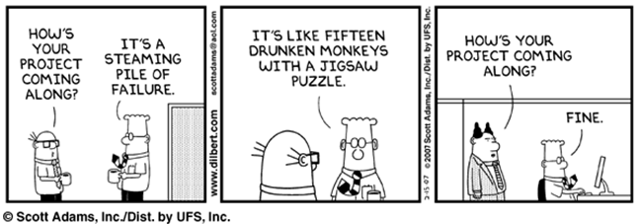

Slide 36
Lack of trust & transparency.

Slide 37
Culture of fear.

Slide 38
A complete detachment from reality.

Slide 39
Everything is going great until it isn’t.

Slide 40
It’s two sets of books.

Slide 41
Using metrics for evil.

Slide 42
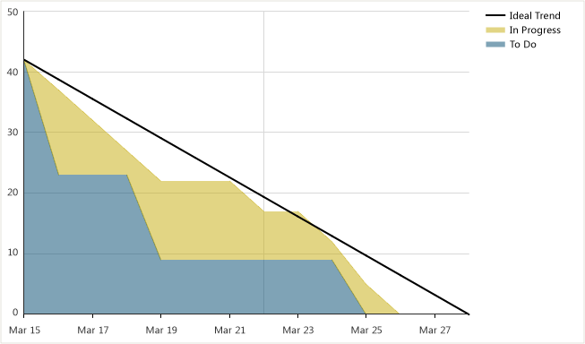
For example,
Using the Burndown for Evil

Slide 43
A lot of orgs are obsessed with individual performance.

Slide 44
“Show it to me when it’s done.”

Slide 45
So, uhhh…how do you make it work?

Slide 46
Five tips.
Think positive.
Come to terms with uncertainty.
Fear is everywhere.
Avoid ‘earned value’.
Avoid keeping two sets of books.

Slide 47
#1.
Think positive.

Slide 48
People get weird when their org starts thinking about getting more Agile.

Slide 49
One problem is requiring people to think.

Slide 50
Another major problem is the human fear of loss.

Slide 51
Focus on what you gain rather than what you lose.

Slide 52
Focus on ‘Done Software’.

Slide 53
We’re going to get done software more often.

Slide 54
You do have to get past change being a bug.

Slide 55
It’s a chance to adapt.
You get ‘done’ software and if you don’t like it, you can change it.

Slide 56
It’s not “rework.”

Slide 57
It’s improving existing features to better meet the needs of the stakeholders.

Slide 58
Use the sprint boundaries as a way to take stock of where you are.

Slide 59
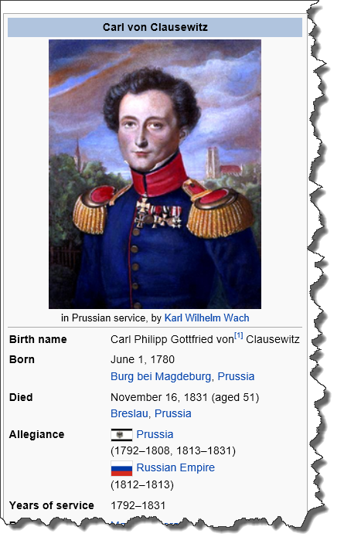
“Strategy is the use of the engagement for the purpose of the war.”
from “On War”
by Carl Phillip Gottfried von Clausewitz

Slide 60
#2.
Come to terms with uncertainty.

Slide 61
Software is not a ‘sure thing.’

Slide 62
Wishing does not make it so.

Slide 63
Gripping tighter also does not make it so.

Slide 64
Software always gets more complex once you start.

Slide 65
Change is going to happen.

Slide 66
Making your teams spend extra time on ‘more accurate accurate planning’ is
(probably) wasteful.

Slide 67
Get to good enough and then stop.

Slide 68
#3.
Fear is everywhere.

Slide 69
Your developers are afraid of you.

Slide 70
Your middle managers are afraid of you and your developers.

Slide 71
Remember that your developers were picked on and bullied.

Slide 72
If you make them nervous…

Slide 73
…they know what you want to hear…

Slide 74
…and they’ll tell it to you.

Slide 75
(Unfortunately, it’s not true.)

Slide 77
You need to try to create trust.

Slide 78
You need to make it ok to be “wrong”.

Slide 79
You need to make it ok for your teams to tell you that you are wrong.

Slide 80

“The goal of a leader should be to maximize resistance—in the sense of encouraging disagreement and dissent.
…
If you aren’t even aware that the people in the organization disagree with you, then you are in trouble.”
Leadership The Hard Way
by Dov Frohman & Robert Howard

Slide 81

"Too often in organizations leaders think that if they get the three R’s clear—rules, roles, and responsibilities—innovation will logically follow. More often than not, results go 180 degrees in the opposite direction."
“Yes To The Mess:
Surprising Leadership Lessons from Jazz”
by Frank J. Barrett
Harvard Business Review Press

Slide 82
They’re terrified of being wrong.

Slide 83
They don’t understand your motivations.

Slide 84
When you say that you
“need all this by X date”…

Slide 85
…they believe you.

Slide 86
“…research shows that the biggest obstacle to creating the psychological safety that allows people to learn from mistakes is a hierarchy. When those with status are distant or intimidating, those beneath them are more likely to save face by hiding or ignoring errors.”
“Yes To The Mess:
Surprising Leadership Lessons from Jazz”
by Frank J. Barrett
Harvard Business Review Press

Slide 87
You have a priority in your head.
Share that vision.

Slide 88
#4.
Avoid ‘earned value’.

Slide 89
“I’m 72.6% done with my task.”

Slide 90
…and now a quote by a leading project management expert.

Slide 91
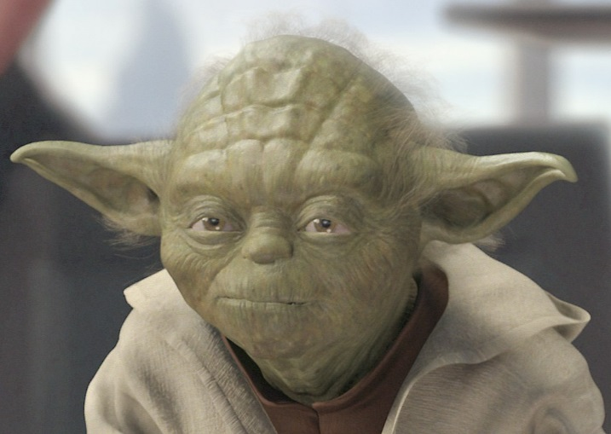
“[Earned value] is the path to the dark side. [Earned value] leads to [technical debt]. [Technical debt] leads to [maintainability problems]. [Maintainability problems] lead to suffering.”
Yoda, Star Wars: Episode 1

Slide 92
Focus on your Definition of Done.

Slide 93
It’s done or it isn’t.
Done software only.

Slide 94
(Oh…and force your team to write unit tests.)

Slide 95
#5.
Avoid keeping two sets of books.

Slide 96
A shared reality is essential.

Slide 97
Try to avoid the overhead of communicating between the two visions.

Slide 98
Tip: Try
Team Foundation Server +
Microsoft Project Server

Slide 99
Team Foundation Server & Visual Studio
One stop shop for your devs
Great tools for running an Agile / Scrum project.
Integrated with source control
Automated build system
QA testing tools for managing / tracking test suites and test progress
Feedback capture
Lightweight requirements

Slide 100
Microsoft Project Server
Plug-in to SharePoint
Accessed via:
  Web interface
  Microsoft Project
Enterprise project management
  Tasks
  Portfolios of projects
  Timesheets
  Resources
  Approval workflows

Slide 101
TFS & MPS Integration
Bi-directional sync
TFS data to/from Enterprise Project Plans

Slide 102
TFS + Project Server Scenarios
Track progress across many teams for a large effort
  Think enterprise “roll-up”
Requirements in Project Server →
Details created in TFS by the teams
  Project Server can approximate your “Product Backlog”
Modifications have an optional approval workflow
  Keeps Waterfall-centric managers in the loop

Slide 103
Big win:
Both groups stay in their preferred tools.

Slide 104
Big win:
Synchronization happens automatically.

Slide 105

“Just the facts, ma’am.”
TFS captures data without judgment
Is it in source control?
Does the build work?
Do the tests pass?
What’s the bug count?
What’s the history on that work item?
Published to Project Server without judgment

Slide 106
Transparency & honesty is crucial for trust in SUW.

Slide 107
Five tips.
Think positive.
Come to terms with uncertainty.
Fear is everywhere.
Avoid ‘earned value’.
Avoid keeping two sets of books.

Slide 108
…in closing.

Slide 109

Quick overview on Clausewitz.
“In Our Time”
BBC Radio 4
May 17, 2012
http://www.bbc.co.uk/programmes/b01hl293

Slide 110
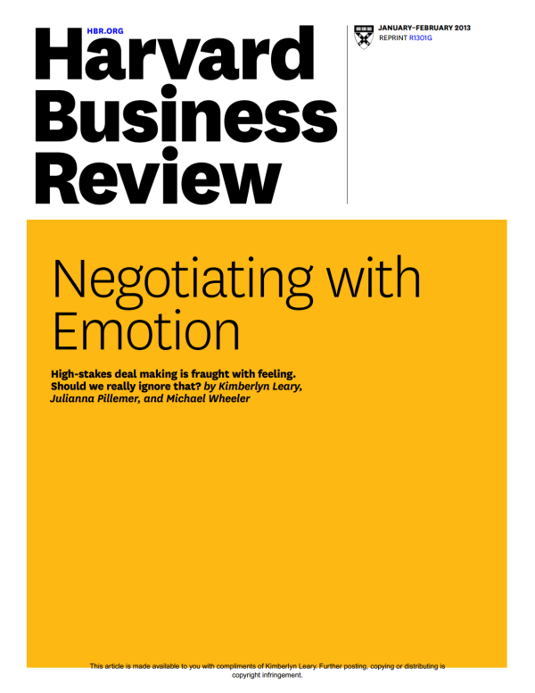
The emotional overhead of discussing scope and other issues.
“Negotiating with Emotion”
by Kimberlyn Leary, et al.
Harvard Business Review
January 2013

Slide 111
Some thoughts on letting go.
“Yes To The Mess:
Surprising Leadership Lessons from Jazz”
by Frank J. Barrett
Harvard Business Review Press

Slide 112

On leadership style, communication, and failures.
“The Generals: American Military Command from World War II to Today”
by Thomas E. Ricks

Slide 113
Summary
SUW can be awkward
There can be trust problems
Use Scrum/Agile to detect problems
TFS & Project Server helps
Project Management Impedance Mismatch
Transparency is the key

Slide 114
Any last questions?

Slide 115
Thank you.
http://www.benday.com | benday@benday.com

